Slide 1
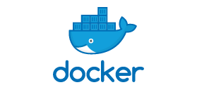

Slide 2
Virtualization
Virtualization is technology that lets you create useful IT services using resources that are traditionally bound to hardware.
It allows you to use a physical machine's full capacity by distributing its capabilities among many users or environments.
Virtualization relies on software to simulate hardware functionality and create a virtual computer system.
This enables IT organizations to run more than one virtual system – and multiple operating systems and applications – on a single server.
The resulting benefits include economies of scale and greater efficiency.

Slide 3
Virtualization process
Virtualization is the process of running a virtual instance of a computer system in a layer abstracted from the actual hardware.
To desktop users, the most common use is to be able to run applications meant for a different operating system without having to switch computers or reboot into a different system.
The two types of Virtualization are:
Type 1: Type 1 hypervisor is a hypervisor that runs directly on the host's hardware to control the hardware and to manage guest operating systems
Type 2: Type 2 hypervisors run on a conventional operating system just as other computer programs do.

Slide 4
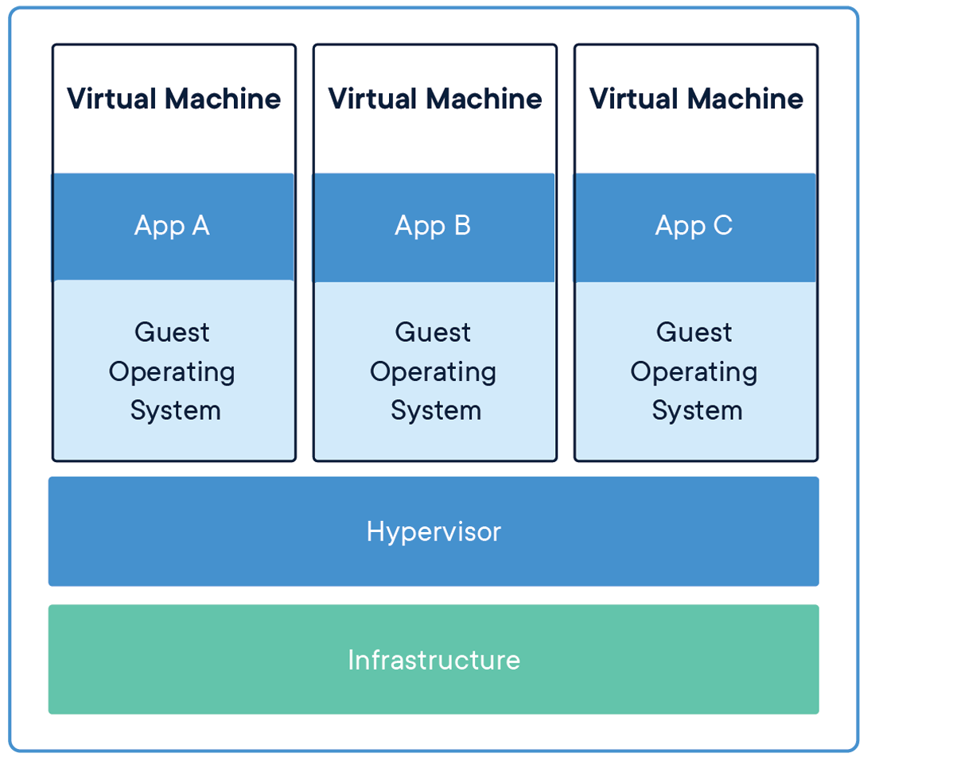
Virtual Machine
In computing, a virtual machine is the virtualization/emulation of a computer system. Virtual machines are based on computer architectures and provide functionality of a physical computer. Their implementations may involve specialized hardware, software, or a combination.
Virtual machines allow you to run an operating system in an app window on your desktop that behaves like a full, separate computer.
You can use them play around with different operating systems, run software your main operating system can't, and try out apps in a safe, sandboxed environment.

Slide 5
Advantages of Virtual machine
Sharing of resources helps cost reduction
Isolation:Virtual machines are isolated from each other as if they are physically separated.
Encapsulation:Virtual machines encapsulate a complete computing environment.
Hardware Independance:Virtual machines run independetly of underlying hardware.
Portability:Virtual machines can be migrated between different hosts.

Slide 6
Disadvantages of Virtual machine
It can have high cost of implemenation.
Virtual machines takes up whole space even when it needs less.
It creates a security risks.
It takes time .
It creates an availability issue.

Slide 7
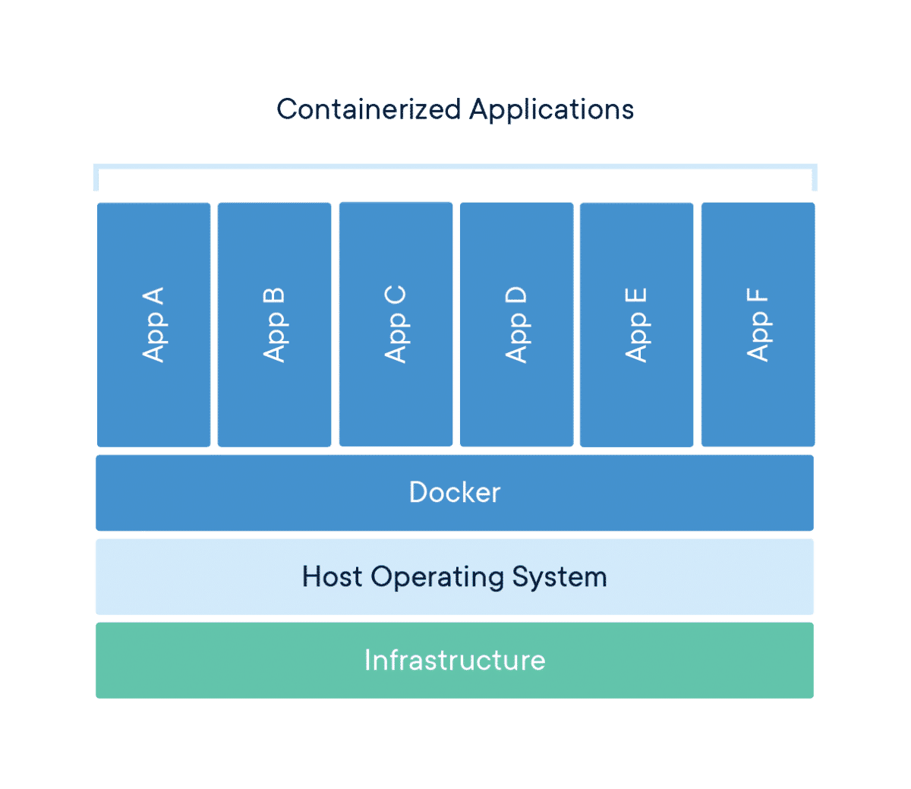
Containers
Containers are packages of software that contain all of the necessary elements to run in any environment.
In this way, containers virtualize the operating system and run anywhere, from a private data center to the public cloud or even on a developer's personal laptop.
Containers provide a standard way to package your application's code, configurations, and dependencies into a single object.
Containers share an operating system installed on the server and run as resource-isolated processes, ensuring quick, reliable, and consistent deployments, regardless of environment.

Slide 8
Containers are used for
Containers are a form of operating system virtualization.
A single container might be used to run anything from a small microservice or software process to a larger application.
Inside a container are all the necessary executables, binary code, libraries, and configuration files.
Other examples of containers include magazines, journals, newspapers, which contain articles; blogs, which contain posts; TV series, which contain episodes; or web sites which contain articles or individual posts.

Slide 9
Docker
Docker is an open source containerization platform.
It enables developers to package applications into containers—standardized executable components combining application source code with the operating system (OS) libraries and dependencies required to run that code in any environment.
Docker is a set of platform as a service products that use OS-level virtualization to deliver software in packages called containers.
The service has both free and premium tiers.
The software that hosts the containers is called Docker Engine.
It was first started in 2013 and is developed by Docker, Inc.

Slide 10
Advantages of Docker/Container
To provide microservices that is possible using container only by using virtual machines it is not possible.
High speed compare to virtual machines.
More lightweight comapre to virtual machines.
Easier to manage and automate.
Containers requires less system resources than traditional or hardware virtual machine environment.

Slide 11
Docker File
Is a text document that conatins all the commands a user could call on the command line to assemble an image.Using docker build users can create an automated build that executes several command line instructions in succession.
Each Dockerfile is a script, composed of various commands and arguments listed successively to automatically perform actions on a base image in order to create (or form) a new one.
They are used for organizing things and greatly help with deployments by simplifying the process start-to-finish.

Slide 12
Some keywords used in docker file
FROM: The FROM keyword specifies the base image on which we want our image to be built on.
ADD: The ADD keyword is used to copy files/directories into a docker image.
RUN : It executes any commands on top of the current image and craetes a new layer by committing the results.
CMD : It specifies the instruction that is to be executed when a Docker conatiner starts.
ENTRY POINT: It is used to set executables that will always run when the container is initiated.
ENV : It is used to set the environment variable.
EXPOSE : It is used to exposes a particular port with a specified protocol inside a Docker Conatiner.

Slide 13
Example for Docker file
FROM ubuntu
RUN apt-get update
RUN apt install -y tzdata
ENV TZ=Asia/Dubai
RUN ln -snf /usr/share/zoneinfo/$TZ /etc/localtime && echo $TZ > /etc/timezone
RUN apt-get -y install apache2
ADD . /var/www/html
ENTRYPOINT apachectl -D FOREGROUND
ENV name DEVOPS SKILLRARY
EXPOSE 8080:8080

Slide 14
Container MAnagement System
It is process of managing the creation,deployment,scaling,availability and destruction of software containers.
Conatiner management software helps optimize how and where to run conatiners as well as which systems to put them on.
The most commonly used container management systems are KUBERNATES(K8’s) and DOCKER SWARM.

Slide 15
Docker Swarm
A Docker Swarm is a group of either physical or virtual machines that are running the Docker application and that have been configured to join together in a cluster.
Once a group of machines have been clustered together, you can still run the Docker commands that you're used to, but they will now be carried out by the machines in your cluster

Slide 16
Docker Swarm used for
Docker swarm is a container orchestration tool, meaning that it allows the user to manage multiple containers deployed across multiple host machines.
One of the key benefits associated with the operation of a docker swarm is the high level of availability offered for applications. In a docker swarm, there are typically several worker nodes and at least one manager node that is responsible for handling the worker nodes

Slide 17
Docker Compose
Docker Compose is a tool, Used to start/Run the application, that was developed to share multi-container applications. With Compose, we can create a YAML file to define the services and with a single command, can spin everything up or tear it all down.
If a Docker application includes more than one container, building, running, and connecting the containers from separate Dockerfiles is cumbersome(Unmanageable) and time-consuming.
Docker Compose solves this problem by allowing you to use a YAML file to define multi-container apps. You can configure as many containers as you want, how they should be built and connected, and where data should be stored.
When the YAML file is complete, you can run a single command to build, run, and configure all of the containers.

Slide 18
How to use a docker-compose file
Open docker- compose. yml in a text editor and add the following content:
Save the file and run Docker Compose from the same directory: CMD -docker-compose up –d. This will build and run the db and word press containers. Just as when running a single container with docker run
Stop and remove the containers: docker-compose down.

Slide 19
Difference between Docker file and docker-compose
A Dockerfile is a simple text file that contains the commands a user could call to assemble an image whereas Docker Compose is a tool for defining and running multi-container Docker applications.
Docker Compose define the services that make up your app in docker-compose.

Slide 20
THANK YOU

