Slide 1
DevOps
By Vageesh T K

Slide 2
What is DevOps?
DevOps is a set of practices that combines software development and IT operations. It aims to shorten the systems development life cycle and provide continuous delivery with high software quality.

Slide 3
History of DevOps
In 1993 the Telecommunications Information Networking Architecture Consortium (TINA-C) defined a Model of a Service Lifecycle that combined software development with (telecom) service operations.
In 2009, the first conference named devopsdays was held in Ghent, Belgium. The conference was founded by Belgian consultant, project manager and agile practitioner Patrick Debois.The conference has now spread to other countries.
In 2012, the State of DevOps report was conceived and launched by Alanna Brown at Puppet.
As of 2014, the annual State of DevOps report was published by Nicole Forsgren, Gene Kim, Jez Humble and others. They stated that the adoption of DevOps was accelerating. Also in 2014, Lisa Crispin and Janet Gregory wrote the book More Agile Testing, containing a chapter on testing and DevOps.
In 2016 the DORA metrics for throughput (deployment frequency, lead time for changes), and stability (mean time to recover, change failure rate) were published in the State of DevOps report.

Slide 4
Different Methodologies followed by Software Industry
Waterfall Model
Agile Model
DevOps

Slide 5
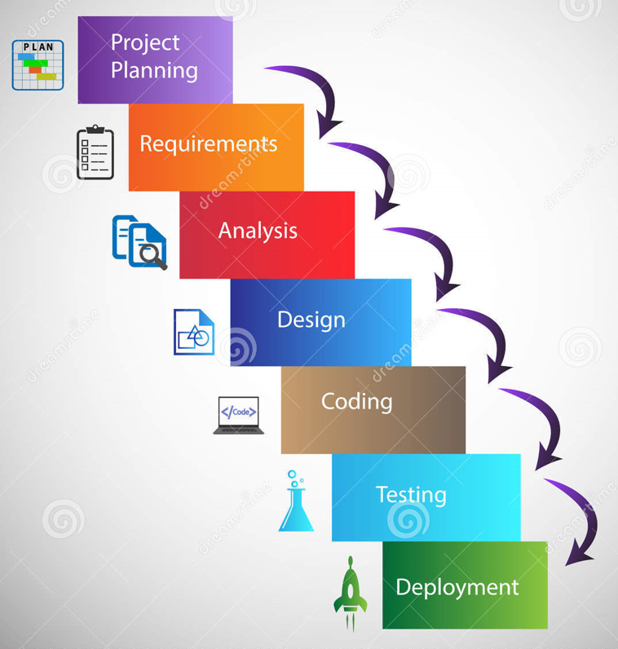
Waterfall Software Practices are Traditional, Plan-Driven Practices for Developing Systems and Software Development Life Cycle (SDLC) Approach. And it is based on Developing in Stages: Gather and Analyze Software Requirements, Design, Develop, Test and Deploy into Operations. The output of one stage is required to initiate the next stage.
The Waterfall

Slide 6
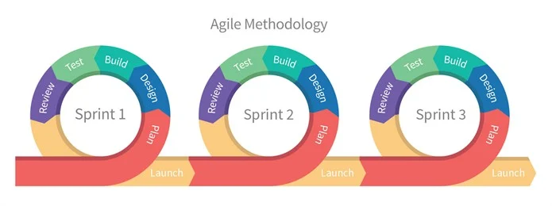
The Agile
The need for a Quick Adaptation and Rapid Delivery of Products was the engine behind Agile Software Development Practices birth. The changing Business needs during Development require a solution. The Methodology allows for the Exploration of New Ideas and Quicker Determinations about which of those Ideas are Viable.
Some of the Agile Frameworks used are Scrum and Kanban. Where Scrum’s Key Components are iterations and velocity, the Key Component with Kanban is its Work in Progress Status.

Slide 7
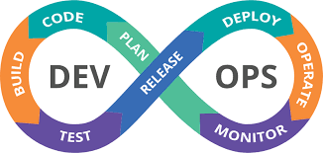
DevOps
DevOps aim is to Unify Development and Operations in ways that lead to More Efficient Development Practices. It is an Engineering Culture, that when done effectively, result in Faster, More Dependable Software Releases that are Aligned to Business Operations. It might not be seen as a Standard or a Framework, but an Organizational Collaboration rises a set of Best Practices through Continuous Integration, Delivery, and Testing.
It is based on one team focused on Speed Delivery and Infrastructure Stability, with the following goals:
· Fast Delivery of Completed Code to Production
· Minimal Production Failures
· Immediate Recovery from Failures

Slide 8
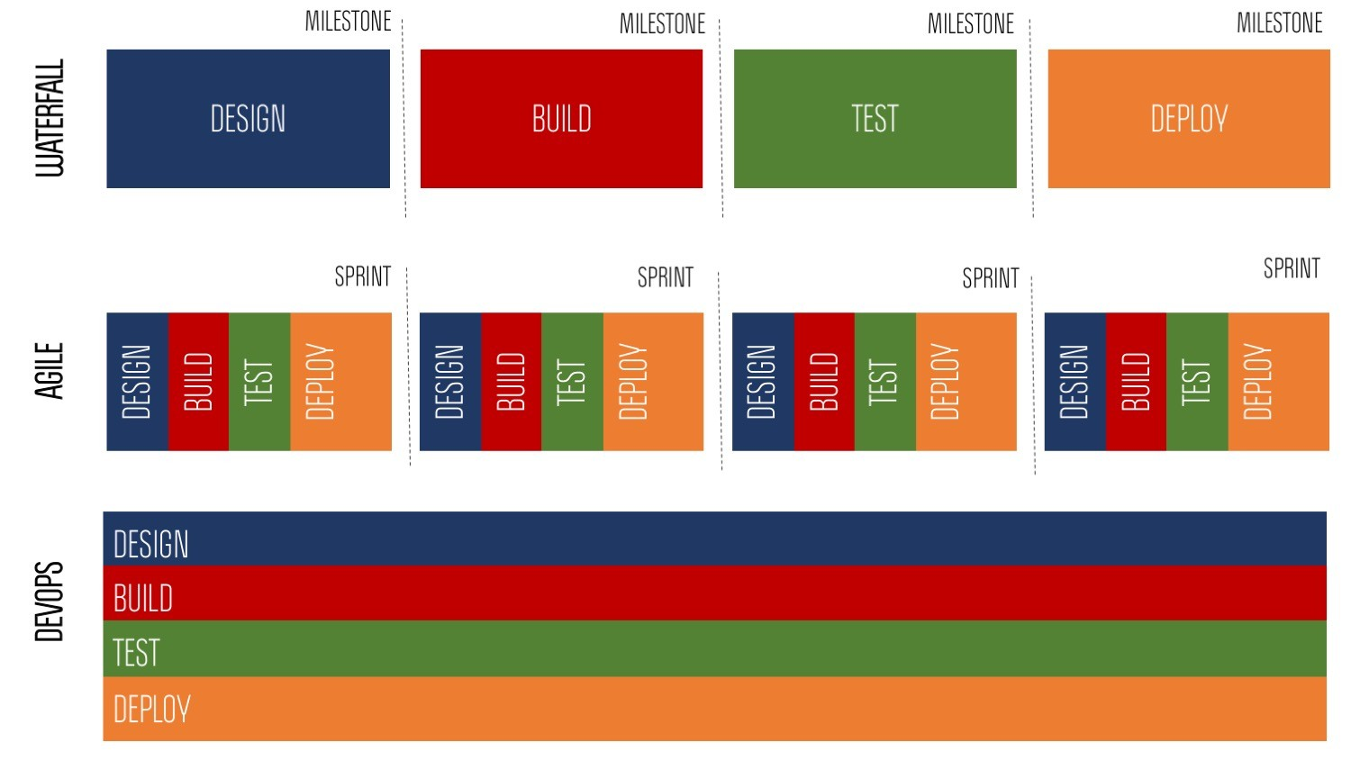
Waterfall vs Agile vs DevOps

Slide 9
Benefits of DevOps
Renews focus on the customers. A key reason for the move to DevOps is that it gets the team back in the mindset of the customer.
Unites teams for faster product shipments.
Simplifies development focus.
Introduces automation to the development process.
Supports end-to-end responsibility.

Slide 10
Thank You

