Slide 1
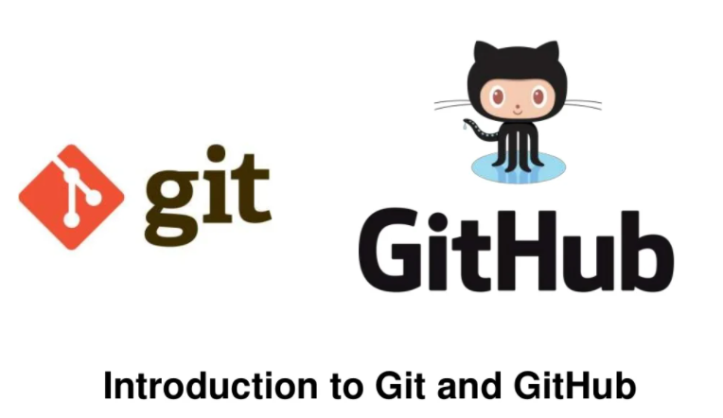

Slide 2
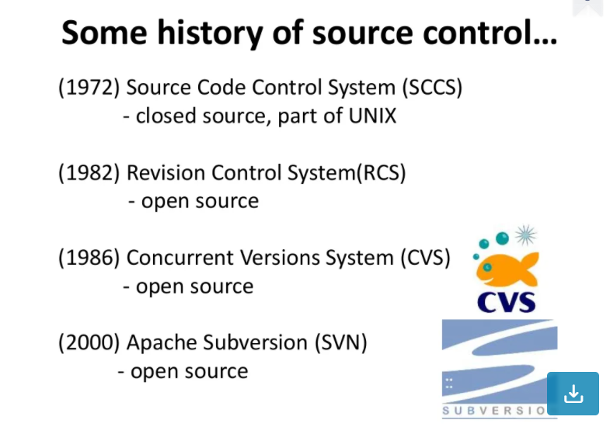

Slide 3
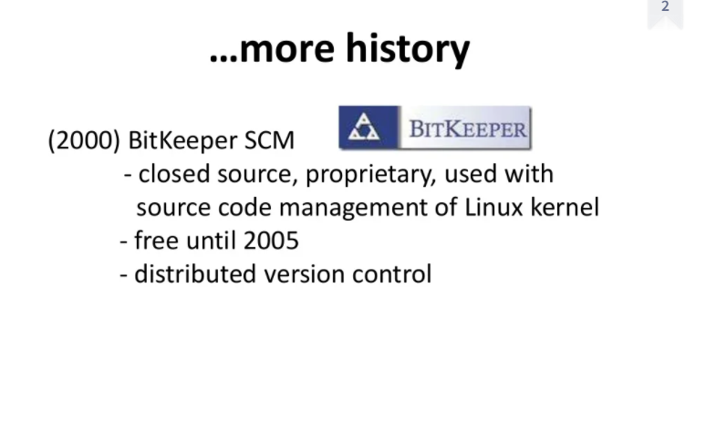

Slide 4
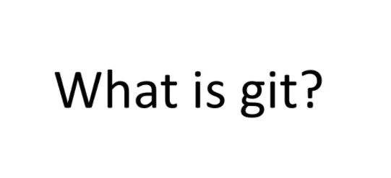

Slide 5
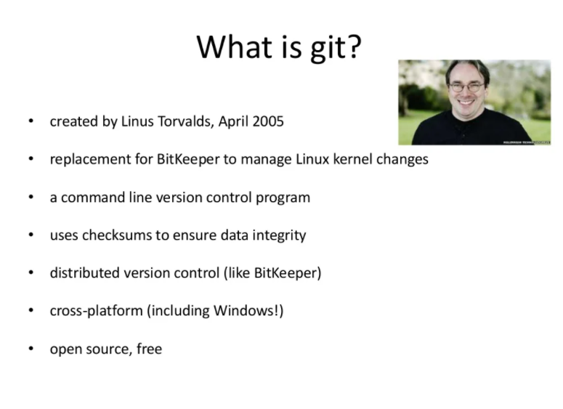

Slide 6
About Git
A version control system, or VCS, tracks the history of changes as people and teams collaborate on projects together. As developers make changes to the project, any earlier version of the project can be recovered at any time.
Developers can review project history to find out:
Which changes were made?
Who made the changes?
When were the changes made?
Why were changes needed?

Slide 7
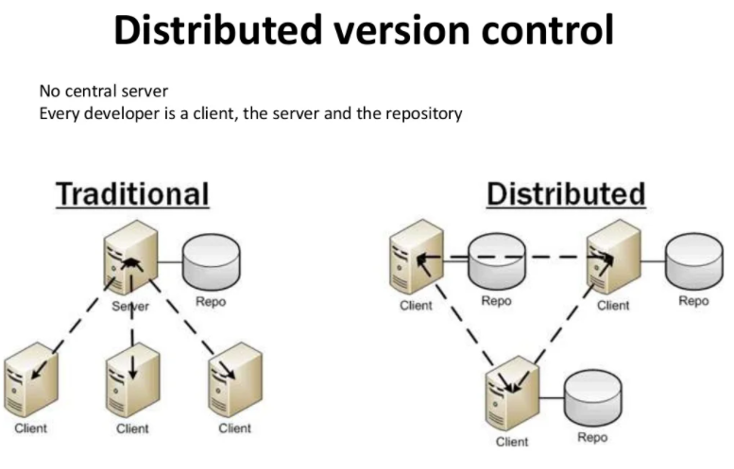

Slide 8
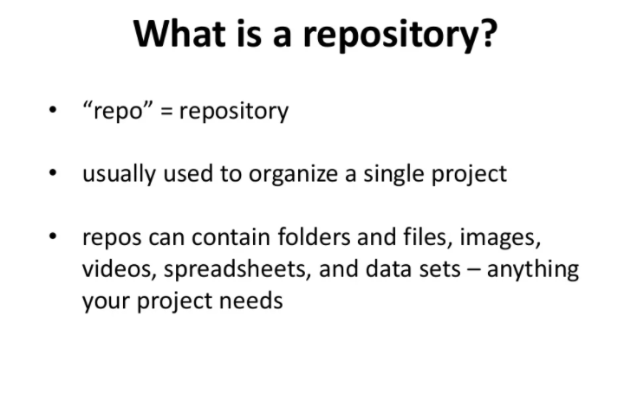

Slide 9
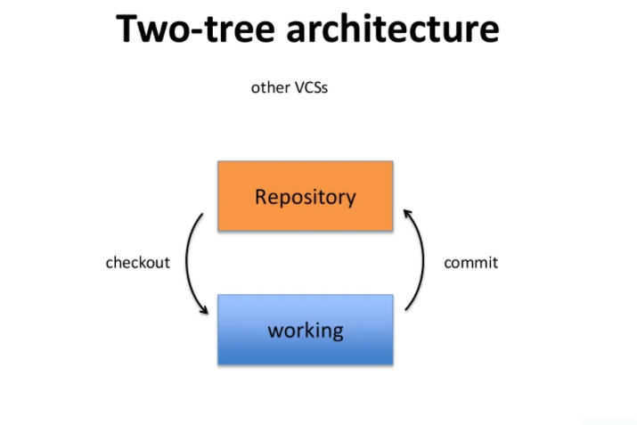

Slide 10
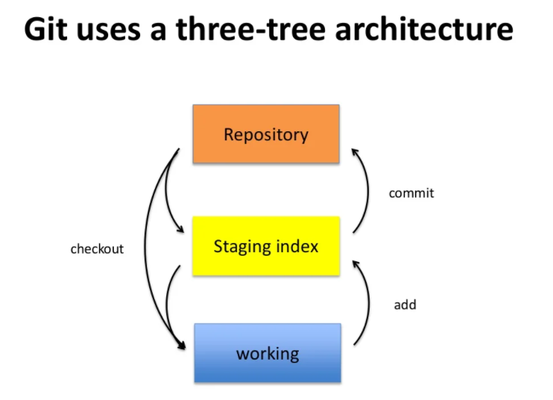

Slide 11
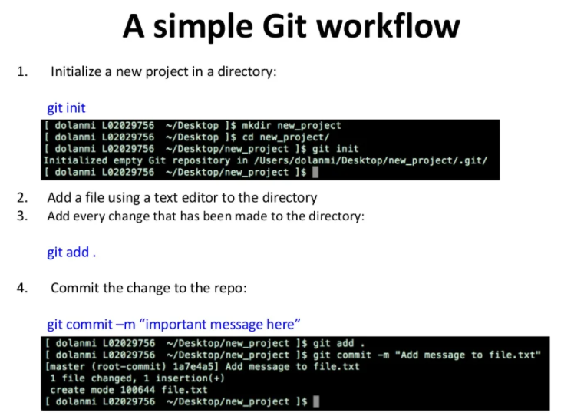

Slide 12
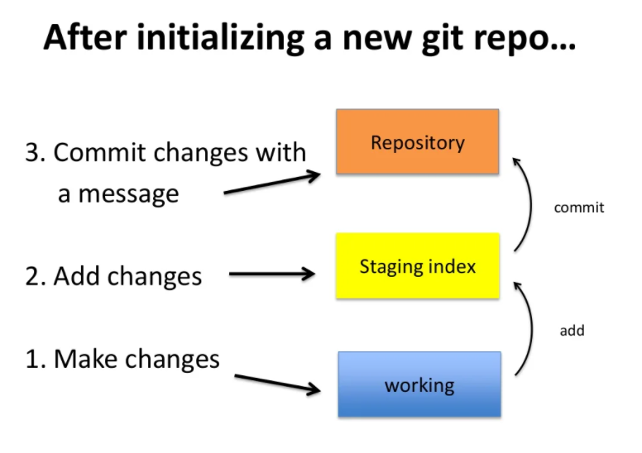

Slide 13
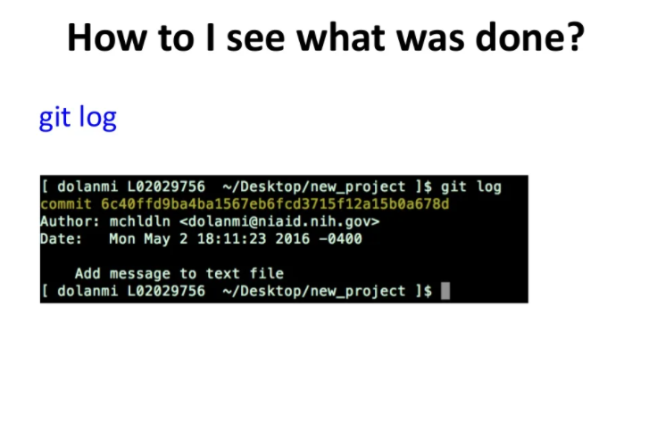

Slide 14
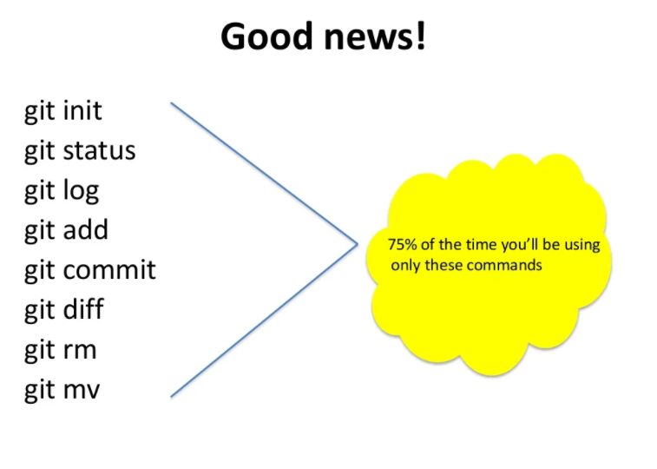

Slide 15
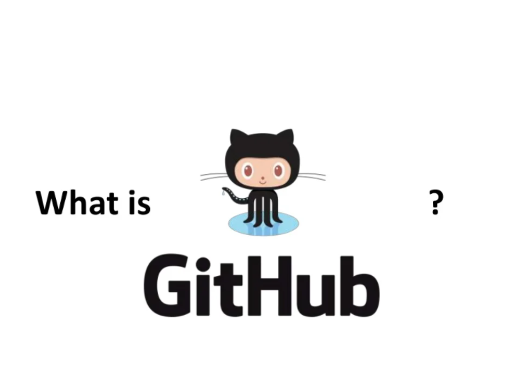

Slide 16
GitHub
GitHub Is the Remote server or cloud-based service that helps developers store and manage their code, as well as track and control changes to their code.
GitHub can be easily accessed by other developers of the same team from anywhere and anytime.

Slide 17
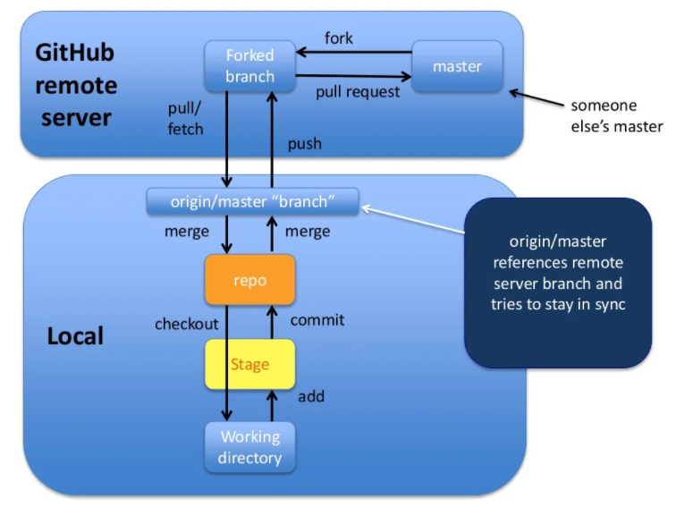

Slide 18
Commands for sharing and updating Code :
Command | Description
git push origin [branch name] | Push a branch to your remote repository
git push -u origin [branch name] | Push changes to remote repository (and remember the branch)
git push | Push changes to remote repository (remembered branch)
git push origin --delete [branch name] | Delete a remote branch
git pull | Update local repository to the newest commit
git pull origin [branch name] | Pull changes from remote repository
git remote add origin ssh://git@github.com/[username]/[repository-name].git | Add a remote repository
git remote set-url origin ssh://git@github.com/[username]/[repository-name].git | Set a repository's origin branch to SSH

Slide 19
Thank You…

