Slide 1

DevOps-The Infinite Loop

Slide 2
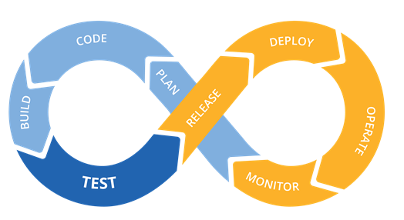
Introduction to DevOps
DevOps is a set of practices that combines software development and IT operations. It aims to shorten the systems development life cycle and provide continuous delivery with high software quality . It emphasises team empowerment, collaboration and technology automation.

Slide 3
Plan :
DevOps teams should adopt agile practices to improve speed and quality. Agile is an iterative approach to project management and software development that helps teams break work into smaller pieces to deliver incremental value.
Build :
Git is a free and open source version control system. It offers excellent support for branching, merging, and rewriting repository history, which has led to many innovative and powerful workflows and tools for the development build process.
Continuous integration and Delivery :
CI/CD allows teams to release quality products frequently and predictably, from source code repository to production with automated workflows. Teams can merge code changes frequently, deploy feature flags, and incorporate end-to-end testing.

Slide 4
Monitor and Alert :
Quickly identify and resolve issues that impact product uptime, speed, and functionality. Automatically notify your team of changes, high-risk actions, or failures, so you can keep services on.
Operate :
Manage the end-to-end delivery of IT services to customers. This includes the practices involved in design, implementation, configuration, deployment, and maintenance of all IT infrastructure that supports an organization’s services.
Continuous Feedback :
DevOps teams should evaluate each release and generate reports to improve future releases. By gathering continuous feedback, teams can improve their processes and incorporate customer feedback to improve the next release.

Slide 5

5W’s of DevOps
What is DevOps ?
Why do we need DevOps ?
When do we need DevOps ?
For whom do we need DevOps ?
Where do we need DevOps ?

Slide 6
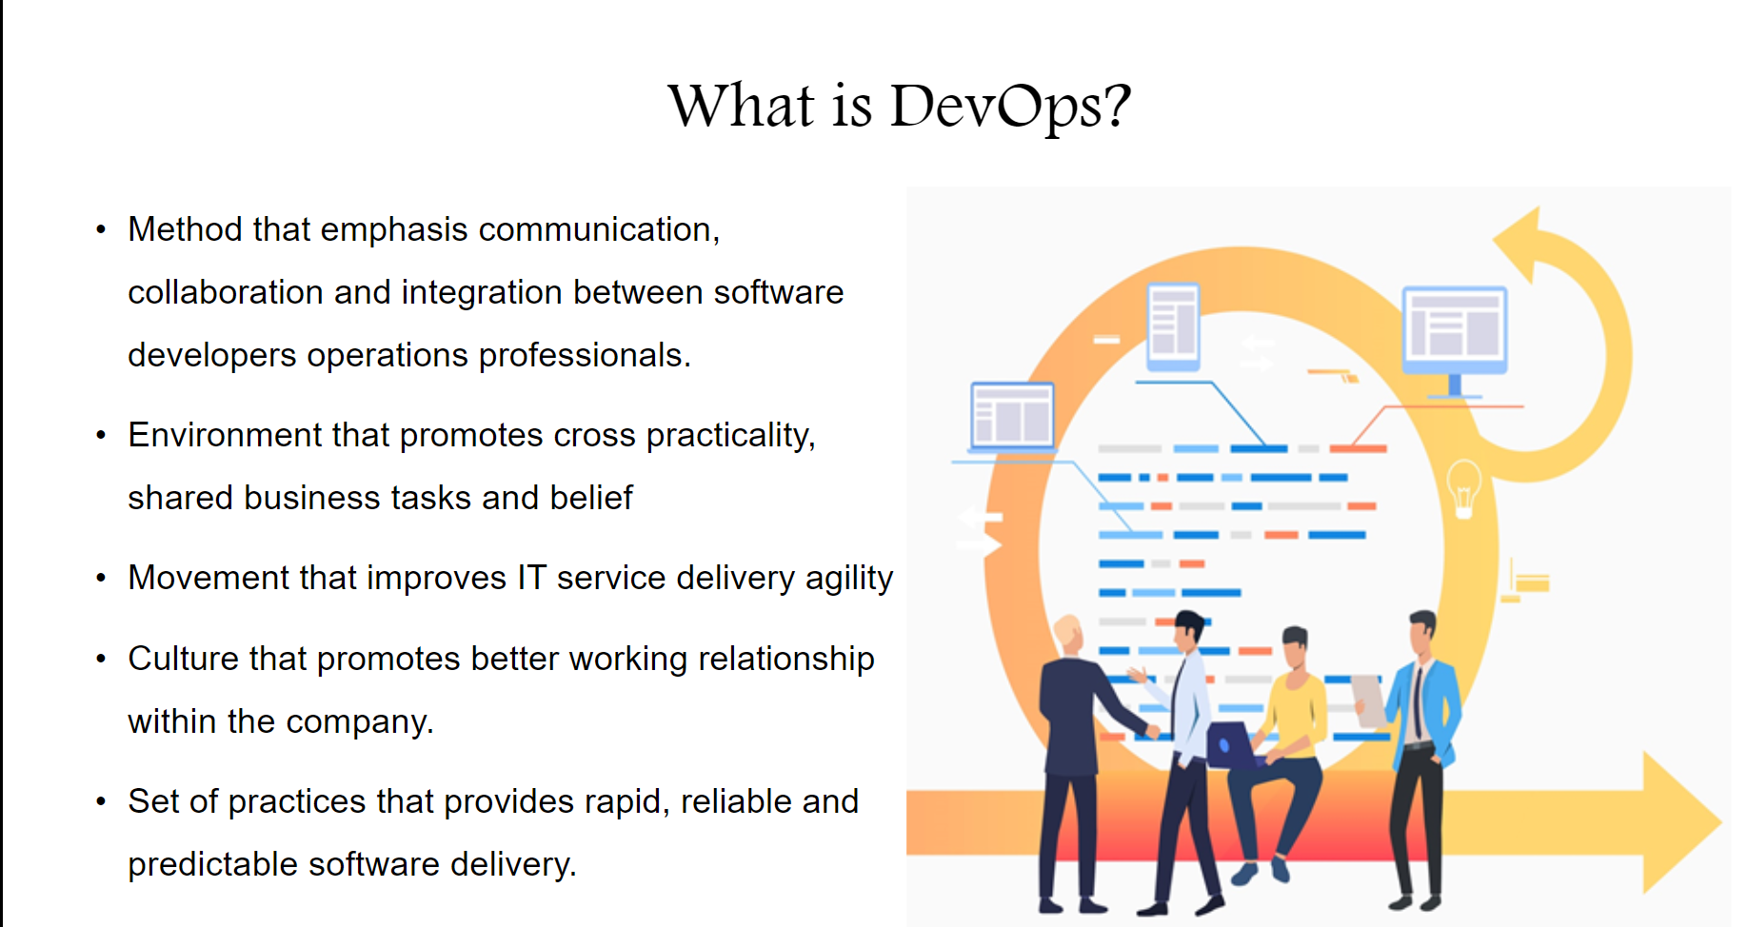

Slide 7
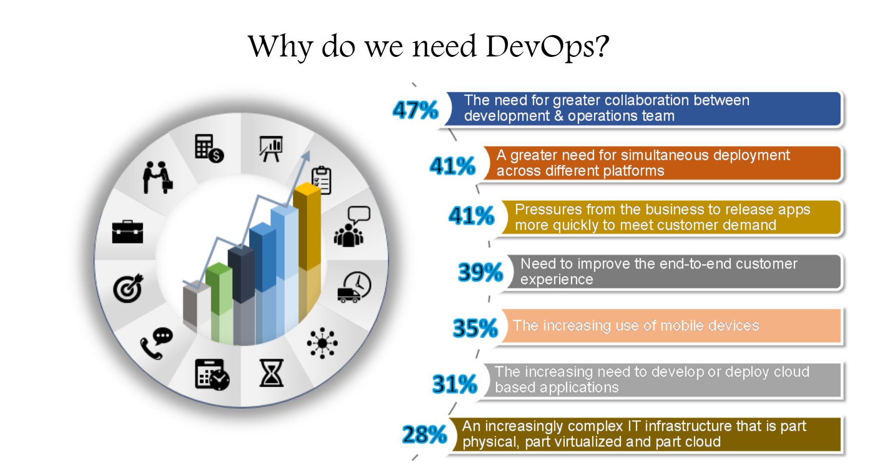

Slide 8
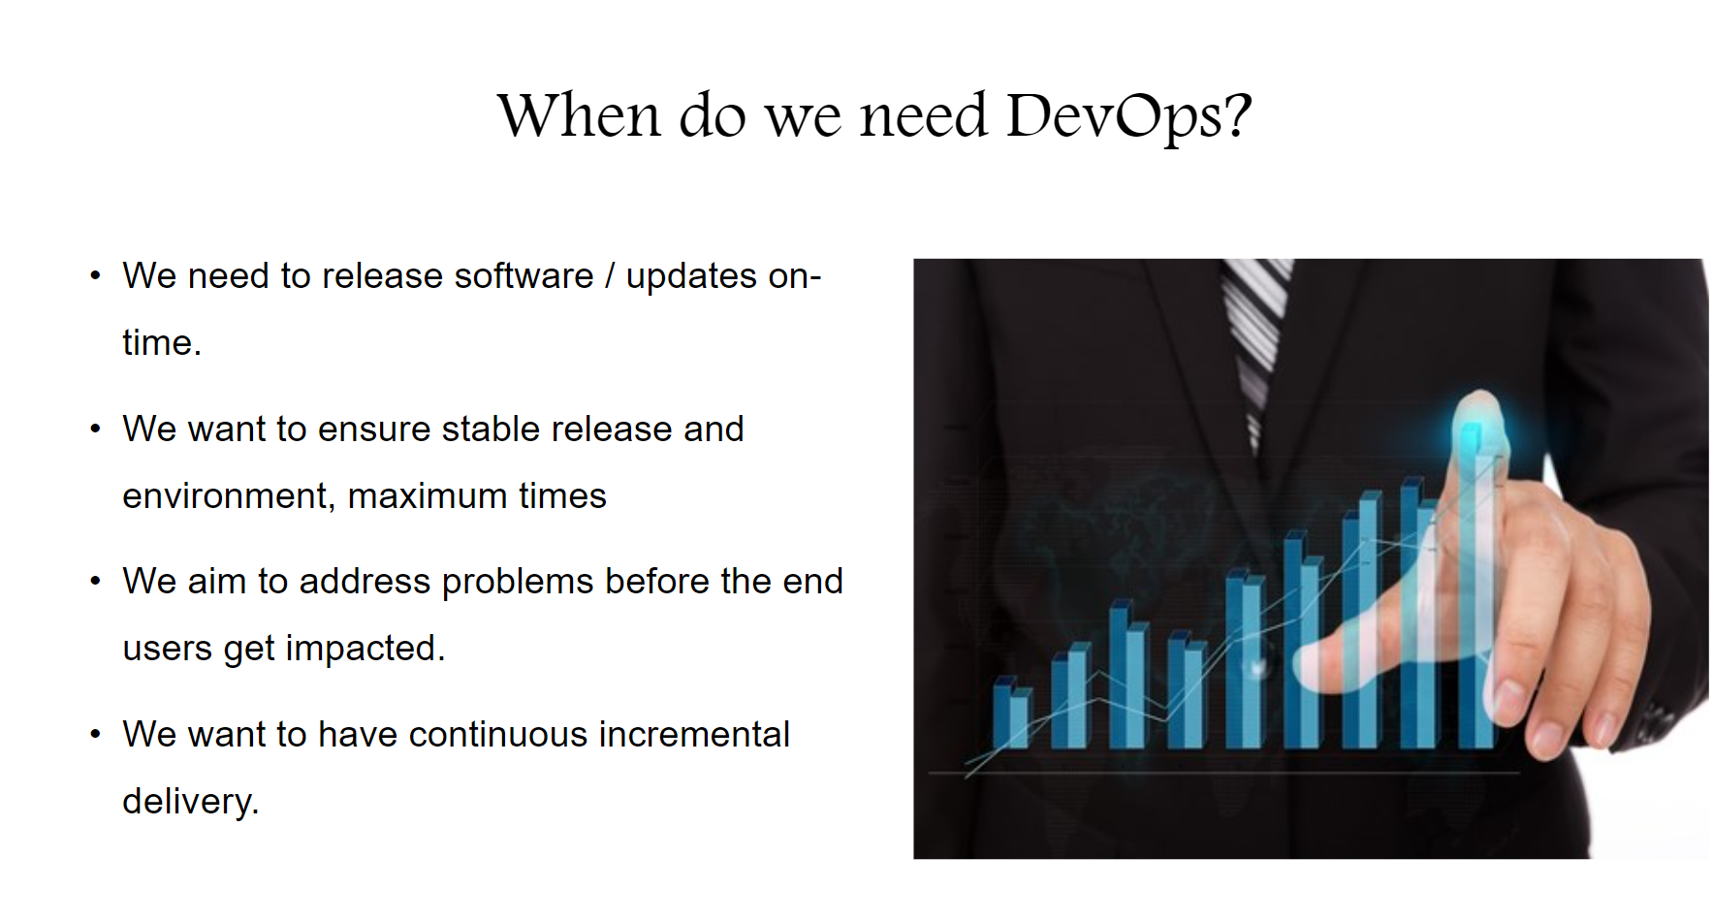

Slide 9
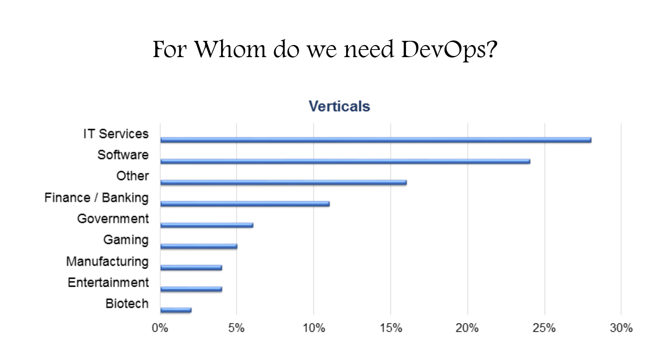

Slide 10
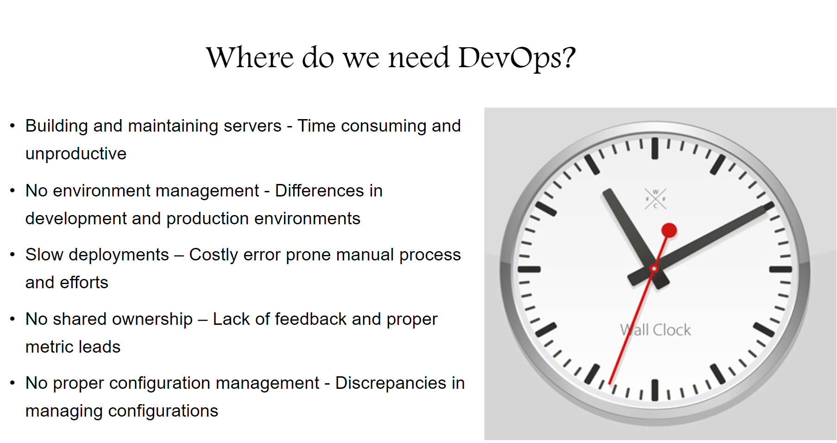

Slide 11
DevOps Tools

Slide 12
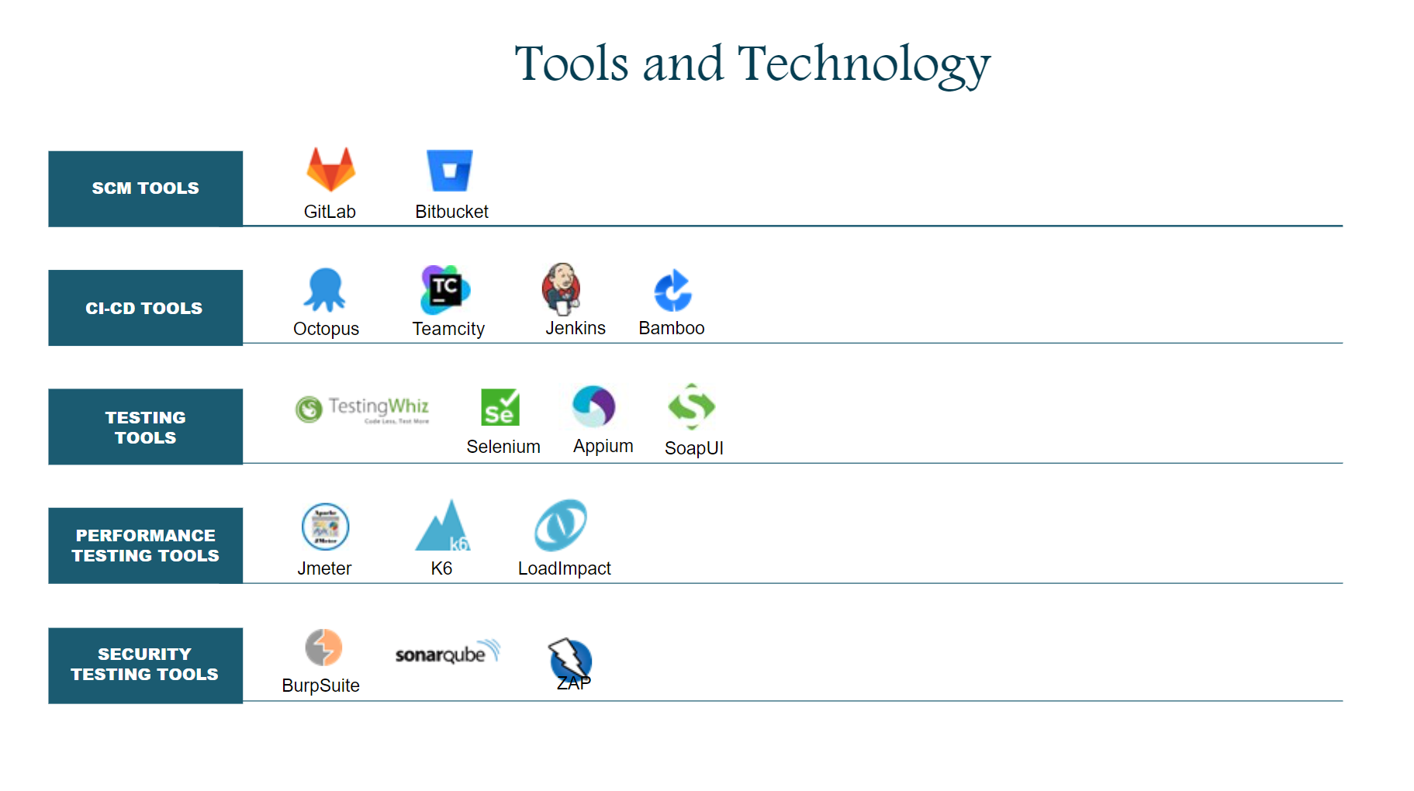

Slide 13
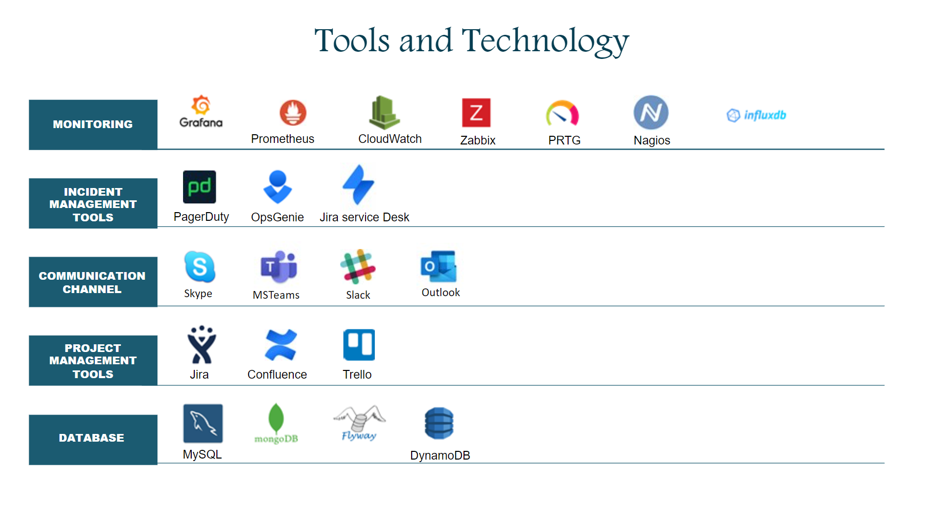

Slide 14
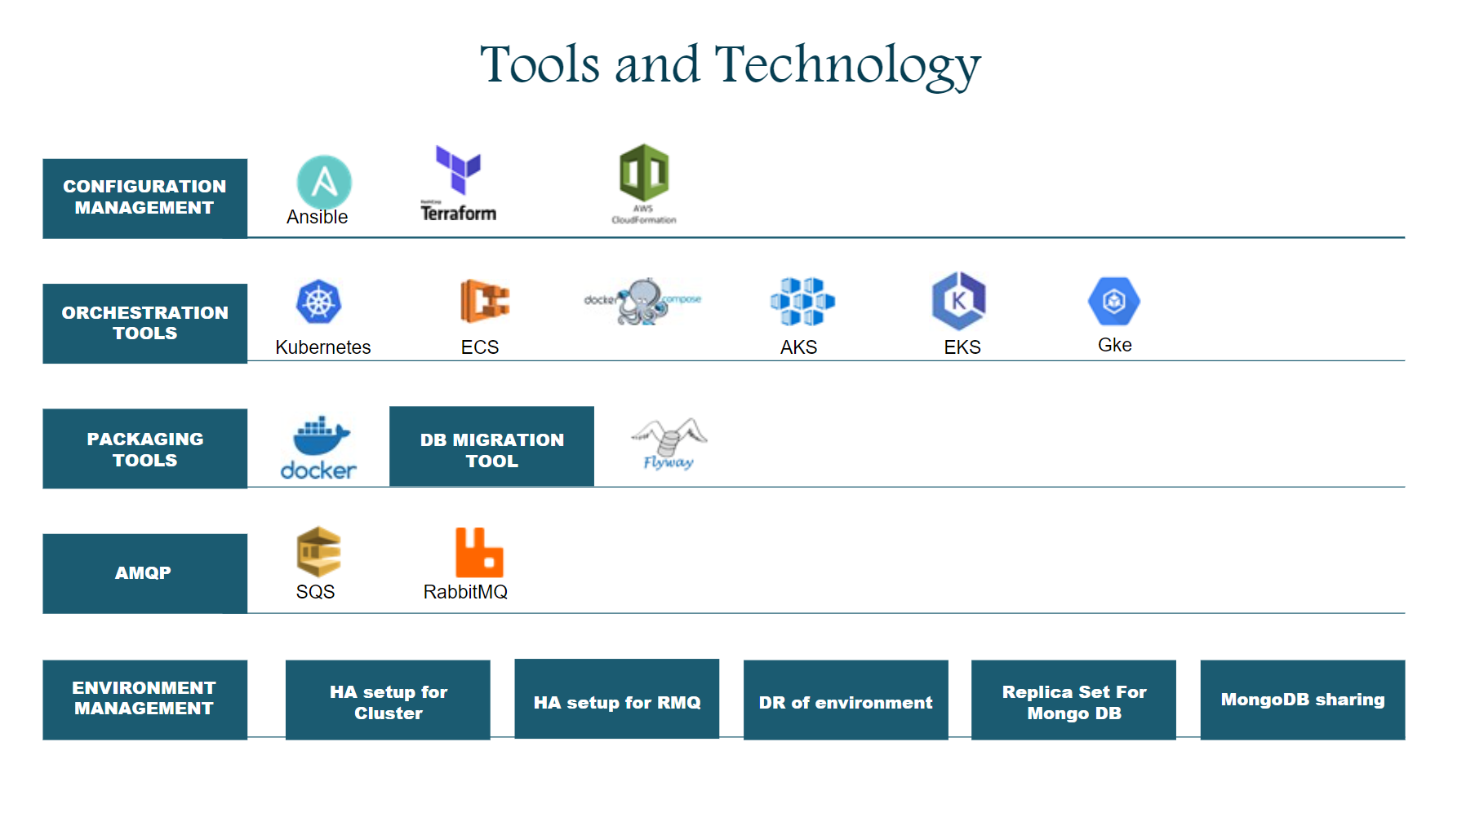

Slide 15
Thank You

