Slide 1
Computer Network
Computer Network tutorial provides basic and advanced concepts of Data Communication & Networks (DCN). Our Computer Networking Tutorial is designed for beginners and professionals.
Our Computer Network tutorial includes all topics of Computer Network such as introduction, features, types of computer network, architecture, hardware, software, internet, intranet, website, LAN, WAN, etc.

Slide 2
What is Computer Network?
Computer Network is a group of computers connected with each other through wires, optical fibres or optical links so that various devices can interact with each other through a network.
The aim of the computer network is the sharing of resources among various devices.
In the case of computer network technology, there are several types of networks that vary from simple to complex level.
A computer network is a set of devices connected through links. A node can be computer, printer, or any other device capable of sending or receiving the data. The links connecting the nodes are known as communication channels.
Computer Network uses distributed processing in which task is divided among several computers. Instead, a single computer handles an entire task, each separate computer handles a subset.

Slide 3
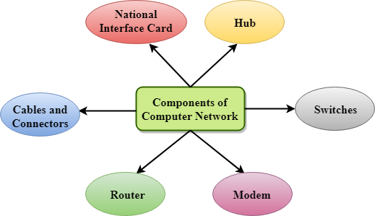

Slide 4
Major components of a computer network are:
NIC(National interface card)
NIC is a device that helps the computer to communicate with another device. The network interface card contains the hardware addresses, the data-link layer protocol use this address to identify the system on the network so that it transfers the data to the correct destination.
There are two types of NIC: wireless NIC and wired NIC.
Wireless NIC: All the modern laptops use the wireless NIC. In Wireless NIC, a connection is made using the antenna that employs the radio wave technology.
Wired NIC: Cables use the wired NIC to transfer the data over the medium.
Hub
Hub is a central device that splits the network connection into multiple devices. When computer requests for information from a computer, it sends the request to the Hub. Hub distributes this request to all the interconnected computers.
Switches
Switch is a networking device that groups all the devices over the network to transfer the data to another device. A switch is better than Hub as it does not broadcast the message over the network, i.e., it sends the message to the device for which it belongs to. Therefore, we can say that switch sends the message directly from source to the destination.

Slide 5
Cables and connectors
Cable is a transmission media that transmits the communication signals. There are three types of cables:
Twisted pair cable: It is a high-speed cable that transmits the data over 1Gbps or more.
Coaxial cable: Coaxial cable resembles like a TV installation cable. Coaxial cable is more expensive than twisted pair cable, but it provides the high data transmission speed.
Fibre optic cable: Fibre optic cable is a high-speed cable that transmits the data using light beams. It provides high data transmission speed as compared to other cables. It is more expensive as compared to other cables, so it is installed at the government level.
Router
Router is a device that connects the LAN to the internet. The router is mainly used to connect the distinct networks or connect the internet to multiple computers.
Modem
Modem connects the computer to the internet over the existing telephone line. A modem is not integrated with the computer motherboard. A modem is a separate part on the PC slot found on the motherboard.
Uses Of Computer Network
Resource sharing: Resource sharing is the sharing of resources such as programs, printers, and data among the users on the network without the requirement of the physical location of the resource and user.
Server-Client model: Computer networking is used in the server-client model. A server is a central computer used to store the information and maintained by the system administrator. Clients are the machines used to access the information stored in the server remotely.
Communication medium: Computer network behaves as a communication medium among the users. For example, a company contains more than one computer has an email system which the employees use for daily communication.
E-commerce: Computer network is also important in businesses. We can do the business over the internet. For example, amazon.com is doing their business over the internet, i.e., they are doing their business over the internet.

Slide 6
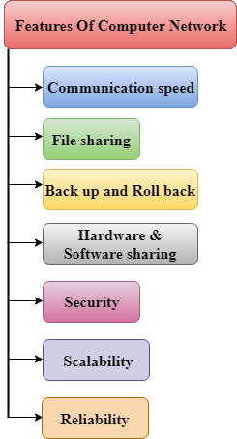
Features Of Computer network
A list Of Computer network features is given below.
Communication speed
File sharing
Back up and Roll back is easy
Software and Hardware sharing
Security
Scalability
Reliability

Slide 7
Communication speed
Network provides us to communicate over the network in a fast and efficient manner. For example, we can do video conferencing, email messaging, etc. over the internet. Therefore, the computer network is a great way to share our knowledge and ideas.
File sharing
File sharing is one of the major advantage of the computer network. Computer network provides us to share the files with each other.
Back up and Roll back is easy
Since the files are stored in the main server which is centrally located. Therefore, it is easy to take the back up from the main server.
Software and Hardware sharing
We can install the applications on the main server, therefore, the user can access the applications centrally. So, we do not need to install the software on every machine. Similarly, hardware can also be shared.
Security
Network allows the security by ensuring that the user has the right to access the certain files and applications.
Scalability
Scalability means that we can add the new components on the network. Network must be scalable so that we can extend the network by adding new devices. But, it decreases the speed of the connection and data of the transmission speed also decreases, this increases the chances of error occurring. This problem can be overcome by using the routing or switching devices.
Reliability
Computer network can use the alternative source for the data communication in case of any hardware failure.

Slide 8
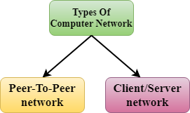
Computer Network Architecture
Computer Network Architecture is defined as the physical and logical design of the software, hardware, protocols, and media of the transmission of data. Simply we can say that how computers are organized and how tasks are allocated to the computer.
Peer-To-Peer network
Peer-To-Peer network is a network in which all the computers are linked together with equal privilege and responsibilities for processing the data.
Peer-To-Peer network is useful for small environments, usually up to 10 computers.
Peer-To-Peer network has no dedicated server.
Special permissions are assigned to each computer for sharing the resources, but this can lead to a problem if the computer with the resource is down.

Slide 9
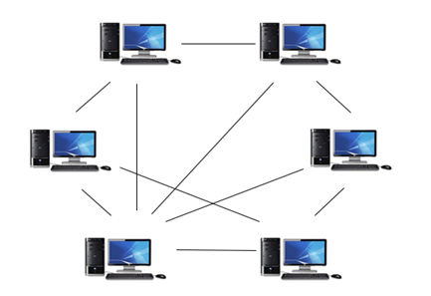

Slide 10
Client/Server Network
Client/Server network is a network model designed for the end users called clients, to access the resources such as songs, video, etc. from a central computer known as Server.
The central controller is known as a server while all other computers in the network are called clients.
A server performs all the major operations such as security and network management.
A server is responsible for managing all the resources such as files, directories, printer, etc.
All the clients communicate with each other through a server. For example, if client1 wants to send some data to client 2, then it first sends the request to the server for the permission. The server sends the response to the client 1 to initiate its communication with the client 2.

Slide 11
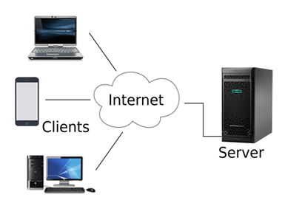

Slide 12
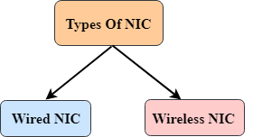
Computer Network Components
Computer network components are the major parts which are needed to install the software. Some important network components are NIC, switch, cable, hub, router, and modem. Depending on the type of network that we need to install, some network components can also be removed. For example, the wireless network does not require a cable.
Following are the major components required to install a network:
NIC
NIC stands for network interface card.
NIC is a hardware component used to connect a computer with another computer onto a network
It can support a transfer rate of 10,100 to 1000 Mb/s.
The MAC address or physical address is encoded on the network card chip which is assigned by the IEEE to identify a network card uniquely. The MAC address is stored in the PROM (Programmable read-only memory).
Wired NIC: The Wired NIC is present inside the motherboard. Cables and connectors are used with wired NIC to transfer data.
Wireless NIC: The wireless NIC contains the antenna to obtain the connection over the wireless network. For example, laptop computer contains the wireless NIC.

Slide 13
Hub
A Hub is a hardware device that divides the network connection among multiple devices. When computer requests for some information from a network, it first sends the request to the Hub through cable. Hub will broadcast this request to the entire network. All the devices will check whether the request belongs to them or not. If not, the request will be dropped.
The process used by the Hub consumes more bandwidth and limits the amount of communication. Nowadays, the use of hub is obsolete, and it is replaced by more advanced computer network components such as Switches, Routers.
Switch
A switch is a hardware device that connects multiple devices on a computer network. A Switch contains more advanced features than Hub. The Switch contains the updated table that decides where the data is transmitted or not. Switch delivers the message to the correct destination based on the physical address present in the incoming message. A Switch does not broadcast the message to the entire network like the Hub. It determines the device to whom the message is to be transmitted. Therefore, we can say that switch provides a direct connection between the source and destination. It increases the speed of the network.
Router
A router is a hardware device which is used to connect a LAN with an internet connection. It is used to receive, analyze and forward the incoming packets to another network.
A router works in a Layer 3 (Network layer) of the OSI Reference model.
A router forwards the packet based on the information available in the routing table.
It determines the best path from the available paths for the transmission of the packet.

