Slide 1


Slide 2
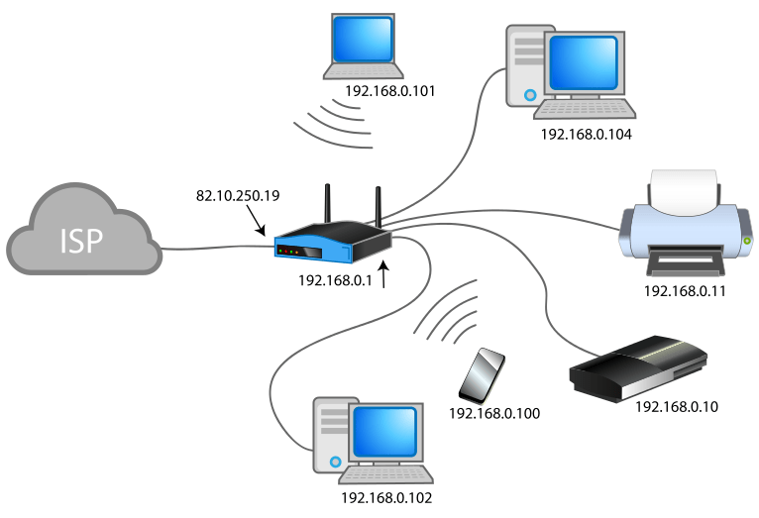
Network
A network is referred to as a set of a number of devices that are connected to each other with the help of a physical media link.
In other words, a network is an interconnected group of a number of similar things such as computers, people, devices, etc.
For example, a computer network is an example of a well-established network that consists a number of computers connected with each other. They share different types of information and data.

Slide 3
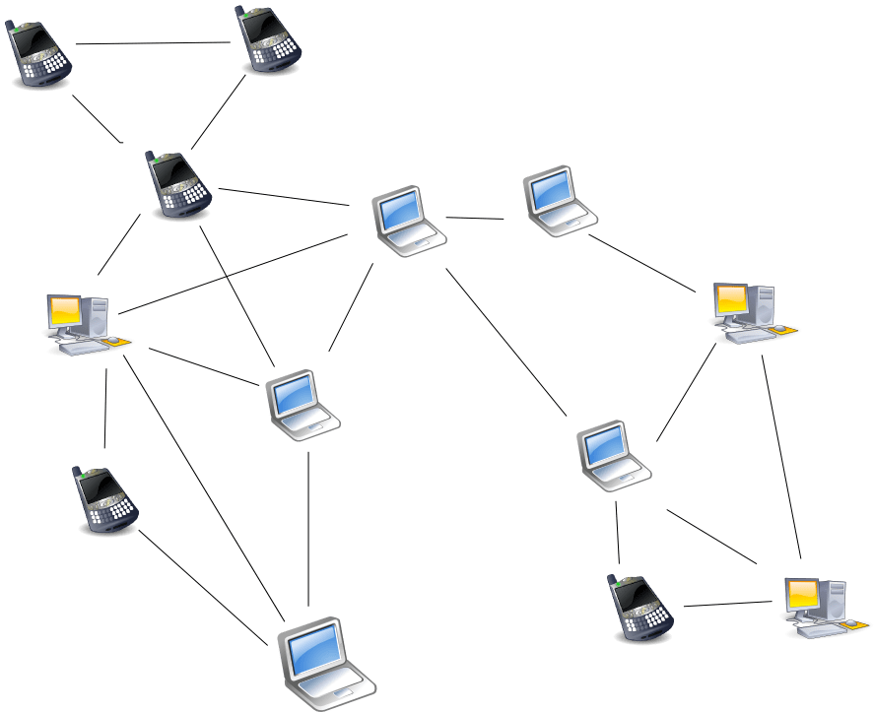
Node
In a network, various devices are connected to each other such as computers, servers and printers.
Wherever a network is established, that specific point is called as a Node.
A device connected to a network is also called as a Node.
A node is the hub of sending, receiving and forwarding a piece of electrical information.

Slide 4
Different types of networks
PAN (Personal Area Network): Such a network allows the connection amongst the devices present over a range of person. For example, phones connected through Bluetooth.
LAN (Local Area Network): LAN is a privately-owned network that works within a building or between a nearby building. For example, at home, office or factory.
MAN (Metropolitan Area Network): As the name suggests, MAN is a type of network that is present in a whole city. For example, a cable connection in a city.
WAN (Wide Area Network): It is spread over a large geographical area. For example, Internet service that is spread all across a country.
GAN (Global Area Network): One of the best-known GAN is the Internet itself that connects the whole world/globe with the help of satellites. The Internet is also known as the Network of WANs.

Slide 5
Networking devices
Hub
Switch
Router
Modem

Slide 6
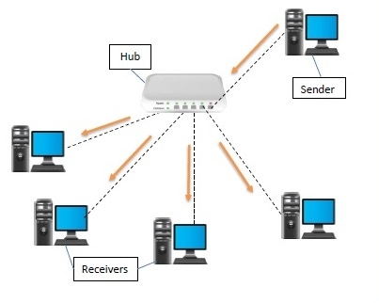
HUB
A hub is a physical layer networking device which is used to connect multiple devices in a network
They are generally used to connect computers in a LAN
A hub has many ports in it
A computer which intends to be connected to the network is plugged in to one of these ports

Slide 7
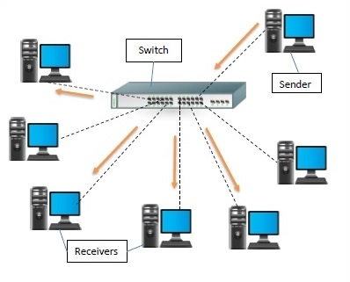
SWITCH
A switch is a data link layer networking device which connects devices in a network and uses packet switching to send and receive data over the network.
Like a hub, a switch also has many ports, to which computers are plugged in

Slide 8
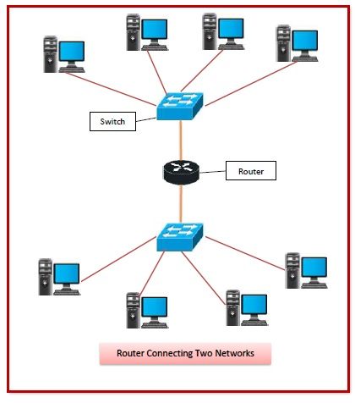
ROUTER
It is a networking device operating at layer 3 or a network layer of the OSI model
They are responsible for receiving, analysing, and forwarding data packets among the connected computer networks
Routers provide protection against broadcast storms

Slide 9
MODEM
Modem is a device that enables a computer to send or receive data over telephone or cable lines
The data stored on the computer is digital whereas a telephone line or cable wire can transmit only analog data

Slide 10
IP ADDRESS
It is a short form of "Internet Protocol Address”
It is a unique number provided to every device connected to the internet network
It is represented in an integer number separated by a dot (.)
For example, 192.168.2.33
TYPES OF IP ADDRESS
IPV4(Internet Protocol version 4)
IPV6(Internet Protocol version 6)

Slide 11
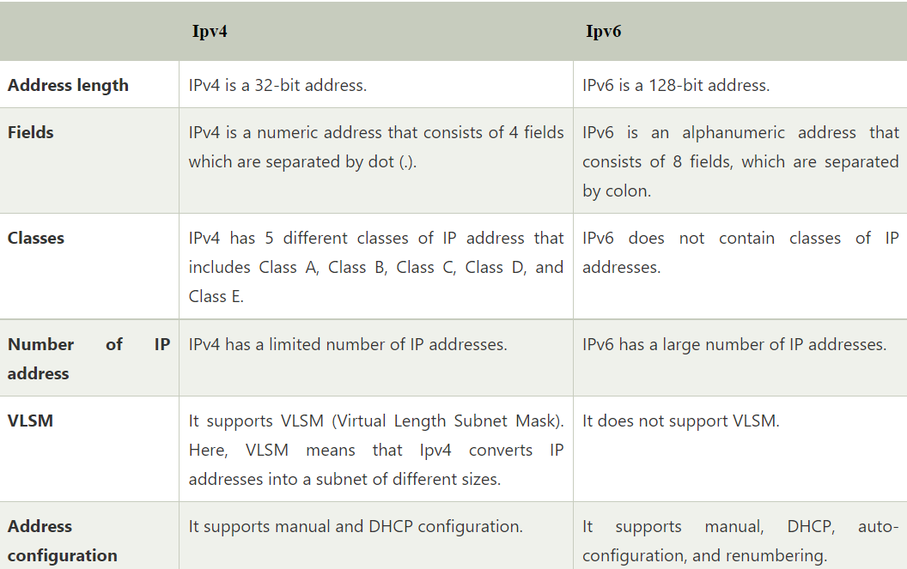

Slide 12
THANK YOU

