Slide 1
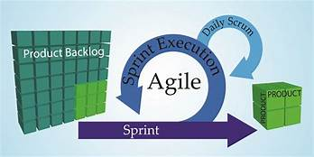

Slide 2
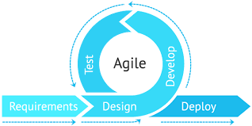
What is agile ?
Agile is an iterative approach to project management and software development that helps teams deliver value to their customers faster and with fewer headaches.

Slide 3
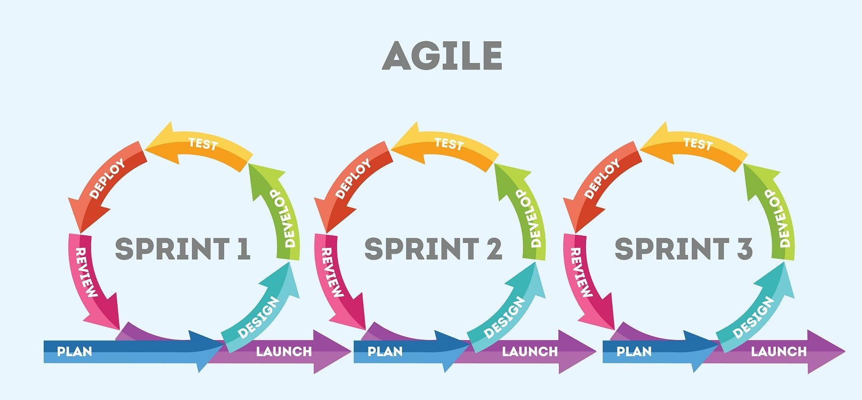
What is a sprint in Agile?
A sprint in Scrum is a short period of time wherein a development team works to complete specific tasks, milestones, or deliverables. Sprints, also referred to as “iterations,” essentially break the project schedule into digestible blocks of time in which smaller goals can be accomplished.

Slide 4
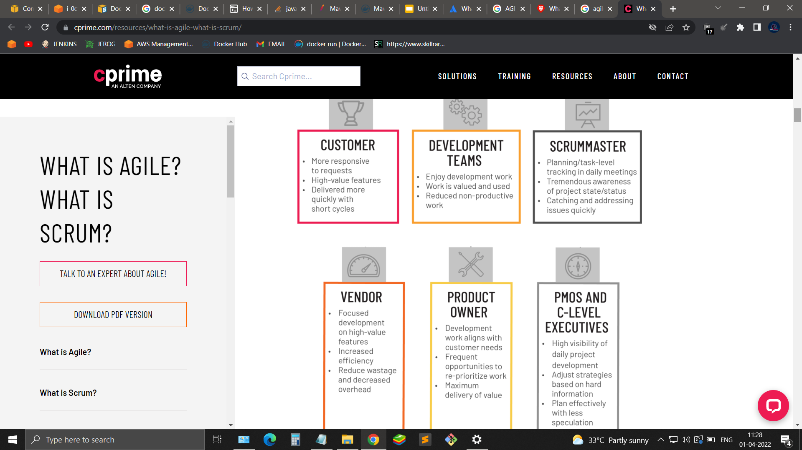
WHAT ARE THE BENEFITS OF AGILE?

Slide 5
EPIC
A very large user story that is eventually broken down into smaller stories. Epics are often used as placeholders for new ideas and related stories to be developed in subsequent sprints.

Slide 6
User Story
A User Story (a.k.a Story) can be thought of as a requirement, feature which has some business value.
Stories describe the work that must be completed to deliver a feature for a product. Stories are the basic unit of communication, planning, and negotiation between the Scrum Team, Business Owners and the Product Owner.
Stories consist of the following elements:
A description, usually in business terms
A size, for rough estimation purposes, generally expressed in story points (such as 1, 2, 3, 5)
One or more Acceptance Criteria, giving a short description of how the story will be validated

Slide 7
Task
Tasks are descriptions of the actual work that an individual or pair does in order to complete a story. They are manageable, doable, and trackable units of work. Typically, there are several tasks per story.
Subtasks
Subtasks are your smallest pieces of work to be tracked and are a tool for those committing to the parent Task or Story to break their work down further and track how they want to do it. Not all Stories or Tasks need to be Subtasked, it should be up to the team, but if a Story or Task is Subtasked, it should be Subtasked out completely so that when all the Subtasks of a Story or Task are complete, the Story or Task should be able to be considered complete as well.

Slide 8
STORY POINT
A rough estimation of the time taken by the dev team to develop a feature and the time taken by the tester team to test that feature.
Its always calculated in the fibonacci series .

Slide 9
Sprint planning meeting
Before your team begins a Scrum sprint, you need to know where you’re going. This is where the sprint planning meeting comes in. A sprint planning meeting should be one of the longest Scrum meetings you hold—plan on two hours of planning for each week of your sprint. (A two week sprint, for example, requires roughly a four hour planning meeting.) While this may seem like a lot, remember that you only need to hold one sprint planning meeting per sprint—right at the start.
Daily standup meeting
As the most frequently held Agile Scrum meetings, daily standup meetings are the bread and butter of Scrum sprints. They’re short, to the point, and, as the name suggests, held each day—they’re typically the first meeting of the work day. By the end of a standup meeting, each team member should have answered two questions: What did I accomplish yesterday? And what am I going to accomplish today? Standup meetings are also a time for team members to bring up any roadblocks they are facing.

Slide 10
Sprint review meeting
Sprint review meetings are held at the end of each sprint. This meeting is an opportunity for you and your team to demonstrate what you’ve accomplished to the product owner and other stakeholders outside of your team.
Sprint retrospective meeting
Just like review meetings, a sprint retrospective meeting is held at the end of each sprint. Whereas review meetings include the product owner and other stakeholders, retrospective meetings are primarily for the benefit of your Scrum team—there’s usually no need to get outside players involved.

