Slide 1
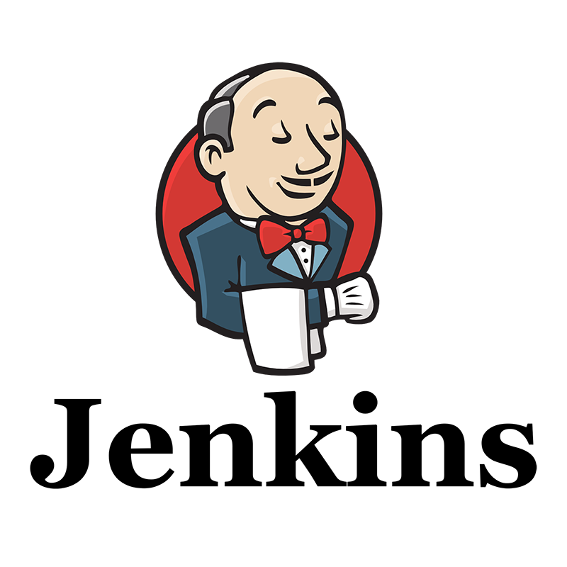

Slide 2
Jenkins
Jenkins is an open source automation server.
It helps automate the parts of software development related to building, testing, and deploying, facilitating continuous integration and continuous delivery.
Repository: GitHub
License: MIT License
Written in: Java
Platform: Java 8, Java 11
Initial release: 2 February 2011
Original author(s): Kohsuke Kawaguchi.

Slide 3
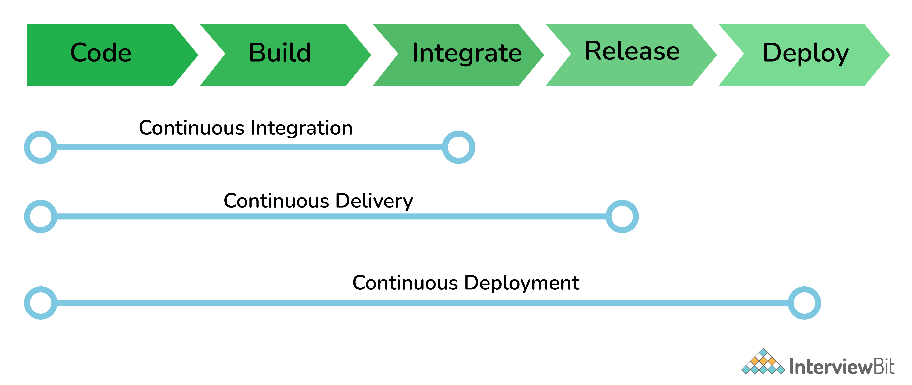

Slide 4
The common use cases Jenkins is used for
Software build jobs
Sanity/Smoke/CI/Regression test jobs
Web/Data Scraping related jobs
Code coverage measurement jobs
General-purpose automation
Reverse Engineering jobs
Key Decoding jobs & many other jobs where software automation will be applicable.

Slide 5
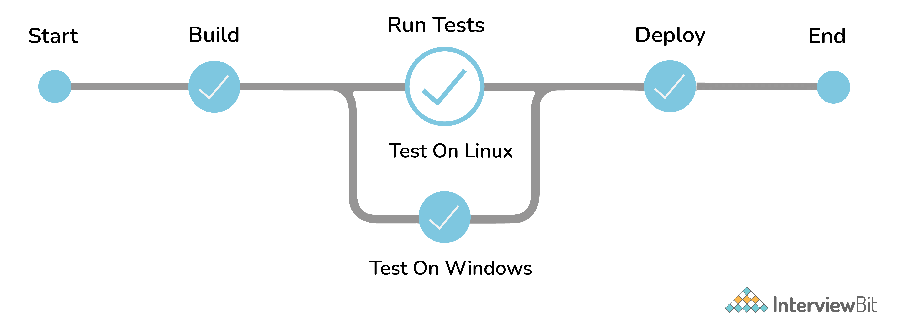
Jenkins Pipeline
The pipeline is a special type of Jenkins job - simply a sequence of steps controlled by a defined logic - which Orchestrates long-running activities that can span across multiple build agents. It is suitable for building pipelines (formerly known as workflows) and/or organizing complex activities that cannot be easily achieved using a freestyle job.
Understand how to create your first pipeline here

Slide 6
The ways to trigger a Jenkins Job/Pipeline
There are many ways we can trigger a job in Jenkins. Some of the common ways are as below -
Trigger an API (POST) request to the target job URL with the required data.
Trigger it manually from the Jenkins web application.
Trigger it using Jenkins CLI from the master/slave nodes.
Time-based Scheduled Triggers like a cron job.
Event-based Triggers like SCM Actions (Git Commit, Pull Requests), WebHooks, etc.
Upstream/Downstream triggers by other Jenkins jobs.

Slide 7
Advantages of Jenkins
It is an open-source tool with great community support.
It is easy to install.
It has 1000+ plugins to ease your work. ...
It is free of cost.
It is built with Java and hence, it is portable to all the major platforms.

Slide 8
The credential types supported by Jenkins
Secret text - A token such as an API token, JSON token, etc.
Username and password - Basic Authentication can be stored as a credential as well.
Secret file - A secret file used to authenticate some secure data services & security handshakes.
SSH Username with a private key - An SSH public/private key pair for Machine to Machine authentication.
Certificate - a PKCS#12 certificate file and an optional password.
Docker Host Certificate Authentication credentials.
And as we can guess, this can be extended to several other extensible credential types like - AWS credential, Azure secrets, etc. using commonly available plugins

Slide 9
Disadvantages of Jenkins
All plug-ins are not compatible with the declarative pipeline syntax.
Jenkins has many plug-ins in its library, but it seems like they are not maintained by the developer team from time to time. ...
Lots of plug-ins have a problem with the updating process.

