Slide 1
Linux
By Madhu A M

Slide 2

Linux
Linux is a family of open-source Unix-like operating systems based on the Linux kernel, an operating system kernel first released on September 17, 1991, by Linus Torvalds. Linux is typically packaged in a Linux distribution.

Slide 3
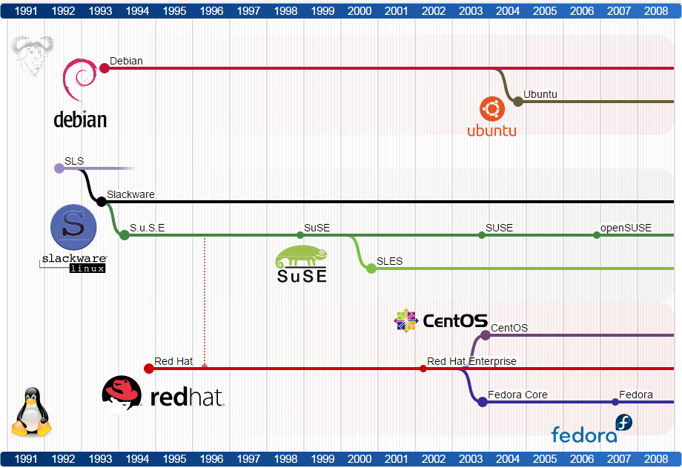

Slide 4
S.NO | Linux | Windows
1. | Linux is a open source operating system. | While windows are the not the open source operating system.
2. | Linux is free of cost. | While it is costly.
3. | It’s file name case-sensitive. | While it’s file name is case-insensitive.
4. | In linux, monolithic kernel is used. | While in this, micro kernel is used.
5. | Linux is more efficient in comparison of windows. | While windows are less efficient.
6. | There is forward slash is used for Separating the directories. | While there is backslash is used for Separating the directories.
7. | Linux provides more security than windows. | While it provides less security than linux.
8. | Linux is widely used in hacking purpose based systems. | While windows does not provide much efficiency in hacking.

Slide 5
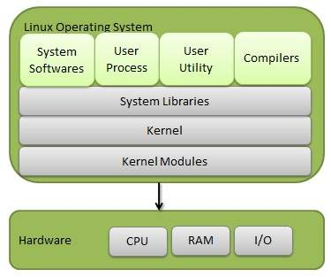
Linux architecture

Slide 6
Kernel
The Linux kernel is a mostly free and open-source, monolithic, modular, multitasking, Unix-like operating system kernel. It was originally authored in 1991 by Linus Torvalds for his i386-based PC, and it was soon adopted as the kernel for the GNU operating system, which was written to be a free replacement for UNIX.
It communicates between the 2, managing resources as efficiently as possible.
The kernel is so named because—like a seed inside a hard shell—it exists within the OS and controls all the major functions of the hardware, whether it’s a phone, laptop, server, or any other kind of computer.

Slide 7
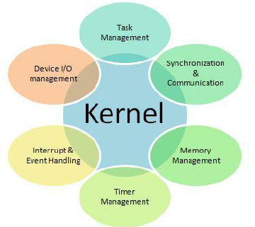
Kernel Responsibilities

Slide 8
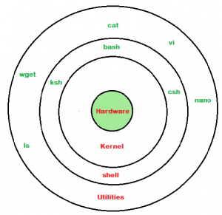
SHELL
a shell is a computer program which exposes an operating system's services to a human user or other programs. In general, operating system shells use either a command-line interface or graphical user interface, depending on a computer's role and particular operation.
Bourne shell − If you are using a Bourne-type shell, the $ character is the default prompt.
C shell − If you are using a C-type shell, the % character is the default prompt.

Slide 9
Advantages of Linux
Multitasking
Open Source
Security
GUI
App Support
File System
Portability
Multi user Capacity
Stability

Slide 10
Why use Linux
Linux is completely different from other operating systems in many ways.
It is an open source OS which gives a great advantage to the programmers as they can design their own custom operating systems.
It gives you a lot of option of programs having some different features so you can choose according to your need.
A global development community look at different ways to enhance its security, hence it is highly secured and robust so you don't need an antivirus to scan it regularly. Companies like Google, Amazon and Facebook use linux in order to protect their servers as it is highly reliable and stable.
Above all you don't have to pay for software and server licensing to install Linux, its absolutely free and you can install it on as many computers as you want.
It's completely trouble free operating system and don't have an issue with viruses, malware and slowing down your computer.

