Slide 1


Slide 2
JIRA is a project management tool used for issues and bugs tracking system. It is widely used as an issue-tracking tool for all types of testing. This tutorial introduces the readers to the fundamental features, usage, and advantages of JIRA. This tutorial will guide the users on how to utilize this tool to track and report bugs in different applications.

Slide 3
JIRA - Project
A Project contains issues; a JIRA project can be called as a collection of issues. A JIRA Project can be of several types. For example −
Software Development Project
Marketing Project
Migration to other platform project
Help Desk Tracking Project
Leave Request Management System
Employee Performance System
Website Enhancement

Slide 4
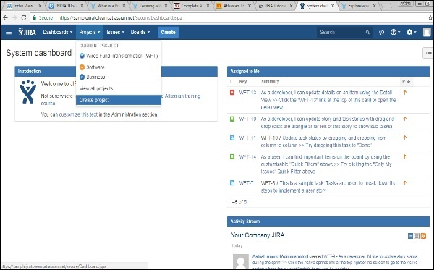
Create a New Project
To create a project, the user should login as a JIRA Service Desk Admin and then Click on Project → Create Project.
The following screenshot shows how to reach to the Create Project button from the Dashboard.

Slide 5
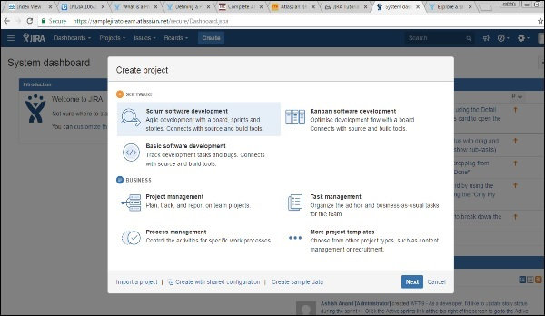
Choose the type of Project that suits your requirement and the process it should follow.
The following screenshot displays the type of projects available in JIRA.

Slide 6
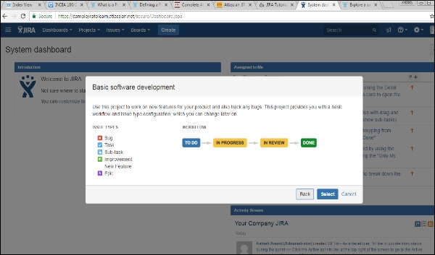
Once the type of project is selected, click on Next. The user will see the flow of the project based on the selection. Here, we have selected Basic Software development.
The following screenshot displays the available issue types and the workflow for the chosen project in the step mentioned above −

Slide 7
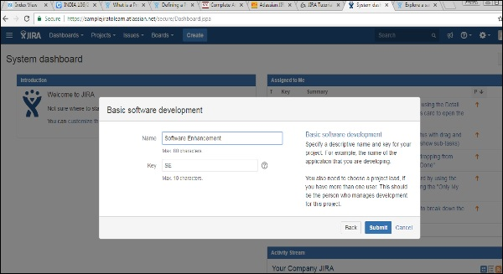
Click on the Select button, enter the name of the project and confirm the Key that the user wants to display as a reference in all the issues. Once this is done, click on the Submit button.
The following screenshot displays the fields to provide details before the creation of a project.

Slide 8
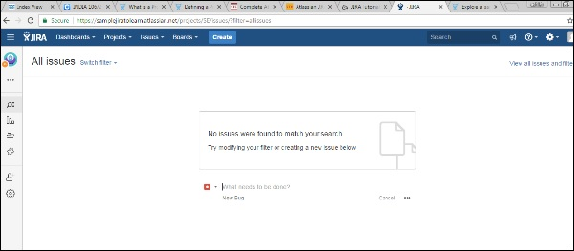
The page having issues will display. The following screenshot displays whether any issues are linked with a new created project.

Slide 9
JIRA - Issues
JIRA is a project management tool and uses issues to track all the tasks. An issue helps to track all works that underlie in a project. In real time, every work or task either technical, non-technical, support or any other type of a project in JIRA are logged as an issue.
An issue can be dependent on the organization and requirements −
Story of a project
Task of a story
Sub-task of a story
A defect or bug can be an issue
Helpdesk Ticket can be logged as issue
Leave Request

Slide 10
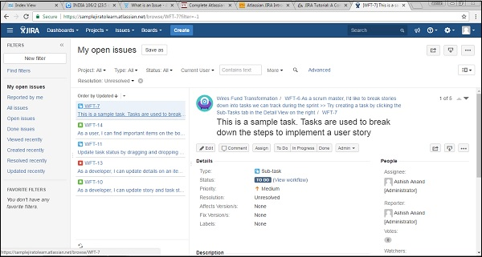
The following screen shot shows the basic page and information of an open issue −

Slide 11
JIRA - Workflow
In JIRA, workflow is used to track the lifecycle of an Issue. Workflow is a record of statuses and transitions of an issue during its lifecycle. A status represents the stage of an issue at a particular point. An issue can be in only one status at a given point of time like Opened, To Do, Done, Closed, Assigned, etc.
A transition is a link between two statuses when an issue moves from one status to another. For an issue to move between two statuses, a transition must exist. In a simple way, a transition is some kind of work done on the issue, while status is the impact of work on that issue.

Slide 12
JIRA workflow has the following stages to track as soon as an issue is created −
Open Issue − After creation, the issue is open and can be assigned to the assignee to start working on it.
In Progress Issue − The assignee has actively started to work on the issue.
Resolved Issue − All sub-tasks and works of that Issue are completed. Now, the issue is waiting to be verified by the reporter. If verification is successful, it will be closed or re-opened, if any further changes are required.
Reopened Issue − This issue was resolved previously, but the resolution was either incorrect or missed a few things or some modifications are required. From Reopened stage, issues are marked either as assigned or resolved.
Close Issue − The issue is considered as finished, resolution is correct as of now. Closed issues can be re-opened later based on the requirement.
JIRA Workflow can be referred as a Defect Lifecycle. It follows the same concepts; the only difference is that it is generic for all issues rather than limited to Defects only.

Slide 13
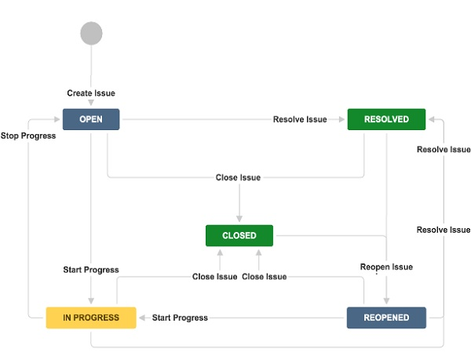
The following diagram shows a standard workflow

Slide 14
JIRA - Issue Types
Since JIRA tracks all the tasks, the sub-tasks or even a work as an Issue, there are several types of Issues to identify the work and categorize the similar issues.
An Issue is classified as follows −
Sub-Task − This is the sub-task of an issue. In a logged issue, there can be different tasks to resolve it, which are called as sub-tasks.
Bug − A problem that impairs or prevents the functions of the product.
Epic − A big user story that needs to be broken down. Created by JIRA Software - do not edit or delete.
Improvement − An improvement or enhancement to an existing feature or task.
New Feature − A new feature of the product, which is yet to be developed.
Story − A user story. Created by JIRA Software - do not edit or delete.
Task − A task that needs to be done to achieve team’s goal.

Slide 15
Important Points to Note
JIRA is a web application that provides a private website to an individual or a set of requested users belonging to the same company/project.
JIRA can be run as a Windows Service at the server side.
JIRA is a pure Java based application and supports all OS platforms like Windows, Linux of different versions or MAC, etc., those satisfy JDK/JRE requirements.
JIRA supports all famous browsers like Chrome, IE, Mozilla and Safari.
It supports Mobile browsers as well in mobile views.

