Slide 1
AwS
(Amazon Web Services)

Slide 2
Introduction

Slide 3
Overview of Cloud Computing

Slide 4







Section 2: What is Cloud? Consumer Examples
Gmail
Facebook
The Internet
Dropbox

Slide 5
Section 2: Cloud Terminology
Term | Description
Cloud Computing | Cloud computing is the on-demand delivery of IT services from a third-party provider over the Internet
Cloud Service | The IT capability that is being provided by the cloud provider
Cloud Provider / Cloud Service Provider | A company that provides a cloud service to organizations and/or individuals
Consumer | The organization or individual who uses the cloud service
”Pay as you go” or “pay per use” | You are charged only for what you use. Analogous to a utility bill
Multi-tenant | Multiple customers consume services delivered using shared infrastructure
“x” as a service | Some cloud capability is delivered to consumers as a service

Slide 6
Section 2: Key Characteristics of Cloud Computing
Name | Description
On-demand, self-service | A user can consume cloud resources, as needed, automatically, and without human interaction
Broad network access | Capabilities are available over the network using standard mechanisms. Can be the Internet or a Wide Area Network (WAN)
Resource pooling | The providers resources are pooled and serve multiple consumers using a multi-tenant model
Rapid elasticity | Capabilities can scale “elastically” based on demand
Measured service | Resource usage is monitored and metered

Slide 7




Section 2: Cloud Computing Service Models
On-premises
Managed by you
IaaS
PaaS
SaaS
Managed by you (VM)
Managed by you (App/Data)
Managed by provider
App 1
Data
Runtime
Guest OS
App 2
Data
Runtime
Guest OS
App 1
Data
Runtime
Guest OS
App 2
Data
Runtime
Guest OS
App 1
Data
Runtime
Guest OS
App 2
Data
Runtime
Guest OS
App 1
Data
Runtime
Guest OS
App 2
Data
Runtime
Guest OS
Hypervisor
Hypervisor
Hypervisor
Hypervisor
Physical Hardware
Physical Hardware
Physical Hardware
Physical Hardware
CPU RAM Disk NIC
CPU RAM Disk NIC
CPU RAM Disk NIC
CPU RAM Disk NIC

Slide 8




Section 2: IaaS, PaaS, and SaaS Examples
IaaS
Request a virtual server
System Admin
Amazon EC2
PaaS
Upload code
Developer
AWS Elastic Beanstalk
SaaS
Log sales data
Salesforce.com
Sales Team

Slide 9
Section 2: Cloud Computing Deployment Models
Name | Description | Examples
Private Cloud | An enterprise deploys their own infrastructure and applications into their own data center | VMware, Microsoft, RedHat, OpenStack
Public Cloud | The IT services that you consume are hosted and delivered from a third-party and accessed over the Internet | AWS, Microsoft Azure, Google Cloud Platform
Hybrid Cloud | A combination of on-premises, private cloud, and public cloud services are consumed
Multicloud | Usage of two or more public clouds at a time, and possibly multiple private clouds

Slide 10



Section 2: Deployment Models – Private Cloud
Private Cloud
Benefits:
Complete control of the entire stack
Security – in a few cases, organizations may need to keep all or some of their applications and data in house
Data center
Organization

Slide 11

Section 2: Deployment Models – Public Cloud
Benefits:
Variable expense, instead of capital expense
Economies of scale
Massive elasticity
Public Cloud
AWS Cloud
Organization
The Internet

Slide 12





Section 2: Deployment Models – Hybrid Cloud
Section 2: Deployment Models – Hybrid Cloud
Benefits:
• Allows companies to keep the critical applications and sensitive data in a traditional data center environment or private cloud
• Take advantage of public cloud resources like SaaS, for the latest applications, and IaaS, for elastic virtual resources
• Facilitates portability of data, apps and services and more choices for deployment models
Public Cloud
Private Cloud
AWS Cloud
Data center
The Internet
Benefits:
Allows companies to keep the critical applications and sensitive data in a traditional data
center environment or private cloud
Take advantage of public cloud resources like SaaS, for the latest applications, and IaaS, for elastic virtual resources
Facilitates portability of data, apps and services and more choices for deployment models
Public Cloud
Private Cloud
AWS Cloud
Data center
Organization
The Internet

Slide 13


Section 2: Legacy IT
Limitations:
Very capital heavy (CAPEX) – need to purchase everything
Operational overhead is high
Scalability is very limited
Costs:
Data center
Power
Computing Equipment
Software licenses
Maintenance contracts
Staff wages
Etc.
Private Cloud
Data center
Operations
Data center operations and security
Equipment installation and maintenance
System monitoring and operations activities
Backup/recovery
Etc.

Slide 14
Section 2: The 6 Advantages of Cloud
Name |  | Description
1 | Trade capital expense for variable expense | Instead of investing in data centers before you know how you’re going to use them, pay only when, and for how much, you consume
2 | Benefit from massive economies of scale | Achieve a lower variable cost due to AWS’ scale
3 | Stop guessing about capacity | Eliminate guessing, scale as demand dictates
4 | Increase speed and agility | Easily and quickly scale your usage
5 | Stop spending money running and maintaining data centers | Focus on business growth and innovation instead!
6 | Go global in minutes | Easily deploy applications in multiple regions around the world
https://docs.aws.amazon.com/whitepapers/latest/aws-overview/six-advantages-of-cloud-computing.html

Slide 15
AWS Cloud Overview

Slide 16
Section 3: Amazon Web Services (AWS) Today
Over 165 services including computing, storage, networking, database, analytics, media services, machine learning, management, mobile, and IoT
22 geographical regions of presence
$25 billion in revenue in 2018

Slide 17
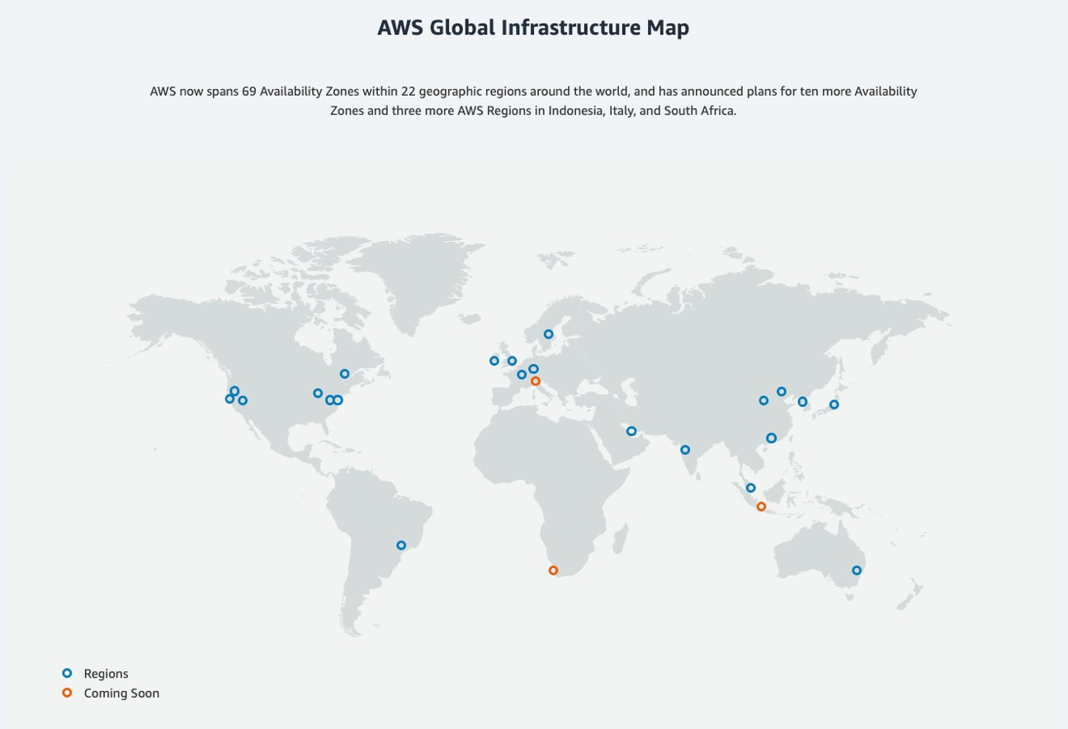
Section 3: AWS Global Infrastructure Map

Slide 18
Section 3: AWS Regions
An AWS region is a geographical area
Each region consists of 2 or more availability zones
Each Amazon Region is designed to be completely isolated from the other Amazon Regions

Slide 19
Section 3: AWS Availability Zones
Availability Zones (AZs) are locations into which you launch resources, such as Amazon EC2 instances
AZs physically separate and isolated from each other
AZs span one or more data centers and have direct, low-latency, high throughput and redundant network connections between each other
Each AZ is designed as an independent failure zone
AZs are physically separated within a typical metropolitan region, and use discrete power sources

Slide 20


Section 3: AWS Global Infrastructure
Region – eu-west-1(Ire)
Every region is connected via a high bandwidth, fully redundant network
Region – us-east-1 (NV)
Availability Zone
Availability Zone
Availability Zone
Availability Zone
Availability Zone
Availability Zone
There are 22 regions around the world
Region – ap-southeast-2(SA)
Each region is completely independent
Availability Zone
Availability Zone
Availability Zone

Slide 21
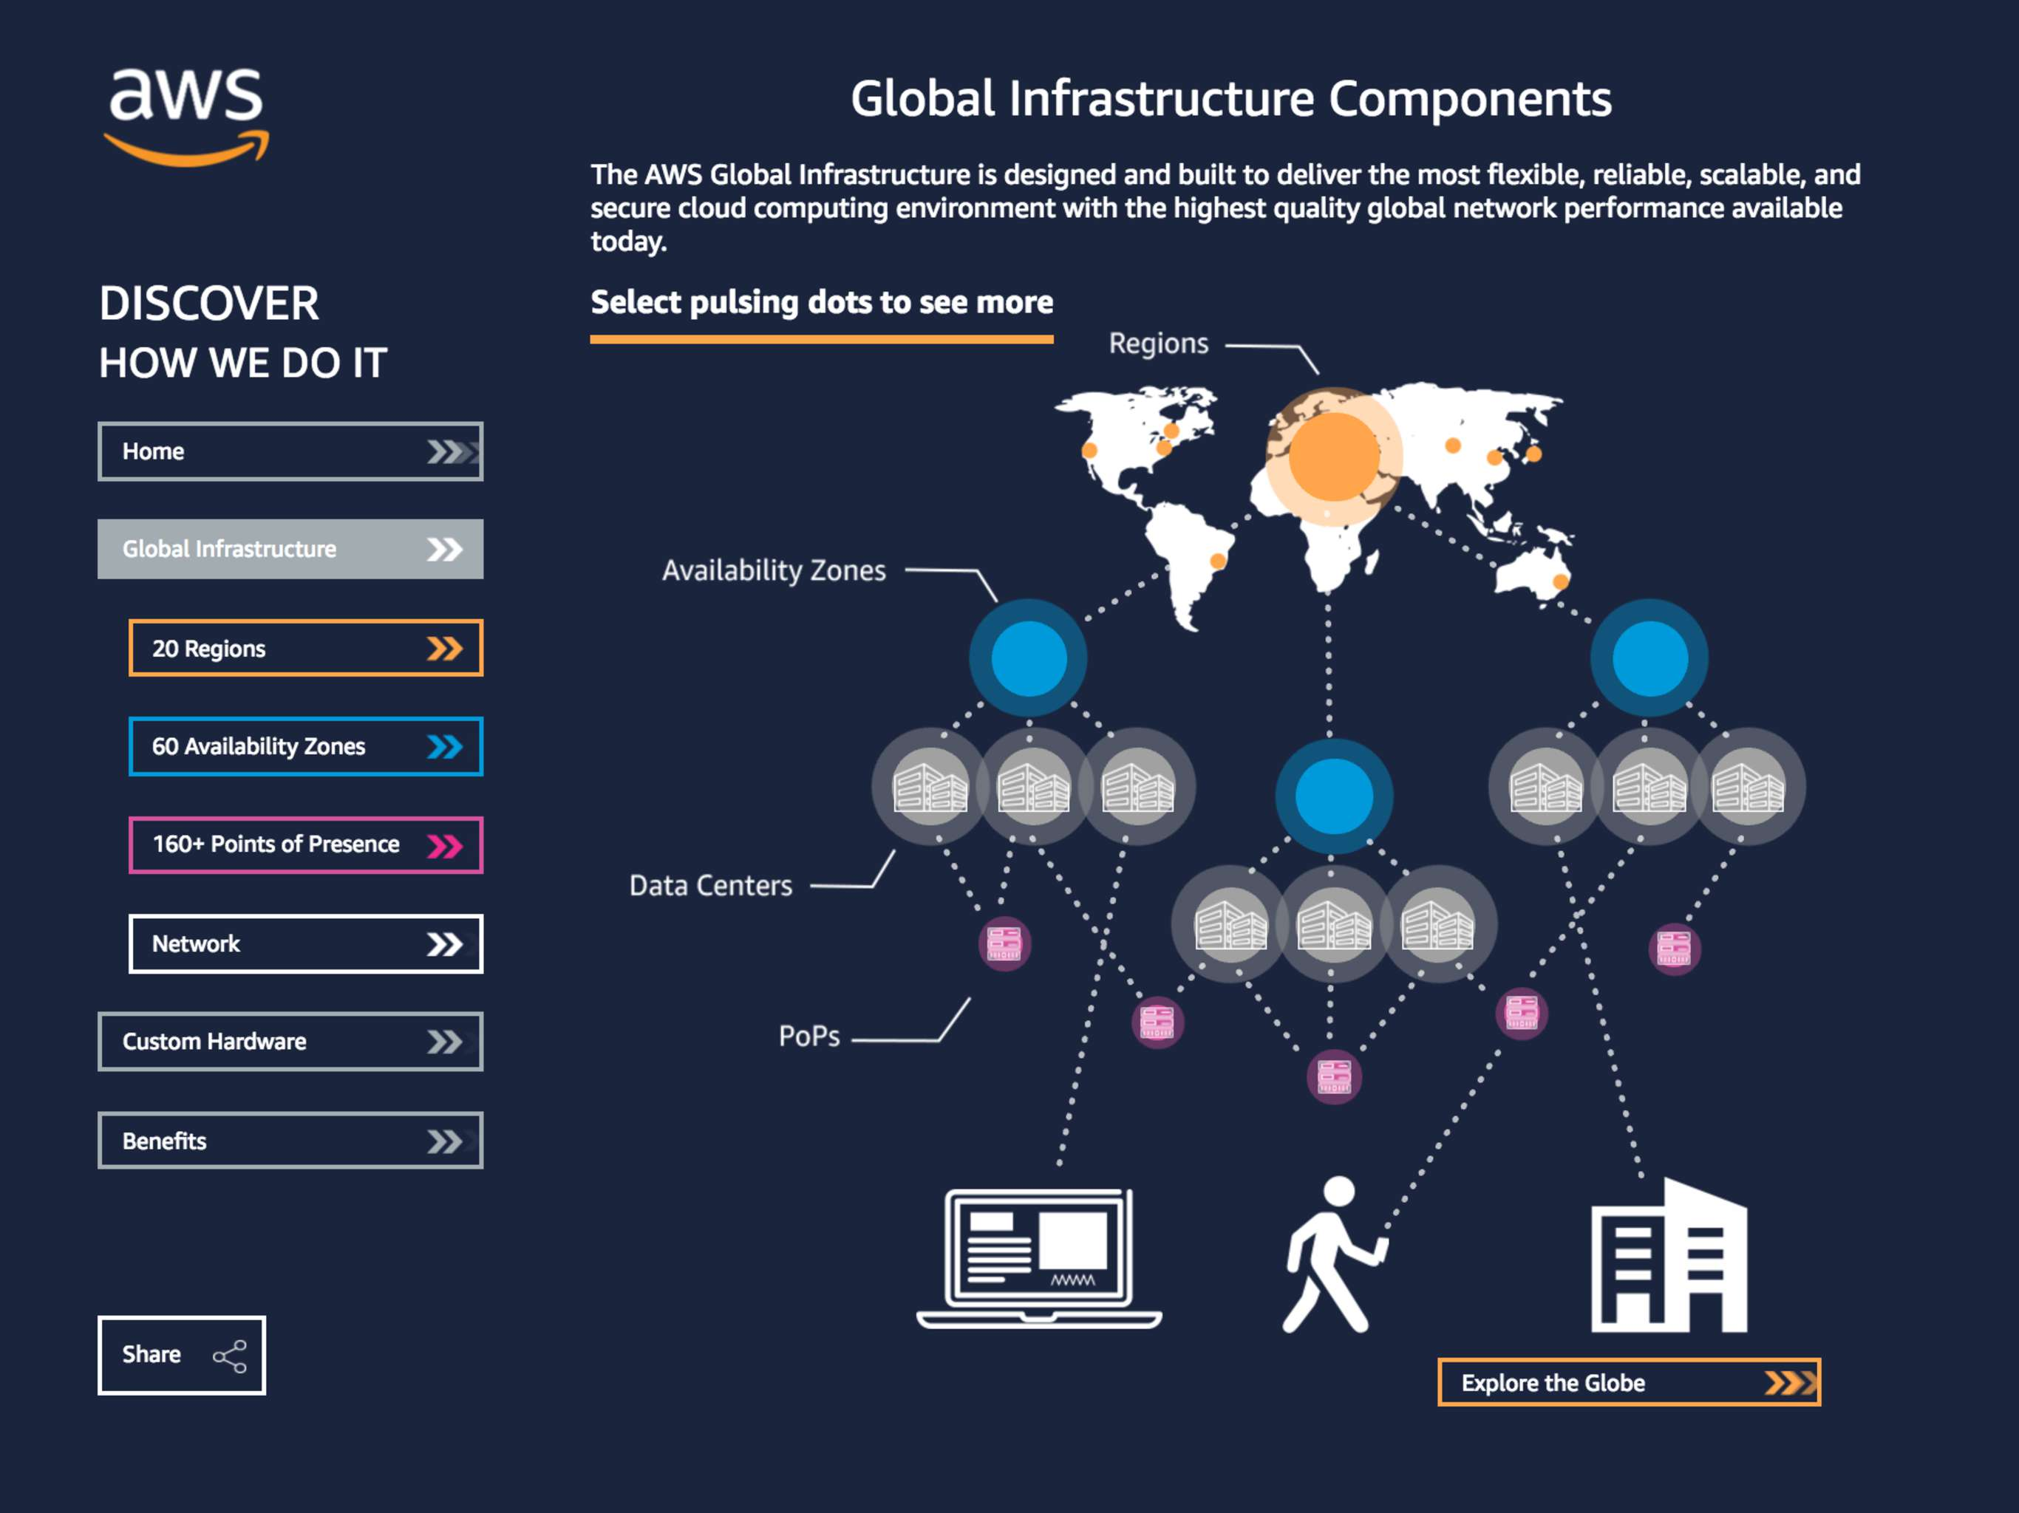


Slide 22



Section 3: Global Service Example - IAM
AWS Cloud
Region – us-east-1
AWS Identity and Access Management (IAM)
Region – eu-west-1
Amazon EC2
Paul logs in using the same IAM account
Amazon EC2
Paul logs in using IAM account
Paul
Paul
New York Office
Dublin Office

Slide 23
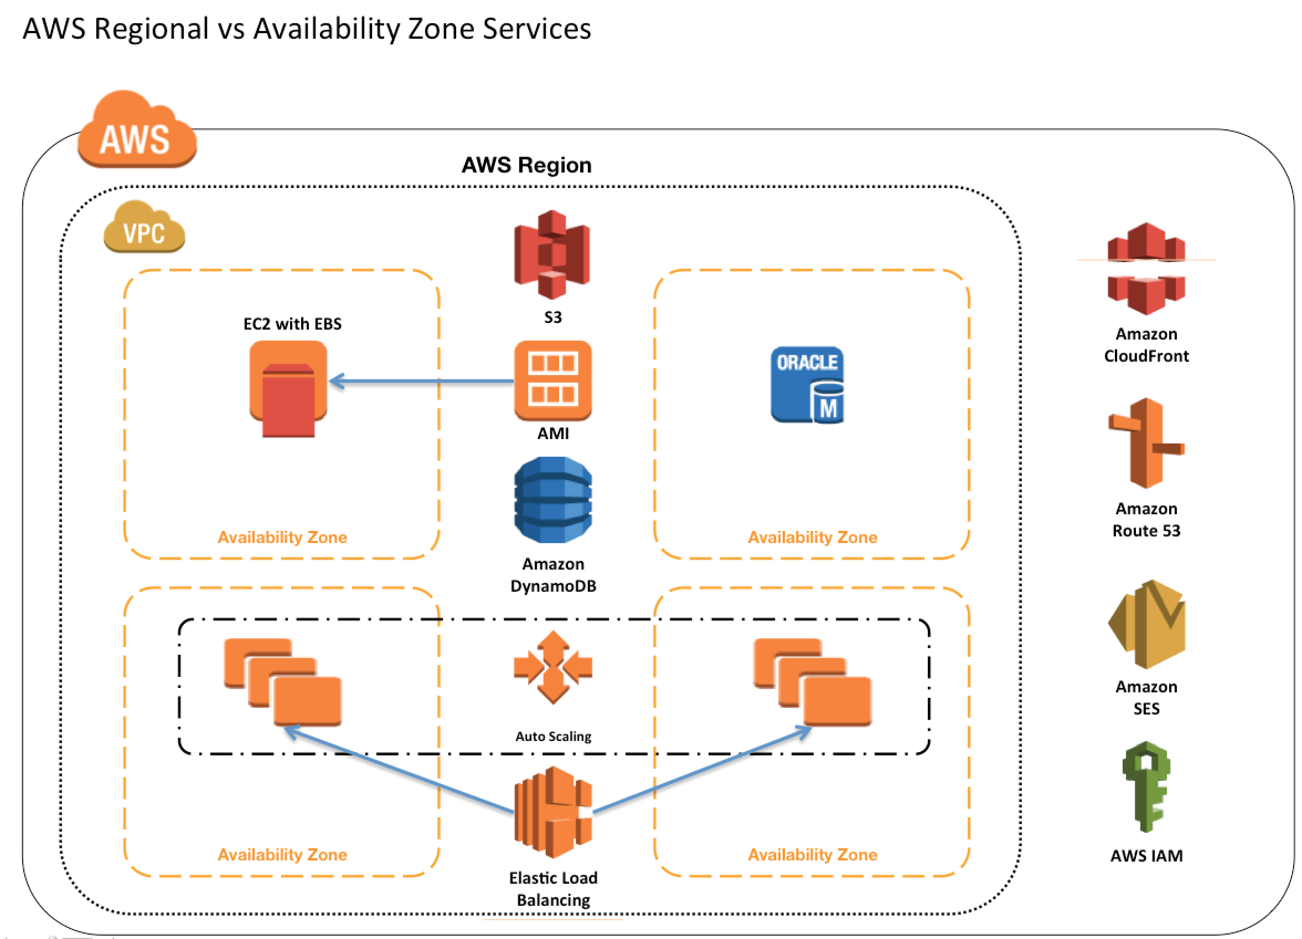

Slide 24




Section 3: Regional Service Examples
AWS Cloud
Region – us-east-1
Amazon EC2 Web Server
Amazon RDS Database
Region – eu-west-1
Bucket
Amazon Simple Storage Service (S3)

Slide 25
Identity and Access Management (IAM)

Slide 26








Section 4: Identity and Access Management (IAM) Overview
AWS Identity and Access Management (IAM)
User
IAM Role
Identity Federation
Group
Multi-Factor Authentication
IAM Policy
API Keys (programmatic access)

Slide 27
Section 4: IAM Users, Groups, Roles and Policies
AWS Identity and Access Management (IAM)
Groups are collections of users and have policies attached to them
IAM Policy
IAM User
An IAM user is an entity that represents a person or service
IAM Policy
IAM Group
Roles are “assumed” by trusted entities and can be used for delegation
IAM Policy
IAM Role

Slide 28
Section 4: IAM Users
An IAM user is an entity that represents a person or service
Can be assigned:
An access key ID and secret access key for programmatic access to the AWS API, CLI, SDK, and other development tools
A password for access to the management console
By default users cannot access anything in your account
The account root user credentials are the email address used to create the account and a password
The root account has full administrative permissions and these cannot be restricted
Best practice for root accounts:
Don’t use the root user credentials
Don’t share the root user credentials
Create an IAM user and assign administrative permissions as required
Enable Multi-Factor Authentication (MFA)
Eric
Ethan
Andrea

Slide 29
Section 4: IAM Users
IAM users can be created to represent applications and these are known as “service accounts”
You can have up to 5000 users per AWS account
Each user account has a friendly name and an Amazon Resource Name (ARN) which uniquely identifies the user across AWS
You should create individual IAM accounts for users (best practice not to share accounts)
A password policy can be defined for enforcing password length, complexity etc.
(applies to all users)
Eric
Ethan
Andrea

Slide 30
Section 4: IAM Groups
Groups are collections of users and have policies attached to them
A group is not an identity and cannot be identified as a principal in an IAM policy
Use groups to assign permissions to users
Use the principal of least privilege when assigning permissions
You cannot nest groups (groups within groups)
Developers
AWS Admins
Operations

Slide 31
Section 4: IAM Roles
Roles are created and then “assumed” by trusted entities and define a set of permissions for making AWS service requests
With IAM Roles you can delegate permissions to resources for users and services without using permanent credentials (e.g. user name and password)
IAM users or AWS services can assume a role to obtain temporary security credentials
that can be used to make AWS API calls
You can delegate using roles
There are no credentials associated with a role (password or access keys)
S3 Full Access
DynamoDB Read-Only
AWSLambdaBasicExecutionRole

Slide 32
Section 4: IAM Policies
Policies are documents that define permissions and can be applied to users, groups and roles
Policy documents are written in JSON (key value pair that consists of an attribute and a value)
All permissions are implicitly denied by default
The most restrictive policy is applied
The IAM policy simulator is a tool to help you understand, test, and validate the effects of access control policies
The Condition element can be used to apply further conditional logic
S3 Full Access
DynamoDB Read-Only
AWSLambdaBasicExecutionRole

Slide 33






Section 4: Authentication Methods
Consists of an Access key ID and secret access key and is used for programmatic access
MFA protection can be added to API operations
Access Key
API
Can also protect with MFA
EJPx!*21p9%
IAM User
Password
AWS Management Console
Signing Certificate
Some AWS services

Slide 34
Section 4: IAM Access Keys
These can be used to make programmatic calls to AWS when using the API in program code or at a command prompt when using the AWS CLI or the AWS PowerShell tools
You can create, modify, view or rotate access keys
When created IAM returns the access key ID and secret access key
The secret access is returned only at creation time and if lost a new key must be created
Ensure access keys and secret access keys are stored securely
Users can be given access to change their own keys through IAM policy (not from the console)
You can disable a user’s access key which prevents it from being used for API calls
Access Key
API
A combination of an access key ID and a secret access key

Slide 35
Section 4: IAM Console Password
A password that the user can enter to sign into interactive sessions such as the AWS Management Console
You can allow users to change their own passwords
You can allow selected IAM users to change their passwords by disabling the option for all users and using an IAM policy to grant permissions for the selected users
EJPx!*21p9%
Password
AWS Management Console

Slide 36
Section 4: IAM Server Certificate / Signing Certificate
SSL/TLS certificates that you can use to authenticate with some AWS services
AWS recommends that you use the AWS Certificate Manager (ACM) to provision, manage and deploy your server certificates
Use IAM only when you must support HTTPS connections in a region that is not supported by ACM
Signing Certificate

Slide 37



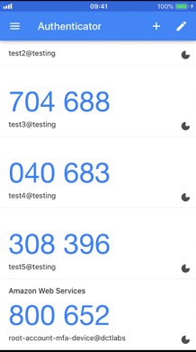
Section 4: Multi-Factor Authentication
Something you know:
Something you have:
Something you are:
EJPx!*21p9%
Password

Slide 38
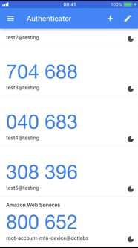


Section 4: Multi-Factor Authentication in AWS
Something you know:
Something you have:
e.g. Google Authenticator on your smart phone
Virtual MFA
IAM User
Physical MFA
EJPx!*21p9%
Password

Slide 39

Section 4: AWS Security Token Service (STS)
The AWS Security Token Service (STS) is a web service that enables you to request temporary, limited-privilege credentials for IAM users or for users that you authenticate (federated users)
By default, AWS STS is available as a global service, and all AWS STS requests go to a single endpoint at https://sts.amazonaws.com
All regions are enabled for STS by default but can be disabled
The region in which temporary credentials are requested must be enabled
Credentials will always work globally
Temporary security credential

Slide 40
Section 4: IAM Best Practices
Lock away the AWS root user access keys
Create individual IAM users
Use AWS defined policies to assign permissions whenever possible
Use groups to assign permissions to IAM users
Grant least privilege
Use access levels to review IAM permissions
Configure a strong password policy for users
Enable MFA
Use roles for applications that run on AWS EC2 instances
Delegate by using roles instead of sharing credentials
Rotate credentials regularly
Remove unnecessary credentials
Use policy conditions for extra security
Monitor activity in your AWS account

Slide 41
AWS Compute

Slide 42



Section 6: Traditional Servers
Physical Hardware
=
+
Linux
Operating Systems
Traditional server
CPU RAM Disk NIC
Microsoft Windows

Slide 43
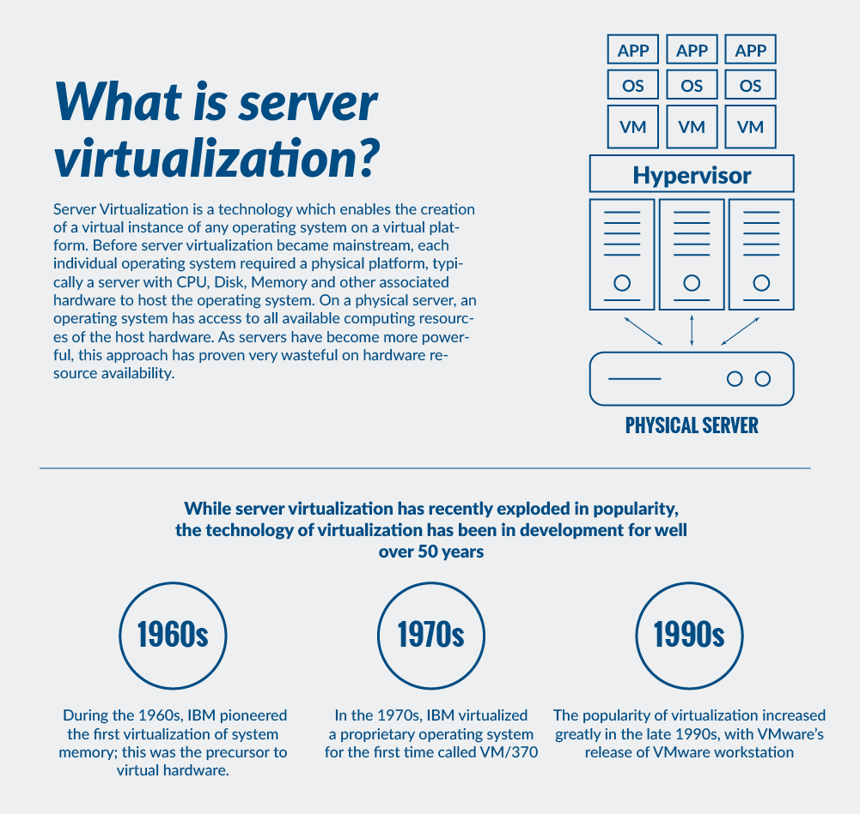

Slide 44
Virtualization
Virtualization is the process of running a virtual instance of a computer system in a layer abstracted from the actual hardware. Most commonly, it refers to running multiple operating systems on a computer system simultaneously. To the applications running on top of the virtualized machine, it can appear as if they are on their own dedicated machine, where the operating system, libraries, and other programs are unique to the guest virtualized system and unconnected to the host operating system which sits below it.
Types
Desktop Virtualization
Application Virtualization
Server Virtualization
Storage Virtualization
Network Virtualization

Slide 45
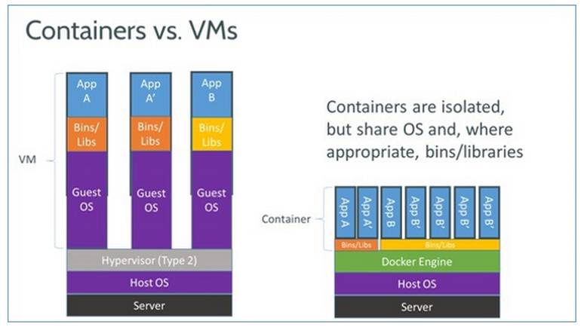
Virtual Machines VS Containers

Slide 46
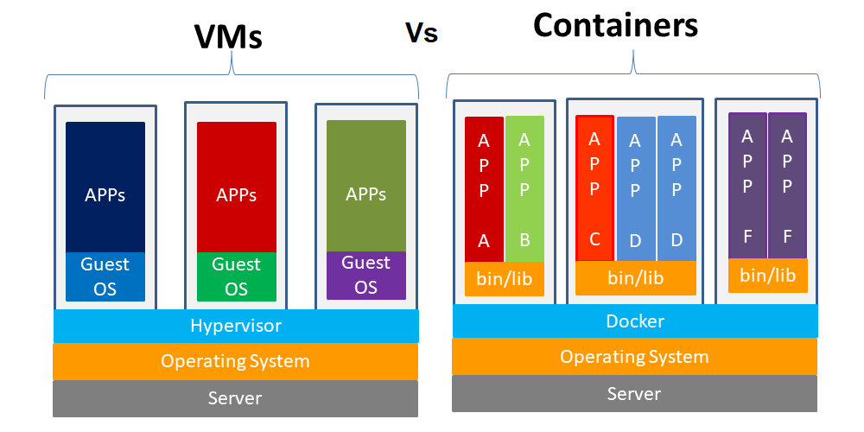

Slide 47





Section 6: Amazon Elastic Compute Cloud (EC2)
Launch EC2 Instance
Virtual Hardware
=
+
Amazon EC2
EC2 Instance
Amazon Machine Image (AMI)
CPU RAM Disk NIC
Instance Type
EBS Snapshot
Linux
Microsoft Windows

Slide 48
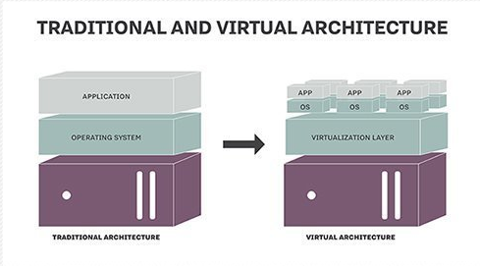

Slide 49
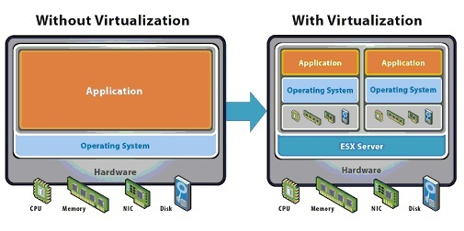

Slide 50
Section 6: Amazon EC2 Overview
Amazon Elastic Compute Cloud (Amazon EC2) is a web service in the AWS Compute suite of products that provides secure, resizable compute capacity in the cloud
Amazon EC2
Elastic Web-Scale computing – you can increase or decrease capacity within minutes and commission one to thousands of instances simultaneously
Completely controlled – You have complete control include root access to each instance and can stop and start instances without losing data and using web service APIs
Flexible Cloud Hosting Services – you can choose from multiple instance types, operating systems, and software packages as well as instances with varying memory, CPU and storage configurations

Slide 51
Section 6: Amazon Machine Images (AMI)
An Amazon Machine Image (AMI) provides the information required to launch an instance
An AMI includes the following:
One or more EBS snapshots, or, for instance-store-backed AMIs, a template for the root
volume of the instance (for example, an operating system, an application server, and applications).
Launch permissions that control which AWS accounts can use the AMI to launch instances.
A block device mapping that specifies the volumes to attach to the instance when it's launched
AMIs come in three main categories:
Community AMIs - free to use, generally you just select the operating system you want
AWS Marketplace AMIs - pay to use, generally come packaged with additional, licensed software
My AMIs - AMIs that you create yourself
Amazon EC2

Slide 52
Section 6: Amazon EC2 Instance Types
Category | Families | Purpose/Design
General Purpose | A1, T3, T3a, T2, M5, M5a, M4 | General purpose instances provide a balance of compute, memory and networking resources, and can be used for a variety of diverse workloads
Compute Optimized | C5, C5n, C4 | Compute Optimized instances are ideal for compute bound applications that benefit from high performance processors
Memory Optimized | R5, R5a, R4, X1e, X1, High Memory, z1d | Memory optimized instances are designed to deliver fast performance for workloads that process large data sets in memory
Accelerated Computing | P3, P2, G4, G3, F1 | Accelerated computing instances use hardware accelerators, or co- processors, to perform functions, such as floating-point number calculations, graphics processing, or data pattern matching
Storage Optimized | I3, I3en, D2, H1 | This instance family provides Non-Volatile Memory Express (NVMe) SSD-backed instance storage optimized for low latency, very high random I/O performance, high sequential read throughput and provide high IOPS at a low cost
Amazon EC2

Slide 53
Section 6: Instance User Data and Instance Metadata
User Data
User data is data that is supplied by the user at instance launch in the form of a script
User data is limited to 16KB
User data and metadata are not encrypted Metadata
Instance metadata is data about your instance that you can use to configure or manage the running instance
Instance metadata is available at http://169.254.169.254/latest/meta-data
The Instance Metadata Query tool allows you to query the instance metadata without having to type out the full URI or category names
Amazon EC2
Link

Slide 54







Section 7: Object, Block, and File Storage
Amazon S3
http://s3.aws-region.amazonaws.com/bucket/object
Amazon Elastic Block Store (EBS)
Amazon Elastic File System
Corporate data center
Availability Zone
HDD/SSD
Volume
/dev/xvdf EC2 Instance
On-premises client
File system
REST API: GET, PUT, POST, SELECT, DELETE
Note: Linux only
NFS
Object
Availability Zone
/efs-mnt
Availability Zone
/efs-mnt
Internet Client
EC2 Instance
EC2 Instance

Slide 55
Section 7: Object, Block, and File Storage Systems
Object Storage
Object-based storage systems manage data as individual objects, rather than as blocks and sectors (block-based) or a file hierarchy (file-based)
Object-based storage is accessed using a REST API (URL with HTTP methods, e.g. GET, PUT)
With object storage data is managed as individual objects rather than a file hierarchy (as with a traditional file system)
Each object includes the data itself, metadata (data about the data), and a globally unique identifier
Due to its flat file structure, object storage has virtually unlimited scalability and allows the retention of massive amounts of unstructured data

Slide 56
Section 7: Object, Block, and File Storage Systems
Block Storage
Data is stored and managed in blocks within sectors and tracks and is controlled by a server- based operating system
Block storage volumes appear as local disks to the operating system and can be partitioned and formatted
You can use block storage devices as a boot volume
Common use cases for block storage are structured information such as file systems, databases, transactional logs, SQL databases and virtual machines (VMs)
File Storage
File-based storage systems manage data in a file hierarchy
A file system is mounted via the network to a client computer where it then becomes accessible for reading and writing data
Protocols used for accessing file systems include NFS or CIFS/SMB

Slide 57

Section 7: Amazon Elastic Block Store (EBS)
EBS volumes are replicated within an AZ
Amazon Elastic Block Store (EBS)
Cannot attach volume to multiple instances
Availability Zone
Availability Zone
EBS Volume
EBS Volume
EBS Volume
EBS Volume
EC2 instances must be in the same AZ as the EBS volume
EC2 Instance
EC2 Instance
EC2 Instance

Slide 58

Section 7: Amazon Elastic Block Store (EBS)
Amazon Elastic Block Store (Amazon EBS) provides persistent block storage volumes for use with Amazon EC2 instances in the AWS Cloud
Each Amazon EBS volume is automatically replicated within its Availability Zone to protect you from component failure, offering high availability and durability
EBS volume data persists independently of the life of the instance
EBS volumes do not need to be attached to an instance
You can attach multiple EBS volumes to an instance
You cannot attach an EBS volume to multiple instances (use Elastic File Store instead)
EBS volumes must be in the same AZ as the instances they are attached to
Termination protection is turned off by default and must be manually enabled (keeps the volume/data when the instance is terminated)
Root EBS volumes are deleted on termination by default
Extra non-boot volumes are not deleted on termination by default
The behaviour can be changed by altering the “DeleteOnTermination” attribute
Amazon Elastic Block Store (EBS)

Slide 59
Section 7: Amazon Elastic Block Store (EBS)
Solid State Drives (SSD) Hard Disk Drives (HDD)
Volume Type | EBS Provisioned IOPS SSD (io1) | EBS General Purpose SSD (gp2) | Throughput Optimized HDD (st1) | Cold HDD (sc1)
Short Description | Highest performance SSD volume designed for latency-sensitive transactional workloads | General Purpose SSD volume that balances price performance for a wide variety of transactional workloads | Low cost HDD volume designed for frequently accessed, throughput intensive workloads | Lowest cost HDD volume designed for less frequently accessed workloads
Use Cases | I/O-Intensive NoSQL and relational databases | Boot volumes, low-latency interactive apps, dev & test | Big data, data warehouses, log processing | Colder data requiring fewer scans per day
Volume Size | 4GB – 16TB | 1 GB – 16 TB | 500 GB – 16 TB | 500 GB – 16 TB
Max IOPS/Volume | 64,000 | 16,000 | 500 | 250
Max Throughput/Volume | 1,000 MB/s | 250 MB/s | 500 MB/s | 250 MB/s

Slide 60

Section 7: EBS Snapshots
Region
Availability Zone A
Amazon S3
Volume
EC2 Instance
Snap A
Snap B
Snap C
Availability Zone B
Volume
EC2 Instance

Slide 61
Section 7: Amazon Elastic Block Store (EBS)
EBS Snapshots
Snapshots capture a point-in-time state of an instance
Snapshots are stored on S3
Does not provide granular backup (not a replacement for backup software)
If you make periodic snapshots of a volume, the snapshots are incremental, which means that only the blocks on the device that have changed after your last snapshot are saved in the new
snapshot
Even though snapshots are saved incrementally, the snapshot deletion process is designed so that you need to retain only the most recent snapshot in order to restore the volume
Snapshots can only be accessed through the EC2 APIs
EBS volumes are AZ specific but snapshots are region specific
Amazon Elastic Block Store (EBS)
Snapshot

Slide 62



Section 7: Amazon Elastic Block Store (EBS) vs Instance Store
EBS volumes are attached over the network
Amazon Elastic Block Store (EBS)
Availability Zone
EBS Volume
EBS Volume
Instance Store volumes are physically attached to the host
EC2 Host Server

Slide 63
Section 7: Amazon Elastic Block Store (EBS)
Instance Store Volumes
Instance store volumes are high performance local disks that are physically attached to the host computer on which an EC2 instance runs
Instance stores are ephemeral which means the data is lost when powered off (non-persistent)
Instances stores are ideal for temporary storage of information that changes frequently, such as buffers, caches, or scratch data
Instance store volume root devices are created from AMI templates stored on S3
Instance store volumes cannot be detached/reattached
Amazon Elastic Block Store (EBS)

Slide 64
Section 7: Launch Instance, create and add new EBS Volume
Region
Availability Zone A
Root Volume
EC2 Instance
Additional Volume

Slide 65
Section 7: Take Snapshot, Create AMI, Launch New Instance
Region
Availability Zone A
Amazon S3
Volume
EC2 Instance
Snapshot
Availability Zone B
AMI
EC2 Instance
Volume

Slide 66
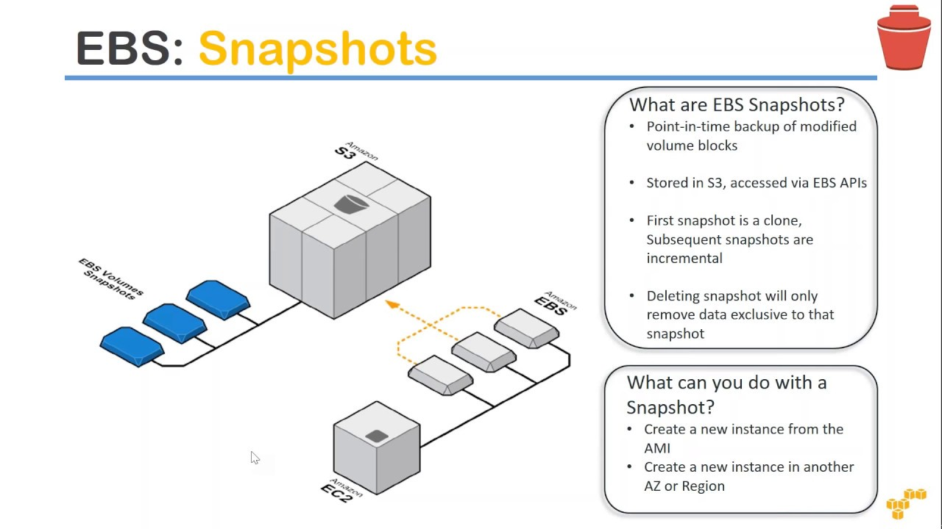

Slide 67
Section 7: Amazon Elastic File System (EFS)
Amazon Elastic File System
Corporate data center
On-premises client
File system
Note: Linux only
NFS
Availability Zone
/efs-mnt
Availability Zone
/efs-mnt
EC2 Instance
EC2 Instance

Slide 68

Section 7: Amazon Elastic File System (EFS)
EFS is a fully-managed service that makes it easy to set up and scale file storage in the Amazon Cloud
EFS provides a file system interface and uses the NFS protocol
Good for big data and analytics, media processing workflows, content management, web serving, home directories etc.
Data is stored across multiple AZ’s within a region
Read after write consistency
Pay for what you use (no pre-provisioning required)
Can scale up to petabytes
EFS is elastic and grows and shrinks as you add and remove data
Can concurrently connect 1 to 1000s of EC2 instances, from multiple AZs
A file system can be accessed concurrently from all AZs in the region where it is located
By default you can create up to 10 file systems per account
On-premises access can be enabled via Direct Connect or AWS VPN
Amazon Elastic File System

Slide 69
Section 7: Amazon Elastic File System (EFS)
Instances can be behind an Amazon Elastic Load Balancer
There are two performance modes:
“General Purpose” performance mode is appropriate for most file systems
“Max I/O” performance mode is optimized for applications where tens, hundreds, or thousands of EC2 instances are accessing the file system
Amazon Elastic File System

Slide 70

Amazon Elastic File System (EFS)
Region
VPC
EFS File system
Availability Zone
/efs-mnt
Availability Zone
/efs-mnt
EC2 Instance EC2 Instance

Slide 71
Section 6: Amazon Data Life Cycle Manager
With Amazon Data Lifecycle Manager, you can manage the lifecycle of your AWS resources. You create lifecycle policies, which are used to automate operations on the specified resources. Amazon DLM supports Amazon EBS volumes and snapshots.
When you automate snapshot and AMI management, it helps you to:
Protect valuable data by enforcing a regular backup schedule.
Create standardized AMIs that can be refreshed at regular intervals.
Retain backups as required by auditors or internal compliance.
Reduce storage costs by deleting outdated backups.
Create disaster recovery backup policies that back up data to isolated accounts.
LINK

Slide 72
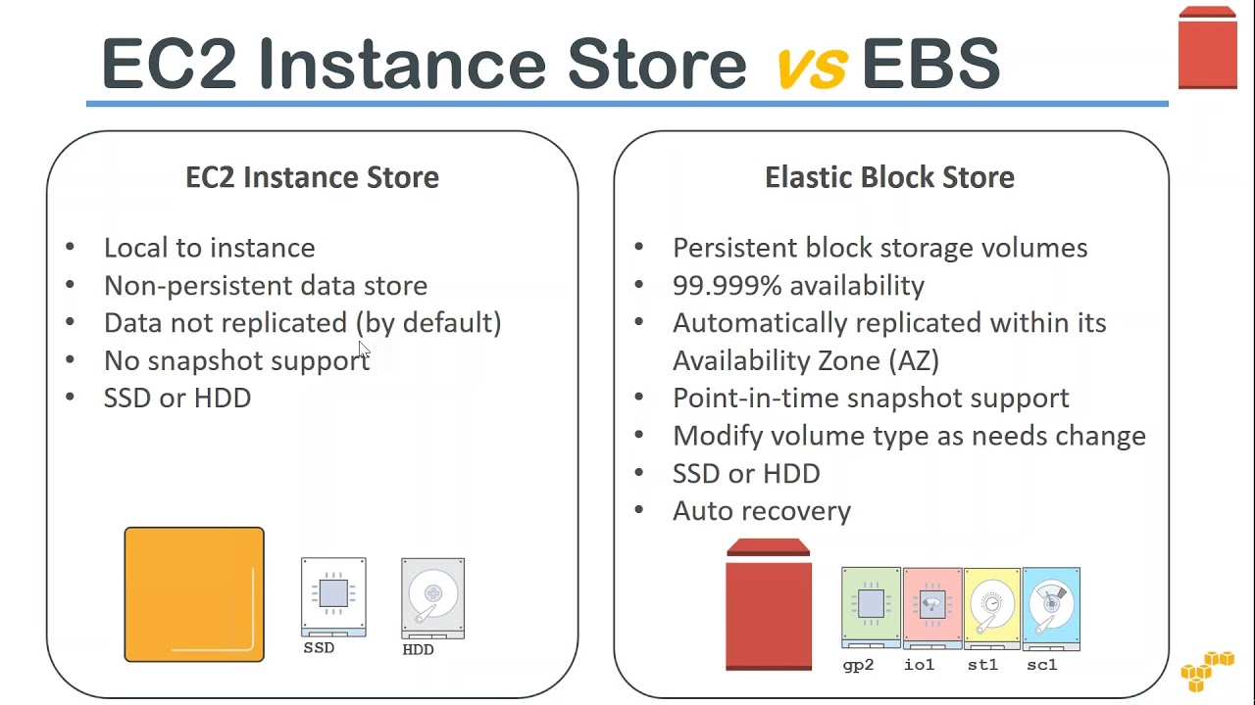
LINK

Slide 73





Section 7: Amazon S3
Amazon S3
Private Connection
Bucket
http://bucket.s3.aws-region.amazonaws.com http://s3.aws-region.amazonaws.com/bucket
VPC
S3 Gateway Endpoint
Public subnet
EC2 Instance
Object
Public Internet
Key
Version ID
Value
Metadata
Subresources
Access control information
Internet gateway
Private subnet
EC2 Instance
Internet Client

Slide 74

Section 7: Amazon Simple Storage Service (S3)
Amazon S3 is object storage built to store and retrieve any amount of data from anywhere – web sites and mobile apps, corporate applications, and data from IoT sensors or devices
You can store any type of file in S3
S3 is designed to deliver 99.999999999% durability
Typical use cases include:
Backup and Storage – Provide data backup and storage services for others
Application Hosting – Provide services that deploy, install, and manage web applications
Media Hosting – Build a redundant, scalable, and highly available infrastructure that hosts video, photo, or music uploads and downloads
Software Delivery – Host your software applications that customers can download
Static Website – you can configure a static website to run from an S3 bucket
Amazon Simple Storage Service (S3)

Slide 75
Section 7: Amazon Simple Storage Service (S3)
Files are stored in buckets
Buckets are root level folders
Files can be anywhere from 0 bytes to 5 TB
There is unlimited storage available
S3 is a universal namespace so bucket names must be unique globally
However, you create your buckets within a REGION
It is a best practice to create buckets in regions that are physically closest to your users to reduce latency
Objects consist of:
Key (name of the object)
Value (data made up of a sequence of bytes)
Version ID (used for versioning)
Metadata (data about the data that is stored)
Amazon Simple Storage Service (S3)

Slide 76
Section 7: Amazon Simple Storage Service (S3)
Pricing:
Storage
Requests
Storage management pricing
Data transfer pricing
Transfer acceleration
Amazon Simple Storage Service (S3)

Slide 77
Section 7: Amazon Simple Storage Service (S3)
There are six S3 storage classes:
S3 Standard (durable, immediately available, frequently accessed)
S3 Intelligent-Tiering (automatically moves data to the most cost-effective tier)
S3 Standard-IA (durable, immediately available, infrequently accessed)
S3 One Zone-IA (lower cost for infrequently accessed data with less resilience)
S3 Glacier (archived data, retrieval times in minutes or hours)
S3 Glacier Deep Archive (lowest cost storage class for long term retention)
Amazon Simple Storage Service (S3)

Slide 78
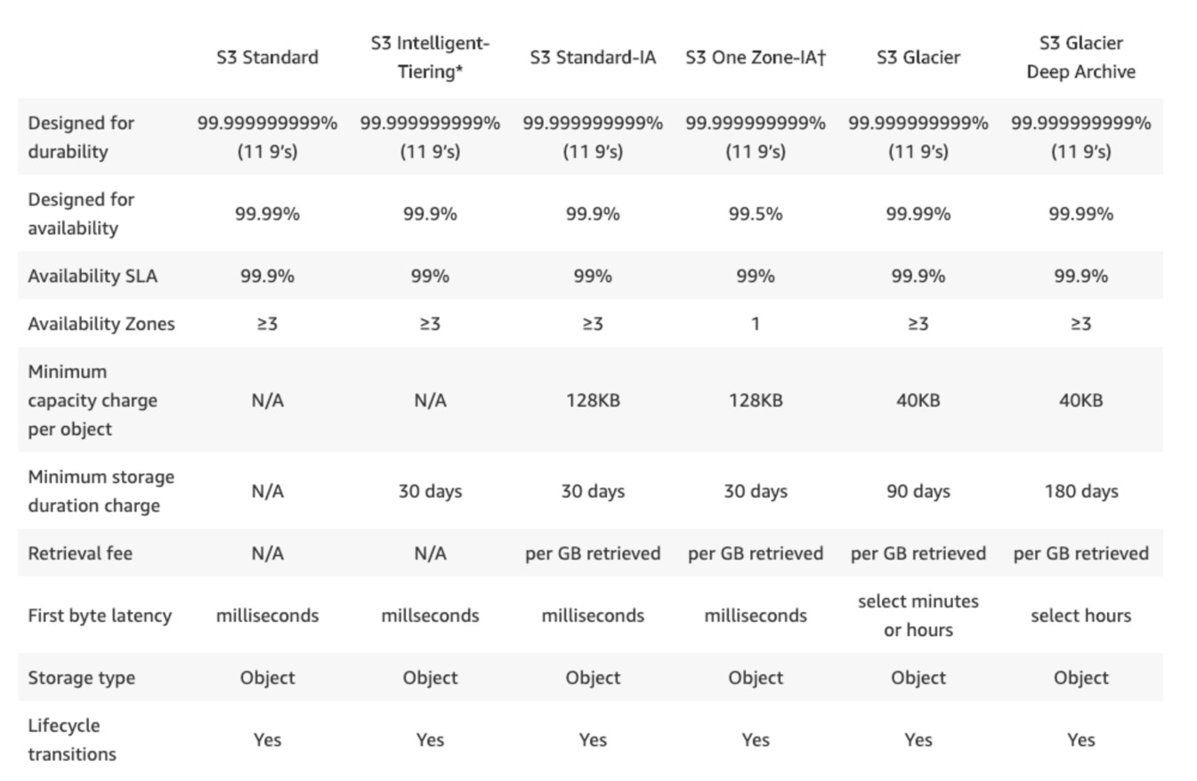
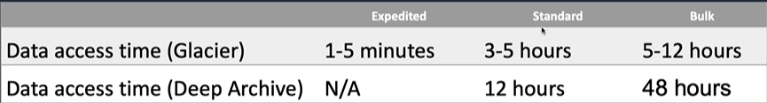
Section 7: Amazon Simple Storage Service (S3)
Amazon Simple Storage Service (S3)
S3 Glacier Vault Lock
S3 Object lock write-once-read-many WORM

Slide 79
Section 7: Amazon Simple Storage Service (S3)
S3 Capability | How it works
Transfer Acceleration | Speed up data uploads using CloudFront in reverse
Requester Pays | The requester rather than the bucket owner pays for requests and data transfer
Tags | Assign tags to objects to use in costing, billing, security etc.
Events | Trigger notifications to SNS, SQS, or Lambda when certain events happen in your bucket
Static Web Hosting | Simple and massively scalable static website hosting
BitTorrent | Use the BitTorrent protocol to retrieve any publicly available object by automatically generating a .torrent file
Amazon Simple Storage Service (S3)

Slide 80
Section 7: Amazon S3 –Versioning
Amazon S3 versioning maintains multiple variants of an object in the same bucket
Can be used to preserve, retrieve, and restore every version of every object in an S3 bucket
Can be enabled at any time
Once enabled can be suspended
Amazon Simple Storage Service (S3)

Slide 81






Section 7: Amazon S3 – Replication
Can be the same or a different account
Cross-Region Replication (CRR)
Region
Region
Amazon Simple Storage Service (S3)
Bucket
Source and destinations must have versioning enabled
Bucket
Account
Account
Region
Same-Region Replication (SRR)
Bucket
Bucket

Slide 82
Section 7: Amazon S3 –Replication
You can replicate objects between different AWS Regions or within the same AWS Region
Cross-Region replication (CRR) is used to copy objects across Amazon S3 buckets in different AWS Regions
Same-Region replication (SRR) is used to copy objects across Amazon S3 buckets in the same AWS Region
Why use replication?
Meet compliance requirements for storing data at greater distances (CRR)
Minimize latency for users who are closer to another AWS Region (CRR)
Backup copy of your data in another AWS Region (CRR)
Copy the objects to another S3 storage class
Aggregate logs into a single bucket
Amazon Simple Storage Service (S3)

Slide 83
Section 7: Amazon S3 – Replication
How:
Enable the AWS Region in account
Enable versioning on source and destination buckets
Ensure S3 has permissions to both buckets
Configure replication
Amazon Simple Storage Service (S3)

Slide 84


Section 7: Access Amazon S3 Bucket from EC2 with IAM Role
VPC
Public subnet
EC2 Instance
Assume role
IAM Role
S3 Bucket
Public subnet
Policy

Slide 85
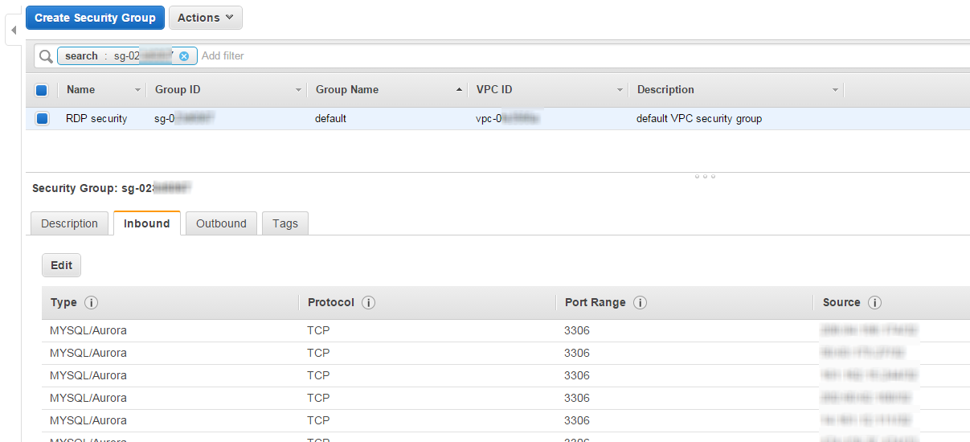

Slide 86
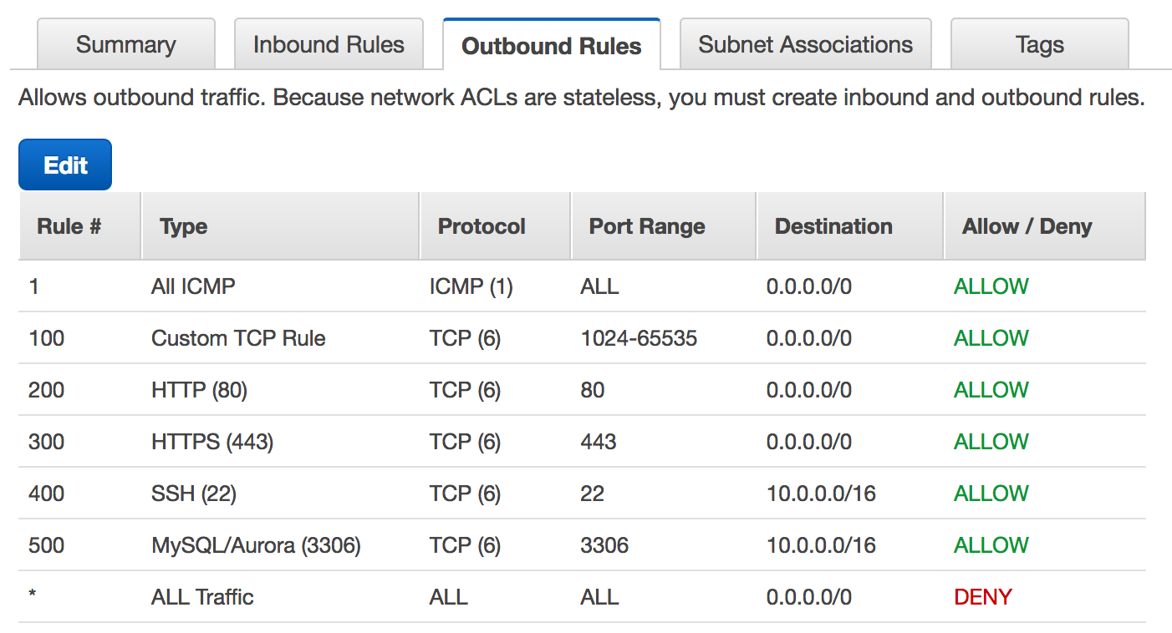

Slide 87
Section 8: Public, Private, and Elastic IP addresses
Name | Description
Public IP address | Lost when the instance is stopped Used in Public Subnets No charge Associated with a private IP address on the instance Cannot be moved between instances
Private IP address | Retained when the instance is stopped Used in Public and Private Subnets
Elastic IP address | Static Public IP address You are charged if not used Associated with a private IP address on the instance Can be moved between instances and Elastic Network Adapters

Slide 88
Elastic Load Balancing and AutoScaling

Slide 89
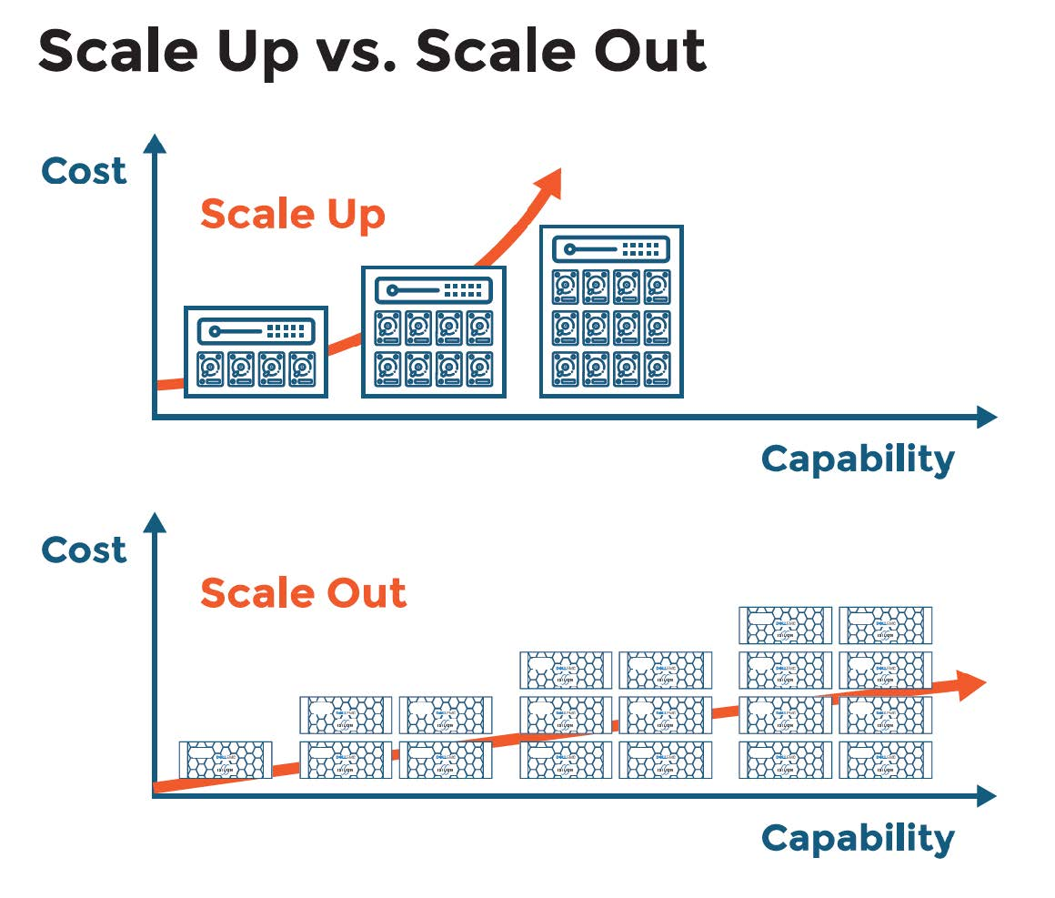
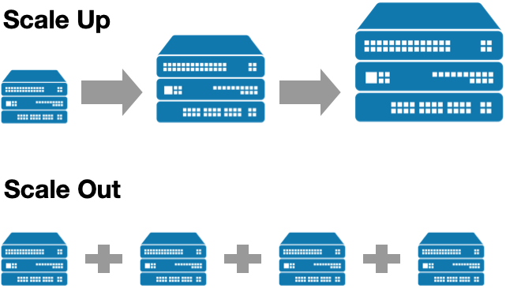
Section 10: Scale Up vs Scale Out

Slide 90




Section 10: Amazon EC2 Auto Scaling
3. ASG launches extra instance
ASG replaces failed instance
Availability Zone
Availability Zone
EC2 Status Checks fail
Public subnet
Public subnet
Auto Scaling group
2. CloudWatch notifies ASG to scale
Metrics
EC2 Instances
Metrics
EC2 Instances
1. Metric reports CPU
> 80%
Amazon CloudWatch

Slide 91

Section 10: Amazon EC2 Auto Scaling
Amazon EC2 Auto Scaling provides horizontal scaling
Auto Scaling provides elasticity and scalability
AWS Auto Scaling automates the process of adding (scaling up) OR removing (scaling down) EC2 instances based on the traffic demand for your application
Auto Scaling helps to ensure that you have the correct number of EC2 instances available to
handle the application load
You create collections of EC2 instances, called Auto Scaling Group (ASG)
You can specify the minimum number of instances in each ASG, and AWS Auto Scaling will ensure the group never goes beneath this size
You can also specify the maximum number of instances in each ASG and the group will never
go above this size
A desired capacity can be configured and AWS Auto Scaling will ensure the group has this number of instances
Amazon EC2 Auto Scaling
Link

Slide 92
Section 10: Amazon EC2 Auto Scaling
You can also specify scaling policies that control when Auto Scaling launches or terminates instances
Scaling policies determine when, if, and how the ASG scales and shrinks (on-demand/dynamic scaling, cyclic/scheduled scaling)
Scaling Plans define the triggers and when instances should be provisioned/de-provisioned
A launch configuration is the template used to create new EC2 instances and includes parameters such as instance family, instance type, AMI, key pair and security groups
Amazon EC2 Auto Scaling

Slide 93
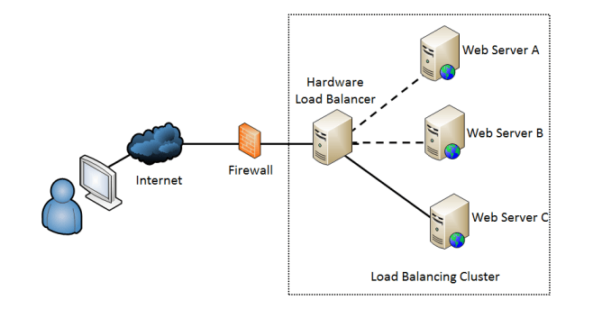
Section 10: Elastic Load Balancing Concepts

Slide 94



Section 10: Elastic Load Balancing Concepts
Client 3 is re-routed to another instance
Availability Zone
Public subnet
Client 1
A single endpoint (address) for your application
Client 3
EC2 Web Servers
Client 1
Health checks are used to determine if instances are available (EC2 or ELB)
Skillrary.com
Availability Zone
Elastic Load Balancer
Client 2
Public subnet
Client 3
Client 2
Client 3
Connections are distributed across targets in multiple AZs (HA/FT)
EC2 Web Servers

Slide 95




Section 10: Elastic Load Balancing (ELB) Types
Application Load Balancer
Operates at the request level
Routes based on the content of the request (layer 7)
Supports path-based routing, host-based routing, query string parameter-based routing, and source IP address-based routing
Supports IP addresses, Lambda Functions and containers as targets
Instance Protocol: HTTP, HTTPS
Load Balancer Protocol: HTTP, HTTPS
Application Load Balancer
Internet Client
Network Load Balancer
Operates at the connection level
Routes connections based on IP protocol data (layer 4)
Offers ultra high performance, low latency and TLS offloading at scale
Can have static IP / Elastic IP
Supports UDP and static IP addresses as targets
Instance Protocol: TCP, TCP_UDP
Load Balancer Protocol: TCP, TLS, UDP, TCP_UDP
Network Load Balancer
Internet Client
Classic Load Balancer
Old generation; not recommended for new applications
Performs routing at Layer 4 and Layer 7
Use for existing applications running in EC2-Classic
Instance Protocol:
TCP, SSL, HTTP, HTTPS
Load Balancer Protocol: TCP, SSL, HTTP, HTTPS
Classic Load Balancer
Internet Client
Gateway Load Balancer

Slide 96

Section 10: Elastic Load Balancing
ELB automatically distributes incoming application traffic across multiple targets, such as Amazon EC2 instances, containers, and IP addresses
ELB can handle the varying load of your application traffic in a single Availability Zone or across multiple Availability Zones
ELB features high availability, automatic scaling, and robust security necessary to make your
applications fault tolerant
There are three types of Elastic Load Balancer (ELB) on AWS:
Application Load Balancer (ALB) – layer 7 load balancer that routes connections based on the content of the request
Network Load Balancer (NLB) – layer 4 load balancer that routes connections based on IP
protocol data
Classic Load Balancer (CLB) – this is the oldest of the three and provides basic load balancing at both layer 4 and layer 7
Elastic Load Balancing
Link

Slide 97
Section 10: Elastic Load Balancing
Application Load Balancer (ALB)
ALB is best suited for load balancing of HTTP and HTTPS traffic and provides advanced request routing targeted at the delivery of modern application architectures, including microservices and containers
Operating at the individual request level (Layer 7), Application Load Balancer routes traffic to targets within Amazon Virtual Private Cloud (Amazon VPC) based on the content of the request
Network Load Balancer (NLB)
NLB is best suited for load balancing of TCP traffic where extreme performance is required
Operating at the connection level (Layer 4), NLB is capable of handling millions of requests per second while maintaining ultra-low latencies
Classic Load Balancer (CLB)
CLB provides basic load balancing across multiple Amazon EC2 instances and operates at both the request level and connection level
Elastic Load Balancing

Slide 98
Application Load Balancer (Internet-Facing)
Region
VPC
Availability Zone
Private subnet
Public subnet
EC2 Instance 1
HTTP/HTTPS
Availability Zone
Application
Internet gateway
Internet Client
Private subnet
Public subnet
Load
Balancer
EC2 Instance 2

Slide 99

Auto Scaling Group with ALB
Region
VPC
Availability Zone
Private subnet
Public subnet
Auto Scaling
HTTP, HTTPS
Availability Zon
group
e
Application
Internet gateway
Internet Client
Private subnet
Public subnet
Load
Balancer

Slide 100



Section 11: DNS Resolution with AWS Route 53
Amazon Route 53
A hosted zone represents a set of records belonging to a domain
What’s the address for skillrary.com?
skillrary.com
Region
VPC
Address is 3.1.92.8
Availability Zone
Public subnet
Internet Client
Web Server: 3.1.92.8
HTTP GET to 3.1.92.8

Slide 101

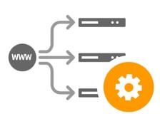

Section 11: Amazon Route 53
Amazon Route 53
Domain Registration
.net
.com
.org
Hosted zone
example.com skillrary.com
Health Checks
EC2 Instances
Traffic Flow

Slide 102
Monitoring and Logging Services

Slide 103



Section 12: Monitoring with Amazon CloudWatch
ConsumedReadCapacityUnits, ConsumedWriteCapacityUnits
CPUUtilization, DiskReadOps, NetworkIn, StatusCheckFailed
Amazon DynamoDB
Amazon EC2
ReadLatency, FreeStorageSpace, WriteIOPS, WriteLatency
BucketSizeBytes, NumberOfObjects, GetRequests, PutRequests
Amazon CloudWatch
Amazon Simple Storage Service (S3)
Amazon RDS

Slide 104
Section 12: Amazon CloudWatch
Amazon CloudWatch is a monitoring service for AWS cloud resources and the applications you
run on AWS
CloudWatch is for performance monitoring (CloudTrail is for auditing)
Used to collect and track metrics, collect and monitor log files, and set alarms
CloudWatch is a regional service
CloudWatch Alarms can be set to react to changes in your resources
CloudWatch Events generates events when resource states change and delivers them to targets for processing
CloudWatch Logs collects and centralizes logs from AWS resources
Any log files generated by your applications
Gain system-wide visibility into resource utilization
CloudWatch monitoring includes application performance
Amazon CloudWatch
Link

Slide 105
Architecting for the Cloud

Slide 106
The Difference Between Traditional and Cloud Computing Environments
IT Assets as Provisioned Resources
Provision as needed, and scale on-demand
Global, Available, and Scalable Capacity
Deploy globally, easily, cost-effectively, and quickly
Higher-Level Managed Services
Lower operational cost by leveraging managed storage, database, analytics, application and deployment services
Built-in Security
Leverage AWS’ significant investment in security, simplify security testing, and use native security and encryption features
Architecting for Cost
Fine grained billing, transparent costs, budgets and alerting tools
Operating on AWS
Tooling, processes and best practices to support operational transitions

Slide 107


Scaling Vertically
c5n.18xlarge with 72 vCPU
and 192 GiB RAM
C5 instance
T3 instance
t3.medium with 2 vCPU and 4 GiB RAM

Slide 108
Scaling Vertically
Examples of vertical scaling are:
Amazon EC2 instances
Amazon RDS Database instances
Limitations of scaling vertically:
Often requires manual intervention (though can be scripted/automated)
Typically requires downtime
Can reach a limit of scalability

Slide 109
Scaling Horizontally
T3 instance
T3 instance T3 instance
t3.medium with 2 vCPU and 4 GiB RAM
T3 instance

Slide 110
Example of Horizontal Scaling with EC2
3. ASG launches extra instance
Availability Zone
Availability Zone
Public subnet
Public subnet
Auto Scaling group
2. CloudWatch notifies ASG to scale
Metrics
EC2 Instances
Metrics
EC2 Instances
1. Metric reports CPU
> 80%
Amazon CloudWatch

Slide 111
Scaling Horizontally
Examples of horizontal scaling are:
Amazon EC2 Auto Scaling
Amazon DynamoDB
Benefits of scaling horizontally:
Seamless scaling, without downtime
Can scale almost limitlessly (in some cases)

Slide 112
The Five Pillars of Operational Excellence
Operational Excellence
The operational excellence pillar includes the ability to run and monitor systems to deliver business value and to continually improve supporting processes and procedures
Security
The security pillar includes the ability to protect information, systems, and assets while delivering business value through risk assessments and mitigation strategies
Reliability
The reliability pillar includes the ability of a system to recover from infrastructure or service disruptions, dynamically acquire computing resources to meet demand, and mitigate disruptions such as misconfigurations or transient network issues

Slide 113
The Five Pillars of Operational Excellence
Performance Efficiency
The performance efficiency pillar includes the ability to use computing resources efficiently to meet system requirements and to maintain that efficiency as demand changes and technologies evolve
Cost Optimization
The cost optimization pillar includes the ability to avoid or eliminate unneeded cost or suboptimal resources

Slide 114
Thank you

