Slide 1
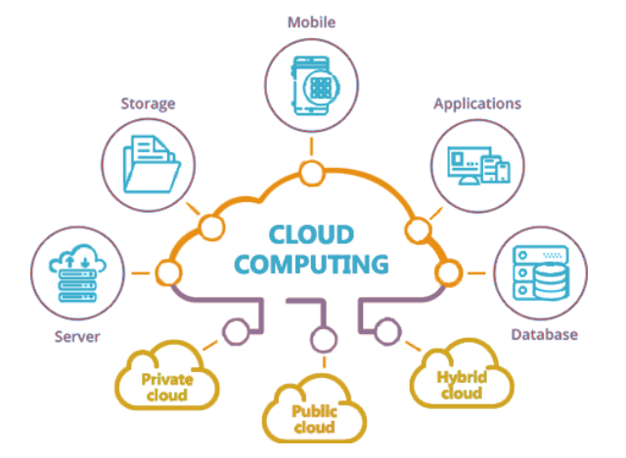
CLOUD COMPUTING

Slide 2
What is Cloud Computing?
Cloud computing is the delivery of different services through the Internet. These resources include tools and applications like data storage, servers, databases, networking, and software.
Some Companies that provide Cloud Computing
Service Are
Amazon Web Services (AWS)
Microsoft Azure
Google Cloud Platform(GCP)
IBM Cloud

Slide 3
Types of Cloud
It has 2 types
Service Models
Deployment Models
Based on service it classified into three types
SaaS(Software as a Service)
Paas(Platform as a Service)
IaaS(Internet as a Service)
Based on deployment it classified into four types
Public Cloud
Private Cloud
Community Cloud
Hybrid Cloud

Slide 4
SaaS(Software as a Service)
Software as a Service (SaaS) SaaS model allows to use software applications as a service to end users.
SaaS is a software delivery methodology that provides licensed multi-tenant access to software and its functions remotely as a Web-based service.
' Usually billed based on usage
Highly scalable architecture
Example:-
Salesforce
Google Apps

Slide 5
Paas(Platform as a Service)
Platform as a Service (PaaS) the runtime environment for applications, PaaS provides development & deployment tools, etc.
PaaS provides all of the facilities required to support the complete life cycle of building and delivering web applications and services entirely from the Internet.
Example:-

Slide 6
IaaS(Internet as a Service)
Infrastructure as a Service (laaS) laaS is the delivery of technology infrastructure as an on demand scalable service.
laaS provides access to fundamental resources such as physical machines, virtual machines, virtual storage, etc.
It is billed based on usage
Example:-
AWS(Amazon Web Services).
Microsoft Azure.

Slide 7
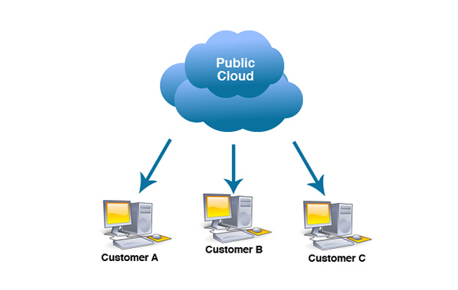
Based on Deployement Models
types of access for cloud
Public Cloud
The Public Cloud allows systems and services to be easily accessible to the general public. Public cloud may be less secure because of its openness.
e.g., e-mail.

Slide 8
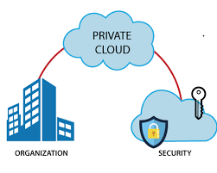
Prviate Cloud
The Private Cloud allows systems and services to be accessible within an organization. It offers increased security because of its private nature.

Slide 9
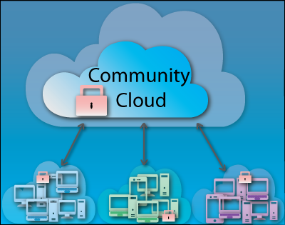
Community Cloud
The Community Cloud allows systems and services to be accessible by group of organizations.

Slide 10
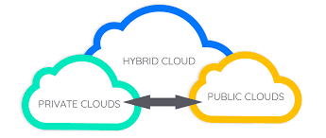
Hybrid Cloud
The Hybrid Cloud is mixture of public and private cloud

