Slide 1
JIRA Madhu A M

Slide 2
Jira
Jira Software is an agile project management tool that supports any agile methodology, be it scrum, kanban, or your own unique flavor. From agile boards, backlogs, roadmaps, reports, to integrations and add-ons you can plan, track, and manage all your agile software development projects from a single tool.
What Is JIRA Software And Its Features
Jira Software is a flexible issue tracking tool that helps teams plan, track, release, and report on their work.
Plan:
Create user stories and issues, plan sprints, and distribute tasks across your team.
Track:
Prioritize and discuss your team’s work in full context with complete visibility.
Release:
Ship with confidence and sanity knowing the information you have is always up-to-date.
Report:
Improve team performance based on real-time, visual data that your team can put to use.

Slide 3
Test management tools
ALM
JIRA
TEST RAI
Version control tools
GIT Hub
SVN
Bit Bucket
Defect management tools
QL/ALM
Bugzilla
Mantise
JIRA
Requirement management tools
ALM
GIT Hub
JIRA

Slide 4
Features of Jira Software
Scrum boards
Kanban boards
Roadmaps
Agile reporting
Connect issues to code
Way more than a bug and issue tracker

Slide 5
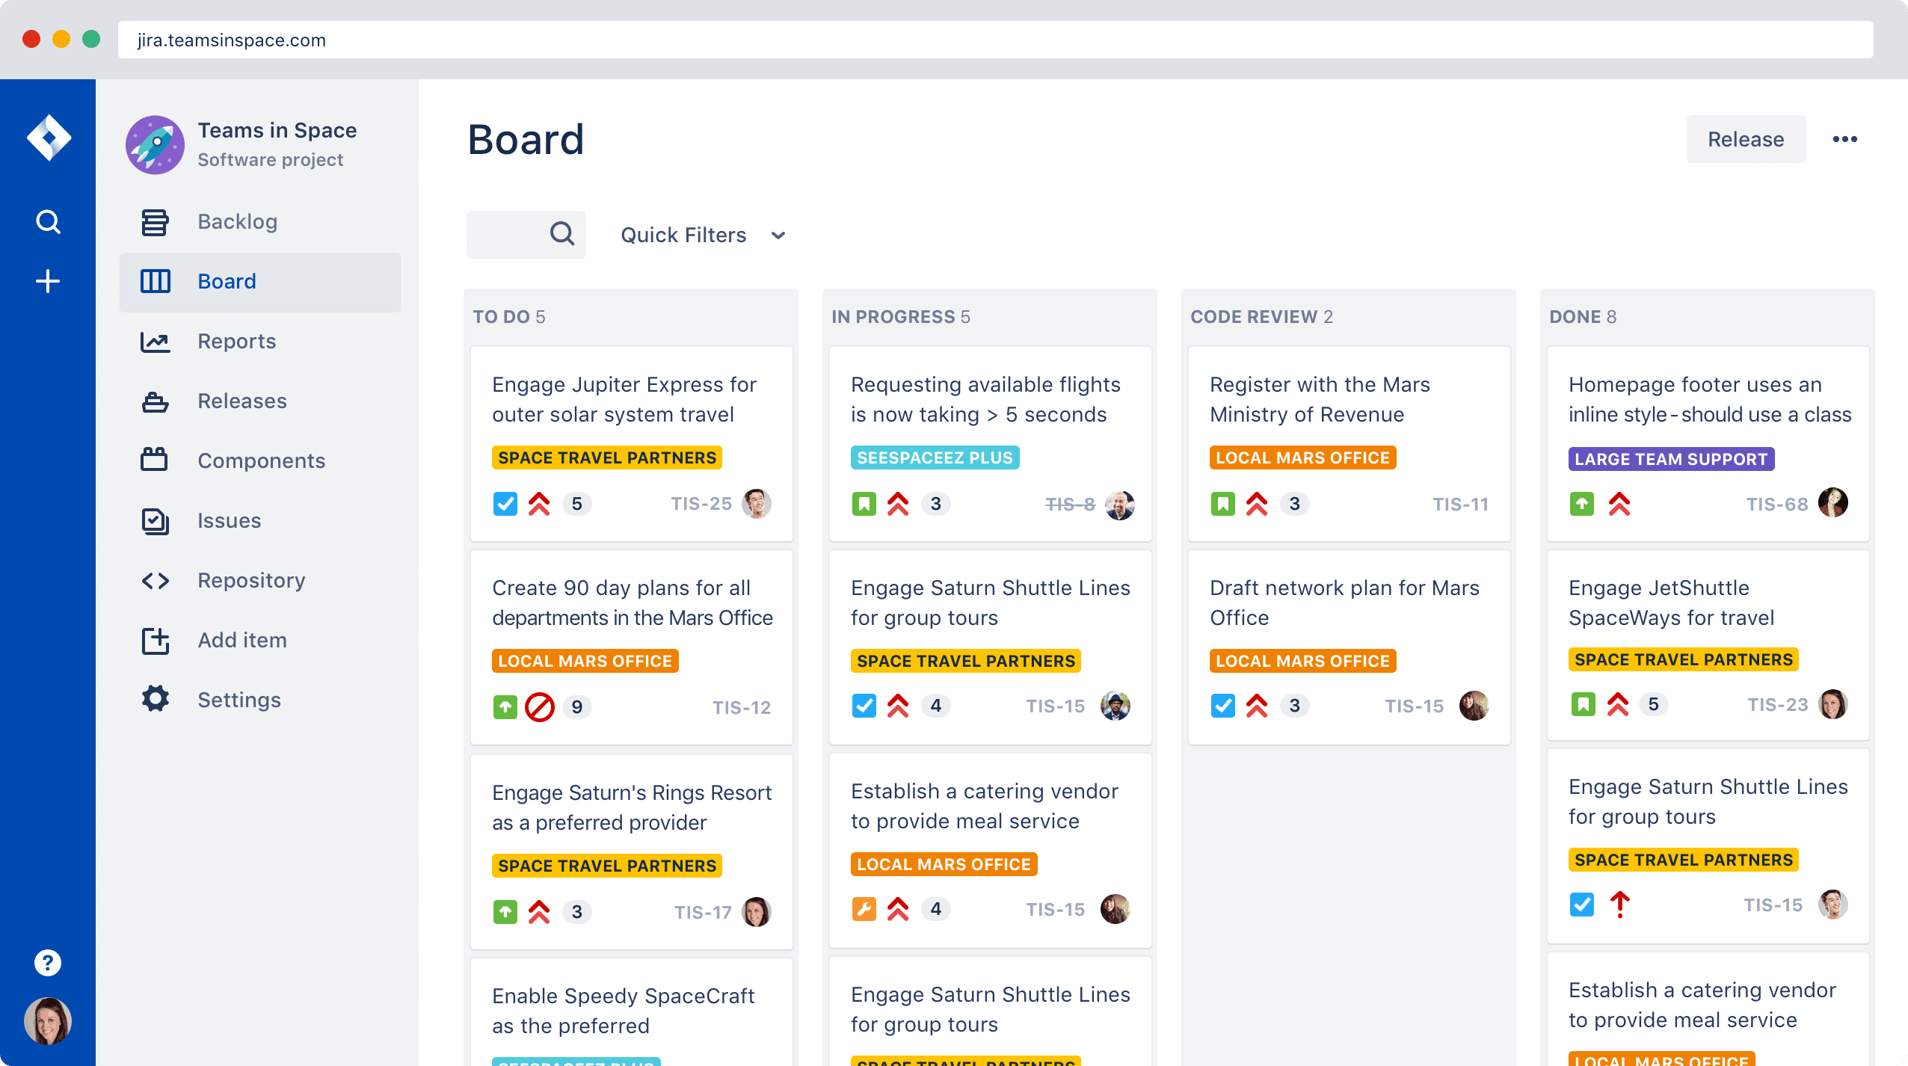

Slide 6
Why use Jira?
Flexible planning:- Scrum? Check. Kanban? Check. Mixed methodology? Check. Jira Software’s rich planning features enable your team to flexibly plan in a way that works best for them.
Accurate estimations:- Estimations help your team become more accurate and efficient. Use story points, hours, t-shirt sizes, or your own estimation technique. Jira Software supports them all.
Value-driven prioritization:- Order user stories, issues, and bugs in your product backlog with simple drag and drop prioritization. Ensure stories that deliver the most customer value are always at the top.

Slide 7
Transparent execution:- Whether your team is across the table or around the world, Jira Software brings a new level of transparency to your team’s work and keeps everyone on the same page.
Actionable results:- Extensive reporting functionality gives your team critical insight into their agile process. Backed by data, retrospectives are more data-driven and actionable than ever before.
Scalable evolution:- Add and change issue types, fields, and workflows as your team evolves. Jira Software is agile project management designed for teams of every shape and size.
Trusted by over 65,000 customers worldwide.

Slide 8
1. Explain What Is Jira?
JIRA is nothing but an issue tracking product or software testing tool developed by the company Atlassian. This tool is mostly used for the bug or issue tracking, managing the project, and debugging the complex errors. JIRA tool usually runs on these three aspects and is widely used in software development projects.
2. Why JIRA is used?
Atlassian developed JIRA is nothing but an issue tracking tool and most commonly used in agile methodology. Let me explain the few advantages of using JIRA;
JIRA is a platform-independent tool and that can run on any operating systems
JIRA workflows are easy to customize completely based on user requirements.
Cost-effective and user-friendly software testing tool
Using the JIRA tool user can easily debug the complex errors
JIRA software tool allows user to track the progress of a project on time to time base

Slide 9
3. Explain the JIRA workflow?
JIRA workflow is a set of software-related activities that are used to perform operations like tracking an issue and transitions during the software development life cycle. The transition is a link between the two statues and the issue moves from one transition status to another status. The status defines the nature of the work which is done by the tester.
The following are the important phases that occur in the JIRA workflow;
Todo List
In progress status
Finally done.
4. Is it possible to access the JIRA cloud site via a mobile device?
The answer is yes, the user can access the JIRA cloud site via a mobile device, for that you have to use the appropriate URL of the JIRA mobile cloud site in your mobile website browser.

Slide 10
5. What are the important differences between JIRA and Bugzilla?
Bugzilla | JIRA
Bugzilla is an open-source software tool | Whereas JIRA is a commercial software tool
Bugzilla is not a user-friendly tool | Whereas JIRA is a user-friendly software tool
Drag and drop issue options are not available in Bugzilla | Drag and drop issue options are available in JIRA
Bugzilla has only one configuration link type | JIRA has a configuration link types which contains user-defined semantics
Supports blocks/user depends on the custom option available | JIRA has a pluggable debugging links and user can access them outside of the tool
Bugzilla owns show/hide the customized common field or specific values | JIRA software tool allows customized configuration based on the project type and type fields

Slide 11
6. Can JIRA be used for test case management?
As we know, the JIRA architecture was not designed to work well with the server as a test case management tool. So it will be configured to support the test case management system in two different possible ways. After that users can either change the native JIRA components to meet the test case management system and also you can use add-ons option available in the parent company (Atlassian marketplace)
7. Explain labeling and linking issues in JIRA?
Labeling issue: This issue enables the user to categorize the raised issue in the form of information and later it is assigned to any component or version. This issue can be found using labels.
Linking issue: this issue enables the user to link any kind of issue or multiple issues that can also be associated either on the same or different JIRA servers.

Slide 12
8. What is cloning an issue in JIRA?
The cloning issue in JIRA allows users to generate a duplicate of the original issue so this makes the developer work on a single issue within a single project. The clone issue in JIRA can be connected to the original issue, and holds information like,
Summary details
Description details
Assignee
Work environment info
Issue type
Security info
Priority detail
Reporter and component detail.

Slide 13
9.Why do we need Jira in DevOps?
Cycle time trends: Since each piece of work in Open DevOps is tied to a Jira issue, Jira can provide insights into bottlenecks that help improve team performance. Teams that need deeper service operations and support capabilities can easily integrate Open DevOps with Jira Service Management.
Create automated workflows on multiple tools with Jira Software's automation engine. Your team can work inside the tools they choose while Jira integrations provide real-time status updates.
10. What is an issue in JIRA?
An issue in JIRA represents anything in the form of a software bug, project-related task, or any request form. Issues are considered as the building blocks of JIRA software projects. The different organization uses the JIRA to track the issues which are raised during the development of a software project.

