Slide 1
DevOps
The DevOps movement began around 2007 when the IT operations and software development communities raised concerns about the traditional software development model.

Slide 2
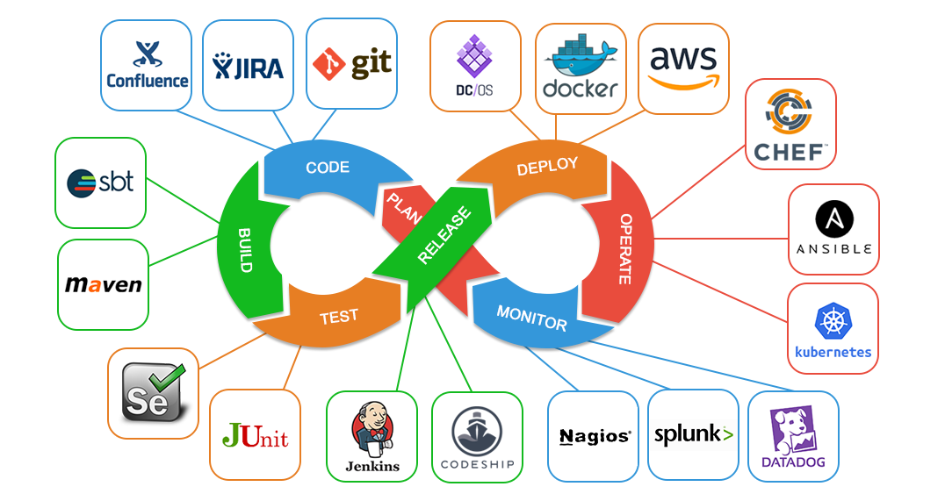
What is DevOps?
DevOps is the combination of cultural philosophies, practices, and tools that increases an organization's ability to deliver applications and services at high velocity

Slide 3
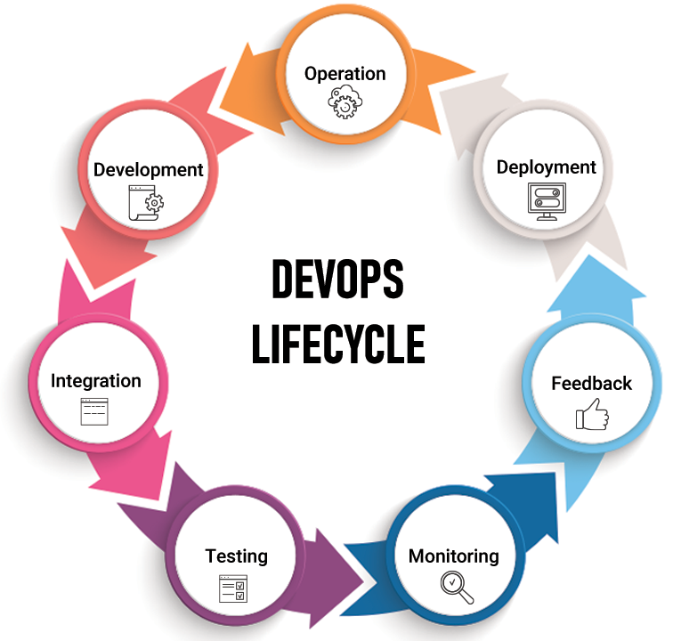
What is DevOps lifecycle?
DevOps lifecycle is defined as a combination of different phases
of continuous software development, integration, testing,
deployment and monitoring.

Slide 4
Benefits of DevOps
Speed
Rapid Delivery
Reliability
Scale
Improved Collaboration
Security

Slide 5
DevOps Practices
The following are DevOps best practices:
Continuous Integration
Continuous Delivery
Microservices
Infrastructure as Code
Monitoring and Logging
Communication and Collaboration

Slide 6
DevOps principles (CALMS)
DevOps is more than just development and operations teams working together. It’s more than tools and practices. DevOps is a mindset, a cultural shift, where teams adopt new ways of working.
Culture
Automation
Lean
Measurement
Sharing

Slide 7
Why DEvOps is Important?
DevOps is important because it's a software development and operations approach that enables faster development of new products and easier maintenance of existing deployments.

Slide 8
What DevOps is not?
1. DevOps is not simply combining Development & Operations teams.
2. DevOps is not a separate team.
3. DevOps is not a tool.
4. DevOps is not a one-size-fits-all strategy.
5. DevOps is not automation.

Slide 9
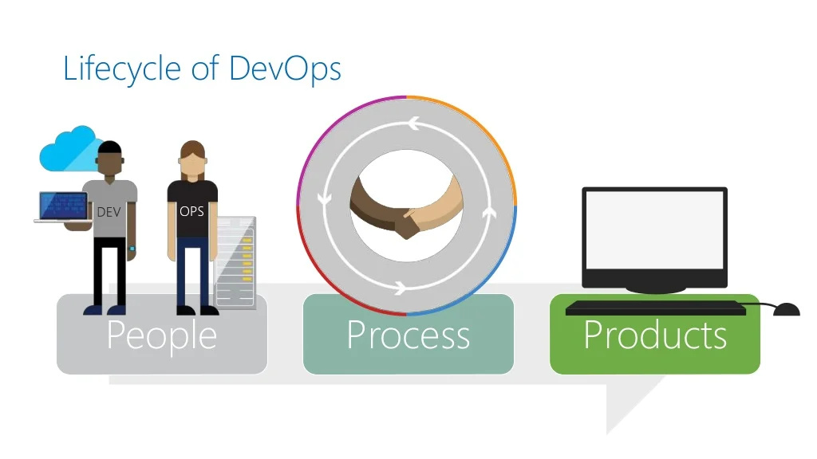

Slide 10
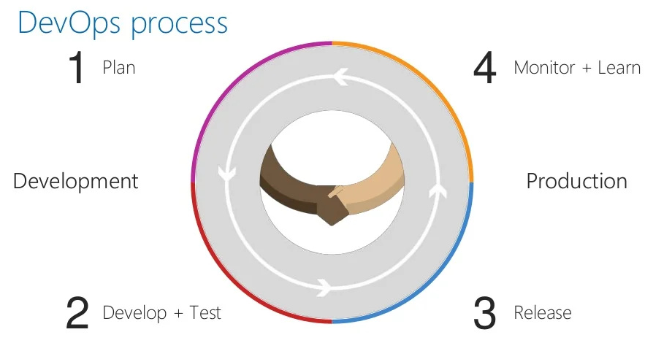

Slide 11
