Slide 1
Agile Software Development
By- Sheeraz Zulfi
Chapter 3 Agile software development

Slide 2
Topics covered
Agile methods
Plan-driven and agile development
Extreme programming
Agile project management
Scaling agile methods
Chapter 3 Agile software development

Slide 3
Rapid software development
Why?
  Need to react to changes more quickly than 2 year long waterfall projects
  2 years and then you got the design wrong anyway! Small deliveries aren't abstract
How?
  Goal - Deliver working software quickly
    Compromise - less functionality in a delivery, not lower quality
    Less documentation
  Focus on the code rather than the design
  Interleave
    Specification, design and implementation are inter-leaved
  Deliver small versions and get user (stakeholder) input
Chapter 3 Agile software development

Slide 4


Painpoints
Your Favorite!
Responsiveness
Transparency
Complexity
Productivity
Long Cycle Times
Quality
Brittle Code
Copyright © 2010 AgileInnovation

Slide 5
Agile manifesto
Our values:
  Individuals and interactions over processes and tools
  Working software over comprehensive documentation
  Customer collaboration over contract negotiation
  Responding to change over following a plan
Chapter 3 Agile software development

Slide 6
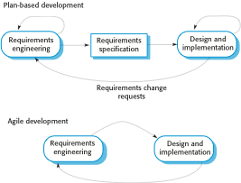
Plan-driven and agile specification
  separate development stages with the outputs to be produced at each of these stages planned in advance.
Iteration within stage
  Not necessarily waterfall model – plan-driven, incremental development is possible
User's full agreement at end, not before code
Iteration of stage
Chapter 3 Agile software development

Slide 7
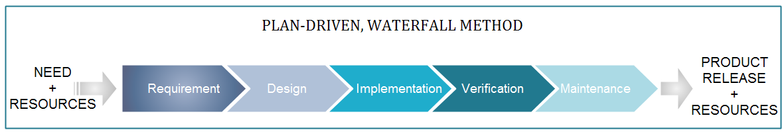
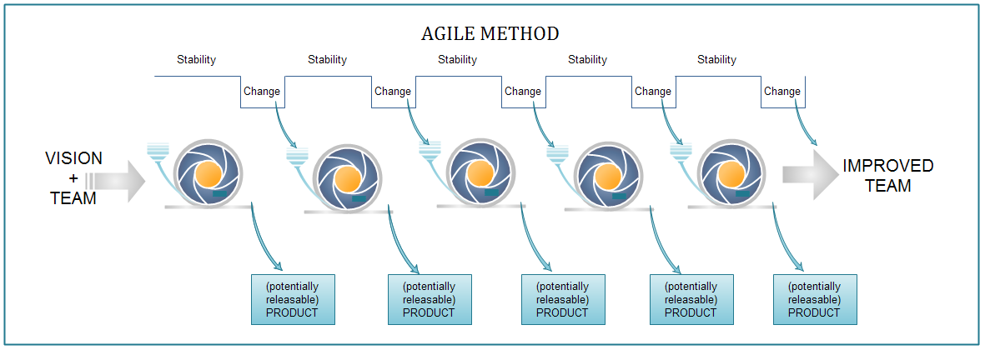
Waterfall Model vs Agile Model
Copyright © 2010 AgileInnovation

Slide 8
Problems with agile methods
It can be difficult to keep the interest of customers / users who are involved in the process.
Team members may be unsuited to the intense involvement that characterizes agile methods.
Prioritizing changes can be difficult where there are multiple stakeholders.
Maintaining simplicity requires extra work.
Contracts may be a problem as with other approaches to iterative development.
Because of their focus on small, tightly-integrated teams, there are problems in scaling agile methods to large systems.
Less emphasis on documentation - harder to maintain when you get a new team for maintenance
Chapter 3 Agile software development

Slide 9
Balance plan driven and agile
Not great for Agile:
  What type of system is being developed?
    Plan-driven approaches may be required for systems that require a lot of analysis before implementation (e.g. real-time system with complex timing requirements).
  What is the expected system lifetime?
    Long-lifetime systems may require more design documentation to communicate the original intentions of the system developers to the support team.
  What technologies are available to support system development?
    Agile methods rely on good tools to keep track of an evolving design
  How is the development team organized?
    Many teams; Outsourcing ---> need design documents to control borders
  Culture or contract needs detailed specification
  Is rapid feedback from users realistic?
  Large scale, not co-located may require more formal communication methods
  Need high level programming skills - refactoring, work with little spec
  Outside regulation documentation requirements
Chapter 3 Agile software development

Slide 10
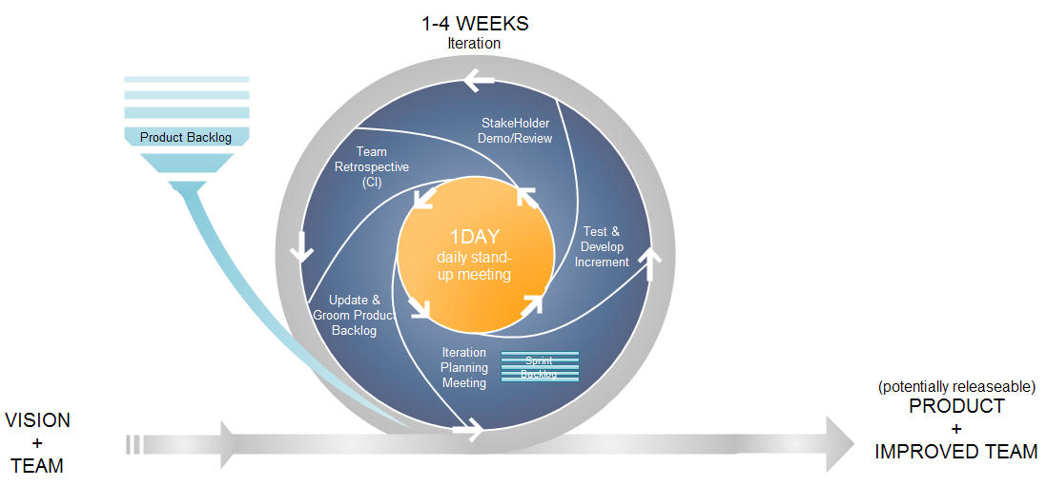
The Life of an Iteration
Copyright © 2010 AgileInnovation

Slide 11
Refactoring
Programming team look for possible software improvements and make these improvements even where there is no immediate need for them.
This improves the understandability of the software and so reduces the need for documentation.
Changes are easier to make because the code is well-structured and clear.
However, some changes requires architecture refactoring and this is much more expensive.
RISK:
  Changes the user does not test
  Changes to working software break it
Chapter 3 Agile software development

Slide 12
Examples of refactoring
Re-organization of a class hierarchy to remove duplicate code.
Tidying up and renaming attributes and methods to make them easier to understand.
The replacement of inline code with calls to methods that have been included in a program library.
Chapter 3 Agile software development

Slide 13
Scrum
Project Manager's job: - Deliver needed system on time within budget
The Scrum approach - manage the iterations
There are three phases in Scrum.
  outline planning phase - general picture and architecture
  Sprint cycles releasing increments of the system.
  The project closure phase - final delivery, documentation and review of lessons learned.
Chapter 3 Agile software development

Slide 14
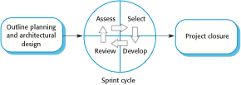
The Scrum process
Chapter 3 Agile software development

Slide 15
The Sprint cycle
Every 2–4 weeks (a fixed length).
1) Project team with customer: Look at product backlog - select stories to implement
2) implement with all customer communication through scrum master (protecting pgmr at this point)
  Scrum master has project manager role during sprint
  Daily 15 min meetings
    Stand up often
    Team presents progress and impediments
    Scrum master tasked with removing impediments
3) Review system release with user
Chapter 3 Agile software development

Slide 16
Scrum benefits
The product is broken down into a set of manageable and understandable chunks.
Unstable requirements do not hold up progress.
The whole team have visibility of everything and consequently team communication is improved.
Customers see on-time delivery of increments and gain feedback on how the product works.
Trust between customers and developers is established and a positive culture is created in which everyone expects the project to succeed.
Chapter 3 Agile software development

Slide 17
Summary
Plan Driven (Ex: Waterfall) vs Incremental (Ex: Agile )
  Structure and benefits and downfalls
Scrum - project management of Agile using sprints
  Iterations of full team contact / Scrum master protection of programmers / full team release review
Chapter 3 Agile software development

Slide 18
THANK YOU
Chapter 3 Agile software development

