Slide 1
Maven
Chandan Gowda H S

Slide 2
What is Maven?
Maven is a project management and comprehension tool that provides developers a complete build lifecycle framework. Development team can automate the project's build infrastructure in almost no time as Maven uses a standard directory layout and a default build lifecycle.
Maven makes life of developer easy while creating reports, checks, build and testing automation setups.

Slide 3
Project Object Model (POM)
POM stands for Project Object Model. It is fundamental unit of work in Maven. It is an XML file that resides in the base directory of the project as pom.xml.
The POM contains information about the project and various configuration detail used by Maven to build the project(s).
POM also contains the goals and plugins. While executing a task or goal, Maven looks for the POM in the current directory. It reads the POM, gets the needed configuration information, and then executes the goal. Some of the configuration that can be specified in the POM are following
project dependencies, plugins, goals, build profiles, project version, developers,
mailing list

Slide 4
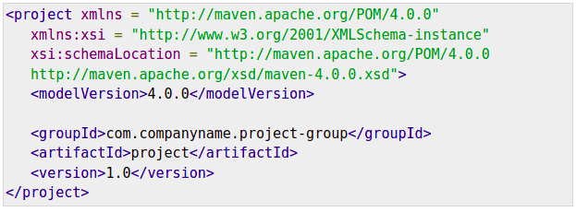
POM Example

Slide 5
What is Build Lifecycle?
A Build Lifecycle is a well-defined sequence of phases, which define the order in which the goals are to be executed. Here phase represents a stage in life cycle. As an example, a typical Maven Build Lifecycle consists of the following sequence of phases.

Slide 6
Phase | Handles | Description
prepare-resources | resource copying | Resource copying can be customized in this phase.
validate | Validating the information | Validates if the project is correct and if all necessary information is available.
compile | compilation | Source code compilation is done in this phase.
Test | Testing | Tests the compiled source code suitable for testing framework.
package | packaging | This phase creates the JAR/WAR package as mentioned in the packaging in POM.xml.
install | installation | This phase installs the package in local/remote maven repository.
Deploy | Deploying | Copies the final package to the remote repository.

Slide 7
Clean Lifecycle
When we execute mvn post-clean command, Maven invokes the clean lifecycle consisting of the following phases.
pre-clean
clean
Post-clean
Maven clean goal (clean:clean) is bound to the clean phase in the clean lifecycle. Its clean:cleangoal deletes the output of a build by deleting the build directory. Thus, when mvn clean command executes, Maven deletes the build directory.

Slide 8
Creating Project
Maven uses archetype plugins to create projects. To create a simple java application, we'll use maven-archetype-quickstart plugin. In example below, we'll create a maven based java application project in C:\MVN folder.
Ex- mvn archetype-generate

