Slide 1
Git
Chandan Gowda H S

Slide 2

Git
Git is a modern and widely used distributed version control system in the world. It is developed to manage projects with high speed and efficiency. The version control system allows us to monitor and work together with our team members at the same workspace.

Slide 3
What is Git?
Git is an open-source distributed version control system. It is designed to handle minor to major projects with high speed and efficiency. It is developed to co-ordinate the work among the developers. The version control allows us to track and work together with our team members at the same workspace.
Git is foundation of many services like GitHub and GitLab, but we can use Git without using any other Git services. Git can be used privately and publicly.

Slide 4
Git was created by Linus Torvalds in 2005 to develop Linux Kernel. It is also used as an important distributed version-control tool for the DevOps.
Git is easy to learn, and has fast performance. It is superior to other SCM tools like Subversion, CVS, Perforce, and ClearCase.

Slide 5
Features of Git
Open Source
Git is an open-source tool. It is released under the GPL (General Public License) license.
Scalable
Git is scalable, which means when the number of users increases, the Git can easily handle such situations.
Distributed
One of Git's great features is that it is distributed. Distributed means that instead of switching the project to another machine, we can create a "clone" of the entire repository.
Speed
Git is very fast, so it can complete all the tasks in a while. Most of the git operations are done on the local repository, so it provides a huge speed. Also, a centralized version control system continually communicates with a server somewhere.

Slide 6
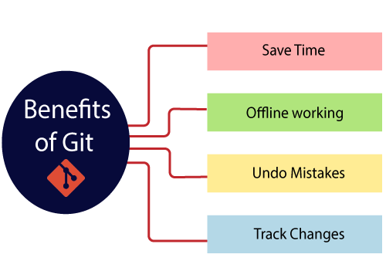
Benefits of Git
A version control application allows us to keep track of all the changes that we make in the files of our project. Every time we make changes in files of an existing project, we can push those changes to a repository. Other developers are allowed to pull your changes from the repository and continue to work with the updates that you added to the project files.
Some significant benefits of using Git are as follows:

Slide 7
What is GitHub?
GitHub is a Git repository hosting service. GitHub also facilitates with many of its features, such as access control and collaboration. It provides a Web-based graphical interface.
GitHub is an American company. It hosts source code of your project in the form of different programming languages and keeps track of the various changes made by programmers.
It offers both distributed version control and source code management (SCM) functionality of Git. It also facilitates with some collaboration features such as bug tracking, feature requests, task management for every project.

Slide 8
Benefits of GitHub
It is easy to contribute to open source projects via GitHub.
It helps to create an excellent document.
You can attract recruiter by showing off your work. If you have a profile on GitHub, you will have a higher chance of being recruited.
It allows your work to get out there in front of the public.
You can track changes in your code across versions.

Slide 9
Git Commands
git config
Usage: git config –global user.name “[name]”
Usage: git config –global user.email “[email address]”
-This command sets the author name and email address respectively to be used with your commits.
git init
-This command is used to start a new repository.
git clone [url]
-This command is used to obtain a repository from an existing URL.
git add .
-This command adds a file to the staging area.

Slide 10
git commit -m “[ Type in the commit message]”
-This command records or snapshots the file permanently in the version history.
git diff
-This command shows the file differences which are not yet staged.
git status
-This command lists all the files that have to be committed
git rm [file]
-This command deletes the file from your working directory and stages the deletion.
git log
-This command is used to list the version history for the current branch.

Slide 11
git branch
-This command lists all the local branches in the current repository.
git checkout
-This command is used to switch from one branch to another.
git remote add [variable name] [Remote Server Link]
-This command is used to connect your local repository to the remote server.
git push [variable name] master
-This command sends the committed changes of master branch to your remote repository.

