Slide 1
Virtualization
Virtualization is the ability to run multiple operating systems on single physical system and share the underlying hardware resources.
It is the process by which one computer hosts the appearance of many computers.
Virtualization is used to improve IT throught and costs by using physical resources as a pool from which virtual resources can be allocated.
Types of Virtual Machine are
* Type 1
* Type 2

Slide 2
Hypervisor
A hypervisor is a virtual machine manager/monitor(VMM),or virtualization manager is a program that allows multiple operating systems to share a single hardware host.
Each guest operating system appears to have the host’s processor,memory,and other resources all to itself.However,the hypervisor is actually controlling the host processor and resources,allocating what is need to each operating system in turn and making sure that the guest operating system(called virtual machines) cannot disrupt ecah other.

Slide 3
Benefits of Virtual Machine
Sharing of resources helps cost reduction
Isolation:Virtual machines are isolated from each other as if they are physically separated.
Encapsulation:Virtual machines encapsulate a complete computing environment.
Hardware Independance:Virtual machines run independetly of underlying hardware.
Portability:Virtual machines can be migrated between different hosts.

Slide 4
Disadvantges of Virtual Machine
It can have high cost of implemenation.
Virtual machines takes up whole space even when it needs less.
It creates a security risks.
It takes time .
It creates an availability issue.

Slide 5
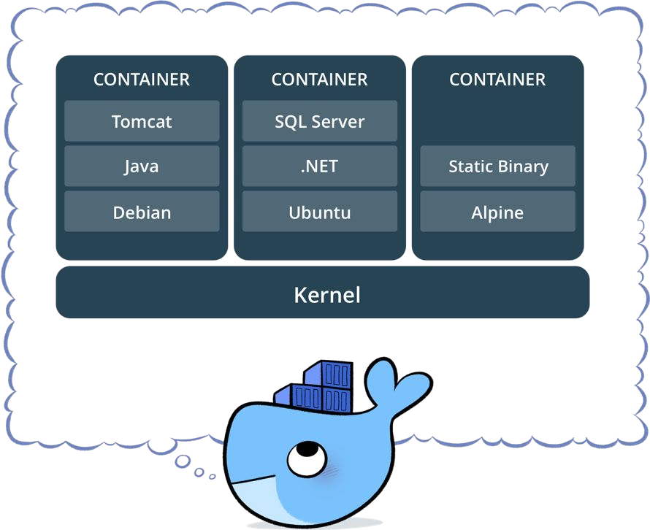
What is a container?
Containers are also same as virtual machines but without physical/guest OS.
Docker is one of the container,using in present IT field.
Standardized packaging for software and dependencies
Isolate apps from each other
Share the same OS kernel
Works for all major Linux distributions
Containers native to Windows Server 2016
.

Slide 6
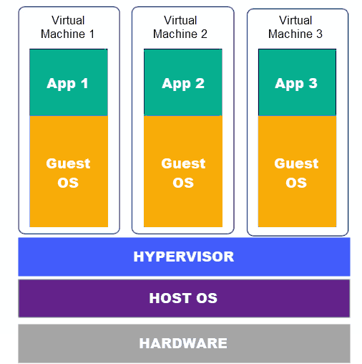
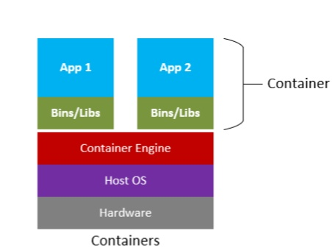
Virtual Machines vs Container

Slide 7
What is Docker?
It is software used to create containers.
Docker is an open source containerization platform.
Docker enables developers to package applications into containers—standardized executable components that combine application source code with all the operating system (OS) libraries and dependencies required to run the code in any environment.

Slide 8
Advantages of Docker/Container
To provide microservices that is possible using container only by using virtual machines it is not possible.
High speed compare to virtual machines.
More lightweight comapre to virtual machines.
Easier to manage and automate.
Containers requires less system resources than traditional or hardware virtual machine environment.

Slide 9
Docker File
Is a text document that conatins all the commands a user could call on the command line to assemble an image.Using docker build users can create an automated build that executes several command line instructions in succession.
Some keywords used in docker file:
FROM: The FROM keyword specifies the base image on which we want our image to be built on.
ADD: The ADD keyword is used to copy files/directories into a docker image.

Slide 10
Continue...
RUN:It executes any commands on top of the current image and craetes a new layer by committing the results.
CMD:It specifies the instruction that is to be executed when a Docker conatiner starts.
ENTRY POINT: It is used to set executables that will always run when the container is initiated.
ENV:It is used to set the environment variable.
EXPOSE:It is used to exposes a particular port with a specified protocol inside a Docker Conatiner.

Slide 11
Example for Docker file
FROM ubuntu
RUN apt-get update
RUN apt install -y tzdata
ENV TZ=Asia/Dubai
RUN ln -snf /usr/share/zoneinfo/$TZ /etc/localtime && echo $TZ > /etc/timezone
RUN apt-get -y install apache2
ADD . /var/www/html
ENTRYPOINT apachectl -D FOREGROUND
ENV name DEVOPS SKILLRARY
EXPOSE 8080:8080

Slide 12
Container Managament System(S/W)
It is process of managing the creation,deployment,scaling,availability and destruction of software containers.
Conatiner management software helps optimize how and where to run conatiners as well as which systems to put them on.
The most commonly used container management systems are KUBERNATES(K8’s) and DOCKER SWARM.

Slide 13
Container Orchestration:
Container orchestration is the automation of much of the operation effort required to run containerized workloads and services.
This includes a wide range of things software teams need to manage a conatiner’s lifecycle,including provisioning,deployment,scaling(up and down),networking,load balancing and more.
Orchestration keeps containers running in the required state,and helps maintain your service-level agreements(SLAs).

