Slide 1
Docker
Docker is a container management service. The keywords of Docker are develop, ship and run anywhere. The whole idea of Docker is for developers to easily develop applications, ship them into containers which can then be deployed anywhere.
The initial release of Docker was in March 2013 and since then, it has become the buzzword for modern world development, especially in the face of Agile-based projects.

Slide 2
What Is Docker?
You can use Docker throughout multiple stages of your DevOps cycle, but it is especially valuable in the deployment stage, especially since it allows developers to use rapid deployment. In addition, the environment itself is highly portable and was designed with efficiencies that will enable you to run multiple Docker containers in a single environment, unlike traditional virtual machine environments.
The Docker container can be moved from environment to environment very easily. In a DevOps life cycle, Docker really shines when used for deployment. When you deploy your solution, you want to guarantee that the code tested will actually work in the production environment. In addition, when you're building and testing the code, it's beneficial to have a container running the solution at those stages because you can validate your work in the same environment used for production.
When getting started with Docker, we first need to understand Docker. Docker is an OS virtualized software platform that allows IT organizations to quickly create, deploy, and run applications in Docker containers, which have all the dependencies within them. The container itself is a very lightweight package with all the instructions and dependencies—such as frameworks, libraries, and bins—within it.

Slide 3
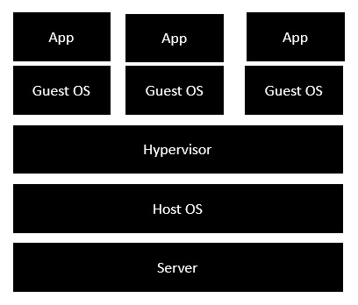
Docker - Architecture
The following image shows the standard and traditional architecture of virtualization.
The server is the physical server that is used to host multiple virtual machines.
The Host OS is the base machine such as Linux or Windows.
The Hypervisor is either VMWare or Windows Hyper V that is used to host virtual machines.
You would then install multiple operating systems as virtual machines on top of the existing hypervisor as Guest OS.
You would then host your applications on top of each Guest OS.

Slide 4
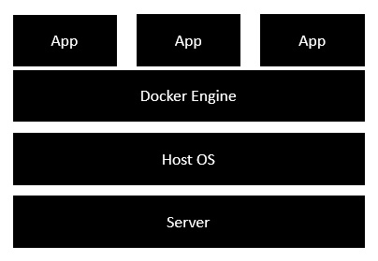
The following image shows the new generation of virtualization that is enabled via Dockers. Let’s have a look at the various layers
The server is the physical server that is used to host multiple virtual machines. So this layer remains the same.
The Host OS is the base machine such as Linux or Windows. So this layer remains the same.
Now comes the new generation which is the Docker engine. This is used to run the operating system which earlier used to be virtual machines as Docker containers.
All of the Apps now run as Docker containers.
The clear advantage in this architecture is that you don’t need to have extra hardware for Guest OS. Everything works as Docker containers.

Slide 5
Features of Docker
Docker has the ability to reduce the size of development by providing a smaller footprint of the operating system via containers.
With containers, it becomes easier for teams across different units, such as development, QA and Operations to work seamlessly across applications.
You can deploy Docker containers anywhere, on any physical and virtual machines and even on the cloud.
Since Docker containers are pretty lightweight, they are very easily scalable.

Slide 6
Advantages of Docker
Next in the getting started with docker tutorial we focus on the advantages of Docker. As noted previously, you can do rapid deployment using Docker. The environment itself is highly portable and was designed with efficiencies that allow you to run multiple Docker containers in a single environment, unlike traditional virtual machine environments.
The configuration itself can be scripted through a language called YAML, which allows you to describe the Docker environment you want to create. This, in turn, allows you to scale your environment quickly. But probably the most critical advantage these days is security.
You have to ensure that the environment you’re running is highly secure yet highly scalable, and Docker takes security very seriously. You’ll see it as one of the key components of the agile architecture of the system you’re implementing.
Now that you know the advantages of Docker, the next thing you need to know in this getting started with docker tutorial is how it works and its components.

Slide 7
How Does Docker Work?
Docker works via a Docker engine that is composed of two key elements: a server and a client; and the communication between the two is via REST API. The server communicates the instructions to the client. On older Windows and Mac systems, you can take advantage of the Docker toolbox, which allows you to control the Docker engine using Compose and Kitematic.
Now that we have learned about Docker, it's advantages, and how it works, our next focus in this getting started with docker tutorial is to learn the various components of Docker.
Components of Docker
There are four components that we will discuss in this getting started with docker tutorial:
Docker client and server
Docker image
Docker registry
Docker container

Slide 8
Docker Client and Server
This is a command-line-instructed solution in which you would use the terminal on your Mac or Linux system to issue commands from the Docker client to the Docker daemon. The communication between the Docker client and the Docker host is via a REST API. You can issue similar commands, such as a Docker Pull command, which would send an instruction to the daemon and perform the operation by interacting with other components (image, container, registry). The Docker daemon itself is actually a server that interacts with the operating system and performs services. As you’d imagine, the Docker daemon constantly listens across the REST API to see if it needs to perform any specific requests. If you want to trigger and start the whole process, you’ll need to use the Dockered command within your Docker daemon, which will start all of your performances. Then you have a Docker host, which lets you run the Docker daemon and registry.
Now let’s talk about the actual structure of a Docker image in this getting started with docker tutorial. A Docker image is a template that contains instructions for the Docker container. That template is written in a language called YAML, which stands for Yet Another Markup Language.

Slide 9
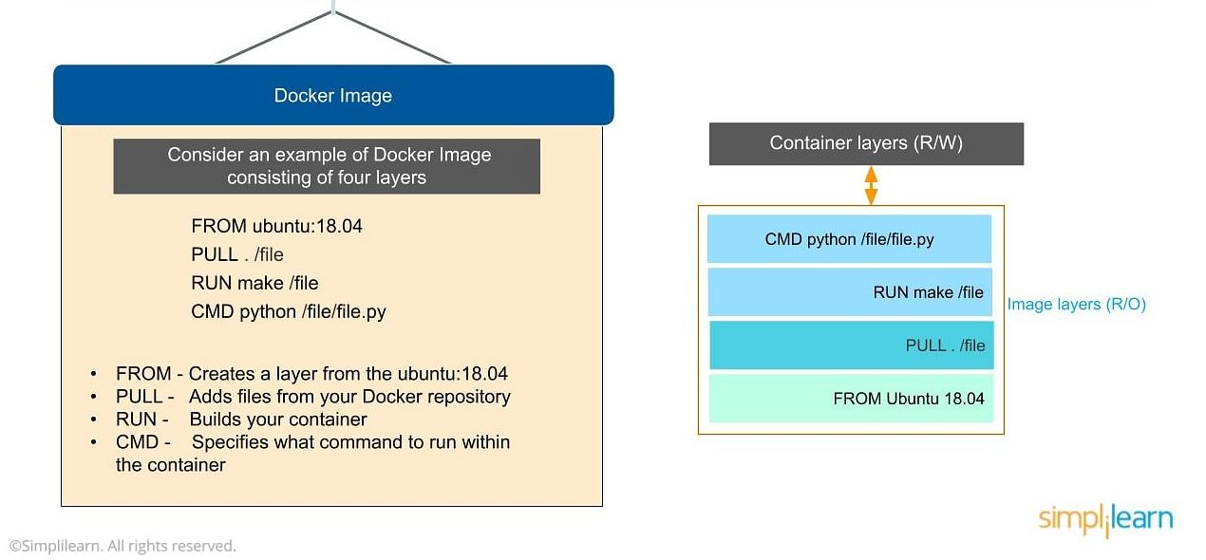

Slide 10
Docker Image
Next in the getting started with docker tutorial, we will learn all about Docker Image. The Docker image is built within the YAML file and then hosted as a file in the Docker registry. The image has several key layers, and each layer depends on the layer below it. Image layers are created by executing each command in the Dockerfile and are in the read-only format. You start with your base layer, which will typically have your base image and your base operating system, and then you will have a layer of dependencies above that. These then comprise the instructions in a read-only file that would become your Dockerfile.
Here we have four layers of instructions: From, Pull, Run and CMD. What does it actually look like? The From command creates a layer based on Ubuntu, and then we add files from the Docker repository to the base command of that base layer.
Pull: Adds files from your Docker repository
Run: Builds your container
CMD: Specifies which command to run within the container
In this instance, the command is to run Python. One of the things that will happen as we set up multiple containers is that each new container adds a new layer with new images within the Docker environment. Each container is completely separate from the other containers within the Docker environment, so you can create your own separate read-write instructions within each layer. What’s interesting is that if you delete a layer, the layer above it will also get deleted.
What happens when you pull in a layer but something changes in the core image? Interestingly, the main image itself cannot be modified. Once you’ve copied the image, you can modify it locally. You can never modify the actual base image.

Slide 11
Docker Registry
Next in the getting started with docker tutorial, we will learn all about Docker Registry. The Docker registry is where you would host various types of images and where you would distribute the images from. The repository itself is just a collection of Docker images, which are built on instructions written in YAML and are very easily stored and shared. You can give the Docker images name tags so that it’s easy for people to find and share them within the Docker registry. One way to start managing a registry is to use the publicly accessible Docker hub registry, which is available to anybody. You can also create your own registry for your own use internally.
The registry that you create internally can have both public and private images that you create. The commands you would use to connect the registry are Push and Pull. Use the Push command to push a new container environment you’ve created from your local manager node to the Docker registry, and use a PullL command to retrieve new clients (Docker image) created from the Docker registry. Again, a Pull command pulls and retrieves a Docker image from the Docker registry, and a Push command allows you to take a new command that you’ve created and push it to the registry, whether it’s Docker hub or your own private registry.

Slide 12
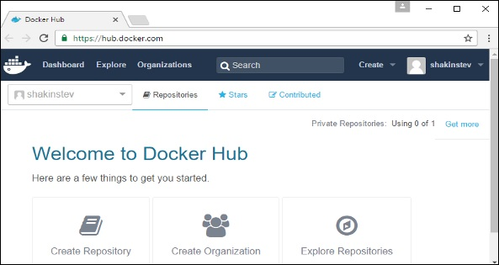
Docker - Hub
Docker Hub is a registry service on the cloud that allows you to download Docker images that are built by other communities. You can also upload your own Docker built images to Docker hub. In this chapter, we will see how to download and the use the Jenkins Docker image from Docker hub.

Slide 13
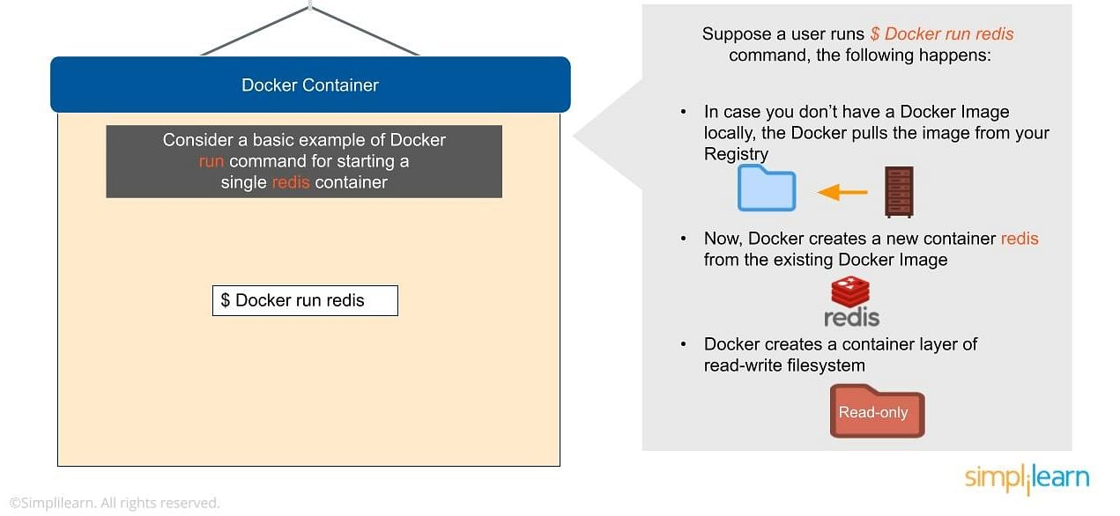

Slide 14
Docker Container
Next in the getting started with docker tutorial, we will learn all about Docker Container. The Docker container is an executable package of applications and its dependencies bundled together; it gives all the instructions for the solution you’re looking to run. It’s really lightweight due to the built-in structural redundancy. The container is also inherently portable. Another benefit is that it runs completely in isolation. Even if you are running a container, it’s guaranteed not to be impacted by any host OS securities or unique setups, unlike with a virtual machine or a non containerized environment. The memory for a Docker environment can be shared across multiple containers, which is really useful, especially when you have a virtual machine that has a defined amount of memory for each environment.
Consider a basic example of Docker run command for starting a single container called redis:
$ Docker run redis
If you don’t have the Redis image locally installed, it will be pulled from the registry. After this, the new Docker container Redis will be available within your environment so you can start using it.
Now let’s look at why containers are so lightweight. It’s because they do not have some of the additional layers that virtual machines do. The biggest layer Docker doesn’t have is the hypervisor, and it doesn’t need to run on a host operating system.

Slide 15
Advanced Docker Components
After going through the various components of Docker, the next focus of this Docker tutorial are the advanced components of Docker:
Docker compose
Docker swamp
Docker Compose
Docker compose is designed for running multiple containers as a single service. It does so by running each container in isolation but allowing the containers to interact with one another. As noted earlier, you would write the compose environments using YAML.
So in what situations might you use Docker compose? An example would be if you are running an Apache server with a single database and you need to create additional containers to run additional services without having to start each one separately. you would write a set of files using Docker compose to do that.
Docker Swarm
Docker swarm is a service for containers that allows IT administrators and developers to create and manage a cluster of swarm nodes within the Docker platform. Each node of Docker swarm is a Docker daemon, and all Docker daemons interact using the Docker API. A swarm consists of two types of nodes: a manager node and a worker node. A manager node maintains cluster management tasks. Worker nodes receive and execute tasks from the manager node.
After having looked into all the components of Docker, let us advance our learning in this getting started with docker tutorial on the Docker commands and use case.

