Slide 1



Slide 2


Slide 3
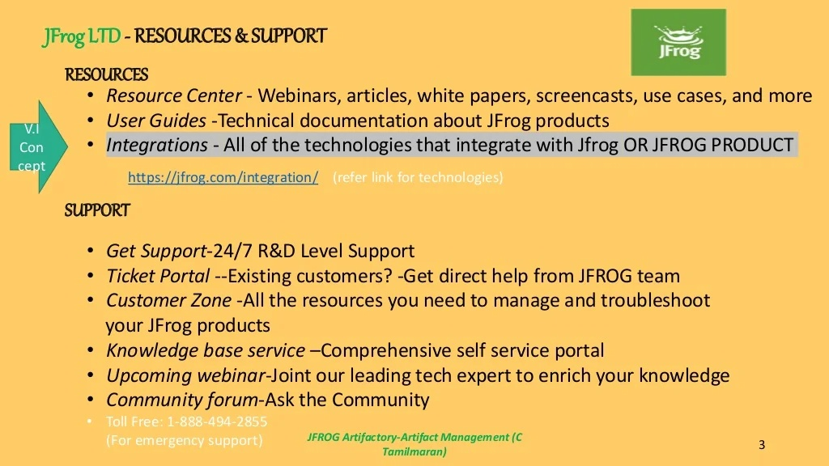

Slide 4
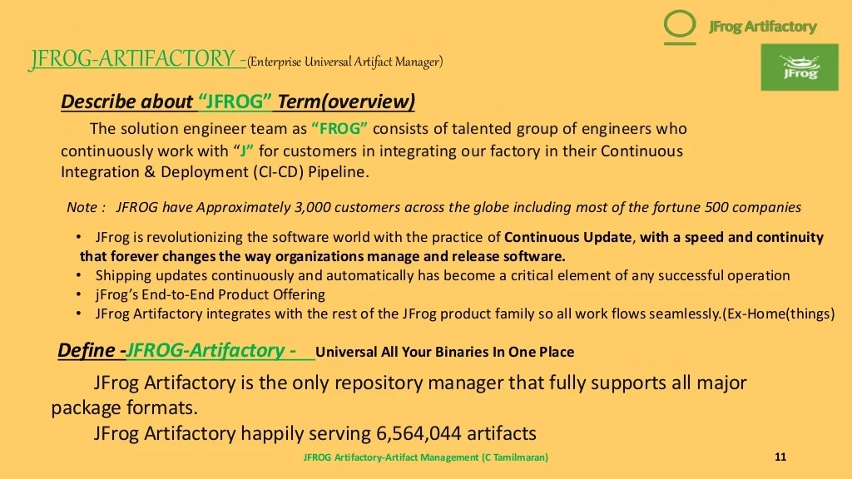

Slide 5
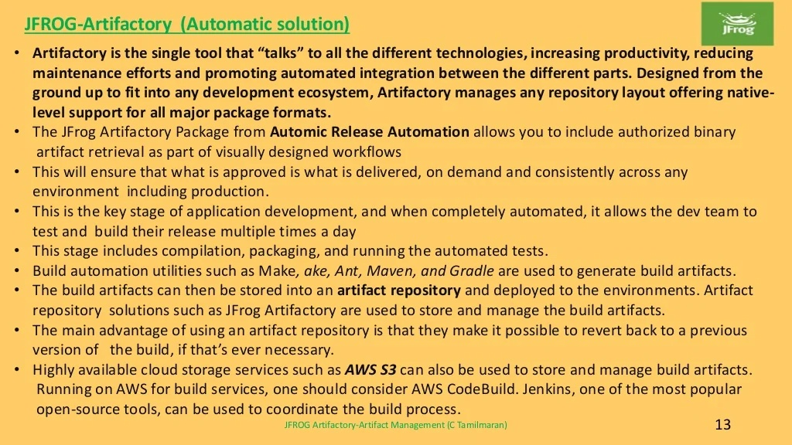

Slide 6
JFROG-Artifactory -HOW IT WORKS
Automic Release Automation combines an integrated application packaging system, smart deployment models and out-of-the box actions for common deployment tasks with robust workflow design and high volume execution capability
The Automic Jfrog Artifactory Package allows users to retrieve artifacts or artifact folders from a specific build, build status, or the latest artifact version.
Optimized for enterprise environments, Automic Release Automation accelerates deployments to all environments from DEV to PROD, from legacy to private/public/hybrid cloud, and ensures the quality of those deployments.

Slide 7
Advantages-JFROG Artifactory-Artifact Managers
Integrating a binary repository into a Continuous Delivery pipeline or a Continuous Deployment process
Standardize the use of a binary artifact library for repeatable, secure, and consistent results
Ensure only the right artifacts are accessed by the right credentials at the right time
Promote more reliable rollbacks if a deployment fails
Perform Continuous Deployments from an immutable, and approved set of binaries

Slide 8


