Slide 1
Amazon web services (aws)
Introduction and basics

Slide 2

?
WHAT IS
?
?

Slide 3
What is cloud computing ?
Cloud computing is the on-demand availability of computer system resources, especially data storage and computing power, without direct active management by the user.

Slide 4
Why we need cloud platform?
Developing in the cloud enables users to get their applications to market quickly.
Data security: Hardware failures do not result in data loss because of networked backups.
Savings on equipment: Cloud computing uses remote resources, saving organizations the cost of servers and other equipment etc.

Slide 5
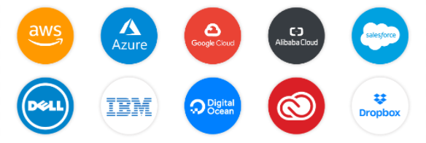
Cloud service providers

Slide 6
AMAZON WEB SERVICES – (AWS)
CEO – ADAM SELIPSKY
Launched in the year – 2006
Features- computing, storage, networking, database, analytics, media services, machine learning, management, mobile and IoT
Services – IaaS , Paas , SaaS
22 geographical regions of presence, 84 Availability Zones

Slide 7
Infrastructure as a service - iaas
Infrastructure as a Service, sometimes abbreviated as IaaS, contains the basic building blocks for cloud IT and typically provide access to networking features, computers (virtual or on dedicated hardware), and data storage space.
Ex: EC2 instance

Slide 8
platform as a service - paas
Platforms as a service remove the need for organizations to manage the underlying infrastructure (usually hardware and operating systems) and allow you to focus on the deployment and management of your applications.
This helps you be more efficient as you don’t need to worry about resource procurement, capacity planning, software maintenance, patching, or any of the other undifferentiated heavy lifting involved in running your application.
Ex: AWS Elastic beanstalk – used for deploying and scaling web applications and services

Slide 9
software as a service - saas
Software as a Service provides you with a completed product that is run and managed by the service provider.
SaaS offering you do not have to think about how the service is maintained or how the underlying infrastructure is managed; you only need to think about how you will use that particular piece of software.
Ex: Netflix, Dropbox, Slack

Slide 10
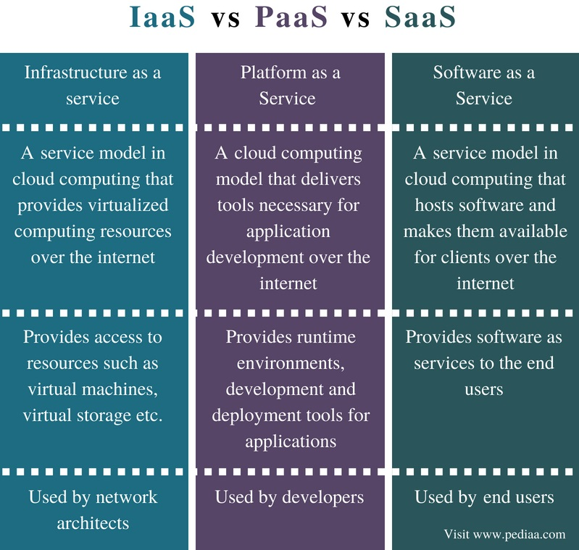
Difference between – iaas, paas & saas

Slide 11
Identity and Access Management (IAM)
Provides fine-grained access control across all of AWS.
With IAM, you can specify who can access which services and resources, and under which conditions.
Users - Specific individual, can receive personal login.
Groups – Collection of Users.
Roles – Collection of Policies.
Policies – Low level permissions to resource.

Slide 12
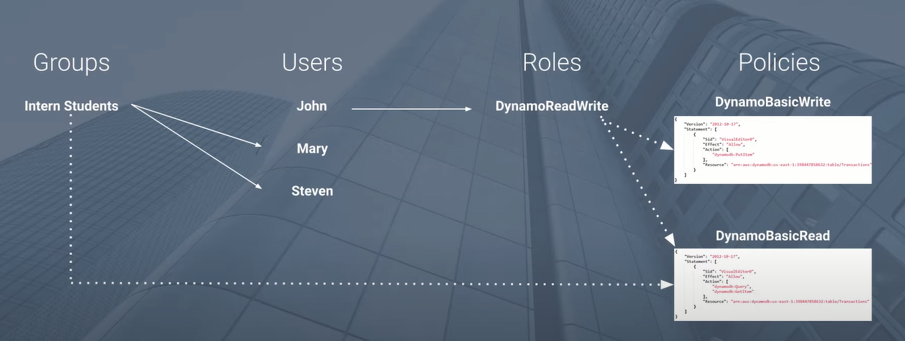
iam

Slide 13
Elastic cloud compute – ec2
An Amazon EC2 instance is a virtual server used for running applications on the Amazon Web Services (AWS) infrastructure.
It consists of Amazon machine Image (AMI) and Instance types comprise varying combinations of CPU, memory, storage, and networking capacity

Slide 14
Properties of ec2
Amazon Elastic Compute Cloud (Amazon EC2) provides secure, resizable compute capacity in the cloud.
Elastic Web-Scale computing you can increase or decrease capacity within minutes and commission one to thousands of instances simultaneously.
Completely controlled You have complete control include root access to each instance and can stop and start instances without losing data and using web service APIs

Slide 15
Storage in aws
Basically we have three types of storages in AWS
EBS – Elastic block Storage
EFS – Elastic File Storage
S3 - Simple Storage Service
Instance Store Volumes

Slide 16
Instance store volume
Instance store volumes are high performance local disks that are physically attached to the host computer on which an EC2 instance runs.
Instance stores are ephemeral which means the data is lost when powered off (non-persistent)
Instances stores are ideal for temporary storage of information that changes frequently, such as buffers, caches, or scratch data

Slide 17
EBS – Elastic block Storage
This is the storage which by default attached with the EC2 instance.
Root EBS volumes are deleted on termination by default
Termination protection is turned off by default and must be manually enabled (keeps the volume/data when the instance is terminated)
EBS volume data persists independently of the life of the instance
Max Capacity of 64 TiB.

Slide 18
EFS – Elastic File Storage
EFS is a fully-managed service that makes it easy to set up and scale file storage in the Amazon Cloud
Good for big data and analytics, media processing workflows, content management, web serving, home directories etc.
EFS is elastic and grows and shrinks as you add and remove data
A file system can be accessed concurrently from all AZs in the region where it is located.
Can scale up to petabytes.

Slide 19
S3 - Simple Storage Service
Amazon S3 is object storage built to store and retrieve any amount of data from anywhere web sites and mobile apps, corporate applications, and data from IoT sensors or devices.
Files are stored in buckets, Buckets are root level folders, Files can be anywhere from 0 bytes to 5 TB.
There is unlimited storage available, S3 is a universal namespace so bucket names must be unique globally

Slide 20
S3 - Simple Storage Service
There are six S3 storage classes
S3 Standard
S3 intelligent-Tiering
S3 Standard-IA (Infrequent Access)
S3 One Zone-IA
S3 Glacier
S3 Glacier Deep Archive
Can be used for Backup and Storage , Application Hosting , Media Hosting , Software Delivery , Static Website.

Slide 21
S3 - Simple Storage Service
There are six S3 storage classes
S3 Standard
S3 intelligent-Tiering
S3 Standard-IA (Infrequent Access)
S3 One Zone-IA
S3 Glacier
S3 Glacier Deep Archive
Can be used for Backup and Storage , Application Hosting , Media Hosting , Software Delivery , Static Website.

Slide 22
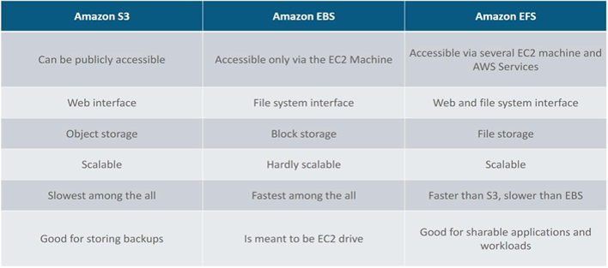

Slide 23
ROUTE-53
There are six S3 storage classes
S3 Standard
S3 intelligent-Tiering
S3 Standard-IA (Infrequent Access)
S3 One Zone-IA
S3 Glacier
S3 Glacier Deep Archive
Can be used for Backup and Storage , Application Hosting , Media Hosting , Software Delivery , Static Website.

Slide 24
ROUTE-53
USES
Domain Registration.
Hosted Zone.
Health Checks of EC2 instances.
Traffic flow.

Slide 25
THANK YOU

