Slide 1
Agile
Agile is an iterative approach to project management and software development that helps teams deliver value to their customers faster and with fewer headaches. Instead of betting everything on a "big bang" launch, an agile team delivers work in small, but consumable, increments. Requirements, plans, and results are evaluated continuously so teams have a natural mechanism for responding to change quickly.

Slide 2
What is Agile Methodology?
An agile methodology is an iterative approach to software development. Each iteration of agile methodology takes a short time interval of 1 to 4 weeks. The agile development process is aligned to deliver the changing business requirement. It distributes the software with faster and fewer changes.
The single-phase software development takes 6 to 18 months. In single-phase development, all the requirement gathering and risks management factors are predicted initially.
The agile software development process frequently takes the feedback of workable product. The workable product is delivered within 1 to 4 weeks of iteration.

Slide 3
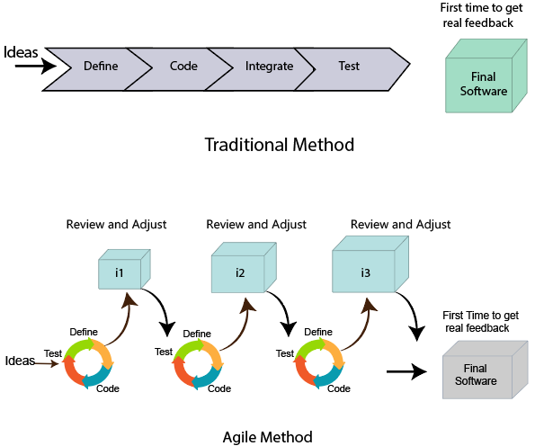

Slide 4
Roles in Agile
1. Scrum Master
The Scrum Master is a team leader and facility provider who helps the team member to follow agile practices, so that the team member meets their commitments and customers requirements. The scrum master plays the following responsibilities:
They enable the close co-operation between all the roles and functions.
They remove all the blocks which occur.
They safeguard the team from any disturbances.
They work with the organization to track the progress and processes of the company.
They ensure that Agile Inspect & Adapt processes are leveraged correctly which includes
Planned meetings
Daily stand-ups
Demo
Review
Retrospective meetings, and
Facilitate team meetings and decision-making process.

Slide 5
2. Product Owner
The Product Owner is one who runs the product from a business perspective. The Product Owner plays the following responsibilities:
He defines the requirements and prioritizes their values.
He sets the release date and contents.
He takes an active role in iteration and releasing planning meetings.
He ensures that the team is working on the most valued requirement.
He represents the voice of the customer.
He accepts the user stories that meet the definition of done and defined acceptance criteria.

Slide 6
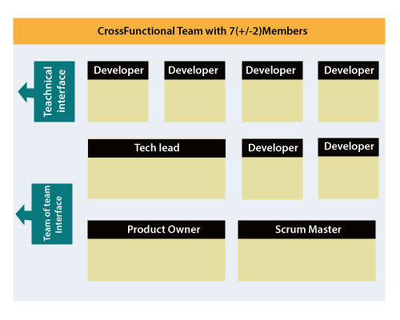
Cross-functional team
Every agile team contains self-sufficient team with 5 to 9 team members. The average experience of each member ranges from 6 to 10 years. The agile team contains 3 to 4 developers, 1 tester, 1 technical lead, 1 scrum master and 1 product owner.
The Scrum master and Product owner are considered as a part of Team Interface, on the other hand remaining members are the part of Technical Interface.

Slide 7
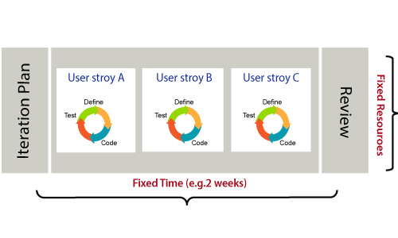
How an Agile Team plan their work?
An Agile methodology is not a specific set of ceremonies or specific development techniques. Rather, it is a group of methodologies that demonstrate a commitment to tight feedback cycles and continuous improvement. An Agile team works in iterations to deliver the customer requirement, and each iteration takes 10 to 15 days. However, the original Agile Manifesto didn't set the time period of two-week iterations or an ideal team size.
Each user requirement is a planned based and their backlog prioritization and size. The team decides, how much scope they have and how many hours available with each team to perform their planed task.

Slide 8
What is a user requirement?
The user requirement defines the requirements of the user in terms of functionalities. There may be of two type of functionality.
As a <User Role> I want <Functionality> so that <Business Value>
In order to <Business value> as a <User Role> I want <Functionality>.
During software release planning, a rough estimate is given to a user requirement using relative scale points. During iteration planning, the requirement is broken down into tasks.

Slide 9
Relation between User requirement and Task
User requirement talks about what is to be done. It defines the needs of users.
Task talks about how it is to be done. It defines how functionality is implemented.
User requirements are implemented by tasks. Every requirement is gathering as the task.
User requirement is divided into different tasks when it is planned in current iteration.
User tasks are estimated in hours based, generally it is between 2 to 12 hours.
Requirements are validated using acceptance test.

Slide 10
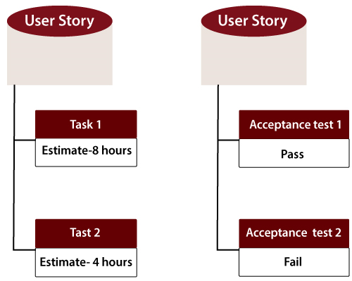
When the requirement is completed
The Agile team decides the meaning of task done. There may be different criteria for it:
When the entire task (development, testing) are completed.
When all the acceptance tests are running and are passed.
When no defects found.
Product owner has accepted the requirement.
When the software product is delivered to the end user.

Slide 11
Agile Software Development Life Cycle (SDLC)
Software development life cycle (SDLC) is a phenomenon to design, develop and, test high-quality software. The primary aim of SDLC is to produce high-quality software that fulfills the customer requirement within times and cost estimates.
Agile Software Development Life Cycle (SDLC) is the combination of both iterative and incremental process models. It focuses on process adaptability and customer satisfaction by rapid delivery of working software product. Agile SDLC breaks down the product into small incremental builds. These builds are provided into iterations.

Slide 12
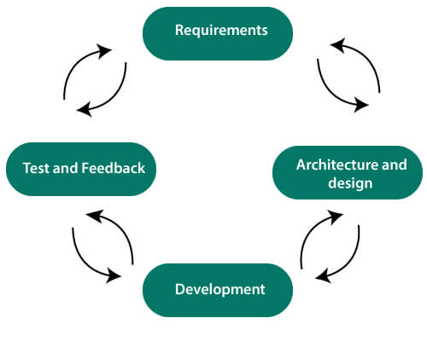
In the agile SDLC development process, the customer is able to see the result and understand whether he/she is satisfied with it or not. This is one of the advantages of the agile SDLC model. One of its disadvantages is the absence of defined requirements so, it is difficult to estimate the resources and development cost.

Slide 13
Each iteration of agile SDLC consists of cross-functional teams working on various phases:
Requirement gathering and analysis
Design the requirements
Construction/ iteration
Deployment
Testing
Feedback

Slide 14
Requirements gathering and analysis
In this phase, you must define the requirements. You should explain business opportunities and plan the time and effort needed to build the project. Based on this information, you can evaluate technical and economic feasibility.
Design the requirements
When you have identified the project, work with stakeholders to define requirements. You can use the user flow diagram or the high-level UML diagram to show the work of new features and show how it will apply to your existing system.
Construction/ Iteration
When the team defines the requirements, the work begins. The designers and developers start working on their project. The aims of designers and developers deploy the working product within the estimated time. The product will go into various stages of improvement, so it includes simple, minimal functionality.
Deployment
In this phase, the team issues a product for the user's work environment.
Testing
In this phase, the Quality Assurance team examine the product's performance and look for the bug.
Feedback
After releasing of the product, the last step is to feedback it. In this step, the team receives feedback about the product and works through the feedback.

Slide 15
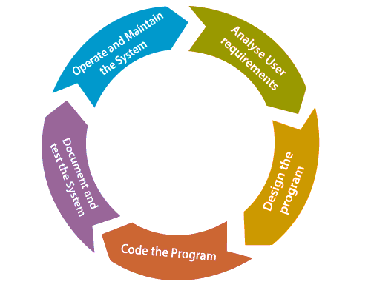
Agile SDLC Process Flow
Concept: Project are imagined and prioritized.
Inception: Team members are created, funding is put in place, and basic environments and requirements are discussed.
Iteration/Constriction: The software development team works to deliver working software. It is based on requirement and feedback.
Release: Perform quality assurance (QA) testing, provides internal and external training, documentation development, and final version of iteration into the product.
Production: It is ongoing support of the software.

Slide 16
What is Scrum?
Scrum is a framework that helps agile teams to work together. Using it, the team members can deliver and sustain the complex product. It encourages the team to learn through practice, self-organize while working on the problem. Scum is a work done through the framework and continuously shipping values to customers.
It is the most frequent software that is used by the development team. Its principle and lessons can be applied to all kinds of teamwork. Its policy and experiences is a reason of popularity of Scrum framework. The Scrum describes a set of tools, meetings, and roles that help the teams structure. It also manages the work done by the team
The framework
Scrum and agile are not the same thing because Scrum focused on continuous improvement, which is a core foundation of agile. Scrum framework focuses on ongoing getting work done.

Slide 17
What are sprints?
With scrum, a product is built in a series of repetition called sprints. It breaks down big complex projects into bite-size pieces. It makes projects more manageable, allows teams to ship high quality, work faster, and more frequently. The sprints give them more flexibility to adapt to the changes.
prints are a short, time-boxed period for Scrum team that works to complete a set amount of work. Sprints are the core component of Scrum and agile methodology. The right sprints will help our agile team to ship better software.

Slide 18
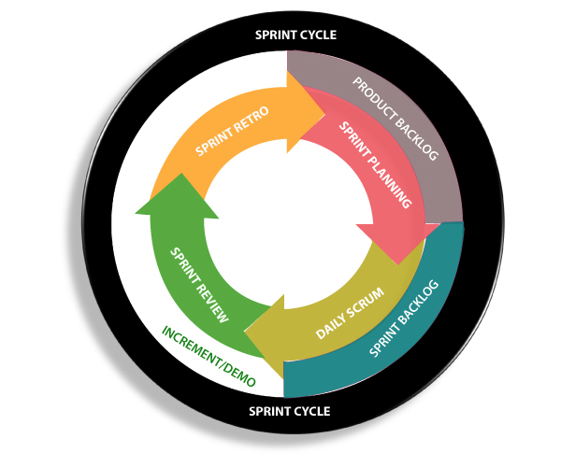

Slide 19
What is sprint plan?
Sprint plan is an action in Scrum that kicks off the sprint. The primary purpose of sprint plan is to define what can deliver in the sprint. It also focuses on how the work will be achieved. It is done in combination with the whole Scrum team members.
The sprint is a set of the period where all the work to be done. Before we start the development, we have to set up the sprint. We need to describe how long time is required to achieve the sprint goal and where we are going to start.
Factors affecting Sprint planning
The What: The product owner describes the goal of the sprint and the backlog items which contribute to achieve that goal.
The How: Agile development team plans its necessary work on how to achieve and deliver the sprint goal.
The Who: The product owner defines the goal based on the value that the customers seek. And the developer needs to understand how they can or cannot deliver that goal.
The Inputs: The product backlog provides the list of input stuff that could potentially be part of the current sprint. The team looks over the existing work done in incremental ways.
The Outputs: The critical outcome of sprint planning is to meet described team goal. The product set the goal of sprint and how they will start working towards the goal.

Slide 20
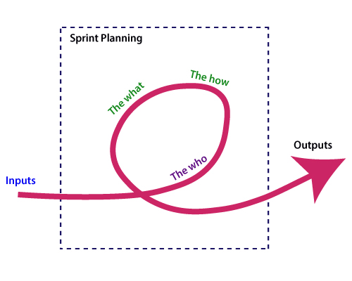

Slide 21
What is the product backlog?
A product backlog is a registered list of work for the development team. It is driven from the roadmap and its requirements. The essential task is represented at the top of the product backlog so that the team member knows what to deliver first. The developer team doesn't work through the backlog from the product owner's side and product owner doesn't push the work to the developer team. The developer team pulls work from the product backlog.
Agile Daily Stand-up
Agile daily stand-up is termed as the day-to-day status meeting on the project of the members of the agile team. The daily meeting of the agile team discussed the forum for regular updates as well as the problems of team members. It focuses on addressing the issues and tries to solve the issues quickly. The daily stand-up is the regular practice, no matter how an agile team is established regardless of its office location.

Slide 22
What is Daily Stand-up?
The daily stand-up is a daily status meeting of the agile team member. This meeting roughly takes 12 to 18 minutes (an average of 15 minutes).
Each member of the team has to answer three important questions
What he/she did yesterday?
What he/she will do today?
The problem he/she is facing . . . He/she blocked due to. . .
The daily stand-up is done for a day-to-day status update. The meeting of team members with the product owner can be scheduled at different time. The participants in the stand-up meetings only stand instead of sitting so that the meetings get finished quickly.
Important of Stand-up:
The importance of having a daily stand-up in agile are as follows:
The team can evaluate the progress report daily.
The team member discusses all the progress and the commitments he/she made for the day.
The members can also see whether they can deliver the project as per the iteration plan or not.
Stand-up provides visibility to the team on any delay that occurs due to some obstacles.

Slide 23
Who Attends a Stand-up?
The project owner, scrum master, and the delivery team should attend the stand-up regularly.
Customers and Stakeholders are encouraged to participate in the meeting, and they act as an observer. However, they are not supposed to participate in stand-ups.
The responsibility of scrum master is to take note each team member's queries and the problems they are facing.
User Story (requirement)
A user story is a requirement which is formulated into few sentences. The user requirement is the everyday language of user. This user story should be completed within iteration. The user story is done when
All the related code and documentation have been checked-in.
The product passed all the processes of unit test.
All the processes of the acceptance test case have been moved.
The product owner must have accepted the story.
The help text (documentation) is written.

Slide 24
Iteration
An iteration is a time-based collection of a user story. It works on the defected product and accepted within the release of a product. Iteration is defined at the time of the iteration planning meeting and completed within the iteration demo and review meeting. The iteration is also known as a sprint. The repetition is required when:
Performance of the product has been tested.
Product backup is complete.
User requirement has been accepted or moved for the next iteration.
Defected product has been fixed or postponed for the next iteration.
Release
The product release is a major occasion that represents an internal and external delivery of work. It also tests the version of the product or system. The product release is done when:
The system is stress tested.
Performance is high.
Contain the security validation in the product.
Disaster recovery plan is tested.

