Slide 1
Git
Git is a distributed revision control and source code management system with an emphasis on speed. Git was initially designed and developed by Linus Torvalds for Linux kernel development. Git is a free software distributed under the terms of the GNU General Public License version 2. This tutorial explains how to use Git for project version control in a distributed environment while working on web-based and non web-based applications development.

Slide 2
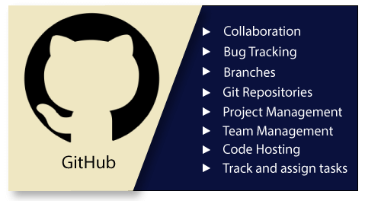
What is GitHub?
GitHub is a Git repository hosting service. GitHub also facilitates with many of its features, such as access control and collaboration. It provides a Web-based graphical interface.
GitHub is an American company. It hosts source code of your project in the form of different programming languages and keeps track of the various changes made by programmers.
It offers both distributed version control and source code management (SCM) functionality of Git. It also facilitates with some collaboration features such as bug tracking, feature requests, task management for every project.

Slide 3
Features of GitHub
GitHub is a place where programmers and designers work together. They collaborate, contribute, and fix bugs together. It hosts plenty of open source projects and codes of various programming languages.
Some of its significant features are as follows.
Collaboration
Integrated issue and bug tracking
Graphical representation of branches
Git repositories hosting
Project management
Team management
Code hosting
Track and assign tasks
Conversations
Wikisc

Slide 4
Version Control System
Version Control System (VCS) is a software that helps software developers to work together and maintain a complete history of their work.
Listed below are the functions of a VCS −
Allows developers to work simultaneously.
Does not allow overwriting each other’s changes.
Maintains a history of every version.
Following are the types of VCS −
Centralized version control system (CVCS).
Distributed/Decentralized version control system (DVCS).
In this chapter, we will concentrate only on distributed version control system and especially on Git. Git falls under distributed version control system.

Slide 5
Distributed Version Control System
Centralized version control system (CVCS) uses a central server to store all files and enables team collaboration. But the major drawback of CVCS is its single point of failure, i.e., failure of the central server. Unfortunately, if the central server goes down for an hour, then during that hour, no one can collaborate at all. And even in a worst case, if the disk of the central server gets corrupted and proper backup has not been taken, then you will lose the entire history of the project. Here, distributed version control system (DVCS) comes into picture.
DVCS clients not only check out the latest snapshot of the directory but they also fully mirror the repository. If the server goes down, then the repository from any client can be copied back to the server to restore it. Every checkout is a full backup of the repository. Git does not rely on the central server and that is why you can perform many operations when you are offline. You can commit changes, create branches, view logs, and perform other operations when you are offline. You require network connection only to publish your changes and take the latest changes.

Slide 6
DVCS Terminologies
Local Repository
Every VCS tool provides a private workplace as a working copy. Developers make changes in their private workplace and after commit, these changes become a part of the repository. Git takes it one step further by providing them a private copy of the whole repository. Users can perform many operations with this repository such as add file, remove file, rename file, move file, commit changes, and many more.
Working Directory and Staging Area or Index
The working directory is the place where files are checked out. In other CVCS, developers generally make modifications and commit their changes directly to the repository. But Git uses a different strategy. Git doesn’t track each and every modified file. Whenever you do commit an operation, Git looks for the files present in the staging area. Only those files present in the staging area are considered for commit and not all the modified files.
Let us see the basic workflow of Git.
Step 1 − You modify a file from the working directory.
Step 2 − You add these files to the staging area.
Step 3 − You perform commit operation that moves the files from the staging area. After push operation, it stores the changes permanently to the Git repository.

Slide 7
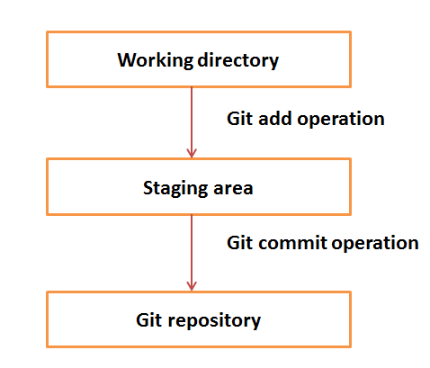
Suppose you modified two files, namely “sort.c” and “search.c” and you want two different commits for each operation. You can add one file in the staging area and do commit. After the first commit, repeat the same procedure for another file.

Slide 8
# First commit
[bash]$ git add sort.c
# adds file to the staging area
[bash]$ git commit –m “Added sort operation”
# Second commit
[bash]$ git add search.c
# adds file to the staging area
[bash]$ git commit –m “Added search operation”
Commits
Commit holds the current state of the repository. A commit is also named by SHA1 hash. You can consider a commit object as a node of the linked list. Every commit object has a pointer to the parent commit object. From a given commit, you can traverse back by looking at the parent pointer to view the history of the commit. If a commit has multiple parent commits, then that particular commit has been created by merging two branches.

Slide 9
Branches
Branches are used to create another line of development. By default, Git has a master branch, which is same as trunk in Subversion. Usually, a branch is created to work on a new feature. Once the feature is completed, it is merged back with the master branch and we delete the branch. Every branch is referenced by HEAD, which points to the latest commit in the branch. Whenever you make a commit, HEAD is updated with the latest commit.
Clone
Clone operation creates the instance of the repository. Clone operation not only checks out the working copy, but it also mirrors the complete repository. Users can perform many operations with this local repository. The only time networking gets involved is when the repository instances are being synchronized.
Pull
Pull operation copies the changes from a remote repository instance to a local one. The pull operation is used for synchronization between two repository instances. This is same as the update operation in Subversion.
Push
Push operation copies changes from a local repository instance to a remote one. This is used to store the changes permanently into the Git repository. This is same as the commit operation in Subversion.

Slide 10
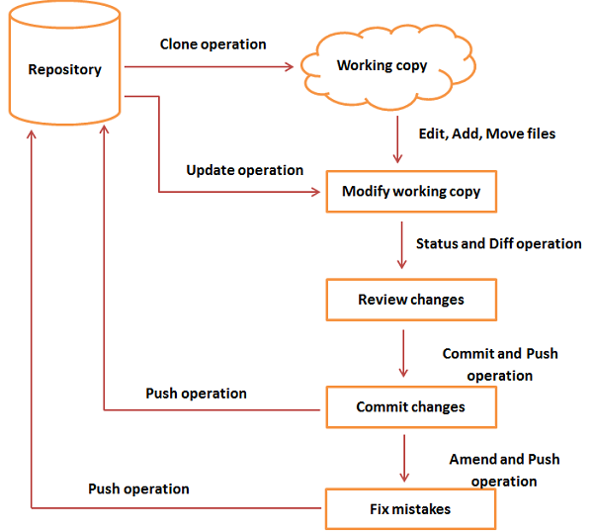
General workflow is as follows −
You clone the Git repository as a working copy.
You modify the working copy by adding/editing files.
If necessary, you also update the working copy by taking other developer's changes.
You review the changes before commit.
You commit changes. If everything is fine, then you push the changes to the repository.
After committing, if you realize something is wrong, then you correct the last commit and push the changes to the repository.

Slide 11
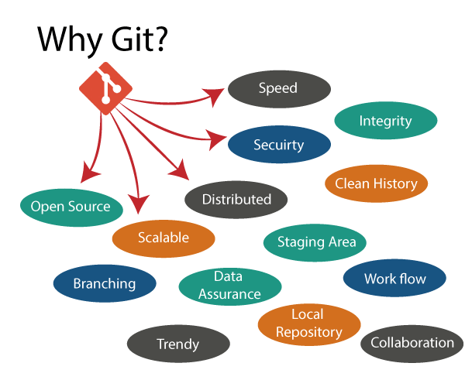
Why Git?
We have discussed many features and benefits of Git that demonstrate the undoubtedly Git as the leading version control system. Now, we will discuss some other points about why should we choose Git.

Slide 12
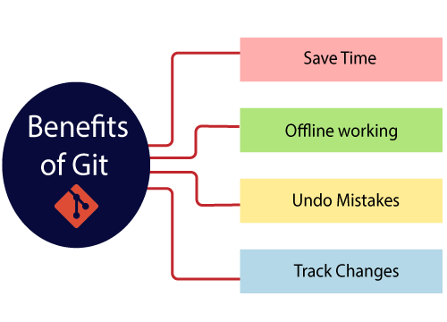
Benefits of Git
A version control application allows us to keep track of all the changes that we make in the files of our project. Every time we make changes in files of an existing project, we can push those changes to a repository. Other developers are allowed to pull your changes from the repository and continue to work with the updates that you added to the project files.

