Slide 1
Jenkins

Slide 2
Jenkins
Jenkins Tutorial is designed for both beginners and professionals. Our Tutorial provides all the basic and advanced concepts of Jenkins, such as Jenkins installation, Jenkins Configuration, Jenkins Pipeline, etc.
Jenkins is an open source automation tool written in Java programming language that allows continuous integration.
Jenkins builds and tests our software projects, which continuously making it easier for developers to integrate changes to the project, and making it easier for users to obtain a fresh build.

Slide 3
What is Jenkins?
Jenkins is an open source automation tool written in Java programming language that allows continuous integration.
Jenkins builds and tests our software projects which continuously making it easier for developers to integrate changes to the project, and making it easier for users to obtain a fresh build.
It also allows us to continuously deliver our software by integrating with a large number of testing and deployment technologies.
Jenkins offers a straightforward way to set up a continuous integration or continuous delivery environment for almost any combination of languages and source code repositories using pipelines, as well as automating other routine development tasks.
With the help of Jenkins, organizations can speed up the software development process through automation. Jenkins adds development life-cycle processes of all kinds, including build, document, test, package, stage, deploy static analysis and much more.
Jenkins achieves CI (Continuous Integration) with the help of plugins. Plugins is used to allow the integration of various DevOps stages. If you want to integrate a particular tool, you have to install the plugins for that tool. For example: Maven 2 Project, Git, HTML Publisher, Amazon EC2, etc.
For example: If any organization is developing a project, then Jenkins will continuously test your project builds and show you the errors in early stages of your development.
Possible steps executed by Jenkins are for example:
Perform a software build using a build system like Gradle or Maven Apache
Execute a shell script
Archive a build result
Running software tests

Slide 4
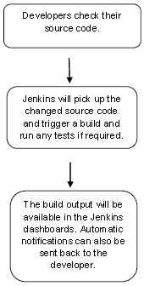
Work Flow:
History of Jenkins
Kohsuke Kawaguchi, who is a Java developer, working at SUN Microsystems, was tired of building the code and fixing errors repetitively. In 2004, he created an automation server called Hudson that automates build and test task.
In 2011, Oracle who owned Sun Microsystems had a dispute with Hudson open source community, so they forked Hudson and renamed it as Jenkins.
Both Hudson and Jenkins continued to operate independently. But in short span of time, Jenkins acquired a lot of contributors and projects while Hudson remained with only 32 projects. Then with time, Jenkins became more popular, and Hudson is not maintained anymore.

Slide 5
What is Continuous Integration?
Continuous Integration (CI) is a development practice in which the developers are needs to commit changes to the source code in a shared repository at regular intervals. Every commit made in the repository is then built. This allows the development teams to detect the problems early.
Continuous integration requires the developers to have regular builds. The general practice is that whenever a code commit occurs, a build should be triggered.
System Requirements
JDK | JDK 1.5 or above
Memory | 2 GB RAM (recommended)
Disk Space | No minimum requirement. Note that since all builds will be stored on the Jenkins machines, it has to be ensured that sufficient disk space is available for build storage.
Operating System Version | Jenkins can be installed on Windows, Ubuntu/Debian, Red Hat/Fedora/CentOS, Mac OS X, openSUSE, FReeBSD, OpenBSD, Gentoo.
Java Container | The WAR file can be run in any container that supports Servlet 2.4/JSP 2.0 or later.(An example is Tomcat 5).

Slide 6
Continuous Integration with Jenkins
Let's consider a scenario where the complete source code of the application was built and then deployed on test server for testing. It sounds like a perfect way to develop software, but this process has many problems.
Developer teams have to wait till the complete software is developed for the test results.
There is a high prospect that the test results might show multiple bugs. It was tough for developers to locate those bugs because they have to check the entire source code of the application.
It slows the software delivery process.
Continuous feedback pertaining to things like architectural or coding issues, build failures, test status and file release uploads was missing due to which the quality of software can go down.
The whole process was manual which increases the threat of frequent failure.
It is obvious from the above stated problems that not only the software delivery process became slow but the quality of software also went down. This leads to customer dissatisfaction.
So to overcome such problem there was a need for a system to exist where developers can continuously trigger a build and test for every change made in the source code.
This is what Continuous Integration (CI) is all about. Jenkins is the most mature Continuous Integration tool available so let us see how Continuous Integration with Jenkins overcame the above shortcomings.

Slide 7
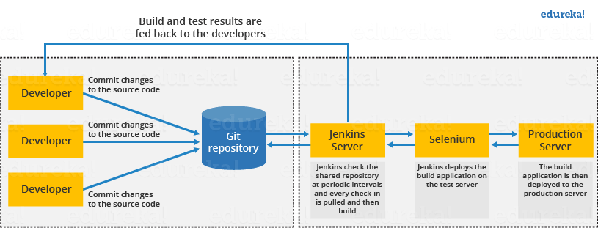
Let's see a generic flow diagram of Continuous Integration with Jenkins:

Slide 8
Let's see how Jenkins works.
First of all, a developer commits the code to the source code repository. Meanwhile, the Jenkins checks the repository at regular intervals for changes.
Soon after a commit occurs, the Jenkins server finds the changes that have occurred in the source code repository. Jenkins will draw those changes and will start preparing a new build.
If the build fails, then the concerned team will be notified.
If built is successful, then Jenkins server deploys the built in the test server.
After testing, Jenkins server generates a feedback and then notifies the developers about the build and test results.
It will continue to verify the source code repository for changes made in the source code and the whole process keeps on repeating.

Slide 9
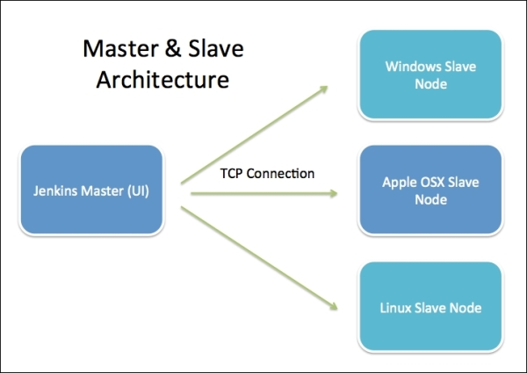
Jenkins Architecture
Jenkins follows Master-Slave architecture to manage distributed builds. In this architecture, slave and master communicate through TCP/IP protocol.
Jenkins architecture has two components:
Jenkins Master/Server
Jenkins Slave/Node/Build Server

Slide 10
Jenkins Master
default it runs on 8080 port. With the help of Dashboard, we can configure the jobs/projects but the build takes place in Nodes/Slave. By default one node (slave) is configured and running in Jenkins server. We can add more nodes using IP address, user name and password using the ssh, jnlp or webstart methods.
The server's job or master's job is to handle:
Scheduling build jobs.
Dispatching builds to the nodes/slaves for the actual execution.
Monitor the nodes/slaves (possibly taking them online and offline as required).
Recording and presenting the build results.
A Master/Server instance of Jenkins can also execute build jobs directly.

Slide 11
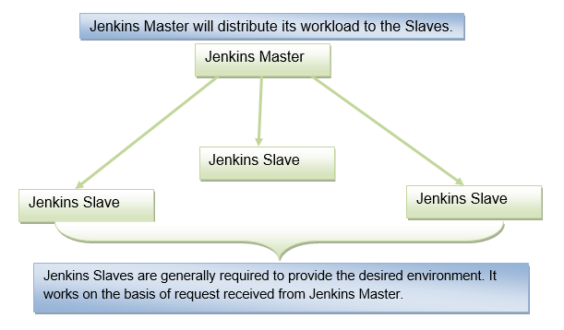
Jenkins Slave
Jenkins slave is used to execute the build jobs dispatched by the master. We can configure a project to always run on a particular slave machine, or particular type of slave machine, or simple let the Jenkins to pick the next available slave/node.
As we know Jenkins is developed using Java is platform independent thus Jenkins Master/Servers and Slave/nodes can be configured in any servers including Linux, Windows, and Mac.

Slide 12
Advantages of Using Jenkins
Jenkins is a powerful tool truly built and friendly for developers. Here are some of the most significant advantages of using Jenkins:
1. Free to Use
Jenkins is fully open-source and free to use. Since its development in 2011, it is the most preferred CI/CD tool used by developers in both early-stage startups and big organizations.
2. Rich Plugin Ecosystem
There are over a thousand different plugins that can be used to enhance the functionality of a Jenkins environment and suit the specific needs of an organization.
3. Easy Integration
Jenkins can be easily integrated with a number of popular cloud platforms such as Google Cloud, Digital Ocean, Amazon EC2 and more.
Disadvantages of Using Jenkins
Jenkins also has its own share of disadvantages. Here are some of the most common ones:
1. Developer Centric
Jenkins is more developer-centric and feature-driven. A person may need to have some sort of developer experience to use Jenkins.
2. Setting Change Issues
There are some issues (such as Jenkins not starting up) that you may face when you change the settings in Jenkins. These issues can come up when you install some plugins as well. Fortunately, Jenkins has a large user base so you can search online for a solution whenever you are faced with these issues.

