Slide 1
What is Maven?
Maven is a project management and comprehension tool that provides developers a complete build lifecycle framework. Development team can automate the project's build infrastructure in almost no time as Maven uses a standard directory layout and a default build lifecycle.
In case of multiple development teams environment, Maven can set-up the way to work as per standards in a very short time. As most of the project setups are simple and reusable, Maven makes life of developer easy while creating reports, checks, build and testing automation setups.
Maven provides developers ways to manage the following −
Builds
Documentation
Reporting
Dependencies
SCMs
Releases
Distribution
Mailing list
To summarize, Maven simplifies and standardizes the project build process. It handles compilation, distribution, documentation, team collaboration and other tasks seamlessly. Maven increases reusability and takes care of most of the build related tasks.

Slide 2
Features of Maven
Simple project setup that follows best practices.
Consistent usage across all projects.
Dependency management including automatic updating.
A large and growing repository of libraries.
Extensible, with the ability to easily write plugins in Java or scripting languages.
Instant access to new features with little or no extra configuration.
Model-based builds − Maven is able to build any number of projects into predefined output types such as jar, war, metadata.
Coherent site of project information − Using the same metadata as per the build process, maven is able to generate a website and a PDF including complete documentation.
Release management and distribution publication − Without additional configuration, maven will integrate with your source control system such as CVS and manages the release of a project.
Backward Compatibility − You can easily port the multiple modules of a project into Maven 3 from older versions of Maven. It can support the older versions also.
Automatic parent versioning − No need to specify the parent in the sub module for maintenance.
Parallel builds − It analyzes the project dependency graph and enables you to build schedule modules in parallel. Using this, you can achieve the performance improvements of 20-50%.
Better Error and Integrity Reporting − Maven improved error reporting, and it provides you with a link to the Maven wiki page where you will get full description of the error.

Slide 3
Maven pom.xml file
POM is an acronym for Project Object Model. The pom.xml file contains information of project and configuration information for the maven to build the project such as dependencies, build directory, source directory, test source directory, plugin, goals etc.
Maven reads the pom.xml file, then executes the goal.
Before maven 2, it was named as project.xml file. But, since maven 2 (also in maven 3), it is renamed as pom.xml.
Element | Description
project | It is the root element of pom.xml file.
modelVersion | It is the sub element of project. It specifies the modelVersion. It should be set to 4.0.0.
groupId | It is the sub element of project. It specifies the id for the project group.
artifactId | It is the sub element of project. It specifies the id for the artifact (project). An artifact is something that is either produced or used by a project. Examples of artifacts produced by Maven for a project include: JARs, source and binary distributions, and WARs.
version | It is the sub element of project. It specifies the version of the artifact under given group.

Slide 4
All POM files require the project element and three mandatory fields: groupId,artifactId, version.
Projects notation in repository is groupId:artifactId:version.
Minimal requirements for a POM −
Sr.No. | Node & Description
1 | Project root This is project root tag. You need to specify the basic schema settings such as apache schema and w3.org specification.
2 | Model version Model version should be 4.0.0.
3 | groupId This is an Id of project's group. This is generally unique amongst an organization or a project. For example, a banking group com.company.bank has all bank related projects.
4 | artifactId This is an Id of the project. This is generally name of the project. For example, consumer-banking. Along with the groupId, the artifactId defines the artifact's location within the repository.
5 | version This is the version of the project. Along with the groupId, It is used within an artifact's repository to separate versions from each other. For example − com.company.bank:consumer-banking:1.0 com.company.bank:consumer-banking:1.1.

Slide 5
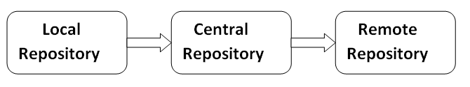
Maven Repository
A maven repository is a directory of packaged JAR file with pom.xml file. Maven searches for dependencies in the repositories. There are 3 types of maven repository:
Local Repository
Central Repository
Remote Repository
Maven searches for the dependencies in the following order:
Local repository then Central repository then Remote repository.

Slide 6
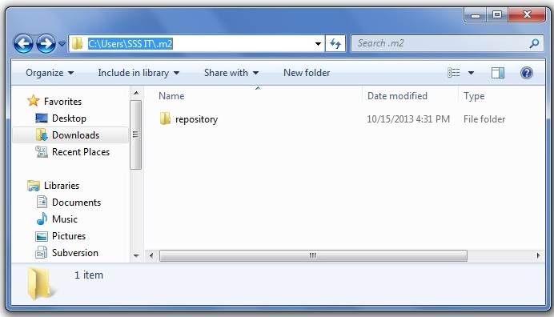
Maven Local Repository
Maven local repository is located in your local system. It is created by the maven when you run any maven command.
By default, maven local repository is %USER_HOME%/.m2 directory. For example: C:\Users\SSS IT\.m2.
We can change the location of maven local repository by changing the settings.xml file. It is located in MAVEN_HOME/conf/settings.xml, for example: E:\apache-maven-3.1.1\conf\settings.xml.

Slide 7
Maven Central Repository
Maven central repository is located on the web. It has been created by the apache maven community itself.
The path of central repository is: http://repo1.maven.org/maven2/
Maven Remote Repository
Maven remote repository is located on the web. Most of libraries can be missing from the central repository such as JBoss library etc, so we need to define remote repository in pom.xml file.
.

Slide 8
Maven Example
We can create a simple maven example by executing the archetype:generate command of mvn tool.
To create a simple java project using maven, you need to open command prompt and run the archetype:generate command of mvn tool.
Syntax
The syntax to generate the project architecture is given below:
mvn archetype:generate -DgroupId=groupid -DartifactId=artifactid
-DarchetypeArtifactId=maven-archetype-quickstart - DinteractiveMode=booleanValue
Example:
mvn archetype:generate -DgroupId=com.javatpoint -DartifactId=CubeGenerator -DarchetypeArtifactId=maven-archetype-quickstart -DinteractiveMode=false

Slide 9
What is Build Lifecycle?
A Build Lifecycle is a well-defined sequence of phases, which define the order in which the goals are to be executed. Here phase represents a stage in life cycle. As an example, a typical Maven Build Lifecycle consists of the following sequence of phases.
Phase | Handles | Description
prepare-resources | resource copying | Resource copying can be customized in this phase.
validate | Validating the information | Validates if the project is correct and if all necessary information is available.
compile | compilation | Source code compilation is done in this phase.
Test | Testing | Tests the compiled source code suitable for testing framework.
package | packaging | This phase creates the JAR/WAR package as mentioned in the packaging in POM.xml.
install | installation | This phase installs the package in local/remote maven repository.
Deploy | Deploying | Copies the final package to the remote repository.
There are always pre and post phases to register goals, which must run prior to, or after a particular phase.

Slide 10
When Maven starts building a project, it steps through a defined sequence of phases and executes goals, which are registered with each phase.
Maven has the following three standard lifecycles −
clean
default(or build)
site
A goal represents a specific task which contributes to the building and managing of a project. It may be bound to zero or more build phases. A goal not bound to any build phase could be executed outside of the build lifecycle by direct invocation.
The order of execution depends on the order in which the goal(s) and the build phase(s) are invoked. For example, consider the command below. The clean and package arguments are build phases while the dependency:copy-dependencies is a goal.
mvn clean dependency:copy-dependencies package
Here the clean phase will be executed first, followed by the dependency:copy-dependencies goal, and finally package phase will be executed.

