Slide 1
Linux
Linux is an open-source operating system like other operating systems such as Microsoft Windows, Apple Mac OS, iOS, Google android, etc. An operating system is a software that enables the communication between computer hardware and software. It conveys input to get processed by the processor and brings output to the hardware to display it. This is the basic function of an operating system. Although it performs many other important tasks, let's not talk about that.
Linux is around us since the mid-90s. It can be used from wristwatches to supercomputers. It is everywhere in our phones, laptops, PCs, cars and even in refrigerators. It is very much famous among developers and normal computer users.

Slide 2
Evolution of Linux OS
The Linux OS
was developed by Linus Torvalds in 1991, which sprouted as an idea to improve the UNIX OS. He suggested improvements but was rejected by UNIX designers. Therefore, he thought of launching an OS, designed in a way that could be modified by its users.
Nowadays, Linux is the fastest-growing OS. It is used from phones to supercomputers by almost all major hardware devices.

Slide 3
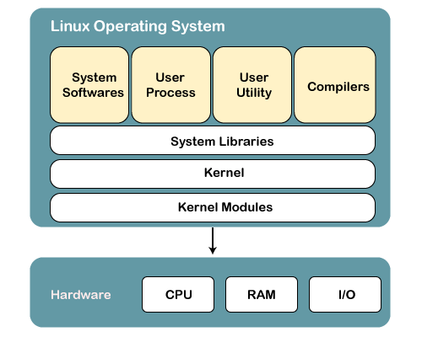
Structure Of Linux Operating System
Linux OS has following components:

Slide 4
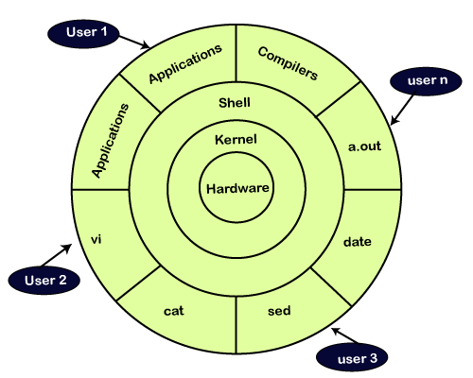
Kernel
Linux kernel is the core part of the operating system. It establishes communication between devices and software. Moreover, it manages system resources. It has four responsibilities:

Slide 5
device management: A system has many devices connected to it like CPU, a memory device, sound cards, graphic cards, etc. A kernel stores all the data related to all the devices in the device driver (without this kernel won't be able to control the devices). Thus kernel knows what a device can do and how to manipulate it to bring out the best performance. It also manages communication between all the devices. The kernel has certain rules that have to be followed by all the devices.
Memory management: Another function that kernel has to manage is the memory management. The kernel keeps track of used and unused memory and makes sure that processes shouldn't manipulate data of each other using virtual memory addresses.
Process management: In the process, management kernel assigns enough time and gives priorities to processes before handling CPU to other processes. It also deals with security and ownership information.
Handling system calls: Handling system calls means a programmer can write a query or ask the kernel to perform a task.

Slide 6
2) System Libraries
System libraries are special programs that help in accessing the kernel's features. A kernel has to be triggered to perform a task, and this triggering is done by the applications. But applications must know how to place a system call because each kernel has a different set of system calls. Programmers have developed a standard library of procedures to communicate with the kernel. Each operating system supports these standards, and then these are transferred to system calls for that operating system.
The most well-known system library for Linux is Glibc (GNU C library).
3) System Tools
Linux OS has a set of utility tools, which are usually simple commands. It is a software which GNU project has written and publish under their open source license so that software is freely available to everyone.
With the help of commands, you can access your files, edit and manipulate data in your directories or files, change the location of files, or anything.
4) Development Tools
With the above three components, your OS is running and working. But to update your system, you have additional tools and libraries. These additional tools and libraries are written by the programmers and are called toolchain. A toolchain is a vital development tool used by the developers to produce a working application.
5) End User Tools
These end tools make a system unique for a user. End tools are not required for the operating system but are necessary for a user.
Some examples of end tools are graphic design tools, office suites, browsers, multimedia players, etc.

Slide 7
The main concept that unites all the versions of Unix is the following four basics −
Kernel − The kernel is the heart of the operating system. It interacts with the hardware and most of the tasks like memory management, task scheduling and file management.
Shell − The shell is the utility that processes your requests. When you type in a command at your terminal, the shell interprets the command and calls the program that you want. The shell uses standard syntax for all commands. C Shell, Bourne Shell and Korn Shell are the most famous shells which are available with most of the Unix variants.
Commands and Utilities − There are various commands and utilities which you can make use of in your day to day activities. cp, mv, cat and grep, etc. are few examples of commands and utilities. There are over 250 standard commands plus numerous others provided through 3rd party software. All the commands come along with various options.
Files and Directories − All the data of Unix is organized into files. All files are then organized into directories. These directories are further organized into a tree-like structure called the filesystem.

Slide 8
Linux Bash
The Linux Bash is also known as 'Bourne-again Shell.' It is a command language interpreter for the Linux based system. It is a replacement of Bourne shell (sh). It was developed under the GNU Project and written by Brian Fox. Nowadays, Bash is the default user shell of most of the Linux distributions.
The Linux/Unix shell allows us to interact with the Linux system through the commands. It let us invoke an executable file to create a running process. Moreover, it also allows us to interact with the Linux file system. It is designed in such a way that we can perform all the Linux operations through Bash.
The Bash is a command language interpreter as well as a programming language. It supports variables, functions, and flow control, like other programming languages. It can also read and execute the commands from a file, which is called a shell script.
It offers various functional improvements over Bourne Shell (sh) for both interactive and programming use. Although many sh scripts can be run by Bash without any change. The Bash contains the following improvements over sh:
It provides command-line editing
It contains unlimited size command history
It provides Job Control
It facilitates with Shell Functions and Aliases
It provides the indexed arrays of unlimited size
It contains integer arithmetic in any base from 2 to 64.

Slide 9
What is Shell
If we are a new Linux user, and we open the terminal, it is assumed that we are well confused as to what to do with it. Here the Shell comes in the role.
The terminal contains the shell; it allows us to execute the commands to interact with the system. We can perform various operations such as store and retrieve data, process information, and various other simple as well as complex tasks.
To open the terminal, press CTRL+ALT+T keys. Perform some basic operations such as date, cal, ls, and pwd to take a tour with it.
What is Scripting
Suppose we are required to execute some basic commands every day, for example above four commands. Linux supports a feature called scripting that allows us to execute more than one task at once. So, it is good to define a script rather than performing repetitive tasks.
To understand how to use Linux script, let's define a script in a combination of some tasks. To define a script, create a file with a .sh extension. We are using the VI text editor. However, any text editor can be used to define a script. Consider below command:
vi tasks.sh

Slide 10
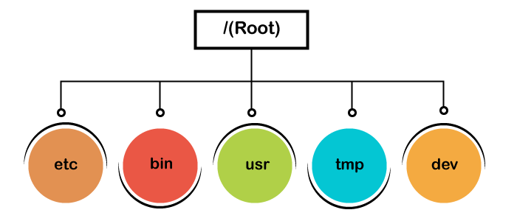
The general file system of Unix is as follows:
General files: General files or ordinary files are files that contain images, text, or a program. These files are in ASCII text or Binary format. The General files are the most common in any Linux system.
Directory files: Directory files are the depository for other files. A directory can have a subdirectory file within it. For Windows, we can understand them as folders.
Device files: Windows represents the external devices (Pendrives, hard drives, and CD-ROM) as letters such as E: F: But, Linux represents devices as files, such as the hard drive's partitions are represented as dev/sda1, dev/sda2, and more (depends upon the number of partitions). All the device files take place within the directory /dev.

Slide 11
Regular User
In Linux, when we install ubuntu on our system, a regular account user is created. By default, all our files are saved in the home directory (/home/). A regular user cannot access the other user's directories.
Root User
Apart from the regular user account, a root user account is also created during installation. The root account is also called as superuser as it can access the restricted files, install the software and other utility, and has administrative rights. For installing the software or editing the system files or any other administrative task, we need the root access. For general tasks such as creating files, playing games, browsing the internet, we don't need the root access.
Service user
The Linux system is widely used as the server operating system. The leading service providers such as Apache, Squid, email, and more have their service accounts to increase security. Linux service user can allow or deny access to various resources depending on the service type.

Slide 12
Home Directory
Linux OS has a separate home directory for a user. The files and directories created by a user are stored under a particular home directory. A user cannot store the files under any other user's directory, as it is not allowed to access the other user's directory. For example, the home directory of a user 'Alex' is automatically created as "/home/alex/" at the time of installation.
The Windows OS also has different home directories for different users. It is as "C:\ documents or \settings."
Other Directories
Linux systems have a tree structure to save the directories; comparatively, Windows uses different drives to save the directories. In Windows, system and program files usually take place in C drive. But in Linux, the system and program files take place in their specific directory such as software files are stored in /bin, programs and device files are in /dev, and boot files are stored in /boot directory.

Slide 13
Linux Set Environment Variable
The environment variables are dynamic values that are stored within a system and used by applications launched in shells or sub-shells. These variables have a name and their respected value. The environment variable customizes the system performance and the behavior of an application.
The environment is the track for a computer application to interact with the system. The environment variable can have information about the default applications of the system, the system locale, the path of the executable file and the keyboard layout setting, and more. The environment variable makes an app available as per the system.
Common Environment Variables
Some standard environment variables are as follows:
PATH
This variable contains a list of directories in which our system looks for files. It separates directories by a (:) colon.
USER
This variable holds the username.
HOME
This variable holds the default path to the user's home directory.
EDITOR
This variable contains the path to the specified editor.

Slide 14
UID
This variable contains the path to the user's unique id.
TERM
This variable contains the path to the default terminal emulator.
SHELL
This variable contains the path to the default shell that is being used by the user.
ENV
This variable displays all the environment variable.

Slide 15
What are Commands
A command is an instruction given to our computer by us to do whatever we want. In Mac OS, and Linux it is called terminal, whereas, in windows it is called command prompt. Commands are always case sensitive.
Commands are executed by typing in at the command line followed by pressing enter key.
This command further passes to the shell which reads the command and execute it. Shell is a method for the user to interact with the system. Default shell in Linux is called bash (Bourne-Again Shell).
There are two types of shell commands:
Built-in shell commands: They are part of a shell. Each shell has some built in commands.
External/Linux commands: Each external command is a separate executable program written in C or other programming languages.

Slide 16
Linux Directory Commands
Directory Command | Description
pwd | The pwd command stands for (print working directory). It displays the current working location or directory of the user. It displays the whole working path starting with /. It is a built-in command.
ls | The ls command is used to show the list of a folder. It will list out all the files in the directed folder.
cd | The cd command stands for (change directory). It is used to change to the directory you want to work from the present directory.
mkdir | With mkdir command you can create your own directory.
rmdir | The rmdir command is used to remove a directory from your system.

Slide 17
Difference between Root and Home Directory
Root Directory | Home Directory
The root directory is the topmost level of the system drive. | The home directory is a subdirectory of the root directory.
It is denoted by a slash '/'. | It is denoted by '~' and has path "/users/username".
The admin has access to make any changes in the files and settings. | No user other than the root user can change the settings of the entire system.
The admin can create a user. | Any user having a home directory cannot create a user.
In the Linux file system, everything comes under the root directory. | The home directory contains a particular user's data.

Slide 18
Linux mkdir | Linux Create Directory
Now let's learn how to create your own directory with the help of command prompt.
The mkdir stands for 'make directory'. With the help of mkdir command, you can create a new directory wherever you want in your system. Just type "mkdir <dir name> , in place of <dir name> type the name of new directory, you want to create and then press enter.
Syntax:
mkdir <dirname>
Mkdir Options
Options | Description
mkdir -p, -parents | Add directory including its sub directory.
mkdir -v, -verbose | Print a message for each created directory.
mkdir -m -mode=MODE | Set access privilege.

Slide 19
Linux command List
Commands | Description
alias | Converts complex commands into simpler ones.
bzip2 / bunzip2 | Compresses a file / Decompress a bzip2 file.
bzcat / bzmore | Displays files compressed with bzip2.
cal | Displays calendar.
cat | It is a multi-function command.
cd | Changes the current working directory.
chage | Sets an expiration date for a user account.
chgrp | Changes group.
chmod | Changes permission for a file or directory.
chown | Changes the owner of a file or directory.
chsh | Changes the shell.

Slide 20
clear | Clears the terminal.
comm | Compares two streams or files.
cp | Copies file content from one file to another file.
cut | Used to display the desired column from a file.
date | Displays the current date.
df | Checks the disk space in the system.
echo | Prints the typed word on the terminal.
exit | Exits from the current user group to the last group.
export | Exports shell variables to other shells.
file | Displays the type of file.
find | Finds files for a particular search.
gpasswd | Transfers group membership to another user.
grep | Filters lines of text containing a certain string.
groupadd | Creates a group.

Slide 21
groupdel | Permanently removes a group.
groupmod | Changes group name.
groups | Displays the group name to which the current user belongs to.
gzip / gunzip | Compresses a file / Decompress a gzip file.
head | Displays the first ten lines of a file.
history | Displays older commands from the shell command history.
HISTSIZE | Determines the number of commands to be stored in the current environment.
HISTFILE | Displays the file that contains the history.
HISTFILESIZE | Sets the number of commands kept in the history file.
id | Tells about the user's id in the system.
less | Displays file content according to the width of the terminal.
locate | Searches a file in the database.
ls | Lists all the files of a directory.
man | Displays the manual page for the specified command.
mkdir | Creates directory.

Slide 22
more | Displays one output screen at a time.
mv | Renames directories or files.
od | Displays a file content in octal format.
passwd | Set a password for a user group.
pwd | Display the current working directory location.
PS1 | Change the prompt name in the terminal.
rename | Renames more than one file at once.
rm | Removes a file.
rmdir | Removes a directory.
set -o noclobber | Prevents file from getting overwritten.
set +o noclobber | Allows overwriting in the existing file.
set -u | Displays undefined variables as an error.
set +u | Displays nothing for an undefined variable.
set -x | Displays shell expansion.
set +x | Disables shell expansion.
sed | Performs editing in streams.

Slide 23
sleep | Waits for the specified number of seconds.
sort | sorts the content in alphabetical order.
su | It allows a user to run a shell as another user.
sudo | It allows a user to start a program with the credentials of another user.
tac | Displays file content in the opposite order.
tail | Displays the last ten lines of a file.
tar | Compresses a directory.
tee | Puts stdin on stdout and then into a file.
time | Displays time taken to execute a command.
touch | It creates an empty file.
tr | Translates characters.
type | Displays information about command type.
uniq | Sorts and display multi times repeating lines only once.
unset | Removes a variable from a shell.
useradd | Adds users.
userdel | Deletes users.
usermod | Modifies the properties of a user.
vi | Opens vi editor to write a program.
w | Displays who is logged on and what are they doing.
wc | Counts words, lines, and characters.
who | Tells who is logged on the system.
whoami | Tells the name of the user.
who am i | Displays the line pointing to your current session.
zcat / zmore | Views the files compressed with gzip.

Slide 24
What is vi
The vi editor is elaborated as visual editor. It is installed in every Unix system. In other words, it is available in all Linux distros. It is user-friendly and works same on different distros and platforms. It is a very powerful application. An improved version of vi editor is vim.
The vi editor has two modes:
Command Mode: In command mode, actions are taken on the file. The vi editor starts in command mode. Here, the typed words will act as commands in vi editor. To pass a command, you need to be in command mode.
Insert Mode: In insert mode, entered text will be inserted into the file. The Esc key will take you to the command mode from insert mode.
By default, the vi editor starts in command mode. To enter text, you have to be in insert mode, just type 'i' and you'll be in insert mode. Although, after typing i nothing will appear on the screen but you'll be in insert mode. Now you can type anything.
To exit from insert mode press Esc key, you'll be directed to command mode.
If you are not sure which mode you are in, press Esc key twice and you'll be in command mode.

