Slide 1
DevOps
SUSHMA M U

Slide 2
HISTORY OF DEVOPS:
The evolution of the Software Development Life Cycle (SDLC) rapidly changes the landscape on how the organization release/produce theirs to the Production environment. The traditional SDLC is commonly tied to the Waterfall approach when coming to how the organization managed its product delivery. This Waterfall is not aligned with the organization’s business goals, which they want more speed and features/products for their customer. With this mindset, they need a new approach to speed up the product delivery but at the same time, improve the Developer and IT Operation team. Therefore, DevOps comes into the picture, the "DevOps" introduced by Petrick Debois at Agile Conference, Toronto in 2008.

Slide 3
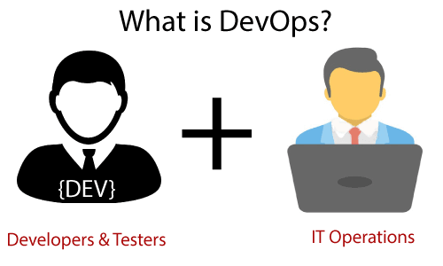
DevOps:
DevOps is a combination of two words, one is software Development, and the second is Operations. This allows a single team to handle the entire application lifecycle, from development to testing, deployment, and operations. DevOps helps you to reduce the disconnection between software developers, quality assurance (QA) engineers, and system administrators.

Slide 4
DevOps promotes collaboration between Development and Operations teams to deploy code to production faster in an automated & repeatable way.
DevOps helps to increase an organization’s speed to deliver applications and services. It also allows organizations to serve their customers better and compete more strongly in the market.
DevOps has become one of the most valuable business disciplines for enterprises or organizations. With the help of DevOps, the quality, and speed of the application delivery have improved to a great extent.
Why DevOps?
The operation and development team worked in complete isolation.
After the design-build, the testing and deployment are performed respectively. That's why they consumed more time than actual build cycles.

Slide 5
Without the use of DevOps, the team members are spending a large amount of time on designing, testing, and deploying instead of building the project.
Manual code deployment leads to human errors in production.
Coding and operation teams have their separate timelines and are not in synch, causing further delays.
DevOps Advantages:
DevOps is an excellent approach for quick development and deployment of applications.
It responds faster to market changes to improve business growth.
DevOps escalate business profit by decreasing software delivery time and transportation costs.

Slide 6
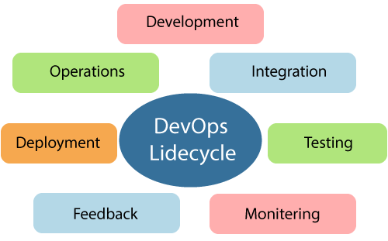
DevOps Disadvantages:
DevOps professional or expert developers are less available.
Developing with DevOps is so expensive.
Adopting new DevOps technology into the industries is hard to manage in short time.
DevOps Lifecycle:

Slide 7
The DevOps lifecycle includes seven phases as given below:
1) Continuous Development:
This phase involves the planning and coding of the software. The vision of the project is decided during the planning phase. And the developers begin developing the code for the application. There are no DevOps tools that are required for planning, but there are several tools for maintaining the code.
2) Continuous Integration:
This stage is the heart of the entire DevOps lifecycle. It is a software development practice in which the developers require to commit changes to the source code more frequently. This may be on a daily or weekly basis. Then every commit is built, and this allows early detection of problems if they are present.

Slide 8
3) Continuous Testing:
This phase is where the developed software is continuously tested for bugs.
4) Continuous Monitoring:
Monitoring is a phase that involves all the operational factors of the entire DevOps process, where important information about the use of the software is recorded and carefully processed to find out trends and identify problem areas.
5) Continuous Feedback:
The application development is consistently improved by analyzing the results from the operations of the software. This is carried out by placing the critical phase of constant feedback between the operations and the development of the next version of the current software application.

Slide 9
6) Continuous Deployment:
In this phase, the code is deployed to the production servers. Also, it is essential to ensure that the code is correctly used on all the servers.
7) Continuous Operation:
All DevOps operations are based on continuity with complete automation of the release process and allow the organization to accelerate the overall time to market continuingly.

Slide 10
DevOps Principles:
End to End Responsibility: DevOps team needs to provide performance support until they become the end of life. It enhances the responsibility and the quality of the products engineered.
Continuous Improvement: DevOps culture focuses on continuous improvement to minimize waste. It continuously speeds up the growth of products or services offered.
Automate Everything: Automation is an essential principle of the DevOps process. This is for software development and also for the entire infrastructure landscape.
Custom Centric Action: DevOps team must take a customer-centric for that they should continuously invest in products and services.
Monitor and test everything: The DevOps team needs to have robust monitoring and testing procedures.
Work as one team: In the DevOps culture role of the designers, developers, and testers is already defined. All they needed to do is work as one team with complete collaboration.

Slide 11
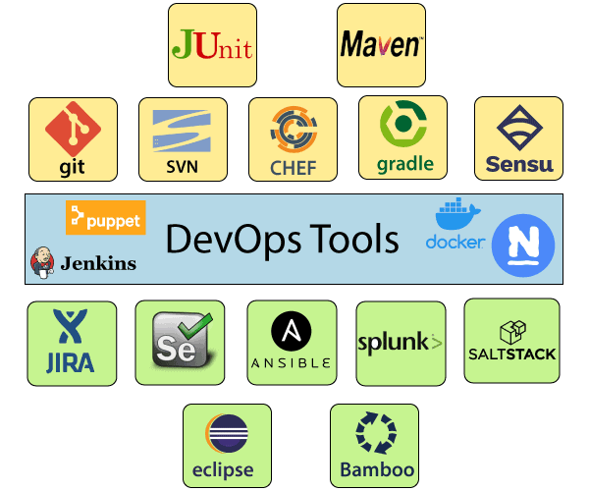
DevOps Tools:

Slide 12
DevOps Engineer Roles and Responsibilities:
DevOps engineers work full time. They are responsible for the production and continuing maintenance of a software application platform.
Manage projects effectively through an open standard-based platform.
Increases project visibility through traceability.
Improve quality and reduce the development cost with collaboration.
DevOps should have the soft skill of a problem solver and a quick learner.
Analyze, design, and evaluate automation scripts and systems.
Able to perform system troubleshooting and problem-solving across the platform and application domains.
Ensuring the critical resolution of system issues by using the best cloud security solution services.

Slide 13
Salary | Area | Experiences | Company
₹4,20,000 | A DevOps engineer in the Bengaluru area reported making ₹4,20,000 per year. | 0-year experience | Private
₹3,00,000 | A DevOps engineer in the Bengaluru area reported making ₹3,00,000 per year. | 1-2 year experience | Public
₹5,00,000 | A DevOps engineer in the Hyderabad area reported making ₹5,00,000 per year. | 3-4 year experiences | Public
₹3,00,000 | A DevOps engineer in the Hyderabad area reported making ₹3,00,000 per year. | 3-4 year experience | Private
₹6,00,000 | An Azure DevOps engineer in the Chennai area reported making ₹6,00,000 per year. | 1-2 year experience | Public
₹4,80,000 | A DevOps engineer in the Pune area reported making ₹4,80,000 per year. | 3-4 year experience | Public
₹11,06,561 | A DevOps engineer in the New Delhi area reported making ₹11,06,561 per year. | 3-4 year experience | Private

