Slide 1
GIT
(Global information tracker)
Sushma m u

Slide 2
INTRODUCTION TO GIT
Git is a version-control system for tracking changes in computer files and coordinating work on those files among multiple people. Git is a Distributed Version Control System. So Git does not necessarily rely on a central server to store all the versions of a project’s files. Instead, every user “clones” a copy of a repository (a collection of files) and has the full history of the project on their own hard drive. This clone has all of the metadata of the original while the original itself is stored on a self-hosted server or a third-party hosting service like GitHub.

Slide 3
What is a version control
Version control, also known as source control, is the practice of tracking and managing changes to software code. Version control systems are software tools that help software teams manage changes to source code over time.
Benefits Of Version Control:
It helps improve the collaborative work culture
It keeps different versions of code files securely
It keeps backup

Slide 4
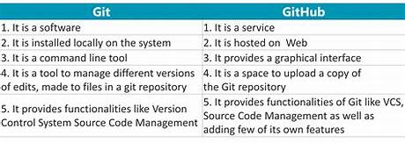
Difference Between Git and GitHub

Slide 5
Advantages of Git
a) Open source and free
b) Security
c) Flexibility
d) Data redundancy and replication
e) High availability
f) Only one Git directory per repository
g) Superior disk utilization and network performance
h) Collaboration friendly
i) Can be used for any sort of projects

Slide 6
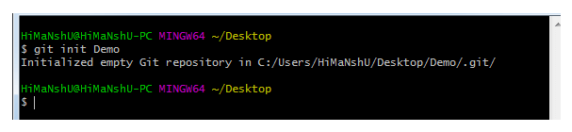
Git Basic Commands:
1) Git init: This command is used to create a local repository.
Syntax: git init Demo
2) Git config: This command configures the user. This command sets the author name and email address to be used with your commits.
Syntax: git config --global user.name “Samaya"
git config --global user. Email “Samaya481@gmail.com"

Slide 7
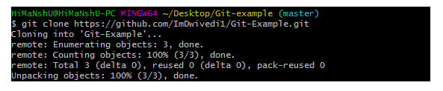
3) Git clone: This command is used to make a copy of a repository from an existing URL. If I want a local copy of my repository from GitHub, this command allows creating a local copy of that repository on your local directory from the repository URL.
Syntax: git clone URL
4) Git add: This command is used to add one or more files to staging (Index) area.
Syntax: git add Filename

Slide 8
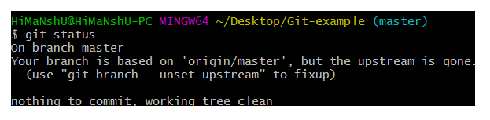
5)Git commit: This command changes the head. It records or snapshots the file permanently in the version history with a message.
Syntax: git commit -m " Commit Message"
6) Git status: The status command is used to display the state of the working directory and the staging area. It allows you to see which changes have been staged, which haven't, and which files aren’t being tracked by Git.
Syntax: git status

Slide 9
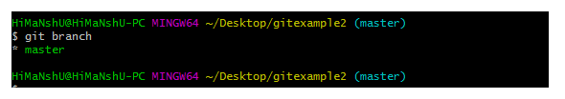
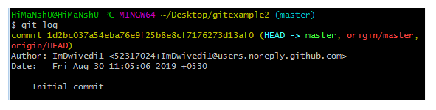
7) Git branch: This command lists all the branches available in the repository.
Syntax: git branch
8) Git log: This command is used to check the commit history.
Syntax: git log

Slide 10

9) Git remote: Git Remote command is used to connect your local repository to the remote server. This command allows you to create, view, and delete connections to other repositories.
Syntax: git remote add origin “URL”
10) Git push: It is used to upload local repository content to a remote repository.
Syntax: git push origin master

