Slide 1
LINUX
SUSHMA M U

Slide 2
INTRODUCTION TO LINUX OS
Linux is a community of open-source Unix-like operating systems that are based on the Linux Kernel. It was initially released by Linus Torvalds on September 17, 1991. It is a free and open-source operating system and the source code can be modified and distributed to anyone commercially or noncommercially under the GNU General Public License. Initially, Linux was created for personal computers and gradually it was used in other machines like servers, mainframe computers, supercomputers, etc. Nowadays, Linux is also used in embedded systems like routers, automation controls, televisions, digital video recorders, video game consoles, smartwatches, etc.

Slide 3
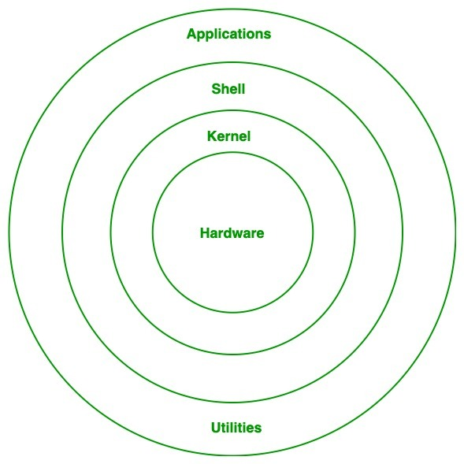
What is Linux?
Linux is an open-source operating system like other operating systems such as Microsoft Windows Apple Mac OS, iOS, Google android, etc. An operating system is software that enables the communication between computer hardware and software. It conveys input to get processed by the processor and brings output to the hardware to display it.
Architecture of Linux

Slide 4
Kernel: Kernel is the core of the Linux-based operating system. It virtualizes the common hardware resources of the computer to provide each process with its virtual resources. This makes the process seem as if it is the sole process running on the machine. The kernel is also responsible for preventing and mitigating conflicts between different processes.
System Library: This is a special type of function that is used to implement the functionality of the operating system.
Shell: It is an interface to the kernel which hides the complexity of the kernel’s functions from the users. It takes commands from the user and executes the kernel’s functions.
Hardware Layer: This layer consists of all peripheral devices like RAM/ HDD/ CPU etc.
System Utility: It provides the functionalities of an operating system to the user.

Slide 5
Advantages of Linux
The software updates in Linux are easy and frequent.
Linux is freely available to use on the internet.
It provides high stability. It rarely slows down or freezes and there is no need to reboot it after a short time.
It maintains the privacy of the user.
It is network friendly.
The flexibility of Linux is high. There is no need to install a complete Linux suit; you are allowed to install only the required components.
Linux is compatible with a large number of file formats.
It is fast and easy to install from the web. It can also install on any hardware even on your old computer system.
It performs all tasks properly even if it has limited space on the hard disk.

Slide 6
Disadvantages of Linux
It is not very user-friendly. So, it may be confusing for beginners.
It has small peripheral hardware drivers as compared to windows.
Linux Basic Commands
1. pwd Command: Stands for print working directory. The pwd command is used to display the location of the current working directory.
Syntax: pwd
2. mkdir Command: Stands for make directory. The mkdir command is used to create a new directory under any directory.
Syntax: mkdir<directory name>
3. rmdir Command: Stands for remove directory. The rmdir command is used to delete a directory.
Syntax: rmdir <directory name>

Slide 7
4. ls Command: Stands for list. The ls command is used to display a list of content of a directory.
Syntax: ls
5. cd Command: Stands for change directory. The cd command is used to change the current directory.
Syntax: cd <directory name>
6. rm Command: Stands for remove. The rm command is used to remove a file.
Syntax: rm <file name>
7. cp Command: Stands for a copy. The cp command is used to copy a file or directory.
Syntax: cp <existing file name> <new file name>
8. Mv Command: Stands for the move. The mv command is used to move a file or a directory from one location to another location.
Syntax: mv <file name> <directory path>

Slide 8
THANK YOU

