Slide 1
MAVEN
SUSHMA M U

Slide 2
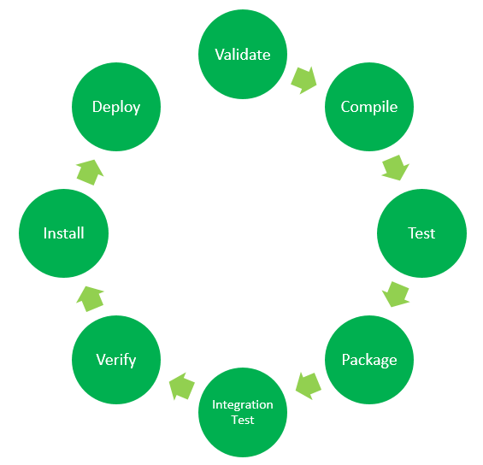
What is Maven?
Maven is a powerful project management tool that is based on POM (project object model), used for project build, dependency, and documentation. It is a tool that can be used for building and managing any Java-based project. Maven makes the day-to-day work of Java developers easier and helps with the building and running of any Java-based project.
Maven Lifecycle:

Slide 3
Validate: This step validates if the project structure is correct. For example – It checks if all the dependencies have been downloaded and are available in the local repository.
Compile: It compiles the source code, converts the .java files to .class, and stores the classes in the target/classes folder.
Test: It runs unit tests for the project.
Package: This step packages the compiled code in a distributable format like JAR or WAR.
Integration test: It runs the integration tests for the project.
Verify: This step runs checks to verify that the project is valid and meets the quality standards.
Install: This step installs the packaged code to the local Maven repository.
Deploy: It copies the packaged code to the remote repository for sharing with other developers.

Slide 4
Maven Commands:
mvn clean: Cleans the project and removes all files generated by the previous build.
mvn compile: Compiles source code of the project.
mvn test-compile: Compiles the test source code.
mvn test: Runs tests for the project.
mvn package: Creates JAR or WAR file for the project to convert it into a distributable format.
mvn install: Deploys the packaged JAR/ WAR file to the local repository.
mvn deploy: Copies the packaged JAR/ WAR file to the remote repository after compiling, running tests, and building the project.

Slide 5
What Maven does do?
We can easily build a project using maven.
We can add jars and other dependencies of the project easily using the help of maven.
Maven provides project information (log document, dependency list, unit test reports, etc.)
Maven is very helpful for a project while updating the central repository of JARs and other dependencies.
With the help of Maven we can build any number of projects into output types like the JAR, WAR, etc., without doing any scripting.
Using maven we can easily integrate our project with a source control system (such as Subversion or Git).

Slide 6
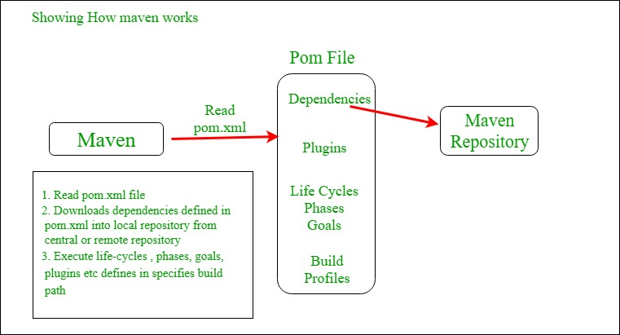
How do Maven works?

Slide 7
POM Files: Project Object Model(POM) Files are XML file that contains information related to the project and configuration information such as dependencies, source directory, plugin, goals, etc. used by Maven to build the project.
Dependencies and Repositories: Dependencies are external Java libraries required for Project and repositories are directories of packaged JAR files. The local repository is just a directory on your machine’s hard drive.
Build Life Cycles, Phases, and Goals: A build life cycle consists of a sequence of build phases, and each build phase consists of a sequence of goals. Maven command is the name of a build lifecycle, phase, or goal. If a lifecycle is requested executed by giving the maven command, all build phases in that life cycle are executed also. If a build phase is requested executed, all build phases before it in the defined sequence are executed too.
Build Profiles: Build profiles are a set of configuration values that allows you to build your project using different configurations. For example, you may need to build your project for your local computer, for development and test. To enable different builds you can add different build profiles to your POM files using its profiles elements which are triggered in a variety of ways.
Build Plugins: Build plugins are used to perform a specific goal. you can add a plugin to the POM file. Maven has some standard plugins you can use, and you can also implement your own in Java.

Slide 8
Advantages of Maven:
Maven can add all the dependencies required for the project automatically by reading the pom file.
One can easily build their project to the jar, war, etc. as per their requirements using Maven.
Maven makes it easy to start a project in different environments and one doesn’t need to handle the dependencies injection, builds, processing, etc.
Adding a new dependency is very easy. One has to just write the dependency code in the pom file.
Disadvantages of Maven:
Maven needs the maven installation in the system for working and the maven plugin for the ide.
If the maven code for an existing dependency is not available, then one cannot add that dependency using maven.

Slide 9
When should someone use maven?
When there are a lot of dependencies for the project. Then it is easy to handle those dependencies using maven.
When dependency version updates frequently. Then one has to only update the version ID in the pom file to update dependencies.
Continuous builds, integration, and testing can be easily handled by using maven.
When one needs an easy way to generate documentation from the source code, Compiling source code, Packaging compiled code into JAR files or ZIP files.

Slide 10
THANK YOU

