Slide 1
BASICS OF NETWORKING
SUSHMA M U

Slide 2
What is Computer Network?
Computer Network is a group of computers connected with each other through wires, optical fibers, or optical links so that various devices can interact with each other through a network.
The aim of the computer network is the sharing of resources among various devices.
Components of Computer Network?
Hub
Switch
Router
1) Hub: Hub is a central device that splits the network connection into multiple devices. When a computer requests information from a computer, it sends the request to the Hub. Hub distributes this request to all the interconnected computers.

Slide 3
2) Switches: A switch is a networking device that groups all the devices over the network to transfer the data to another device. A switch is better than Hub as it does not broadcast the message over the network, i.e., it sends the message to the device to which it belongs. Therefore, we can say that switch sends the message directly from the source to the destination.
3) Router: A router is a device that connects the LAN to the internet. The router is mainly used to connect distinct networks or connect the internet to multiple computers.
What is IP Address?
An IP address is a unique address that identifies a device on the internet or a local network. IP stands for "Internet Protocol," which is the set of rules governing the format of data sent via the internet or local network.

Slide 4
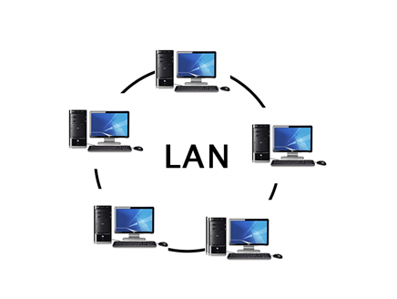
Types of Computer Networks:
LAN(Local Area Network)
PAN(Personal Area Network)
MAN(Metropolitan Area Network)
WAN(Wide Area Network)
1) LAN(Local Area Network):

Slide 5
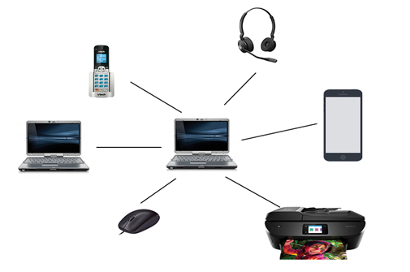
Local Area Network is a group of computers connected to each other in a small area such as a building, or office.
LAN is used for connecting two or more personal computers through a communication medium such as a twisted pair, coaxial cable, etc.
It is less costly as it is built with inexpensive hardware such as hubs, network adapters, and ethernet cables.
The data is transferred at an extremely faster rate in the Local Area Network.
Local Area Network provides higher security.
2) PAN(Personal Area Network):

Slide 6
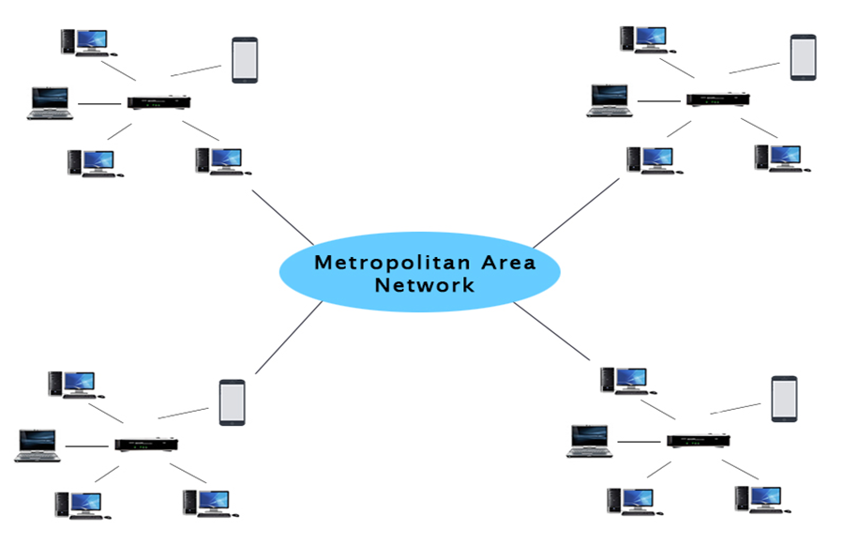
Personal Area Network is a network arranged within an individual person, typically within a range of 10 meters.
Personal Area Network is used for connecting the computer devices of personal use is known as Personal Area Network.
Personal Area Network covers an area of 30 feet.
Personal computer devices that are used to develop the personal area network are the laptop, mobile phones, media players, and play stations.
3) MAN(Metropolitan Area Network):

Slide 7
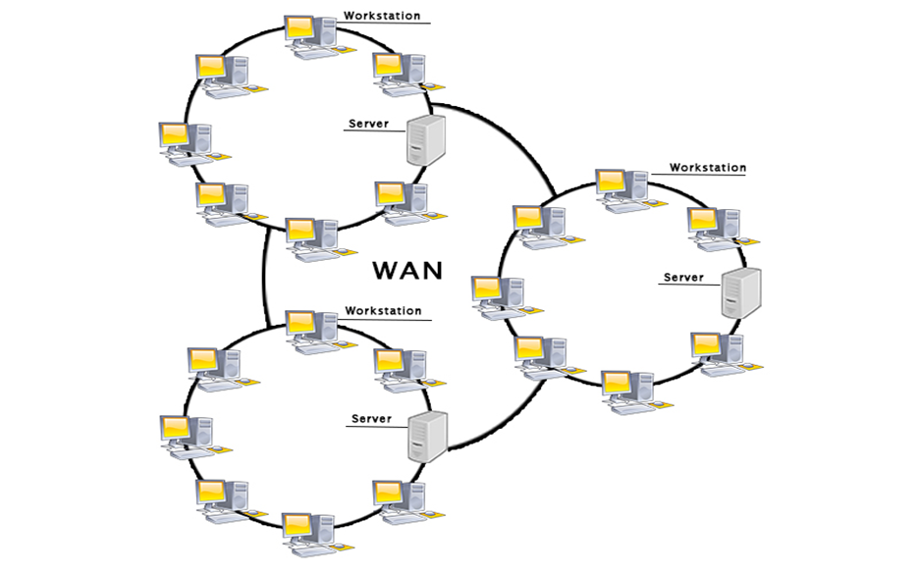
A metropolitan area network is a network that covers a larger geographic area by interconnecting a different LAN to form a larger network.
Government agencies use MAN to connect to the citizens and private industries.
In MAN, various LANs are connected to each other through a telephone exchange line.
The most widely used protocols in MAN are RS-232, Frame Relay, ATM, ISDN, OC-3, ADSL, etc.
It has a higher range than the Local Area Network(LAN).
4) WAN(Wide Area Network):

Slide 8
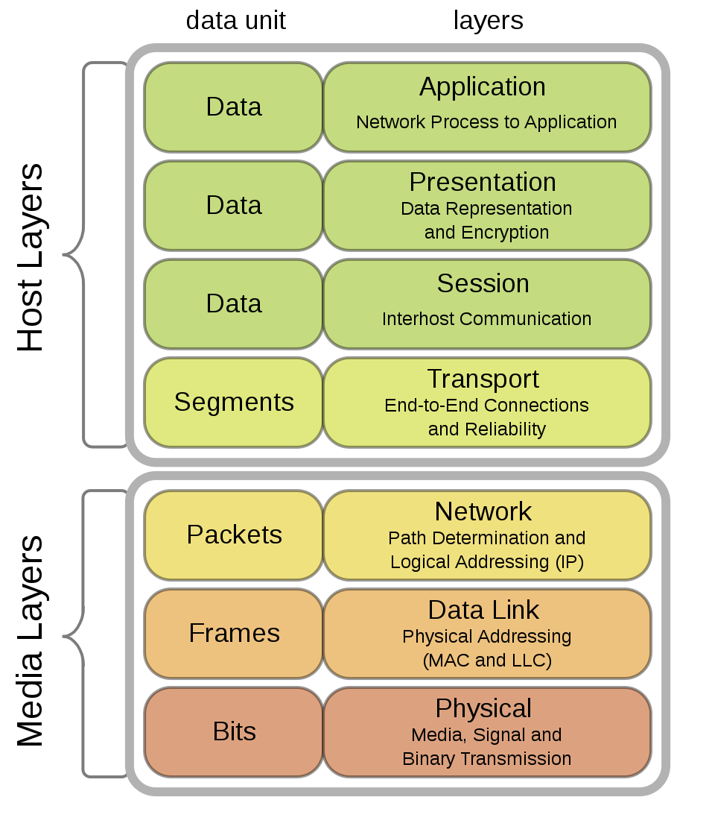
A Wide Area Network is a network that extends over a large geographical area such as states or countries.
A Wide Area Network is quite a bigger network than the LAN.
A Wide Area Network is not limited to a single location, but it spans over a large geographical area through a telephone line, fiber optic cable, or satellite links.
The internet is one of the biggest WANs in the world.
A Wide Area Network is widely used in the field of Business, government, and education.
OSI Model:

Slide 9
1. Physical Layer:
It is the bottom-most or the first layer of the OSI Model
It comprises the raw data which is further transmitted to the higher layers of the structure
Preparing the physical devices in the network and accepting the received data for transmission
The termination of the connection between two nodes of a network also takes place at this stage
This layer converts the digital bits into electrical, radio, or optical signals.
2. Data Link Layer:
Access to get the data is achieved at this layer
It breaks the input data into frames which makes analyzing the data easier
Ensures that the data received is free of any errors
It controls the flow of data in the stipulated time duration and along with a set speed of transmission
The data is sent to the next layer in the form of packets which are then reviewed for further processing

Slide 10
3. Network Layer:
It acts as a network controller
Transferring of variable data from one node to another, connected in a network, takes place at this layer
Each node has a specific address and the network layer ensures that the data is sent to its destination address.
The data is sent in the form of fragments which are then connected to each other once the processing is done.
4. Transport Layer:
The delivery of data packets is managed by the transport layer
It manages the flow of data, segmentation, and error control
There are five classes of the transport protocol, starting from 0 and continuing till 4 (TP0 to TP4)
Fragmentation and reassembly of data packets occur that this stage

Slide 11
5. Session Layer:
The connection between the computers connected in a network is managed at this layer
Establishment, management, and termination between the remote and local application take place here
Authentication and authorization happen at this layer
This layer can also terminate or end any session or transmission which is complete.
6. Presentation Layer:
The data is converted into the syntax or semantics that an application understands
Before passing on the data any further, the data is formatted at this stage
Functions including compression, encryption, compatible character code set, etc. are also done at this layer of the model
It serves as a data translator for the network

Slide 12
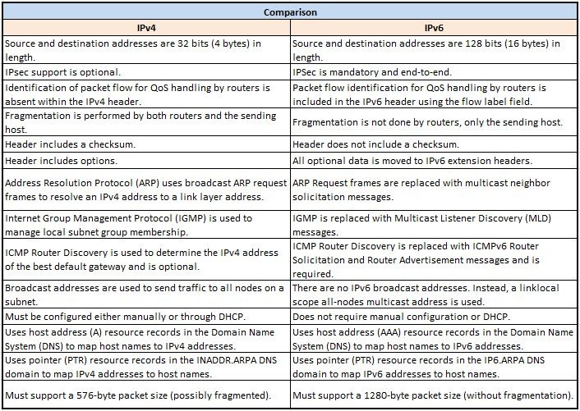
7. Application Layer:
The interaction with the user or the user application takes place at this stage
When identifying communication partners, the application layer determines the identity and availability of communication partners for an application with data to transmit.

Slide 13
THANK YOU

