Slide 1



UNIX System Basics
NU Robotics Club
Software Workshop Track

Slide 2

What is UNIX?
Unix is an operating system that was designed with an emphasis on easing how the user interacts with the OS through the use of a shell and a suite of tools that would be simple to develop and understand.
It originated out of Bell Labs through the work of some well known software engineers like Ken Thompson and Dennis Ritchie (creator of C).
Although originally proprietary, an open-source version (except a kernel) was developed by Richard Stallman and members of the FSF called GNU (GNU’s Not Unix).

Slide 3
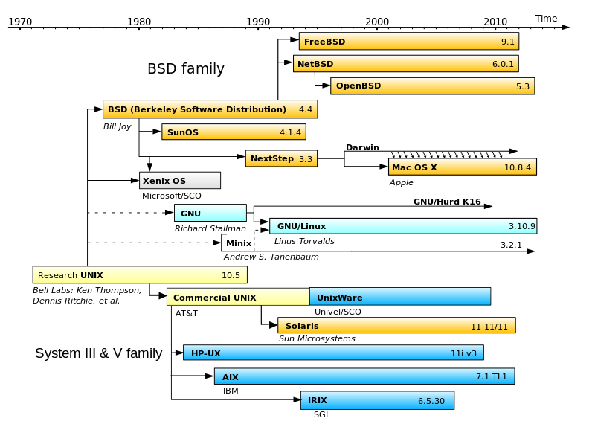
Unix Primer
Many other different operating systems stem from Unix, and it is for that reason that various OSes like Mac OS X and Ubuntu have many commonalities at a fundamental level.

Slide 4
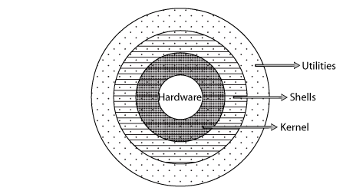
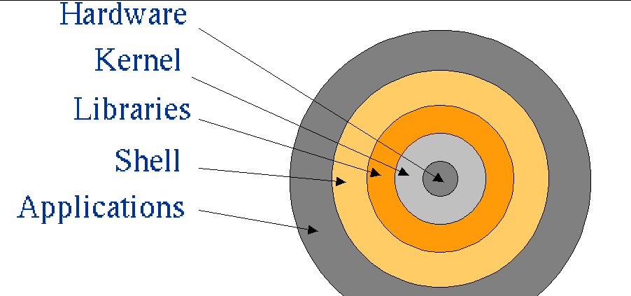
Unix Primer
The general design of Unix can be understood through the following diagram. The system is has layers like an onion with the hardware and kernel at its core.

Slide 5
Unix Primer
Shell
The shell servers as lower-level intermediary between you, the user, and the operating system. From the start you have many different utilities available through the shell.
Some Important Commands
Cd
Ls
Mkdir
Rm
Cp
Pwd
Sudo
Wget
Cat
Tar
Nano
Make
Mv
Grep
Find
Su
Chmod
Chown
Chgrp

Slide 6
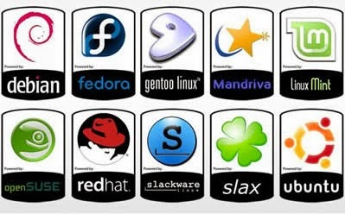
Unix Primer
Linux, which was developed by Linus Torvalds, is the kernel of choice for many open source Unix spinoffs. Below are some of the most popular Linux distributions. Note the lightweight Arch Linux distribution is missing from this list.

Slide 7
Unix Primer
Many of the aforementioned distributions share something that is common with Unix-based systems: package managers. They will be one of the best changes to Windows systems.
On Ubuntu the following utilities exist for package management
apt-get
aptitude
In order to simplify the installation process of most of the programs that we use in Ubuntu 14.04 we wrote a simple installation script located at http://github.com/NURobotics/installation-scripts

Slide 8
Unix Primer
wget https://bootstrap.pypa.io/ez_setup.py
Now go install pip through a publically available script:
Grab easy_install from the web.
wget https://bootstrap.pypa.io/ez_setup.py
Change the permissions and make it executable.
chmod +x ez_setup.py
Run the script with super user permissions.
sudo python ez_setup.py
Install pip using easy_install
easy_install pip
Install numpy using pip
pip install numpy

