Slide 1

NUS-ISS · PATTERN RECOGNITION SYSTEMS · PRACTICE MODULE · FIRST PRESENTATION
A Multimodal Medical Imaging Assistant for Pulmonary Infection Classification
Chest CT + de-identified clinical information → Aspergillus / non-Aspergillus fungal / non-fungal infection, with confidence, lesion localisation and severity
Lai Wendi
A0352629X
Practice Project Group (FT) 26 · NUS-ISS
Tang Shiyan
A0329902B
Xia Yan
A0352818X
6 October 2026
Zhou Jiasheng
A0315819X
Notes:
Title. Introduce the team and the one-line idea: CT plus clinical data, three infection classes.

Slide 2
Introduction
Scope & Data
System Design
Progress & Results
Plan
Introduction — Clinical Problem and Project Objectives
CLINICAL PROBLEM
PROJECT GOAL
Invasive Aspergillus infection, other fungal pneumonias and non-fungal (bacterial / viral) pneumonias can look alike on chest CT — nodules, consolidation, cavities and ground-glass change overlap. The three groups need different first-line treatment, so an early, evidence-based differential matters.
A research prototype that reads one patient's chest CT and clinical record and returns a three-class infection prediction with confidence — decision support, not a diagnosis.
OBJECTIVES
Imaging alone is ambiguous
Lab tests alone are slow / partial
01
Classify
Radiological signs such as the halo sign or cavitation are suggestive but not specific.
G-test and GM-antigen are positive in only a minority of cases in our data.
Aspergillus vs non-Aspergillus fungi vs non-fungal, with calibrated confidence
02
Fuse modalities
Show whether CT + clinical beats CT-only and clinical-only
Our hypothesis
03
Explain
Combining the CT pattern with a small set of routine clinical variables (immune status, comorbidities, fungal markers, lymphocyte count, D-dimer) gives a more reliable three-way classification than either source alone. We test this on PAC569, a public multi-centre dataset released in September 2026.
Highlight suspicious lung regions (saliency); severity estimate as stretch goal
04
Study the data regime
Pre-trained backbones, training-set size and augmentation
2
Notes:
Why this matters: the three groups look alike on CT and are treated differently. Lab markers help but are positive in only a minority. Our hypothesis is that combining both sources is more reliable. Then the four objectives — classification is the core, localisation and severity are secondary.

Slide 3
Introduction
Scope & Data
System Design
Progress & Results
Plan
Project Scope — What the Prototype Will and Will Not Do
FUNCTIONAL REQUIREMENTS
PATTERN-RECOGNITION TECHNIQUES
ID | Requirement | Priority
FR1 | Load one case: CT volume (NIfTI) + clinical record | Must
FR2 | Preprocess CT (window, lung crop, slice sampling) | Must
FR3 | Encode clinical data (impute, scale, one-hot) | Must
FR4 | Predict 3 classes with probabilities | Must
FR5 | Return 'uncertain' when confidence is low | Should
FR6 | Saliency map over CT slices (lesion localisation) | Should
FR7 | Severity estimate (definition to agree with supervisor) | Could
FR8 | Viewer UI: CT slices + clinical panel + outputs | Must
Supervised deep learning
Transfer learning from ImageNet ResNet-18 / ResNet-50 on 2.5D CT slices
Multimodal fusion
CT features ⊕ clinical MLP features → MLP classifier (late / feature fusion)
Classical ML baselines
Logistic regression, random forest, LightGBM on clinical variables
Explainability
Grad-CAM saliency for weakly-supervised lesion localisation
Out of scope: clinical validation or certification, deployment in hospital workflow, pathogen species identification, voxel-level lesion segmentation (no masks in the dataset).
3
Notes:
Scope: eight functional requirements with priorities. Must = classification pipeline and viewer. Severity is 'Could' because the dataset has no severity labels. Techniques map to the course: transfer learning, fusion, classical baselines, explainability. Be explicit about what is out of scope.

Slide 4
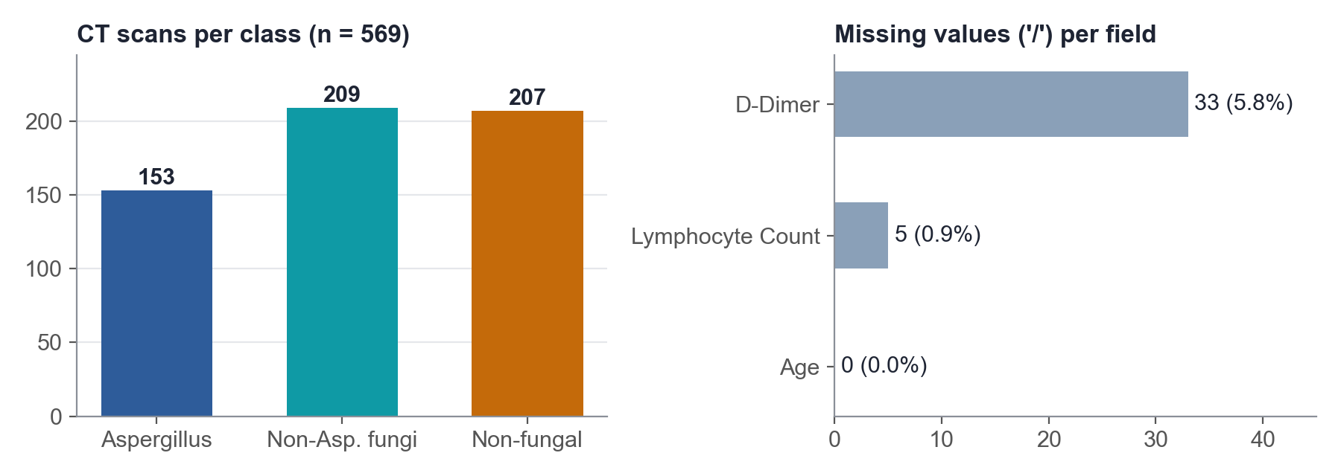
Introduction
Scope & Data
System Design
Progress & Results
Plan
Data — PAC569 Multi-Modal Dataset (OMIX014539, NGDC China)
WHAT WE DOWNLOADED
CT VOLUMES
File | Content | Cases | Size
OMIX014539-03 | Aspergillus CT (.nii.gz) | 153 | 3.53 GB
OMIX014539-04 | Non-Aspergillus fungi CT | 209 | 4.88 GB
OMIX014539-05 | Non-fungal CT | 207 | 4.67 GB
OMIX014539-08 | Clinical variables (.csv) | 569 rows | 28 KB
• One volume per case: CaseXXX.nii.gz, IDs match the CSV 569 / 569, labels agree 100%
• Geometry (all 569): 512 × 512 in-plane (0.50–0.97 mm), 31–81 slices (median 65), all 5 mm thick
• Intensity: raw Hounsfield units (air ≈ −1000, soft tissue ≈ 0–100)
• No lesion masks, no severity labels
CLINICAL VARIABLES (12)
Group | Variables
Demographics | Gender, Age
Comorbidity | Solid tumour, Diabetes, Renal dysfunction, AIDS
Treatment | Immunosuppressants
Laboratory | Lymphocyte count, D-dimer
Fungal markers | (1,3)-β-D-glucan (G), GM antigen
A 13th column, Pathogen Identification, is 1 for every row and is dropped. Source: ngdc.cncb.ac.cn/omix/release/OMIX014539 (released 11 Sep 2026, Wuxi People's Hospital).
4
Notes:
Dataset: public PAC569 from NGDC, four centres, 569 CT scans with labels and 12 clinical variables. We checked that every CT file has exactly one clinical row and the labels agree. Note: CT only, no lesion masks.

Slide 5
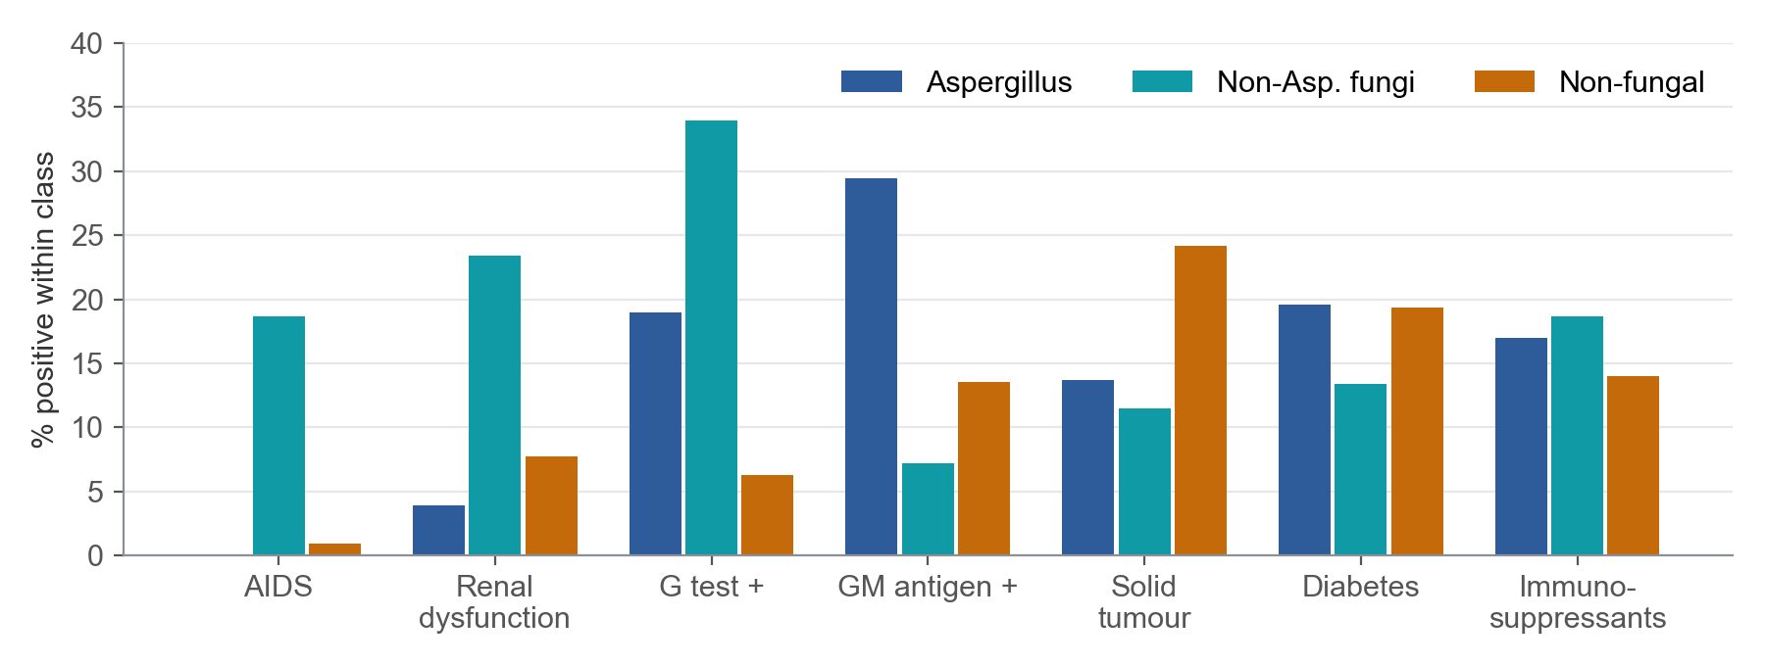
Introduction
Scope & Data
System Design
Progress & Results
Plan
Data Exploration — What We Found Before Modelling
CLINICAL RISK FACTORS DIFFER BY CLASS
DATA-QUALITY CHECKS
21 repeated clinical records
21 rows repeat the previous row exactly (consecutive IDs) → likely repeat scans of one patient. Grouped into 548 patient groups; a group never crosses splits.
Missing values
D-dimer 33 ('/'), lymphocyte count 5. Imputed with training-set median.
Inconsistent coding
AIDS: 39 of 41 AIDS patients are in the non-Aspergillus fungal class. GM antigen is positive in 29.4% of Aspergillus cases; G-test in 34.0% of non-Aspergillus fungal cases.
Gender values with trailing spaces ('F ' vs 'F'); constant Pathogen Identification column.
Implication: clinical data carry real signal, but no single marker separates the classes — each is positive in a minority. G / GM are themselves diagnostic criteria, so we also report results with and without them to check for label shortcuts.
No lesion / severity ground truth
Localisation becomes weakly supervised (Grad-CAM); severity needs an agreed proxy definition.
Class balance is moderate (153 / 209 / 207) → class-weighted loss, macro-F1 as primary metric.
5
Notes:
What EDA told us: risk factors differ by class (AIDS almost only in non-Aspergillus fungi, GM higher in Aspergillus) but none separates the classes alone. Quality issues: repeated records → group-level split; missing values → median imputation; no lesion ground truth → weakly supervised localisation.

Slide 6
Introduction
Scope & Data
System Design
Progress & Results
Plan
System Design — Multimodal Architecture
CT BRANCH
Chest CT
Preprocess
ResNet-18
Mean pool
NIfTI volume
512×512×31–81, HU
lung window, lung crop,
16 slices × 3 adjacent
→ 224×224
ImageNet pre-trained,
shared over 16 slices
→ 16 × 512
patient-level
512-d
Concat
MLP head
512 + 64
= 576-d
dropout,
softmax ×3
CLINICAL BRANCH
Clinical record
Encode
Clinical MLP
12 variables
median impute, z-score,
one-hot (train-fit only)
2 layers → 64-d
Grad-CAM
Outputs
saliency on the CT slices
→ lesion localisation
class probabilities,
'uncertain' flag
BASELINES SHARE THE SAME PARTS
• CT-only: same CT branch + head, clinical branch removed
• Clinical-only: logistic regression / random forest / LightGBM on the encoded record
• Training: class-weighted cross-entropy, AdamW, cosine LR, mixed precision; model chosen on validation macro-F1
Why 2.5D, not 3D? Slices are 5 mm thick, so a 3D network gains little along z; 2D ImageNet weights transfer directly, and 16 slices × 224² fits our 8 GB GPU. 3 adjacent slices as RGB keep local z-context.
6
Notes:
Architecture: two branches. CT branch: 16 sampled slices through a shared ImageNet ResNet-18, averaged into one patient vector. Clinical branch: encoded record through a small MLP. Concatenate and classify. Baselines are the same model with one branch removed, so comparisons are fair. Explain why 2.5D.

Slide 7
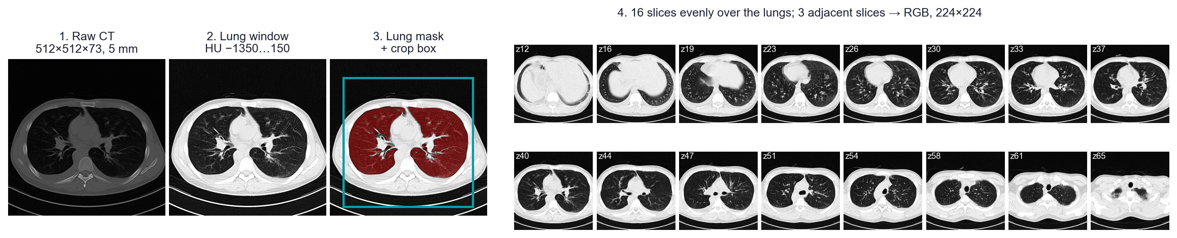
Introduction
Scope & Data
System Design
Progress & Results
Plan
Data Pipeline — CT Preprocessing and Leak-Free Split
CT PREPROCESSING (IMPLEMENTED)
PATIENT-GROUP STRATIFIED SPLIT · SEED 42
• 70 / 15 / 15 split over patient groups, stratified by class
• No leakage: repeat scans stay together; imputer, scaler and encoder are fitted on train only
• Augmentation only on training cases: ±10° rotation, ±5% shift (same transform for all slices)
• Test set is touched once per final configuration
Split | Aspergillus | Non-Asp. fungi | Non-fungal | Scans | Groups
Train | 107 | 150 | 145 | 402 | 383
Val | 23 | 30 | 31 | 84 | 82
Test | 23 | 29 | 31 | 83 | 83
Total | 153 | 209 | 207 | 569 | 548
7
Notes:
Implemented pipeline: show the four preprocessing steps on a real case. Then the split table — stratified by class and grouped so repeat scans never leak between train and test.

Slide 8
Introduction
Scope & Data
System Design
Progress & Results
Plan
Experimental Design — Three Supervisor-Requested Comparisons
E1 · Pre-trained Baseline & Modality
E2 · Training-Set Size
E3 · Data Augmentation
Does adding clinical data help?
How much data do we need?
Which augmentation is clinically reasonable?
• CT-only ResNet-18 (ImageNet) — baseline
• Backbone: ResNet-18 vs ResNet-50
• Modality ablation: CT-only vs clinical-only vs fusion
• Clinical with / without G & GM markers
• 25 / 50 / 75 / 100% of training groups (nested, stratified)
• ≈ 96 / 192 / 287 / 383 groups
• Validation and test sets fixed
• Learning curve: still improving at 100%?
• None
• Basic: small rotation + translation
• Extended: basic + mild intensity shift + noise
• Parameters fixed on validation before test
Output: comparison table + confusion matrices
Output: learning curve, macro-F1 vs #groups
Output: ablation table, per-class recall
EVALUATION PROTOCOL
One factor at a time. Default = full training set, basic augmentation, ResNet-18. Each experiment changes only its own factor, so differences can be attributed. Augmented images are never counted as extra patients.
• Primary metric: macro-F1 (three classes weighted equally)
• Also: balanced accuracy, per-class recall, confusion matrix, training / inference time, #parameters
• Small test set (83 scans): each configuration × 3 seeds, report mean ± SD; 5-fold group CV where cheap
8
Notes:
Three experiments the supervisor asked for: pre-trained baseline and modality ablation, training-set size curve, augmentation ablation. One factor at a time; macro-F1 primary; three seeds because the test set is small.

Slide 9
Introduction
Scope & Data
System Design
Progress & Results
Plan
What We Have Done So Far
✓ DONE
Dataset acquired & verified
4 files (13 GB); 569 CT ↔ 569 clinical rows, labels consistent
✓ DONE
Clinical EDA & cleaning
missing values, coding errors, constant column, 21 repeated records
✓ DONE
Leak-free split
548 patient groups, stratified 70/15/15, fixed seed
✓ DONE
CT preprocessing pipeline
RAS reorientation, lung window, lung mask & crop, 16×2.5D slices, cached
✓ DONE
Clinical-only baselines
LR / RF / LightGBM, with and without G & GM markers
✓ DONE
CT-only ResNet-18 baseline
end-to-end training on GPU
✓ DONE
First CT + clinical fusion model
same split, same head
✓ DONE
First Grad-CAM saliency maps
layer-4 Grad-CAM on the fusion model, inspected on test cases
○ NEXT
E1–E3 experiment matrix + severity proxy
backbones, training size, augmentation × 3 seeds
○ NEXT
Prototype UI
CT viewer + clinical panel + prediction panel
9
Notes:
Progress checklist: everything up to the baselines is done and reproducible from scripts. Next: the full experiment matrix, Grad-CAM, UI.

Slide 10
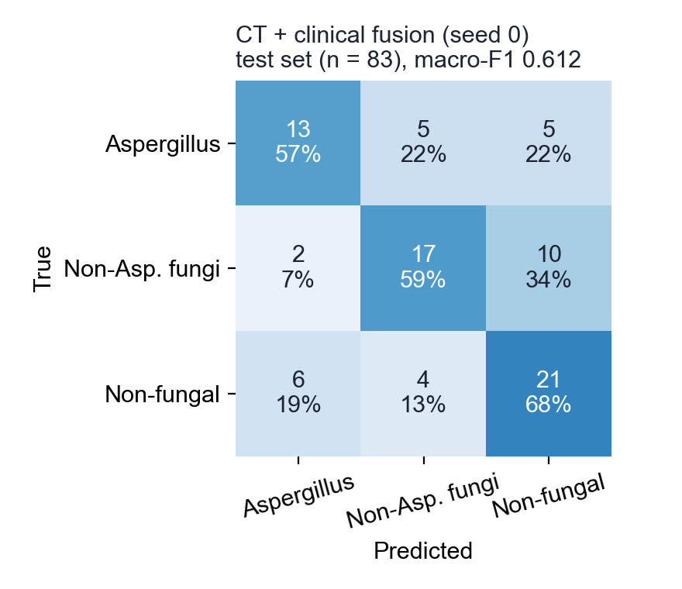
Introduction
Scope & Data
System Design
Progress & Results
Plan
Preliminary Results — Baselines on the Fixed Split
MACRO-F1 (CHANCE = 0.333)
Model | Features | 5-fold CV (train+val) | Test, 3 seeds
Logistic regression | clinical | 0.495 ± 0.065 | 0.512 (deterministic)
Random forest | clinical | 0.569 ± 0.035 | 0.539 ± 0.017
LightGBM | clinical | 0.524 ± 0.061 | 0.597 (deterministic)
Random forest | clinical − G/GM | 0.532 ± 0.062 | 0.561 ± 0.010
ResNet-18 (2.5D) | CT only | — | 0.607 ± 0.022
ResNet-18 (2.5D) | CT + clinical | — | 0.595 ± 0.013
Highlighted: best clinical model and best image model, chosen on validation macro-F1.
Reading so far (first, untuned runs)
• Clinical alone: CV macro-F1 ≈ 0.57; dropping G/GM costs only 0.037 → no obvious marker shortcut.
• CT-only ResNet-18 is the best so far (0.607 ± 0.022).
• Fusion (0.595 ± 0.013) does not beat CT-only yet. Training loss falls to 0.04–0.07 while the best validation epoch is 8–21 of 25 → overfitting; the 64-d clinical vector is also outweighed by 512 CT features.
• Next: late fusion of the two models' probabilities, partial backbone freezing, stronger regularisation.
Fusion model, seed 0, 83-scan test set. Most common error: non-Asp. fungi predicted as non-fungal (10 of 29).
10
Notes:
Preliminary numbers. Chance macro-F1 is 0.33. Clinical-only models reach the mid-0.5s; removing G/GM costs little, so no obvious label shortcut. CT-only is the best model so far; fusion does not beat it yet — explain overfitting and the feature-size imbalance, and the planned fixes. Emphasise these are first, untuned results.

Slide 11
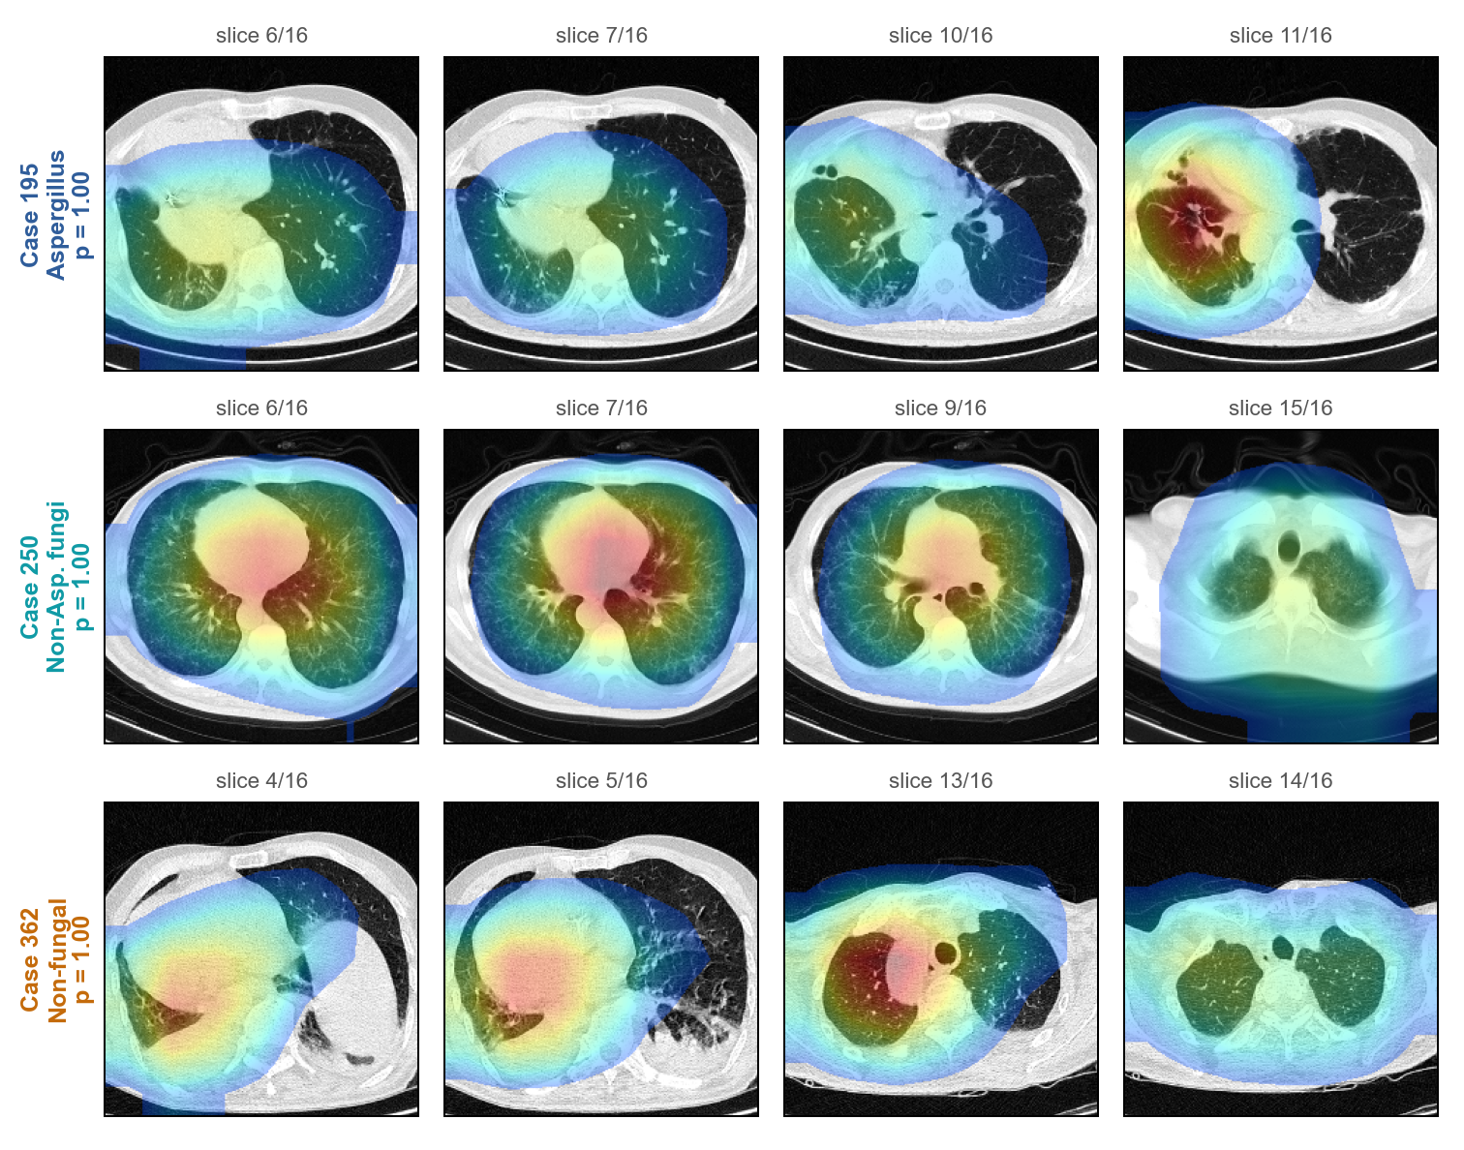
Introduction
Scope & Data
System Design
Progress & Results
Plan
First Explainability Check — Grad-CAM on Test Cases
WHAT WE SEE
• Method: Grad-CAM on ResNet layer 4 for the predicted class; 4 slices with the most saliency per case (most confident correct test case per class).
• Plausible: Case 195 — heat on the right lung, which is visibly abnormal on slices 10–11.
• Mixed: Case 362 — slice 13 points into the right upper lung, slices 4–5 sit on the lung base / liver dome.
• Not plausible: Case 250 focuses on the heart / mediastinum, not lung tissue.
Actions
• Mask non-lung pixels before the backbone, so saliency must come from the lungs
• Probabilities of 1.00 → overconfident; add calibration (temperature scaling) before the 'uncertain' flag
• No lesion masks → review maps qualitatively, ideally with a clinician
11
Notes:
Grad-CAM: one example clearly looks at the abnormal lung, one is mixed, one looks at the mediastinum. Be honest: this tells us to mask non-lung regions, and the 1.00 probabilities tell us calibration is needed.

Slide 12
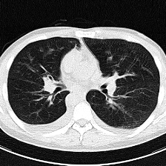
Introduction
Scope & Data
System Design
Progress & Results
Plan
Prototype Interface and Next Steps
PLANNED UI (MOCK-UP)
TIMELINE
Wk 1–2
Fix overfitting & fusion (late fusion, freezing, lung masking); E1 incl. ResNet-50
Clinical record · Case 071
Age 27 · M
Immunosuppressants − · AIDS −
G − · GM −
Lymphocytes 2.41
D-dimer n/a
Wk 3
E2 training-size curve and E3 augmentation ablation
Wk 4
Lung-masked Grad-CAM review; agree severity proxy (e.g. affected-lung fraction)
Prediction
Wk 5
Prototype UI (CT viewer + panels), uncertainty threshold
Aspergillus
Wk 6
Error analysis, final report, demo video
Non-Asp. fungi
Non-fungal
RISKS & MITIGATION
• Small data (569 scans): pre-training, augmentation, seeds + CV
• Repeat scans / leakage: group-level split
• No lesion masks: saliency only, reviewed qualitatively
• Severity undefined: stretch goal, proxy agreed with supervisor
◀ slice 40 / 73 ▶ ☐ show saliency
(probabilities illustrative)
Research prototype — decision support only, not a diagnosis.
12
Notes:
UI mock-up with a real case: viewer on the left, clinical record and probabilities on the right, research-use disclaimer. Timeline for the remaining weeks and the main risks with mitigations.

Slide 13
NUS-ISS · PATTERN RECOGNITION SYSTEMS · PRACTICE MODULE · FIRST PRESENTATION
Thank You
Questions & Answers
A Multimodal Medical Imaging Assistant for Pulmonary Infection Classification
Notes:
Q&A. Likely questions: how the single-agent baseline is defined; why graph is a constraint rather than a score; how unknown compatibility is presented; cost of local models; how the 15 reviews are used.

