Slide 1

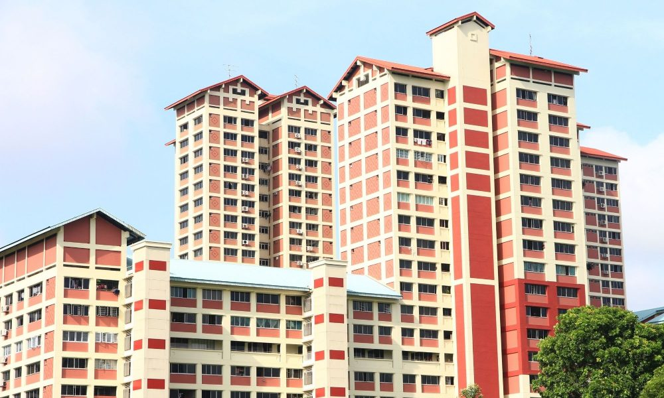
HDB Resale Price Prediction
JA2: Stonkers

Slide 2
01 Problem Statement
HDB Resale Price Prediction
You’re working for a real estate company who wishes to create an easy tool for customers to instantly value their HDB flats.
They have asked you to come up with an ML algorithm that will be used as the basis of this tool.

Slide 3
02 Introduction to Dataset
Variable | Definition | Type | Example
month | Year-month of posting | Ordinal | 2017-01
town | Town name | Categorical | ANG MO KIO
flat_type | Type of flat | Categorical | 2 ROOM
block | Block number | Categorical | 406
street_name | Street name | Categorical | ANG MO KIO AVE 10
storey_range | Range of storeys | Categorical | 10 TO 12
floor_area_sqm | Floor area of flat, in sqm | Numerical | 44.0
flat_model | Type of model | Categorical | Improved
lease_commence_date | Lease commence year | Ordinal | 1979
remaining_lease | Remaining Lease | Ordinal | 61 years 04 months
resale_price | Price of resale | Numerical | 232000.0

Slide 4
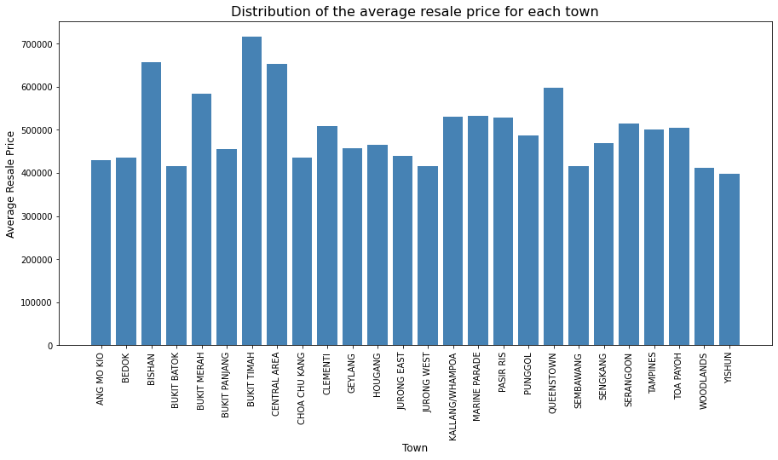
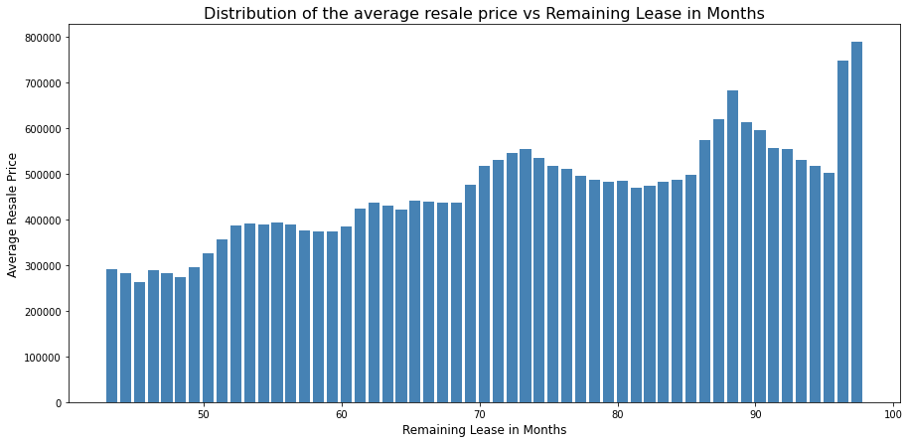
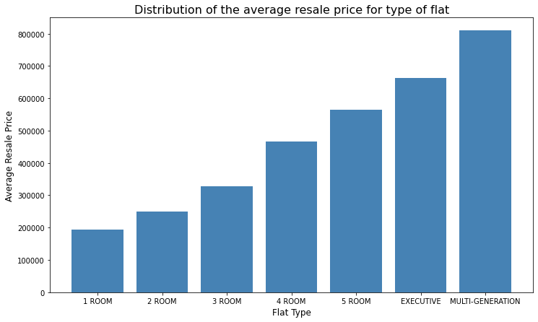
02 Introduction to Dataset – EDA
Notes:
Areas such as Bukit Timah, Bishan and Central Area have the highest average HDB resale price.
As the size of the flat increases, the average resale price of the HDB flat increases.

Slide 5
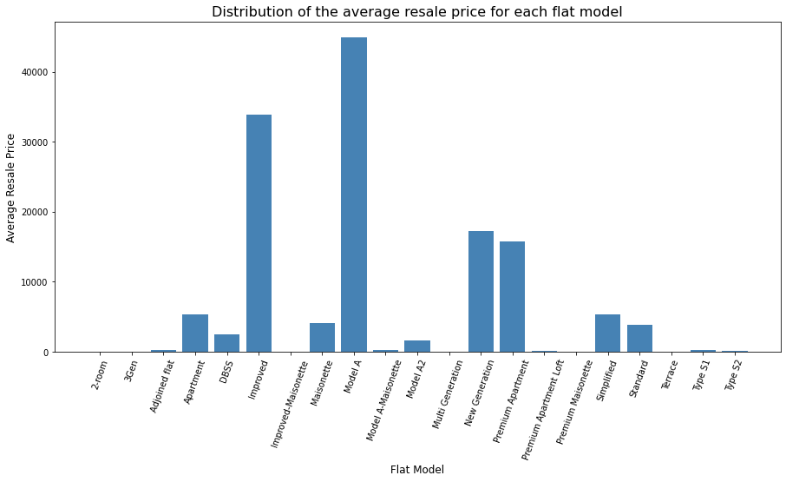
02 Introduction to Dataset – EDA: Categorical
Flat model such as Model A, Improved, New Generation and Premium Apartment have the highest average HDB resale price.
(Hide: due to slide limit)

Slide 6
03: Methodology – Data Pre-processing, Model Selection and Training
Data Pre-processing
Categorical variables such as town, flat type, storey range and flat model were converted to numerical variables by assigning an integer to them
This will enable us to create dummy variables or one-hot encode the columns before using it to train the model
Other pre-processing also include changing remaining_lease from text to numeric
Model Selection and Training
Data was split into training and test set during the train_test_split function
Linear Regression was chosen as the model because the coefficients of the variables can be easily interpreted

Slide 7
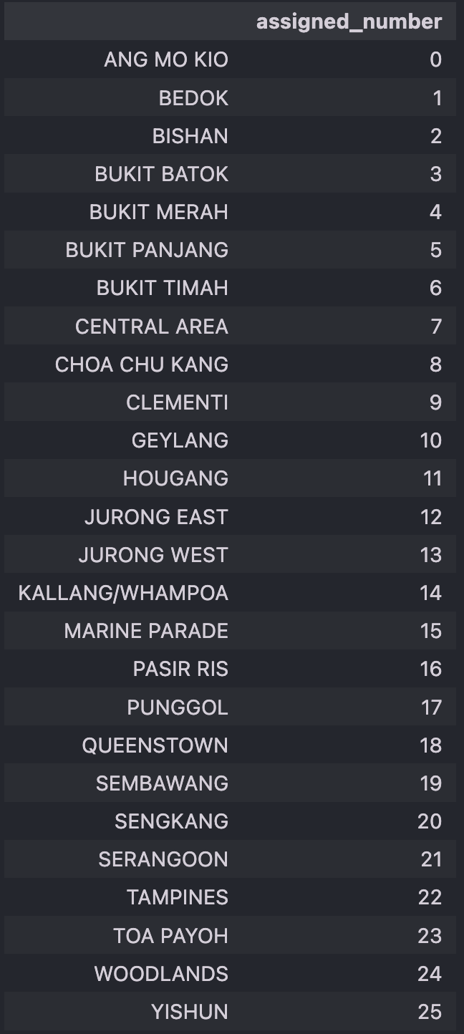
03: Methodology – Data Pre-processing, Model Selection and Training
Categorical variables such as town, flat type, storey range and flat model were converted to numerical variables
This was done by assigning an integer to each of the unique values in the columns
An example of how this was done is shown on the right
The purpose of doing so is to enable us to carry out one-hot encoding or create dummies for them
Other pre-processing include changing remaining lease from text to numeric

Slide 8
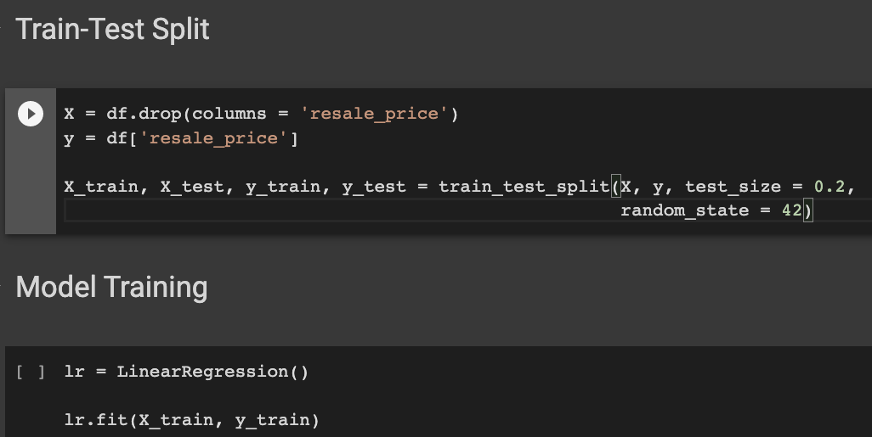
03: Methodology – Model Selection and Training
Data was split into training and test set during the train_test_split function
Linear Regression was chosen as the model because it is easier to interpret the coefficients of the variables
We fit the Linear Regression model to the Train set

Slide 9
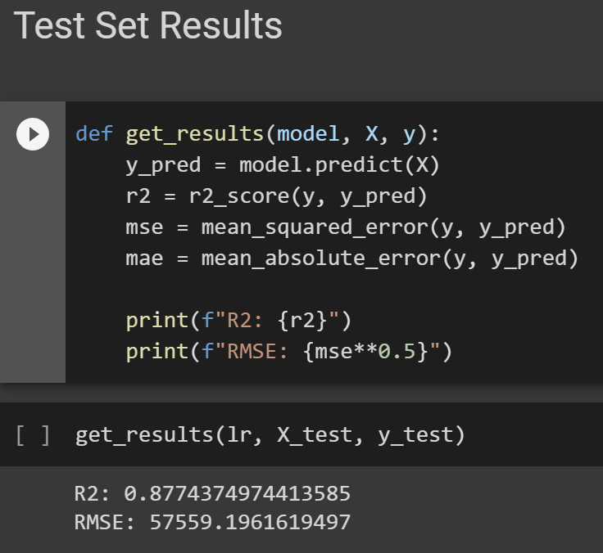
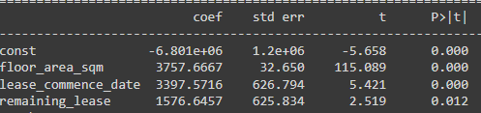
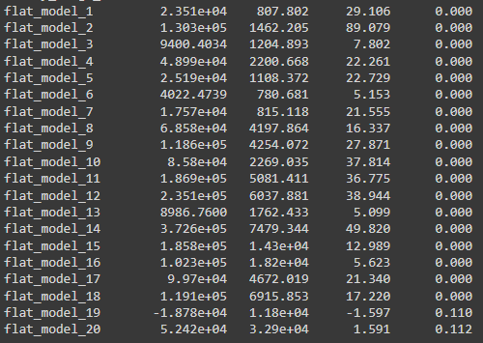
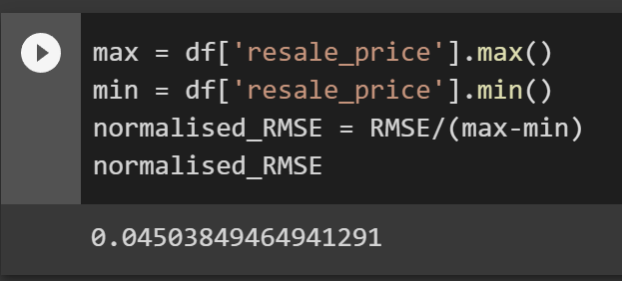
04: Test set results & model interpretation
Notes:
R2 value tells us how well the data fits our regression model, with 1 being the best value
RMSE tells us the average distance between the predicted values and the actual values.
In this case, we normalised the RMSE value to scale it according to the prices. The closer to 0 it is, the better fitting our model is
Coef shows us how much the resale price will change when there is a change in a unit of the X variable
P-value tells us if the X variable is significant at determining the resale price, so only variables with P-values of under 0.05 will be considered significant
In our model, the only variables that were considered insignificant were certain months when the sales took place and the last 2 flat model types (Type S1 and Type S2)

Slide 10
04: Test set results & model interpretation
Test set results
R2 evaluates the difference in the values in the baseline model and the regression line that our model comes up with, showing how much better our model can predict values compared to the baseline model, with 1 being the best value
R2 value is 0.877
RMSE is the root of the average of the difference between the predicted value and the actual value. To better compare it, we use the normalised RMSE, which is scaled down to be between 0 and 1, with 0 being the best value
Normalised RMSE value is 0.122
Model Interpretation
Notes:
R2 value tells us how well the data fits our regression model, with 1 being the best value
RMSE tells us the average distance between the predicted values and the actual values.
In this case, we normalised the RMSE value to scale it according to the prices. The closer to 0 it is, the better fitting our model is
Coef shows us how much the resale price will change when there is a change in a unit of the X variable
P-value tells us if the X variable is significant at determining the resale price, so only variables with P-values of under 0.05 will be considered significant
In our model, the only variables that were considered insignificant were certain months when the sales took place and the last 2 flat model types (Type S1 and Type S2)

Slide 11
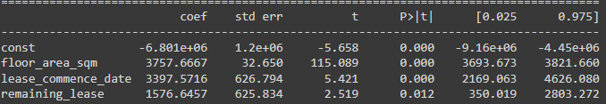
05: Business Insights - Floor Area & Remaining Lease
Effect of floor area on resale price
Positive coef of 3757.6667 for floor area per square meter, which indicates that on average, the resale price increases by $3757.67 as floor area increases by a unit
Effect of remaining lease on resale price
Positive coef of 1576.6457 for remaining lease, which indicates that on average, resale price increases by $1576.65 as the lease increases

Slide 12
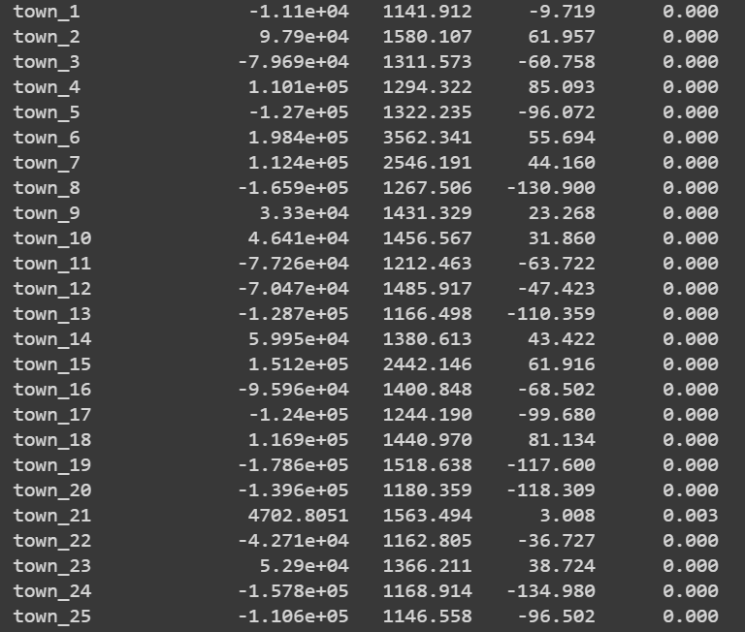
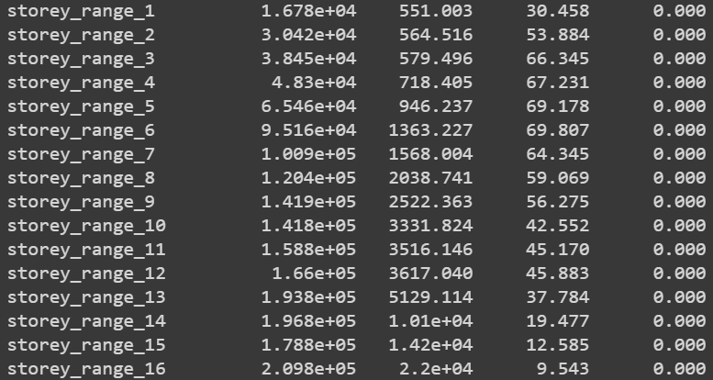
05: Business Insights - Town & Storey Range
Effect of town on resale price
Coef indicates the difference in resale prices between the reference town (AMK) and other towns
Towns include: Bedok, Bishan, Bukit Batok, Bukit Merah, Bukit Panjang, Bukit Timah, Central Area, CCK, Clementi, Geylang, Hougang, JE, JW, Kallang/Whampoa, Marine Parade, Pasir Ris, Punggol, Queenstown, Sembawang, Sengkang, Serangoon, Tampines, Toa Payoh, Woodlands, Yishun
Highest Resale Price: Town 6 (Bukit Timah)
Lowest Resale Price: Town 19 (Sembawang)
Effect of storey range on resale price
Coef indicates the difference in resale prices between the reference storey range 0-3 and other ranges
Ranges include: 4-6, 7-9, 10-12, 13-15, 16-18, 19-21, 22-24, 25-2, 28-30, 31-33, 34-36, 37-39, 40-42, 43-45, 46-48, 49-51
Highest Resale Price: Storey range 16 (49-51 storeys)
Lowest Resale Price: Storey range 0 (0-3 storeys)
As the number of storeys increases, the resale price increases
Notes:
Bukit timah 198.4K more
Sembawang 178.6k less
Storey 16 (209.8k more)

Slide 13
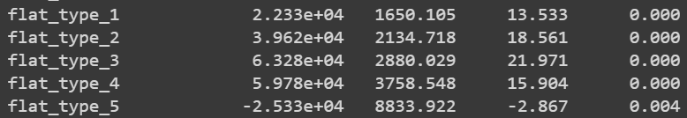
05: Business Insights - Flat Type & Flat Model
Effect of flat type on resale price
Coef of each flat type represents the average difference in resale prices between that flat type and the reference flat type (2-Room)
By increasing price order: 1-5 Room, Executive, Multi-generation
Highest/Lowest Resale Price: Multi-Generation/1-Room Flat
Effect of flat model on resale price
Coef of each flat model represents the average difference in resale prices between that flat model and the reference flat type (Improved)
Flat models include: 'Improved', 'New Generation', 'DBSS', 'Standard', 'Apartment','Simplified', 'Model A', 'Premium Apartment', 'Adjoined flat','Model A-Maisonette', 'Maisonette', 'Type S1', 'Type S2', 'Model A2', 'Terrace', 'Improved-Maisonette', 'Premium Maisonette','Multi Generation', 'Premium Apartment Loft', '2-room', '3Gen'
Highest/Lowest Resale Price: Terrace/2-room
Coefs for 2-room and 3Gen are statistically insignificant - no significant difference between the resale prices of 2-room, 3Gen and Improved flats
Notes:
Multi-Generation flat type is $597,800 more expensive than the 2-room flat, while the 1-room flat type is $253,300 cheaper.
Terrace is $372,600 more expensive than the Improved flat model, while 2-room flats cost $187,800 cheaper.
In conclusion, our ML tool performs rather well in predicting house prices given the significant determinants that we have discussed.
A further extension to this project can investigating more price factors such as proximity to public transport, proximity to nearby flats.

Slide 14
Thank you!

