Slide 1

NUS Students’
Games Development Group

Slide 2


What we do?
Make video games
Play games (that we made)
Teach you how to make your own game
Thus our motto:Learn. Design. Create.

Slide 3
How can we help you?
You are future developers of tomorrow!
You can learn to be one of the following:
A programmer (especially relevant to you)
A game artist
An aspiring game designer
All of the above (why not?)

Slide 4
How can we help you?
Expand your portfolio!
Meet like-minded people who like games!
Have fun while doing the above! (Hey! It’s games!)

Slide 5




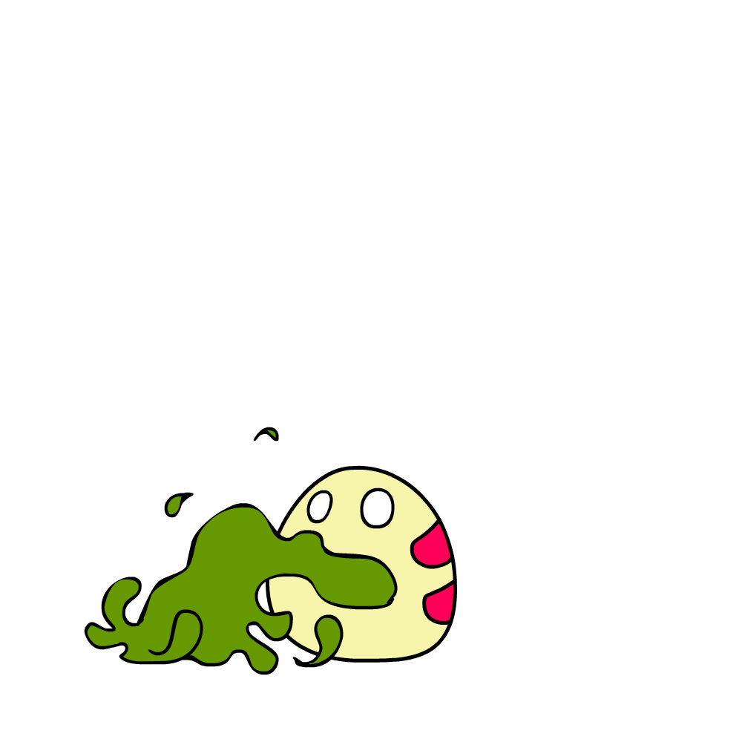


What’s coming up?
Student Life Fair (14th-16th Aug @ Utown MPH 2)
Welcome Tea (20th August @ CNM Playroom)
GameCraft!2014 (20th-21st Sep, COM1 Basement)
Workshops (throughout the year!)
Games Development Phase

Slide 6
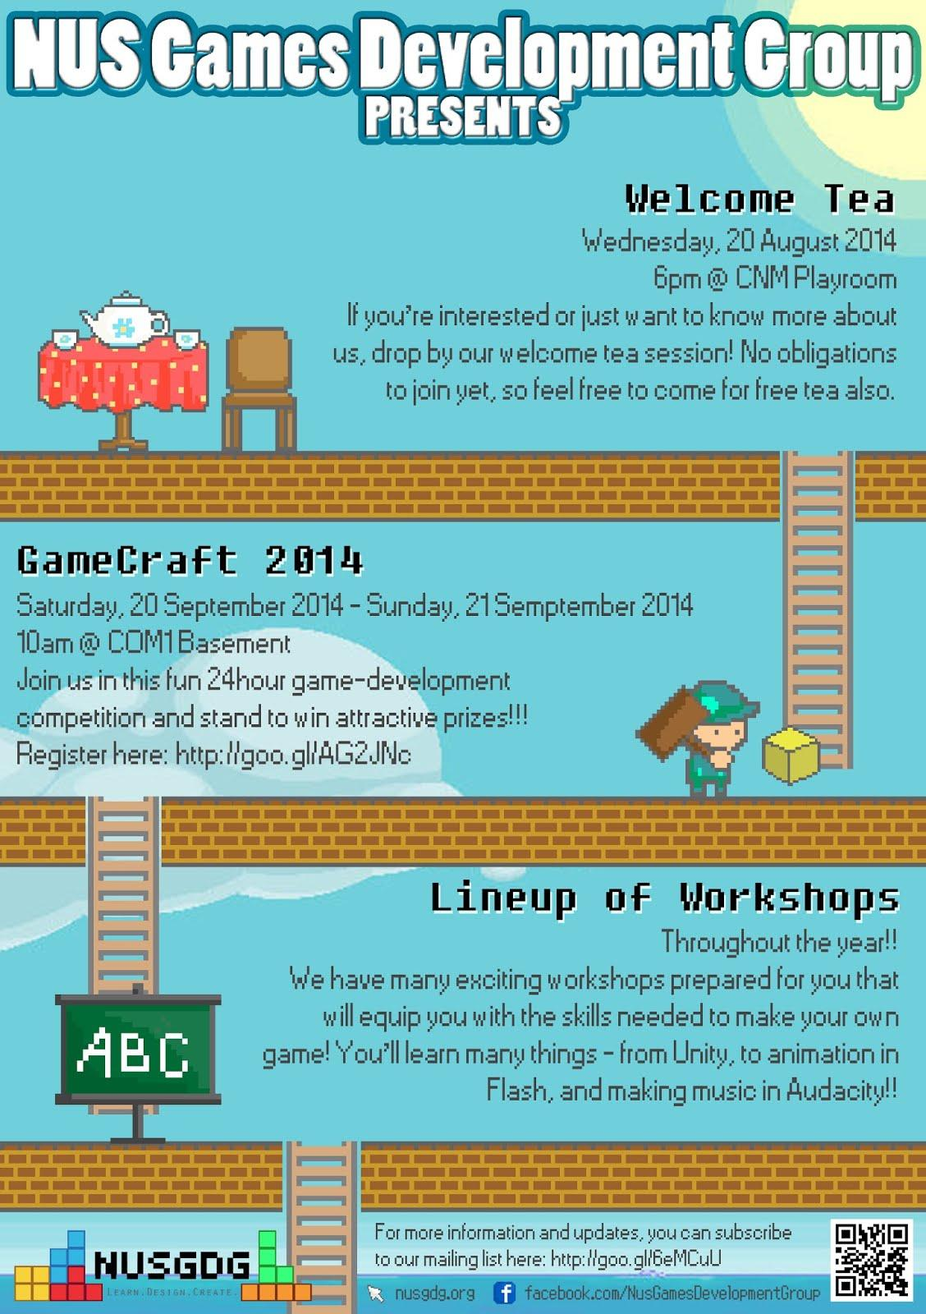

Slide 7
GameCraft! 2014
24-hours hackathon/games dev competition
Stand to win attractive prizes (details TBC)!
Just come down and gain some experience
Make friends, have fun!

Slide 8




Pre-Gamecraft! Workshops
Game design theories
Game-Maker
Unity
Flash
Audacity
Basic Scripting
Art and animation

Slide 9
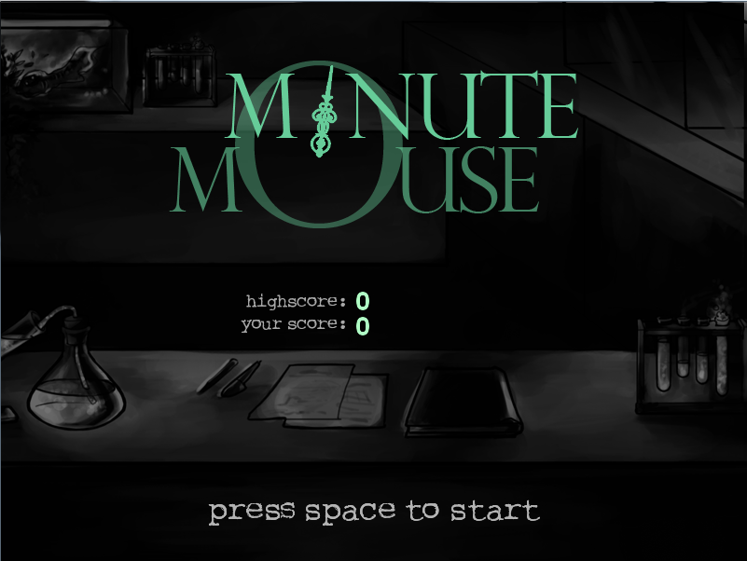
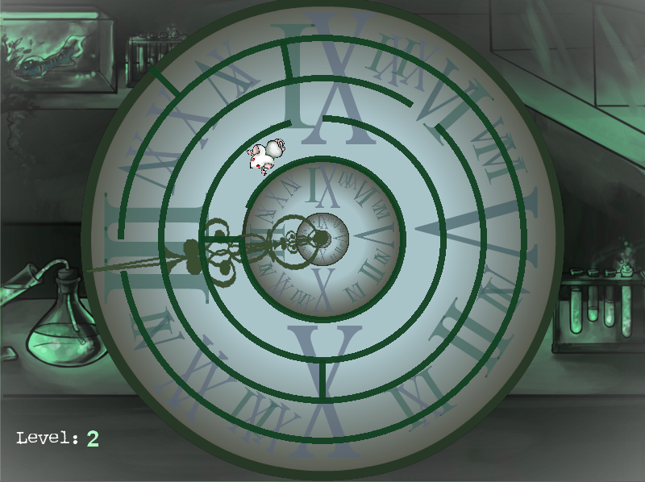
Gamecraft! 2014
Last year’s theme: Minute
Winning entry: Minute Mouse

Slide 10
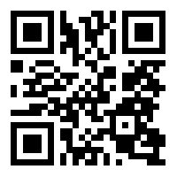
How can you start?
Just follow these simple steps:
Take out your phone
Scan the QR code: (or go to this URL: http://goo.gl/6eMCuU)
Do the 1-minute survey
Press submit

Slide 12


Nusgdg.org facebook.com/NusGamesDevelopmentGroup

