Slide 1
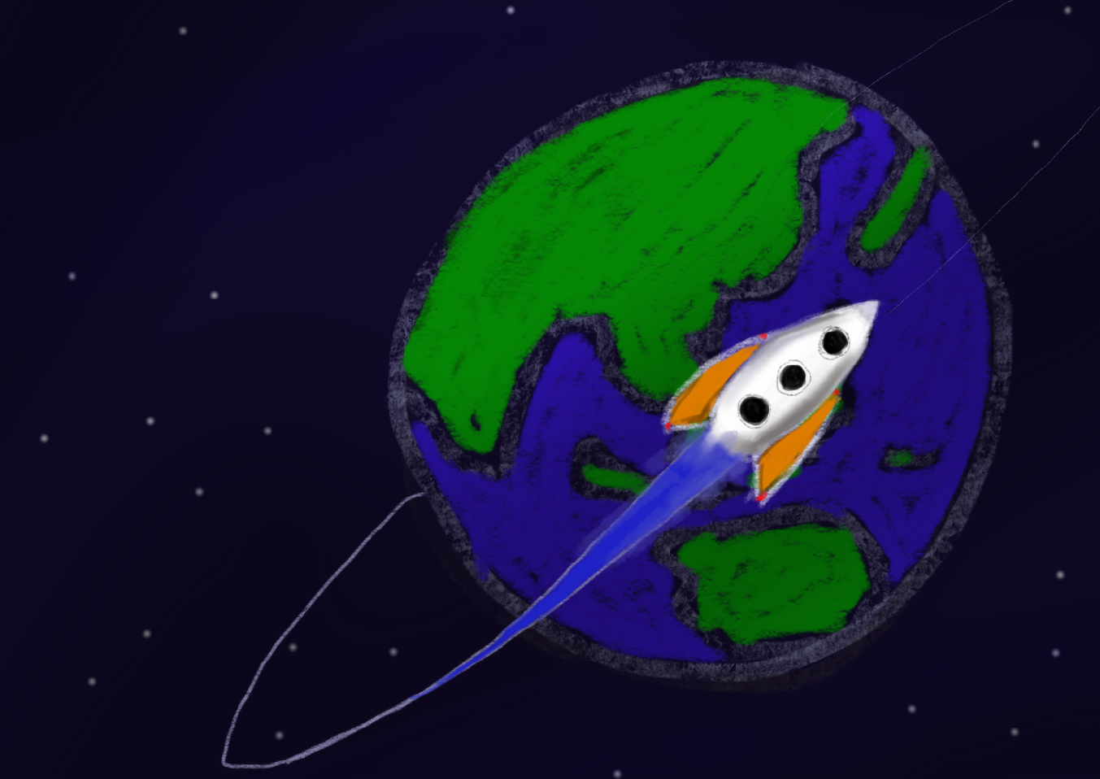
Orbital at Acad Day
5 August 2014
http://orbital.comp.nus.edu.sg/

Slide 2
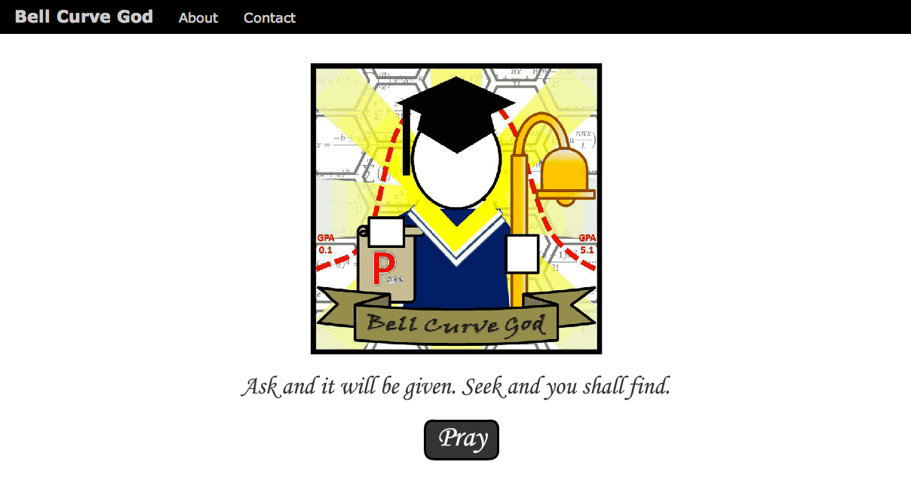
Sample Project from 2013 Bell Curve God

Slide 3
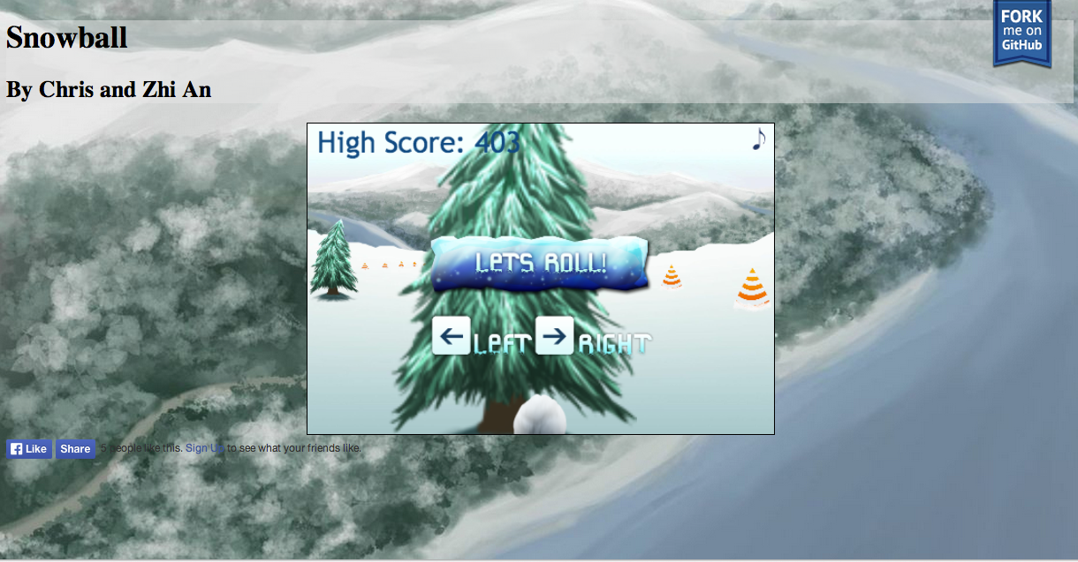
Sample Project from 2013 Snowball

Slide 4
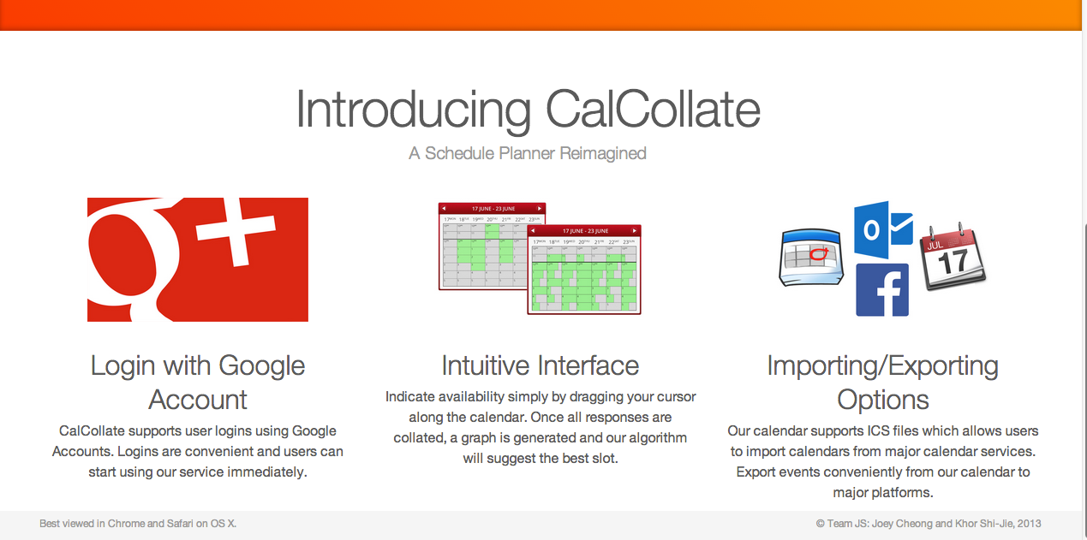
Sample Project from 2013 CalCollate

Slide 5
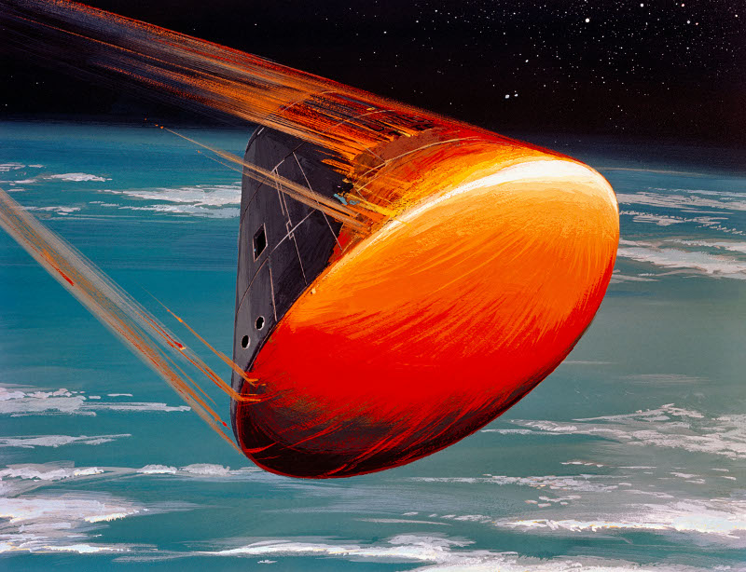
Invitation to Splashdown 2014
Get Inspired!
Friday 22 Aug 2014
SR1
Check your emails for details closer to the date

