Slide 1
Unix Workshop 2014
5 Aug 2014

Slide 2

What is Unix
Multitasking, multiuser operating system
Often the OS of choice for large servers, large clusters
Notes:
65% of web servers run some type of Unix
95% of Top500 supercomputers run Linux
http://en.wikipedia.org/wiki/Usage_share_of_operating_systems

Slide 3



Unix Around You
You’re probably familiar with these:
Linux
Solaris
Mac OS X (roots from FreeBSD and NetBSD)
Many websites run on Unix
Notes:
Workhorse of much of the Internet. Many appliances (e.g. firewalls, routers, load balancers) also run on some form of Unix. Embedded gadgets like Raspberry Pi run Linux. Android has a Linux kernel in there.

Slide 4
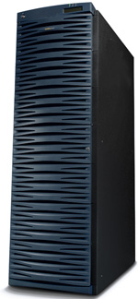
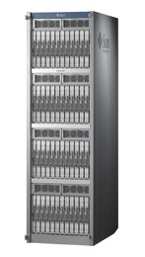
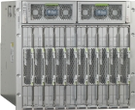
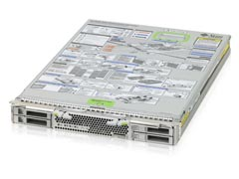
What is SunFire?
In 2001: Full-sized rack
Today: A solaris zone in a blade of a chassis quarter-size of a rack!
2m
Virtual Machine
Notes:
SunFire is a server. Full height rack in 2001. Has since shrunk into just a zone (Solaris Container) in a tiny blade.
SunFire is also the hostname of the general login server all students use.

Slide 5
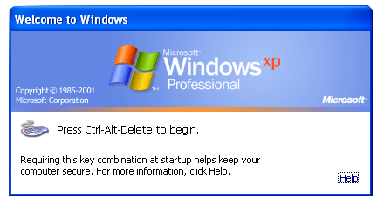
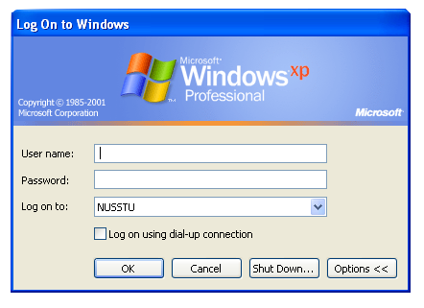
Activity: Login to NUSNET
Press Ctrl-Alt-Delete
Type in your NUSNET user name, password, and select the NUSSTU domain
Click the OK button

Slide 6
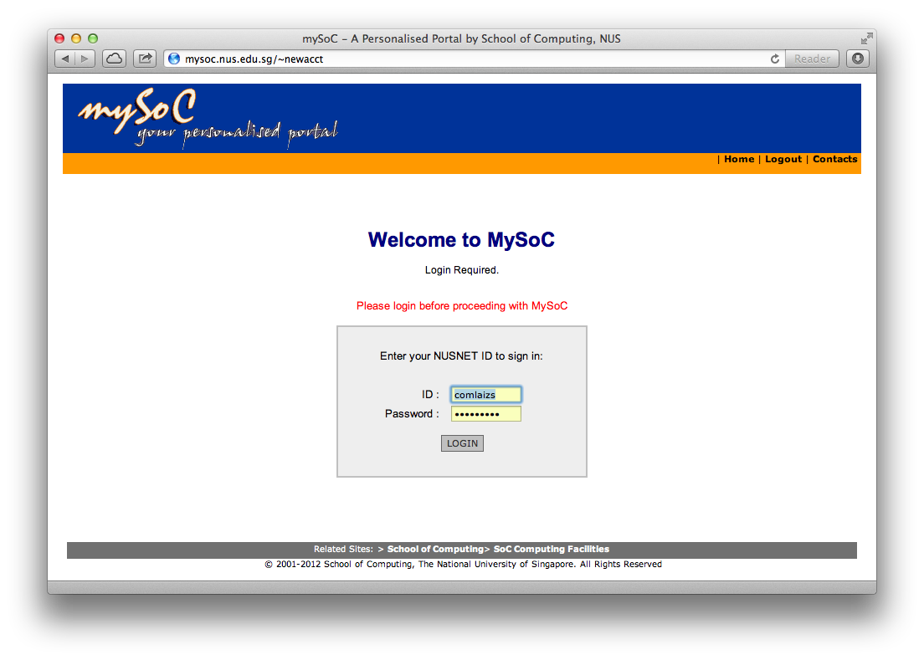
Activity: Create Your SoC Account
https://mysoc.nus.edu.sg/~newacct
Login using your NUSNET user name and password

Slide 7
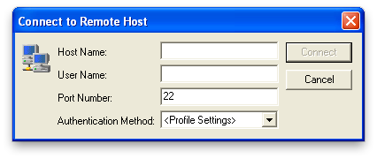
Activity: Connecting to SunFire
From the desktop, launch the SSH Secure Shell Client application
Click on Quick Connect Host Name: sunfire.comp.nus.edu.sg User Name: Your SoC user name
Click on Connect
Click on “Yes” at the Host identification dialog
Enter your SoC password in the password dialog

Slide 8
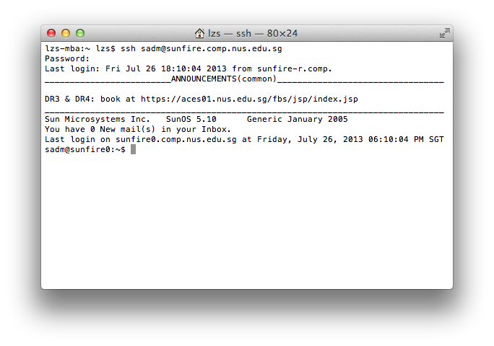
The Shell
This is a CLI
Notes:
There are other shells. The default is bash (Bourne Again Shell). Others are sh, tcsh, zsh.

Slide 9
Unix Directory Tree
/ (root)
bin
dev
home
a
ahkow
b
tmp
bin
sbin
usr
Notes:
Directory structure in Unix. Concept similar to Windows or MSDOS (if anyone still knows MSDOS?). Notice in Unix there are no “drive letters”, and the slashes are forward-slash (as opposed to backslash in Windows/MSDOS). Special directories like . and .. .

Slide 10
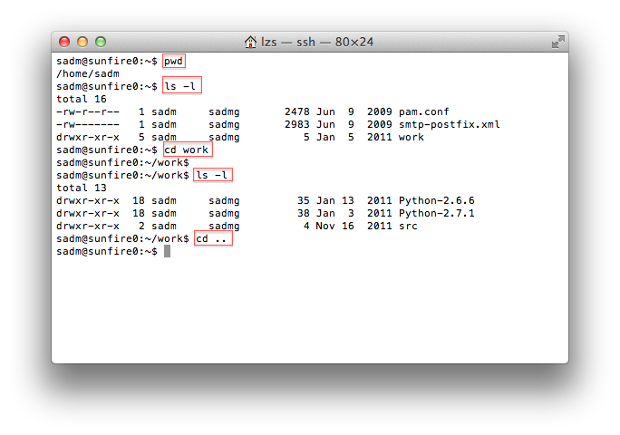
Activity: Working With Directories

Slide 11
Working With Files
Command | Description
cp <file1> <file2> | Copy a file
mv <file1> <file2> | Move or rename a file
mv <file> ~/<dir>/ | Move file into a subdirectory
rm <file> | Remove (delete) a file
mkdir <dir> | Create a subdirectory
rmdir <dir> | Remove (delete) a subdirectory
rm –r <dir> | Recursively remove subdirectory and its contents

Slide 12
Directory Contents
-rw-r--r-- 1 sadm sadmg 2478 Jun 9 2009 test
drwxr-xr-x 5 sadm sadmg 5 Jan 5 2011 work
^^^^^^^^^^
| | | |
| | | other
| | group
| user
type
Notes:
Talk about the meaning of the permission bits. Particularly in context of directories, what do the r, w and x mean.
r: Can read content of file; Can get directory listing.
w: Can modify file; Can create/remove files.
x: Can execute binary code; Can “access” the directory (needed to operate in the directory).

Slide 13
Viewing Files
Command | Description
cat <file> | Print out contents of file
more <file> | Print out contents of file page at a time
less <file> | Like above, but can go back and forth
head <file> | Show first few lines of file
tail <file> | Show last few lines of file

Slide 14
Editing Files
Several editors are available:
pico / nano
vi / vim
Emacs
Interactive vi/vim tutorial:
http://www.openvim.com/tutorial.html
Notes:
Share a little about the editors. No way we have time to teach editors here, particularly the vi editor that we would recommend for regular use. Suggest to learn on own.

Slide 15
Shell Features
Command history
Filename completion
Wildcards

Slide 16
Spying Around
Command | Description
who | See who are currently logged in
w | See what programs users are running
w <userid> | See what program this user is running
last | Get login history of users
last <userid> | Get login history of this user
last -3 <userid> | Get last 3 login records of this user

Slide 17
Getting Help
Help
man and apropos

Slide 18
Activity: Get Sample Files
Run this in your shell:
$ mkdir workshop
$ cd workshop
$ cp /tmp/uw/uw.zip .
$ unzip uw.zip
Check you got the samples:
$ ls –l
gcd.c index.html wordlist.txt
Notes:
Remind everyone to create the workshop subdirectory, and change into it.

Slide 19
Programming Workflow
Edit
Compile
Run
Test
Notes:
Our goal here is only to gently introduce what programming involves. For people who’ve no prior programming knowledge, the idea is to ease them in so that they do not get shocked when they turn up for CS1010 labs.

Slide 20
Activity: Compiling and Running
C programs are compiled using the gcc compiler $ gcc gcd.c
To run a program, you must add ./ in front of its name; the default name used by gcc is a.out
Run the GCD program $ ./a.out
Type in a pair of integers followed by the Enter key, for example: 58 24
Repeat step 4 as many times as you like
To quit the program, press Ctrl-D
Notes:
Quitting is not ^Z unlike in Windows.

Slide 21
Activity: Logging Out
$ logout
Logging out is important!
To change your SoC password, go to:
https://mysoc.nus.edu.sg/~myacct/resetpass.cgi
Notes:
Share a bit on security awareness. Responsibility of own Unix account.

Slide 22
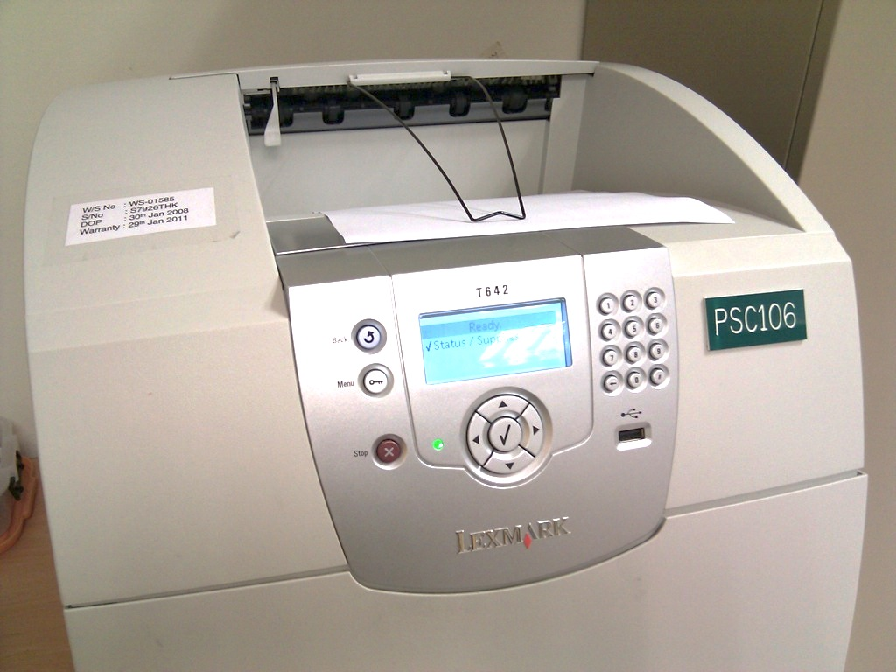
Printing
SoC printers accessed via network
Usually through client desktop or notebook (Windows, Mac, Linux, etc)
Also central Unix servers
Print queue management only possible through central Unix servers
Command | Description
lpq –P<printer> | Check print queue of specified printer
lprm –P<printer> <id> | Remove job id from specified printer
pusage | Check print quota
Notes:
Can give examples of printer names: psts, pstsb, pstsc in front of Technical Services

Slide 23
Processes and Disk Usage
Command | Description
quota | Check disk quota
du | Check disk usage in each subdirectory
du –s * | Like above, but summarize at specified directories
find … | Find files
chmod … | Modify file permissions
ps … | List processes
kill … | Kill process
Notes:
Do chmod elaboration

Slide 24
Pipes and Redirection
Redirection:
$ sort < wordlist.txt > sorted.txt
Pipes:
$ cat wordlist.txt | sort | less
Notes:
Redirection: Supply input from file, or to save output to file
Pipes: Send output of one program to the input of another

Slide 25
Shell Initialization
File | Description
~/.profile | Executed for login shells
~/.bashrc | Executed for interactive non-login shells
Used to setup the shell environment
Examples:
Setting of $PATH
Setting command aliases

Slide 26
Activity: Setup Your Webpage
Create public_html:
$ mkdir ~/public_html
Set the right permissions:
$ chmod 711 ~ ~/public_html
Put up a default index.html:
$ cp index.html ~/public_html
$ chmod 644 ~/public_html/index.html

Slide 27
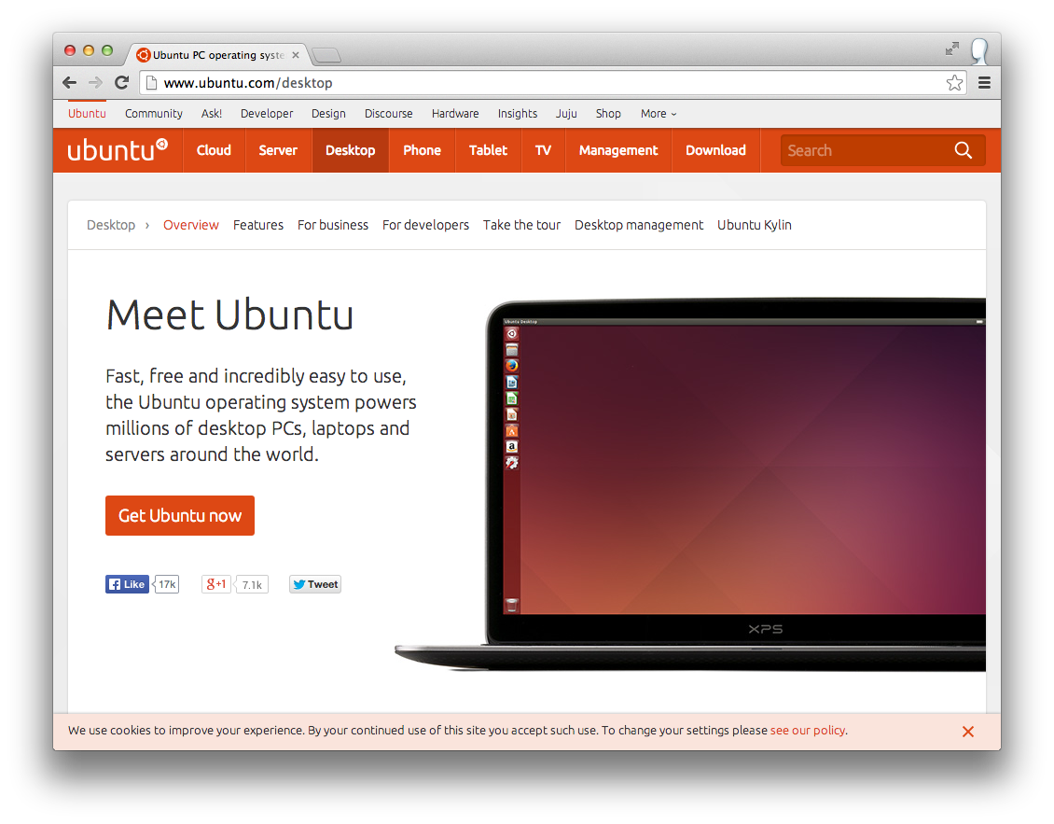
Learning Unix on Your Own
www.ubuntu.com
Notes:
Or Fedora. Or Solaris. Or just use a Mac (next slide)! Talk about using virtualization solutions.

Slide 28
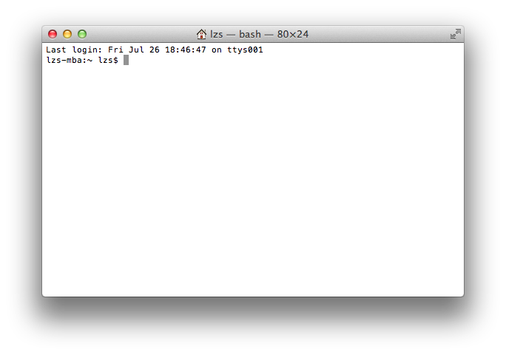
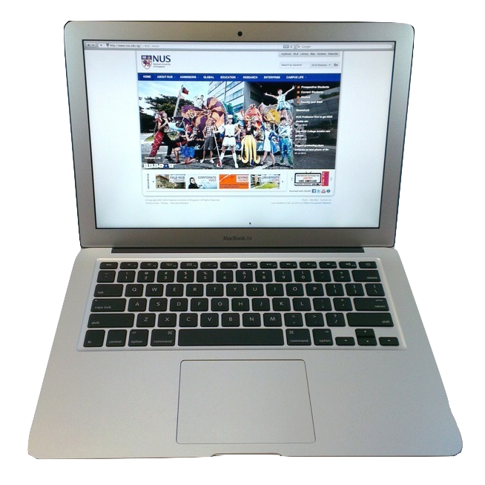
Unix on a Mac
OS X is every bit Unix.
Development tools in Xcode.
Notes:
NeXTSTEP had its roots from FreeBSD and NetBSD. OS X is descendent from NeXTSTEP. Pretty much everything you need from Unix is in the Mac.
Compile toolchain (gcc) requires additional install from within Xcode.

Slide 29
Useful Websites
Secure SSH https://docs.comp.nus.edu.sg/sites/default/files/SSHSecureShellClient-3.2.9.exe
Putty, SSH client: http://www.chiark.greenend.org.uk/~sgtatham/putty/
KiTTY, another SSH client for Windows: http://www.9bis.net/kitty/
Cygwin, UNIX-like environment for Windows: http://www.cygwin.com/
Description of computing facilities in SoC: https://docs.comp.nus.edu.sg/cf
MySoC, intranet portal: https://mysoc.nus.edu.sg
http://goo.gl/uSydr4

Slide 30
Q&A
Download slides: http://goo.gl/bNBHlB

Slide 31
Challenge Activity
Look at the wordlist.txt file.
Find:
Determine the most frequently occurring word(s). How many times and what is/are the word(s)?
Notes:
Optional slide. If there is time, give this as a challenge.
cat wordlist.txt | sort | uniq –c | sort

Slide 32
Thanks for attending Acad Day!
Do give us your feedback at: http://tinyurl.com/otqt2ee
☺

