Slide 1


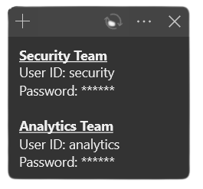
NUSecure
Name
User ID :
Password :
Log in

Slide 2

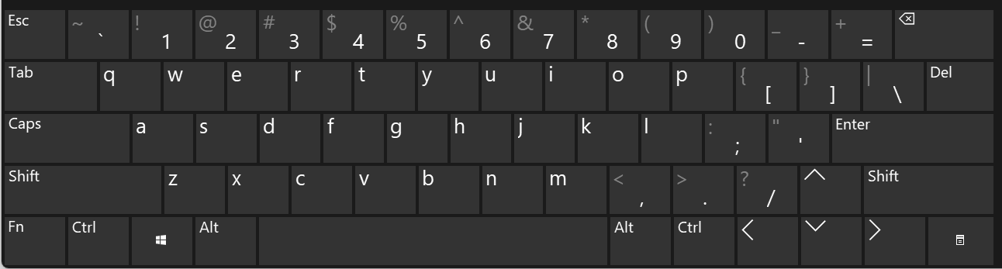
NUSecure
Name
u
r
User ID :
s
t
e
i
c
y
*
*
*
Password :
*
*
*
Log in

