Slide 1

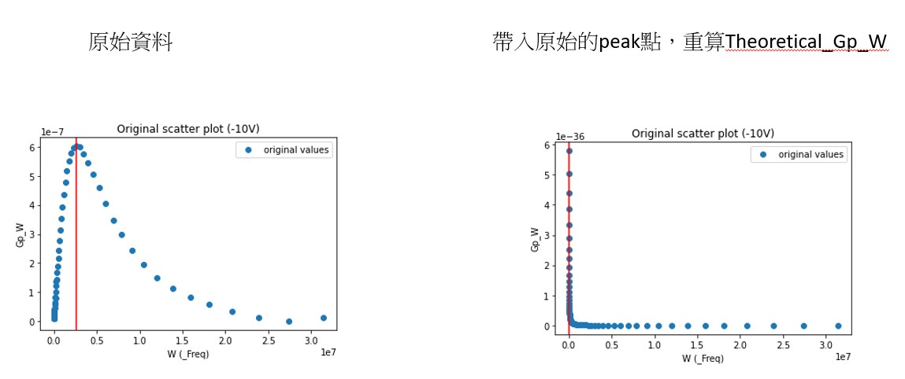
G_{P} /ω from measurement
For D_{it} and τ_{it} fitting

Slide 2



G_{P} /ω from measurement
For D_{it} and τ_{it} fitting
find maximum
Find (x₀, y₀) when y = y_{max}
D_{it} = y₀ * 2 / q
τ_{it} = 1 / x₀
#

Slide 3
找出 理論曲線(橘線) 與原始數據(藍點) 的擬合度(0~1)

