Slide 1
f=1000
Group 1
f
Group 2
f
C
G
V
V
C_{ox}=C_{max}@(f=1000)
Group 3
V
W=2PI()f
f
Gp/w
w
Area = 10⁻³
Area = 10⁻³

Slide 2
Group 3
V
Group 4
Peak max => (y,x)
W=2PI()f
f
Gp/w
V
x
y
1/x
Y*q/2
w
q=(1.6*10⁻¹⁹)
Fitting curve
Peak max => (y,x)

Slide 3
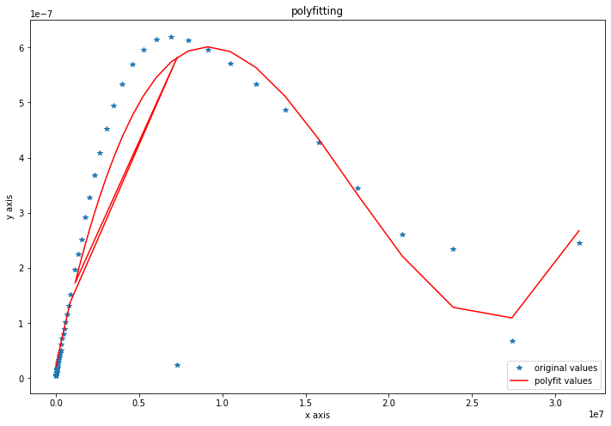
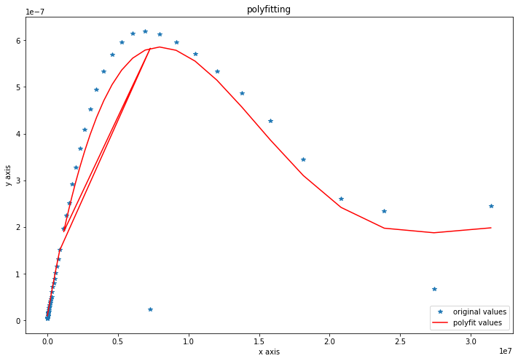
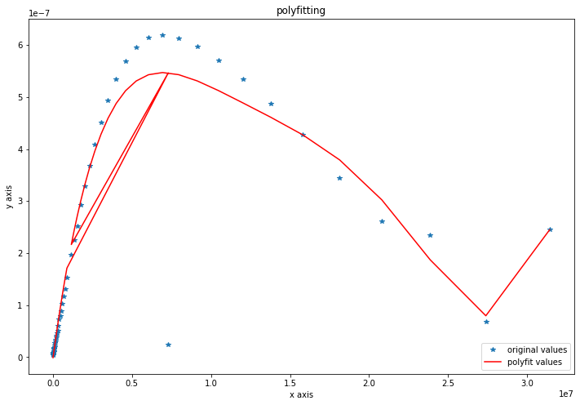
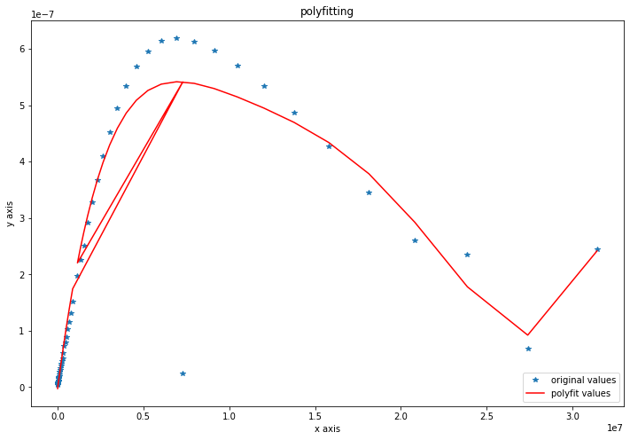
3
4
5
6

Slide 4
