Slide 1
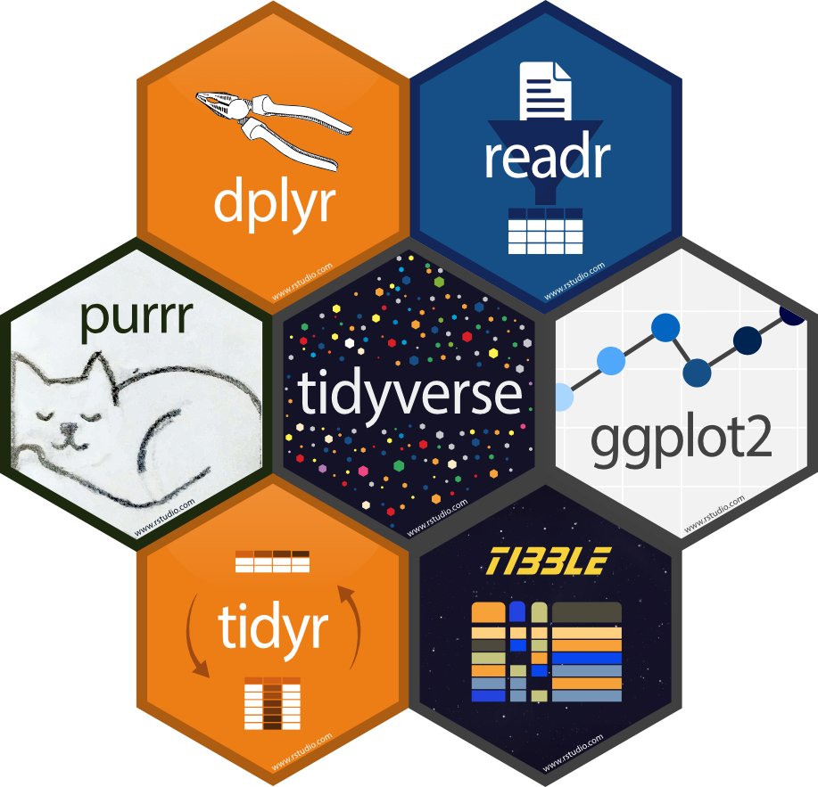
Math Camp 2022 Day 4
Introduction to tidyverse

Slide 2
What is tidyverse?
Library of packages designed for modern data science
All packages share an underlying design philosophy, grammar, and data structures. High learning curve but big returns.
Workflow simplifying
Easier to use and more efficient than base R
We’ll focus on:
dplyr – data manipulation
ggplot2 – data visualization
tidyr – data cleaning
readr – data importing

Slide 3
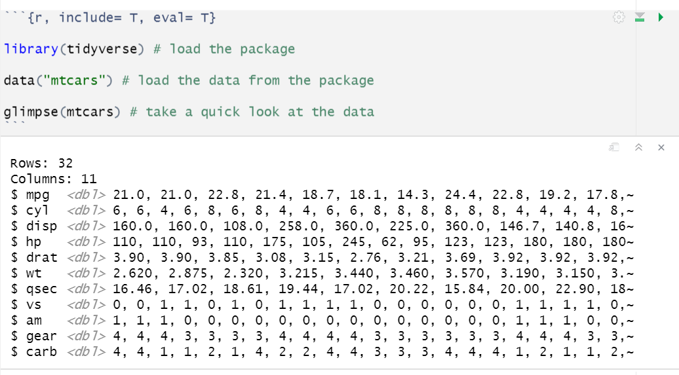

Slide 4
Piping
The pipe, %>% or |>, allows us to chain together functions to create meaningful function pipelines
Shortcuts:
command+shift+M – Mac
ctrl+shift+M – Windows
Start with a data object and use different functions in a coordinated manner to achieve an efficient outcome with the data
Input is on the LHS and output on the RHS, chain in the middle
Can think of the pipe as an AND THEN statement, do this and then this
Piping is a great option for saving intermediate objects. Intermediate objects might be subsets that have various parameters on the data, summarized parts of your data, or data that has otherwise been transformed that does not fit the existing dimensions of your data.

Slide 5
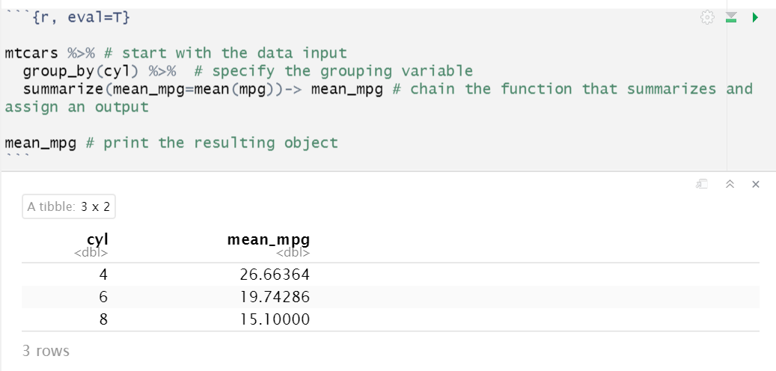

Slide 6
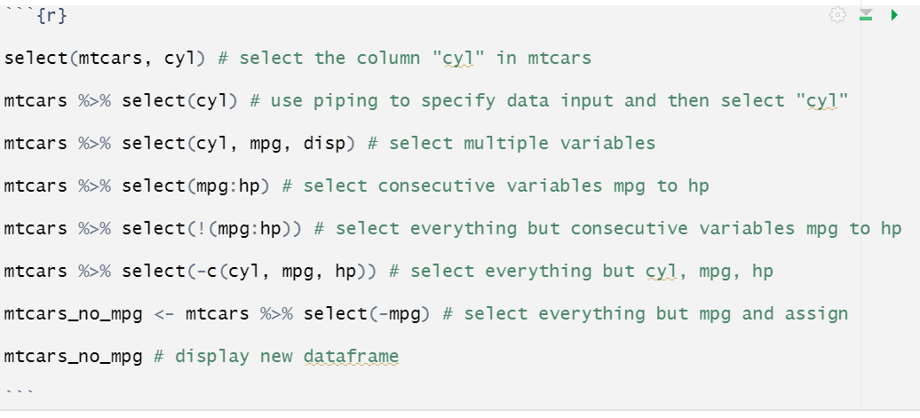
select: the `select` command allows us to easily select or filter columns from our data frame.

Slide 7
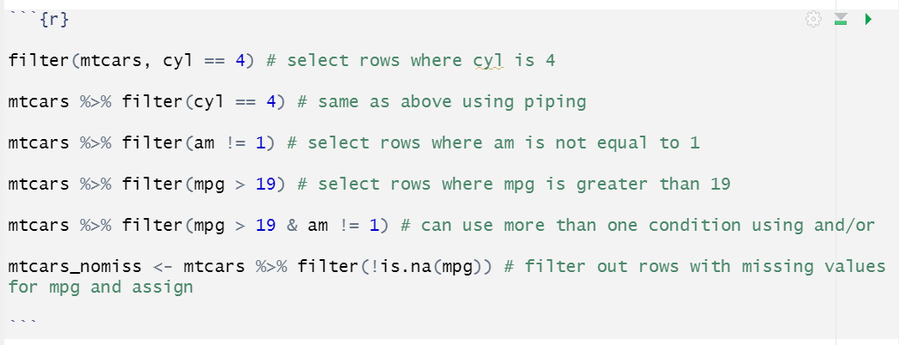
filter: The filter command allows us to select or flter rows from our dataframe. Can add conditions with commas or with AND/OR (&/|).

Slide 8
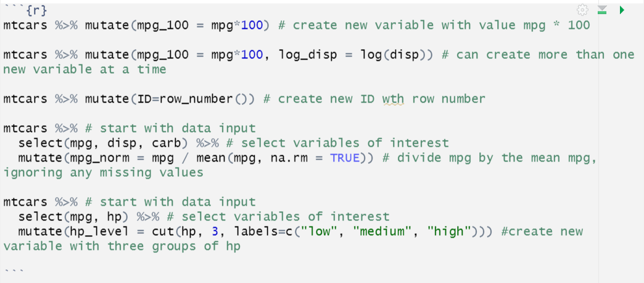
mutate: used to create new columns in a data frame

Slide 9
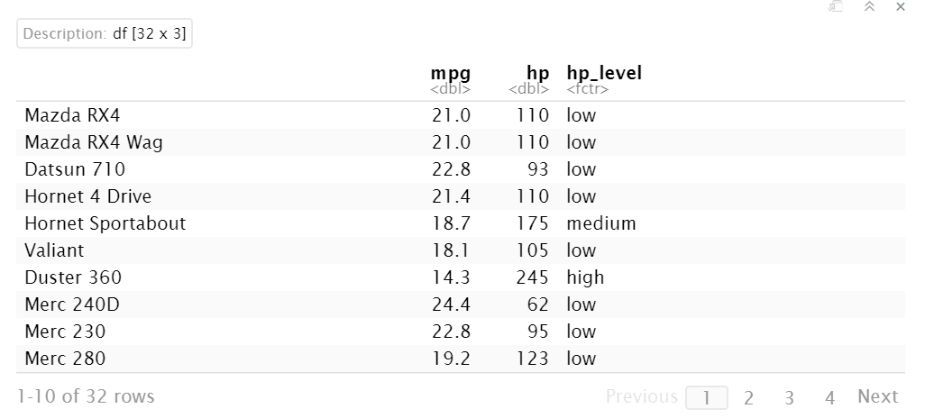

Slide 10
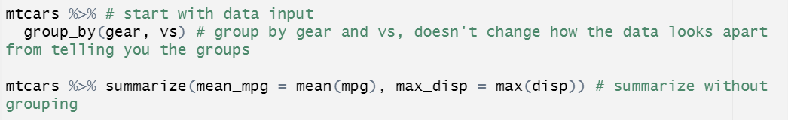
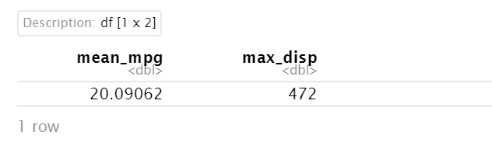
group_by: group data by one or more variables often used in combination with summarize

Slide 11
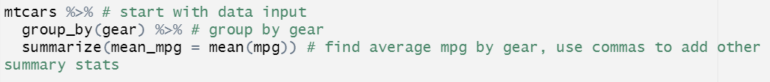
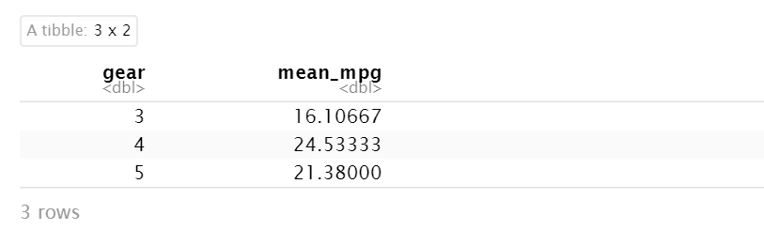

Slide 12
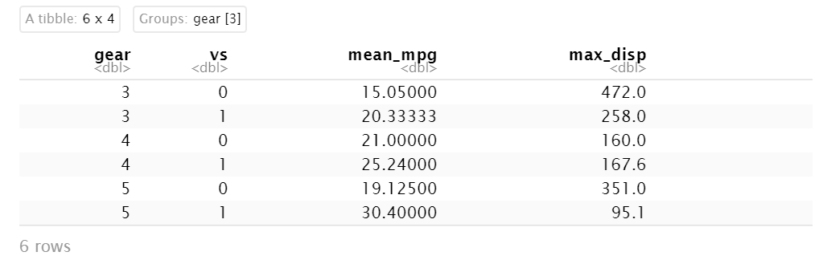
Use commas to group by more than one variable and summarize more than one stat

Slide 13

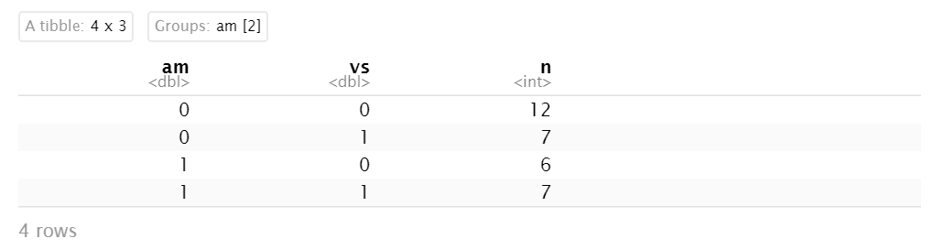

Slide 14
Merging data with dplyr
MUTATING JOINS
Inner join
Left join
Right join
Full join
FILTERING JOINS
Semi join
Anti join

Slide 15
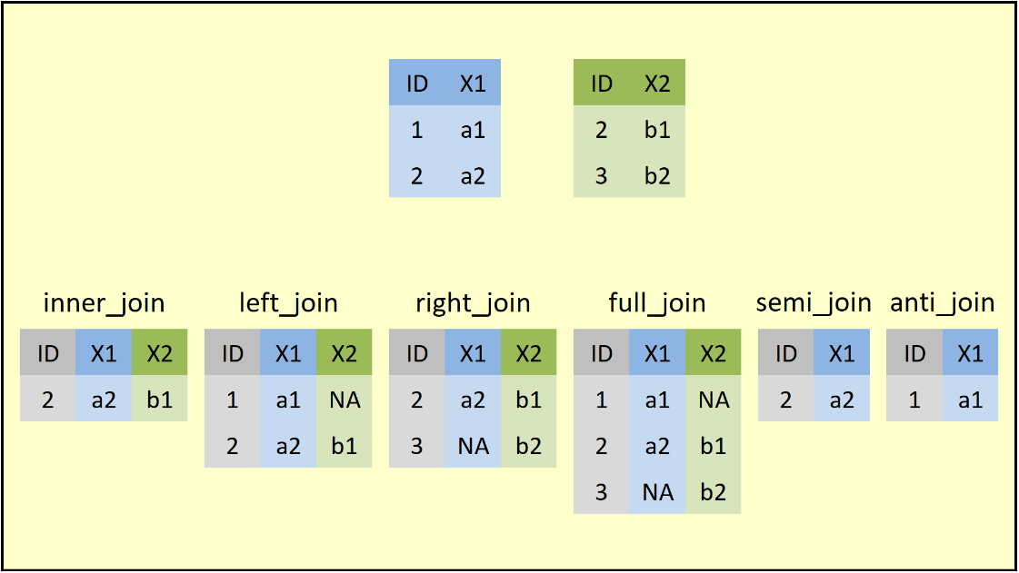
Source: Statistics Globe (https://statisticsglobe.com/r-dplyr-join-inner-left-right-full-semi-anti)

Slide 16
inner_join: merges the variables of both data frames, but retains only rows with a shared ID
left_join: returns all rows of the data frame put first in the function (x). Rows in x with no match in y will have NA values. If there are multiple matches between x and y, all matches will be returned
right_join: returns all rows of the data frame put first in the function (y). Rows in y with no match in x will have NA values. If there are multiple matches between x and y, all matches will be returned
inner_join(data1, data2, by = "ID")
left_join(data1, data2, by = "ID")
right_join(data1, data2, by = "ID")

Slide 17
Source: Statistics Globe (https://statisticsglobe.com/r-dplyr-join-inner-left-right-full-semi-anti)

Slide 18
full_join: return all rows and columns from both x and y. Where there are no matching values, returns NA for those missing
semi_join: keeps data from x and uses y as a filter. Returns all rows from x where there are matching values from y, keeping just columns from x. an inner_join will keep one row of x for each matching row of y but semi_join will not duplicate rows of x.
anti_join: keeps data from x and uses y as a filter. Returns all rows from x where there are not matching values from y, keeping just columns from x.
full_join(data1, data2, by = "ID") OR data1 %>% full_join(data2, by = "ID")
semi_join(data1, data2, by = "ID") OR data1 %>% semi_join(data2, by = "ID")
anti_join(data1, data2, by = "ID") OR data1 %>% anti_join(data2, by = "ID")

Slide 19
Source: Statistics Globe (https://statisticsglobe.com/r-dplyr-join-inner-left-right-full-semi-anti)

Slide 20
join by multiple columns
full_join(data2, data3, by = c("ID", "X2"))
join by columns with different names
full_join(data2, data3, by = c("ID" = “name”)

Slide 21
Exercise
Load the built in dataset “iris” in R
Select everything but petal length and then filter out rows with sepal width less than or equal to 3.1. Save this new dataframe.
Group by species and find mean sepal length for each group
How many observations of each species have sepal width over 3.5? Make a table
Create a new ID variable with row number called “ID” and save this as iris_id
Generate a new data frame like this:
sample_df <- data.frame(ID = 11:200, x1 = 99)
Do an inner join, a left join and a full join of iris_id and sample_df
What are each of these joins doing?

