Slide 1














Fraud Detection in Reviews
Instructor: Đỗ Trọng Hợp
Group member:
Nguyễn Lê Vy - 21520811
Nguyễn T.M Trinh - 21522718

Slide 2
INTRODUCTION
01.
DATASET
02.
Report content
METHODOLOGY
03.
EXPERIMENTAL RESULTS
04.
CONCLUSION
05.

Slide 3
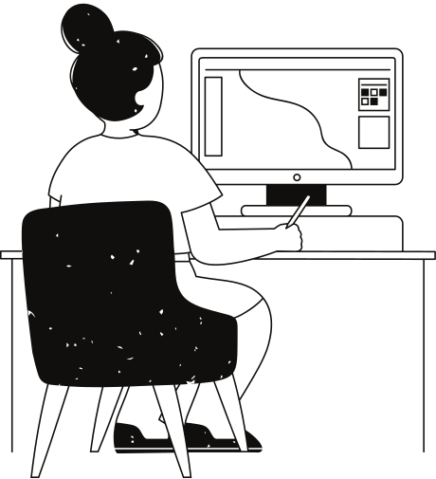
01. INTRODUCTION
Product reviews on e-commerce sites are often manipulated for personal or collective gain through dishonest practices like seeding, insluding link, .... The rise of fraudulent reviews significantly challenges the fairness and integrity of the market.
We trained and evaluated on two Graph Neral Network models to detect fraudulent reviews on YelpChi dataset for fraud detection task in reviews. Subsequently, we deploy distributed inference graph neural network in reviews.

Slide 4
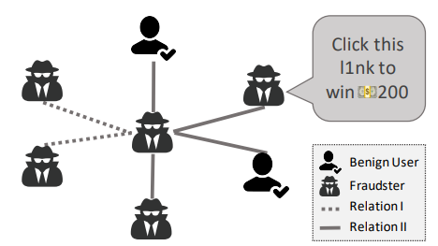
02. DATASET
The YelpChi dataset, collected from Yelp.com with 45,954 rows of data, includes hotel and restaurant reviews filtered (spam) and recommended (legitimate).
Source: kaggle.com
Users with > 80% helpful votes are labeled as benign entities
Users with < 20% helpful votes are labeled as fraudulent entities.

Slide 5
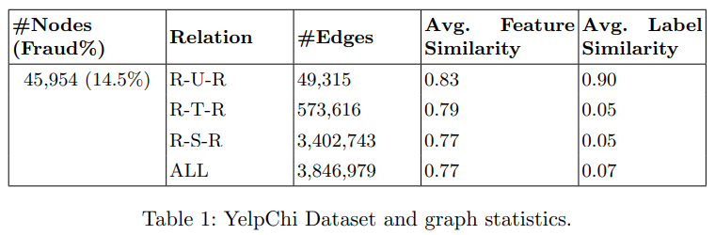
02. DATASET
3 relations:
R-U-R: links reviews by the same user
R-S-R: connects reviews for the same product with identical star ratings
R-T-R: links two reviews for the same product within the same month.

Slide 6
PREPROCESSING DATA
We use a 4-step pipeline to clean and prepare the data:
1. Normalize the sparse matrix 'mx' by adjusting row values relative to their sums.
2. Transform a sparse adjacency matrix into an adjacency list format and save it to a specified file.
3. Categorize nodes into positive and negative sets based on labels.
4. Undersample negative nodes to balance with positive nodes using a defined scaling factor.
Notes:
This pipeline enhances data integrity and ensures robust and equitable analysis.

Slide 7
03. METHODOLOGY

Slide 8
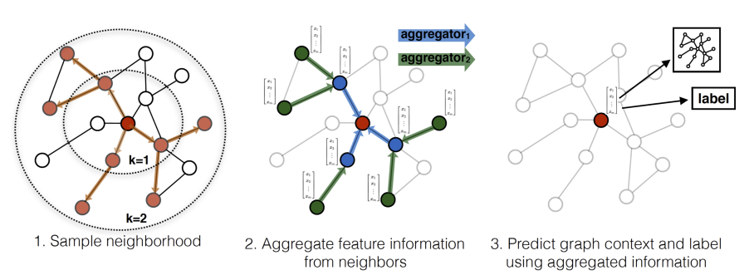
GraphSAGE
Visual illustration of the GraphSAGE sample and aggregate approach.

Slide 9
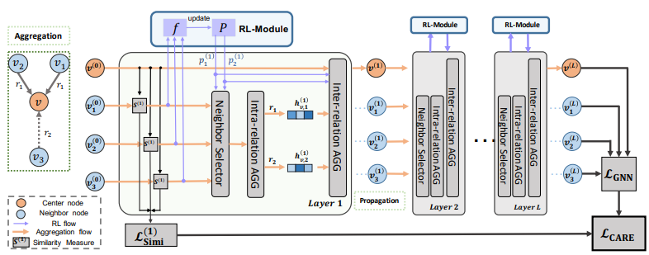
CARE-GNN
The aggregation process of proposed CARE-GNN at the training phase.

Slide 10
Parameters
General Parameters:
emb size = 64
batch size = 1024
number of layers = 1
lr = 0.01
optimizer (Adam)
L2 regularization weight (0.001)
CARE-CNN:
RL action step size = 0.02
the similarity loss weight = 2
Evaluation metrics: ROC-AUC, Recall Score, F1-Score, Accuracy

Slide 11
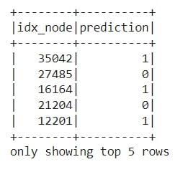
Distributed inference
Faster Inference: Distributes tasks across multiple devices, reducing processing time.
Large Data Handling: Distributes data and computation across machines.
Resource Utilization: Uses CPUs, GPUs, and TPUs from multiple devices.
Scalability: Easily scales by adding more devices.
Reliability: Maintains system operation even if some devices fail.

Slide 12
04. EXPERIMENTAL RESULTS
MODEL
ROC-AUC
Recall Score
F1 score
Accuracy
GraphSAGE
0.50
0.50
0.46
0.85
CARE-GNN
0.76
0.70
0.59
0.7
Remarks: CARE-GNN performs significantly better than GraphSAGE. CARE-GNN can diffe-rentiate fraud more effectively and detect fraudulent reviews more efficiently. In contrast, GraphSAGE's performance is equivalent to random guessing.

Slide 13
05. CONCLUSION
We successfully built models for fraud detection in reviews on YelpChi dataset. CARE-GNN can differentiate fraud more effectively and detect fraudulent reviews more efficiently with ROC-AUC (0.76) and Accuracy (0.69). In contrast, GraphSAGE's performance is equivalent to random guessing.
Future directions include improving the performance of the two mo-dels, developing model integration, and training on more extensive datasets.

Slide 14
Thank you for listening!
Additional questions about the report can be sent to 21522718@gm.uit.edu.vn

