Slide 1


Slide 2
01
02
Team
Idea
03
04
Work stages
app

Slide 3
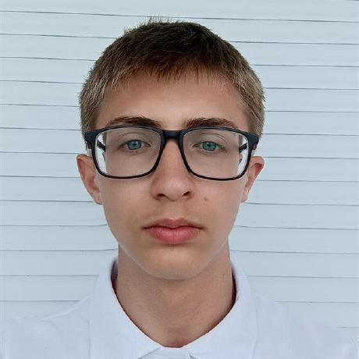
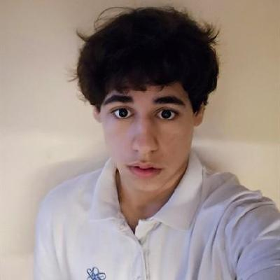
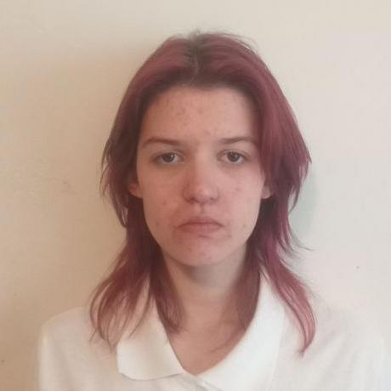
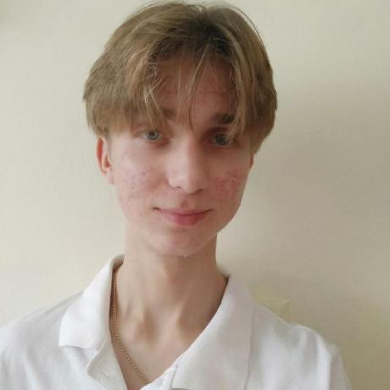

Team
Nikita Baladin
Scrum Trainer
Georgi Dimitrov
QA
Anna Rikova
Backend developer
Valentin Nikolenko
Frontend developer
Denis Pirig
Backend developer

Slide 4
Idea
A simple C++ app to manage historical events.A user can choose and create historical lines.
-Stores events in a linked list
-Each event has a date, name, place, and details
-Lets you add, edit, delete, and search events
-Saves and loads data from a file
-Easy menu for users to interact

Slide 5
Work stages
Form a team
Develop an idea
Work on project
Finish the app
Project documentation
Rehearsal for the project presentation

Slide 6





Used technologies

Slide 7
Let’s go to the application

