Slide 1
rizz.hpp
HACKAUBG 5.0 - Entertainment

Slide 2





OUR TEAM
Ivan Tsrangalov
Front-end
Hakan Chandar
Front-end
Ivaylo Stoyanov
Back-end
Nikolay Despotov
Back-end
Alexander Baev
Designer

Slide 3
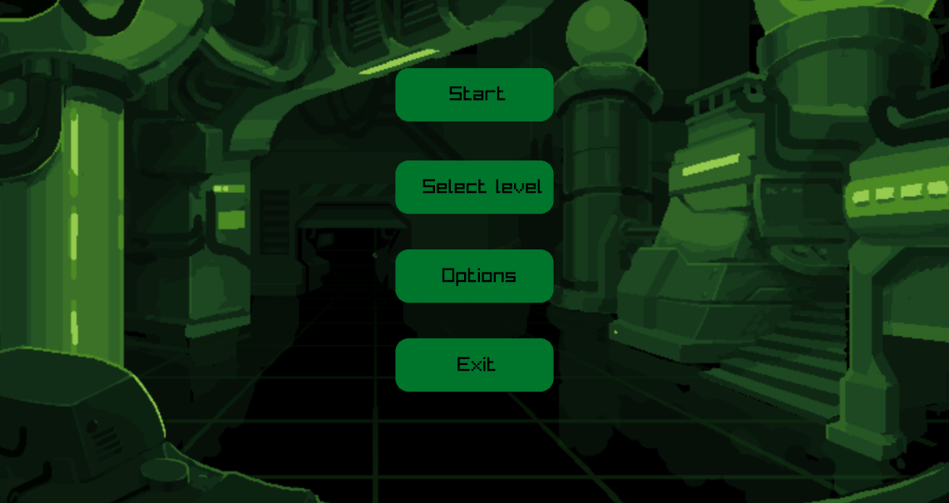
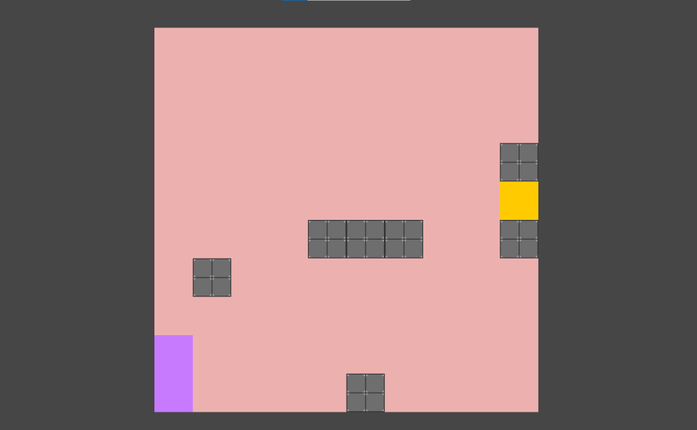
OUR IDEA

Slide 4








USED PROGRAMS

Slide 5
LET’S JUMP TO THE PROJECT!

