Slide 1
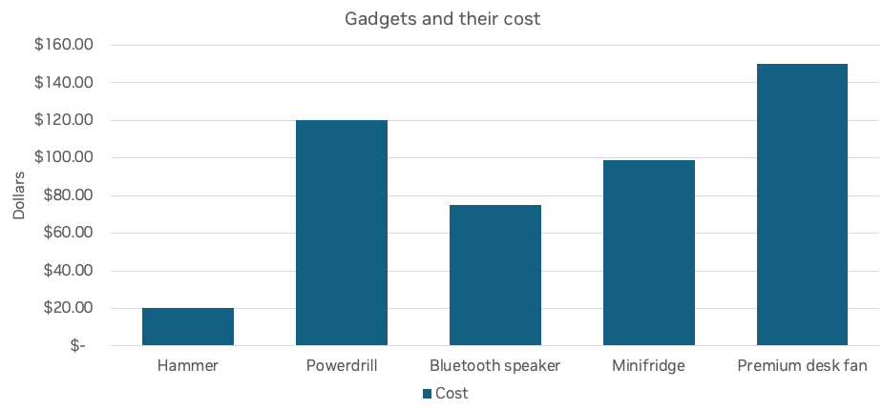

Slide 2
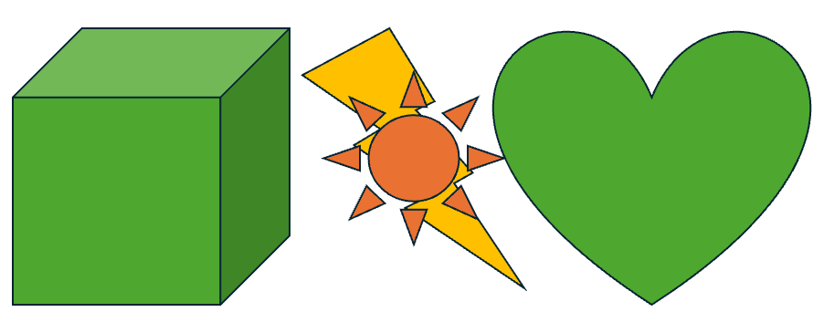
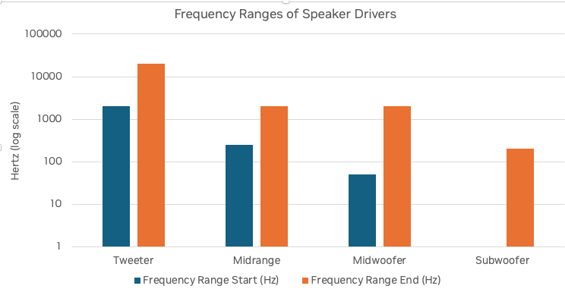

Slide 3
Animal | Activity | Place
Giraffe | Driving a car | At the beach
Lion | Putting on sunscreen | At the park
Cat | Jumping onto a laptop | In a home office
Dog | Chasing a squirrel | In the front yard

Slide 4
