Slide 1
SPA Workshop
Developing Single Page Web Applications
Notes:
This is the introduction and uses the first 4 slides. There isn’t any scripted content for this section, as you just expand on the slides.
[Slides 1,2,3,4 -> Intro material ]
Comparison of SPA Vs. Traditional Web Applications
This is the framework introduction and uses slides 5 through 17. You should be familiar with the text below which is the information to talk about over these slides. Slide position is mentioned where possible.
[Slides 5,6,7 -> Variance in composing pages / page layout ]
There have been various methods over the years for composing pages. There are very traditional includes, such as in PHP, ASP, etc.
In the J2EE world there has been JSTL for includes, and libraries like Tiles for composing pages.
Even before all of this, designers and developers were using frames to try and avoid rebuilding the entire page.
With an SPA, even when a template engine isn’t used, the entire page is rendered once, and from there only the portions of the page concerned with what is changing are updated. Users spend an increasing amount of time interacting with an application before it has to go back to the server. The blink of the page render is gone and replaced by progress bars or animations.
Responsibility also changes. The server can now focus on areas like services and security. Server side developers can focus on data storage and service interfaces without knowing anything about the look, feel or even design of the front end. Services can be designed to be a mix of public and private APIs.
On the front end, the responsibility for page composition is taken on, as well as routing logic and some business logic. It should be noted here that what doesn’t change, is the need to validate all data arriving at the server. Do not calculate the shopping cart total on the front end and then trust the value ☺.
For developers, there is much more clarity of role. Work can be more easily divided into roles; with developers work on the server, look & feel, and front end application logic.
Framework Tour and Comparison
Compare the frameworks based on their usage and features, then give a deeper overview of each framework.
[Slides 8,9,10,11 -> Basics framework comparison]
There are a growing number of frameworks for developing client based applications, whether “SPA” style or not. We’re going to look at a couple of them and talk about their popularity, differences and finish with some warnings about relying too heavily on these frameworks.
All of these frameworks work to provide a structured MVC/MV* pattern for building applications. Each usually provides more or less features with the trade being control of implementation and architecture or ease of use in the basic case.
Market Share @TODO
Trends and other Info @TODO
Angular.JS [Slide 12]
Angular is a library currently supported by Google. It’s widely popular and based on adding additional markup to your html. By placing markup you give Angular instructions and information about your page.
Angular is one of the larger frameworks available, because of all the features it provides. It’s Very declarative and inspired by ideas like Silverlight, which is exemplified by the two way data binding and html markup control. Angular has no dependencies, but wants to stand on its own; so it doesn’t work well with other technologies like JQuery.
= Still more to add here =
Backbone.JS [Slide 13]
Backbone is a small library that provides just enough structure to assist you in building small to medium sized applications. As application sizes grow, Backbone requires more and more architecture on your part.
Being one of the smallest libraries available, you get the benefit of fast review of the source code and easy handling of special cases. Backbone provides Routers as a primary controller, and is considered a MV* library.
Backbone depends on Underscore, and you will want to provide a templating library; usually Handlebars, Mustache or _.template.
Ember.JS [Slide 14]
@TODO
Knockout.JS [Slide 15]
@TODO
Data Binding and Conclusion [Slide 16, 17]
One of the differentiating factors with framework and libraries is the amount of binding they offer. Developers are split on this idea. Some think the inclusion of binding is a necessity, and others feel that binding depends on the project needs.
One-way : Either changing the model updates the view, or changing the view updates the model.
Two-way: Changing either the model or the view, updates the other.
We’re going to be working with Backbone. It’s the easiest framework to plug into an existing application, and even when you want to use a larger framework, the ideas learned from Backbone are a good starting to organizing front end code.

Slide 2
Introduction
nVisia
Have built multiple Single Page Web Applications for various clients and of various depths.
Wizard workflow to SPA.
Control Panel workflow to SPA.
Client management SPA.
George Frick
Developing web applications for eight years.
Started adding Javascript front ends in 2008.
Built multiple SPAs for nVisia clients.
“Jump into Backbone” JS Meetup.

Slide 3
Why Are We Here?
Goals and Scope
We are here to:
Learn what an SPA is.
Learn how SPA architecture compares to a classical web application architecture.
Compare SPA frameworks.
Learn skills for developing single page web applications.
Learn Backbone and associated popular libraries.

Slide 4
Why Are You Here?
Goals and Scope
What is your experience level? Have you used any of this?
What do you hope to learn?
What are your leading concerns?
Is there something important I should try to cover or mention?

Slide 5
SPA Workshop
Outline Of Activities
Comparison: SPA vs. Traditional Web Apps.
SPA Framework Tour.
Before break sessions.
We’ll take a 15 minute break.
After break sessions.
Advanced Topics Presentation.
Security and Mobile Devices
Closing
Q&A, Attendee Presentations.
Links to resources and suggested reading.

Slide 6
Comparison
Comparing an SPA to a traditional web application.
The server no longer composes the page.
A move to client side template engines.
Server generated views can still be integrated.
Server no longer maps page transitions.
A move to client side routing methods.
Server managed routes still work.
Lots of reuse.
Page footer/header/menu is delivered once.
Constants delivered to browser as needed.
No more screen “blink” or non-responsive wait.
Developers control progress/wait display.
Long actions happen in the background.
Form and Model VS. Form as Model.
Flexible use of forms and models.
Difference in separation of code and web design.

Slide 7
Framework VS Library
Defining the difference in our context.
There are lots of definitions.
A definition to guide us, but not the final word.
From Martin Fowler:
A library is essentially a set of functions that you can call, these days usually organized into classes. Each call does some work and returns control to the client.
A framework embodies some abstract design, with more behavior built in. In order to use it you need to insert your behavior into various places in the framework either by sub-classing or by plugging in your own classes. The framework's code then calls your code at these points.

Slide 8
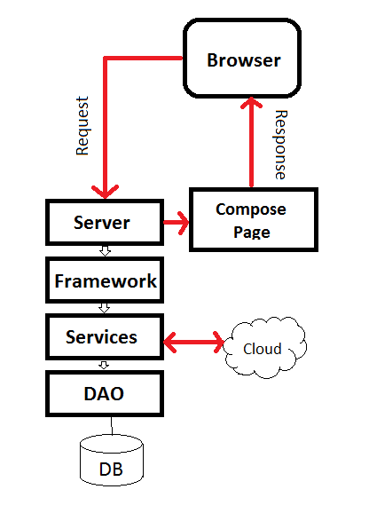
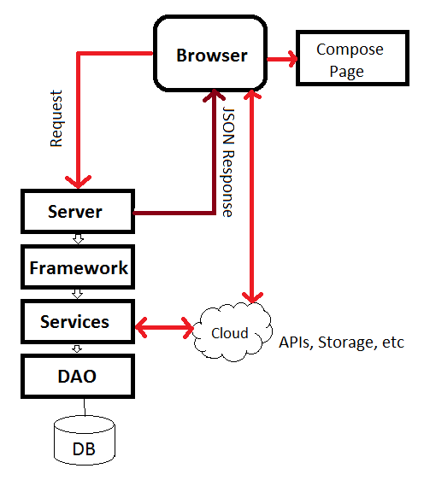
Comparison
Visualizing the difference
Traditional
SPA

Slide 9
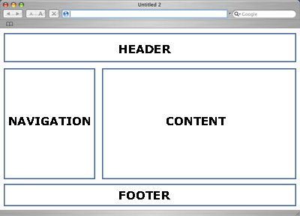
Comparison
Visualizing the difference

Slide 10
Frameworks
A guided tour of the community.
Some Major Frameworks/Libraries
Angular
Backbone
Ember
Knockout
Others (CanJs,Meteor,MooTools,Ext)
Size Vs. Power Vs. Complexity
How much control do you want?

Slide 11
Frameworks
A Market Share Survey
Notes:
There is another graphic you can show.

Slide 12
Frameworks
A look at GitHub
*As of 01/06/2014
Notes:
Be more brief on this slide, don’t say anything controversial.

Slide 13
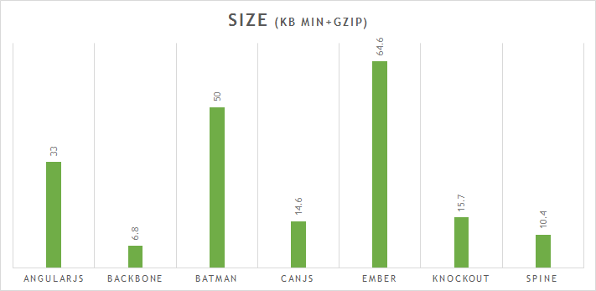
Frameworks
A look at size
Source: http://www.funnyant.com/choosing-javascript-mvc-framework/

Slide 14

Frameworks
A look at Angular.js
Established, Largest Growth, Google Approved!
No dependencies.
Doesn’t always play well with others (JQuery, etc)
Inspired by Flex and Silverlight, so it’s declarative and has no ‘main’.
A declarative framework, where you annotate HTML 5 with declarations.
Claims to not require ‘full commitment‘.
The dependency injection allows you to declaratively describe how your application is wired.
Large codebase.
Used for the PS3 Youtube app, whichairline.com, dailybreak, and many others.

Slide 15
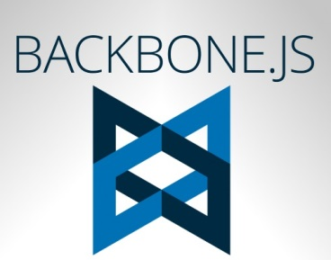
Frameworks
A look at Backbone.js
Mature, with codebase leveling out. (less commits)
Has dependencies on Underscore and JQuery.
A smaller library providing structure to architect with.
Add Marionette to go from library to framework.
Can be “Injected” and used with other libraries or frameworks.
Uses Underscore’s template method, but Handlebars or Mustache commonly used.
Used in apps like FourSquare, GroupOn, USAToday and many more.
Notes:
Doesn’t prescribe an architecture, which allows you to adapt it to be used in an architecture of your design.

Slide 16

Frameworks
A look at Ember.js
The largest framework, twice the size of Angular.
The evolution of the Cocoa inspired SproutCore’s move towards JQuery.
Has dependencies on JQuery and Handlebars.
Intended to control the whole page, so only suitable to be used alone.
Depends on scaffolding and convention.
Uses Handlebars for templates.
Used by Zendesk, Square, LivingSocial and many more.

Slide 17

Frameworks
A look at Knockout.js
Developed by Steve Sanderson, currently working for Microsoft.
Considered a MVVM library.
Declarative syntax similar to Angular.
Declarative DOM based templates, but can also do string based.
Small codebase.
Gives importance to compatibility with older browsers.
Used for amctheatres.com, pillsbury.com, jsFiddle and many others.

Slide 18
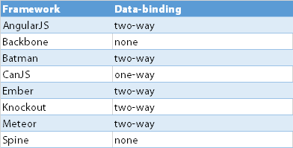
Frameworks
Data Binding
Source: http://www.funnyant.com/choosing-javascript-mvc-framework/

Slide 19
Frameworks
Conclusion
A dozen or so popular frameworks.
The correct choice is dependent on many variables:
Application size and complexity.
Team experience.
Backbone.js
Small, readable code base.
Add Marionette to go from library to framework.
Control your own architecture, while benefiting from some structure.

Slide 20
Sessions
Let’s start coding
We’ll return later!
Break time
Wrap-up.

Slide 21
Break Time!
A 15 minute break.
Ahhhhhh, intermission.

Slide 22
Session II
Let’s start coding
We’ll return later!
Wrap-up.

Slide 23
Advanced Topics
Showing The Next Steps
Security Example
Mobile Example

Slide 24
Q&A Session
Questions?

Slide 25
Wrapping Up
Resources and Contact Us
Resources
Backbone (https://github.com/jashkenas/backbone)
Backbone-Validation (https://github.com/thedersen/backbone.validation)
Underscore (https://github.com/jashkenas/underscore)
Handlebars (https://github.com/wycats/handlebars.js/)
Jquery (https://github.com/jquery/jquery)
Qunit (https://github.com/jquery/qunit)
NodeJS (http://nodejs.org/)

