Slide 1
SPA Workshop
Developing Single Page Web Applications

Slide 2
Introduction
nVisia
Have built multiple Single Page Web Applications for various clients and of various depths.
Wizard workflow to SPA.
Control Panel workflow to SPA.
Client management SPA.
George Frick
Developing web applications for eight years.
Started adding Javascript front ends in 2008.
Built multiple SPAs for nVisia clients.
“Jump into Backbone” JS Meetup.

Slide 3
Why Are We Here?
Goals and Scope
We are here to:
Learn what an SPA is.
Learn how SPA architecture compares to a classical web application architecture.
Compare SPA frameworks.
Learn skills for developing single page web applications.
Learn Backbone and associated popular libraries.

Slide 4
SPA Workshop
Outline Of Activities
Comparison: SPA vs. Traditional Web Apps.
SPA Framework Tour.
Before break sessions.
We’ll take a 15 minute break.
After break sessions.
Advanced Topics Presentation.
Security and Mobile Devices
Closing
Q&A, Attendee Presentations.
Links to resources and suggested reading.

Slide 5
Comparison
Comparing an SPA to a traditional web application.
The server no longer composes the page.
A move to client side template engines.
Server generated views can still be integrated.
Server no longer maps page transitions.
A move to client side routing methods.
Server managed routes still work.
Lots of reuse.
Page footer/header/menu is delivered once.
Constants delivered to browser as needed.
No more screen “blink” or non-responsive wait.
Developers control progress/wait display.
Long actions happen in the background.
Form and Model VS. Form as Model.
Flexible use of forms and models.
Difference in separation of code and web design.

Slide 6
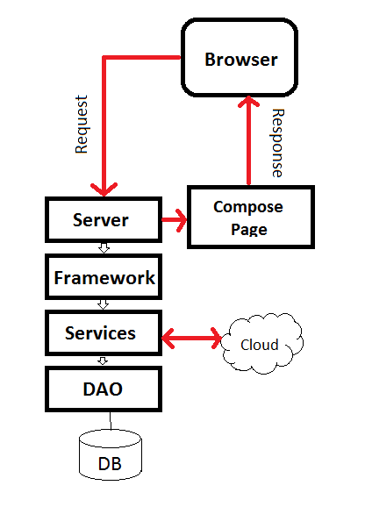
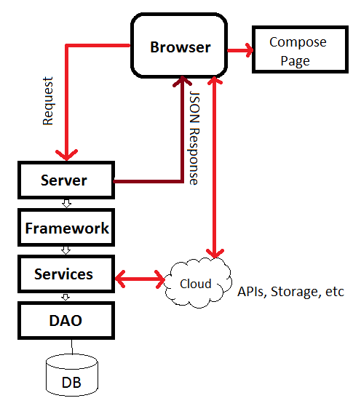
Comparison
Visualizing the difference
Traditional
SPA

Slide 7
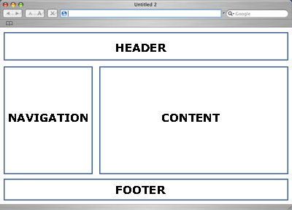
Comparison
Visualizing the difference

Slide 8
Frameworks
A guided tour of the community.
Some Major Frameworks/Libraries
Angular
Backbone
Ember
Knockout
Others (CanJs,Meteor,MooTools,Ext)
Size Vs. Power Vs. Complexity
How much control do you want?

Slide 9
Frameworks
A Market Share Survey
Notes:
There is another graphic you can show.

Slide 10
Frameworks
A look at GitHub
*As of 01/06/2013

Slide 11
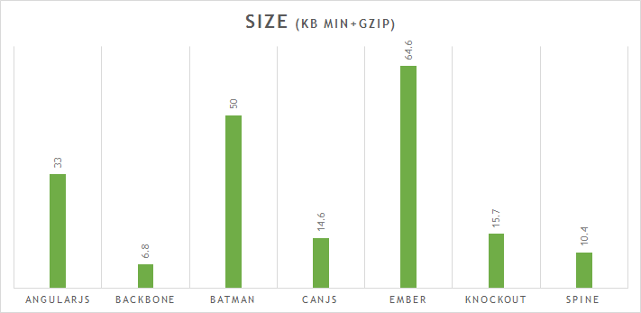
Frameworks
A look at size
Source: http://www.funnyant.com/choosing-javascript-mvc-framework/

Slide 12

Frameworks
A look at Angular.js
Established, Largest Growth, Google Approved!
No dependencies.
Doesn’t always play well with others (JQuery, etc)
Inspired by Flex and Silverlight, so it’s declarative and has no ‘main’.
An opinionated framework, where you annotate HTML 5 with declarations.
Claims to not require ‘full commitment‘.
The dependency injection allows you to declaratively describe how your application is wired.
Large codebase.
Declarative DOM based templates.
Used for the PS3 Youtube app, whichairline.com, dailybreak, and many others.

Slide 13
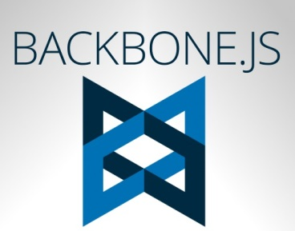
Frameworks
A look at Backbone.js
Mature, with codebase leveling out. (less commits)
Has dependencies on Underscore and JQuery.
Not opinionated at all, a smaller library providing structure to architect with.
Add Marionette to go from library to framework.
Can be “Injected” and used with other libraries or frameworks.
No template framework provided, Backbone or Mustache commonly used.
Used in apps like FourSquare, GroupOn, USAToday and many more.

Slide 14

Frameworks
A look at Ember.js
The largest framework, twice the size of Angular.
The evolution of the Cocoa inspired SproutCore framework’s move towards JQuery.
Has dependencies on JQuery and Handlebars.
Intended to control the whole page, so only suitable to be used alone.
Very opinionated, depending on scaffolding and convention.
Uses Handlebars for templates.
Used by Zendesk, Square, LivingSocial and many more.

Slide 15

Frameworks
A look at Knockout.js
Developed by Steve Sanderson, currently working for Microsoft.
Considered a MVVM library.
Declarative syntax similar to Angular.
Declarative DOM based templates, but can also do string based.
Small codebase.
Gives importance to compatibility with older browsers.
Used for amctheatres.com, pillsbury.com, jsfiddle and many others.

Slide 16
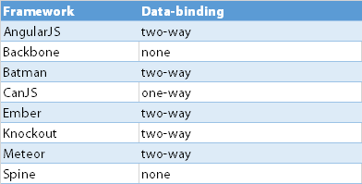
Frameworks
Data Binding
Source: http://www.funnyant.com/choosing-javascript-mvc-framework/

Slide 17
Frameworks
Conclusion
A dozen or so popular frameworks.
The correct choice is dependent on application size and complexity.
Backbone.js
Unobtrusive / Not opinionated.
Small, readable code base.
Add Marionette to go from library to framework.
Control your own architecture, while benefiting from some structure.

Slide 18
Sessions
Let’s start coding
We’ll return later!
Break time
Wrap-up.

Slide 19
Break Time!
A 15 minute break.
Ahhhhhh, intermission.

Slide 20
Session II
Let’s start coding
We’ll return later!
Wrap-up.

Slide 21
Advanced Topics
Showing The Next Steps
Security Example
Mobile Example

Slide 22
Q&A Session
Questions?

Slide 23
Wrapping Up
Resources and Contact Us
Resources
Backbone (https://github.com/jashkenas/backbone)
Backbone-Validation (https://github.com/thedersen/backbone.validation)
Underscore (https://github.com/jashkenas/underscore)
Handlebars (https://github.com/wycats/handlebars.js/)
Jquery (https://github.com/jquery/jquery)
Qunit (https://github.com/jquery/qunit)
NodeJS (http://nodejs.org/)

