Slide 1

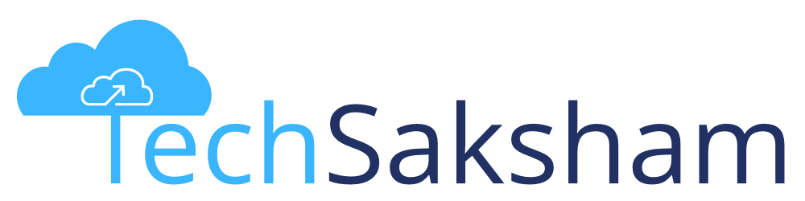

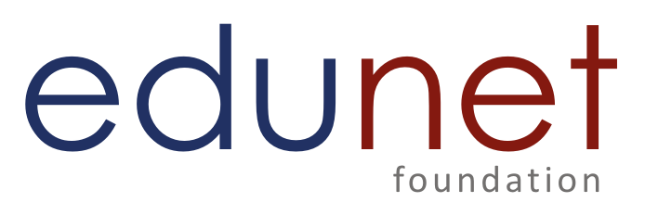

PROJECT NAME
Team : Name & Email id Guide:
Disclaimer: The content is curated for educational purposes only.
Notes:
Slides: Prepare a short slide deck (10-12 slides) summarizing the project objectives, methodology, and key results.

Slide 2
OUTLINE
Abstract of the Project
Problem Statement
Proposed Solution
System Architecture
Live Demo of the Project
Embedded Video of Project
Conclusion
Future Scope

Slide 3
Abstract
1. Objective: The project aims to bridge the communication gap between doctors and patients while ensuring timely medicine intake through automated reminders.
2. Medicine Reminders: Patients receive timely reminders for their prescribed medications, helping improve adherence to treatment plans.
3. Report and Analytics: The system tracks medicine intake and visualizes data using line graphs in the report section for better monitoring.
4. Doctor’s Dashboard: Doctors can access patient reports, modify prescriptions, and manage medication schedules efficiently.
5. AI Chatbot Integration: A chatbot assists patients by providing information about their prescribed medicines and answering related queries.
6. Hospital Integration: The platform can be adopted by hospitals to allocate patients to doctors, enabling direct supervision of medication intake by doctors and nurses.
7. Impact: This system enhances patient care, reduces medication non-compliance, and provides healthcare professionals with a data-driven approach to treatment management.

Slide 4
Problem Statement
Medication Adherence Issues:
Patients often forget to take their prescribed medications on time, leading to non-adherence, which can result in delayed recovery, complications, and increased healthcare costs.
Lack of Communication Between Patients and Doctors:
Patients and doctors face challenges in maintaining regular communication regarding the patient's health status and medicine adherence. Doctors may not have real-time access to patient progress or medication intake data.
Inconvenient Tracking of Medicine Intake:
Tracking and monitoring patient medication intake is often done manually or through traditional methods, which are time-consuming and prone to human error.
Limited Access to Medication Information:
Patients may not have easy access to detailed information regarding their medications, including the correct dosages, timing, and side effects, which can lead to confusion and improper usage.
Inefficient Patient Management in Hospitals:
Hospitals face difficulties in efficiently assigning patients to doctors and tracking patient progress and medicine intake. Doctors and nurses may struggle to monitor all patients' adherence and health status in real-time.

Slide 5
Proposed Solution
Medicine Reminders:
The system automatically sends notifications to patients to remind them to take their medicines, helping ensure medication adherence.
Medicine Intake Reporting:
Based on the patient’s recorded medicine intake, the system generates graphical reports (line charts) to visually display their adherence history and progress over time.
Doctor’s Dashboard:
Doctors can view detailed reports on patient medicine intake, and have the ability to add or remove medicines, helping them manage prescriptions more efficiently.
Chatbot for Patient Queries:
A chatbot is integrated into the system, allowing patients to ask questions about their medicines, such as dosage, timing, and possible side effects, providing them with quick and accurate information.
Hospital Management Integration:
Hospitals can use the system to assign patients to specific doctors, track patient medicine intake, and monitor progress more efficiently, ensuring better patient care and management.
This solution aims to streamline communication, improve patient adherence, and enhance the overall efficiency of managing patient health, medication schedules, and doctor-patient interactions.

Slide 6
System Architecture
1. Users & Roles:
- Patients → Receive reminders, log medicine intake, view reports, and use chatbot.
- Doctors → Monitor reports, manage prescriptions, and update medicines.
- Hospitals/Nurses → Assign patients to doctors and track medicine intake.
2. System Components:
- Frontend (Web/Mobile App): User interface for patients, doctors, and hospitals.
- Backend (Server & Database): Handles authentication, reminders, reports, chatbot, and data storage.
- Notification System: Sends medicine reminders via SMS, push notifications, or emails.
- Report & Analytics Engine: Generates **line graphs** based on medicine intake.
- Chatbot System: Provides medicine-related information to patients.
3. Workflow:
1. Patients log in → Receive reminders → Log medicine intake → View reports.
2. System generates **line graphs** for medicine intake trends.
3. Doctors access reports → Modify prescriptions in the dashboard.
4. Chatbot assists patients with medicine-related inquiries.
5. Hospitals manage patient allocation and track medicine intake.

Slide 7
System Architecture
4. Technology Stack:
- Frontend: React.js (Web), Flutter (Mobile).
- Backend: Node.js/Express or Django/Python (REST API).
- Database: PostgreSQL/MySQL.
- Notifications: Firebase Cloud Messaging (FCM), Twilio, SendGrid.
- Chatbot: OpenAI API/Dialogflow.

Slide 8
Live Demo of Project
Shivam-03-hub/
Bootcamp-Pj
git hub repo

Slide 9
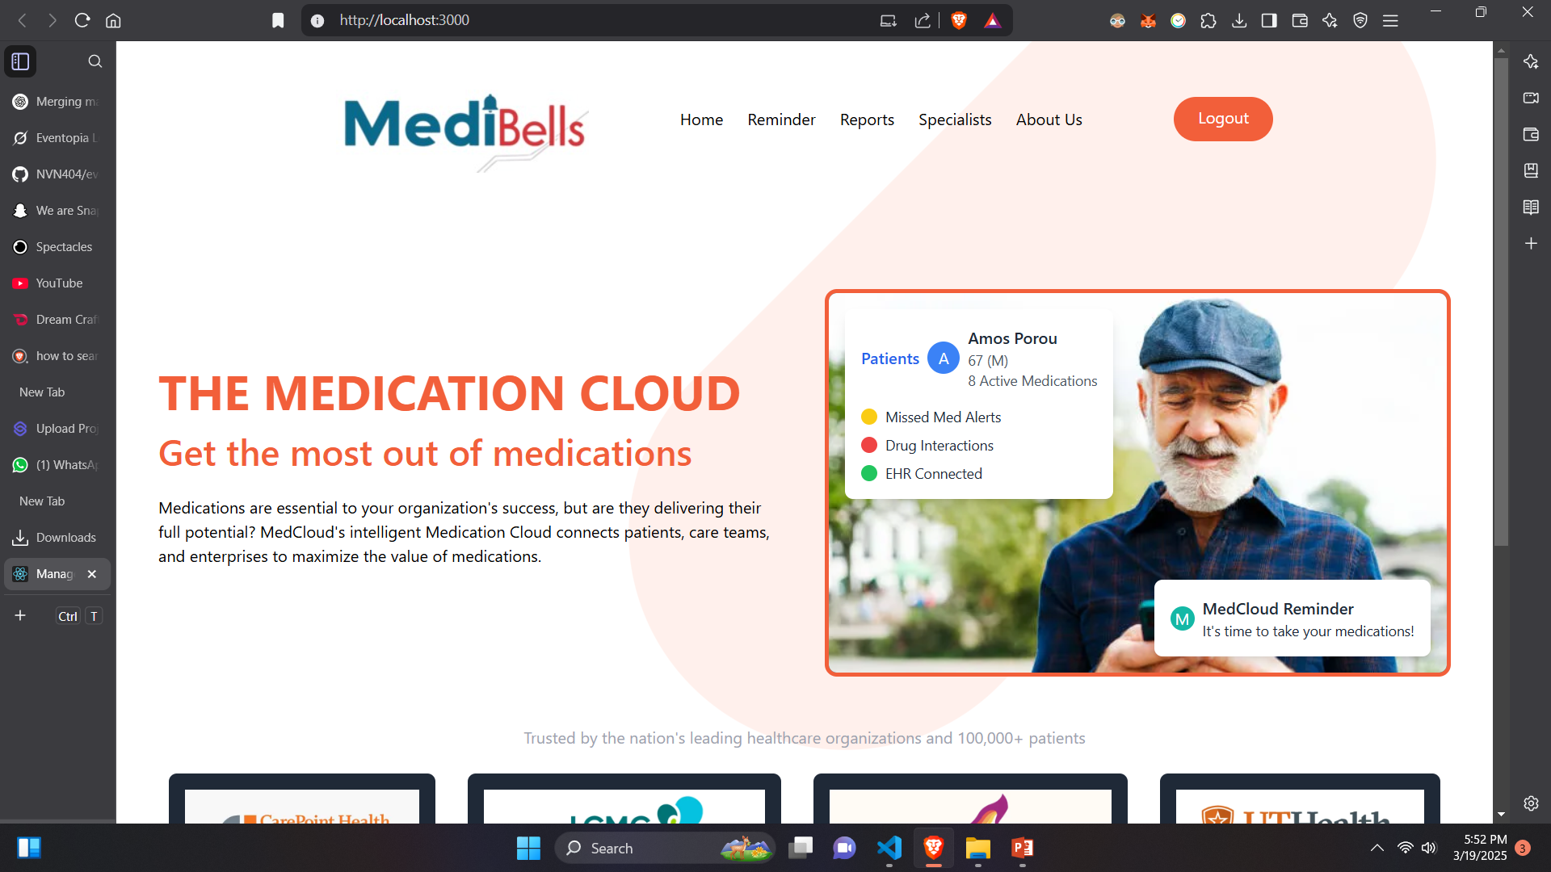

Slide 10
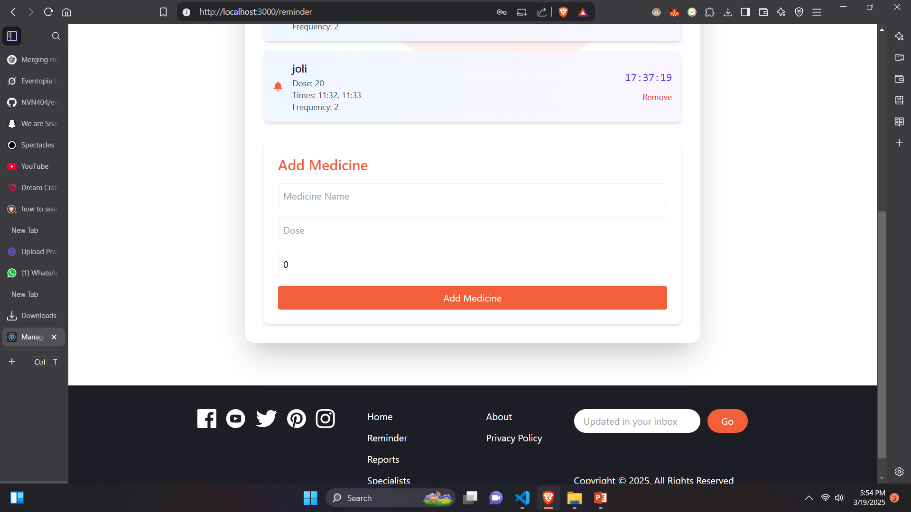

Slide 11
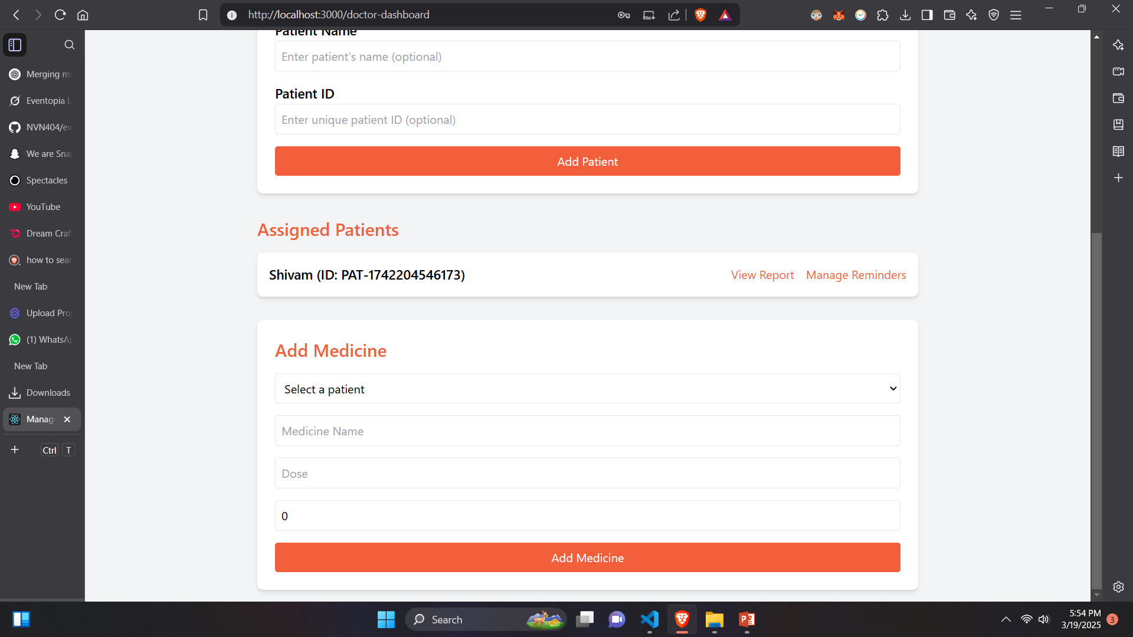
Video of Project Demo

Slide 12
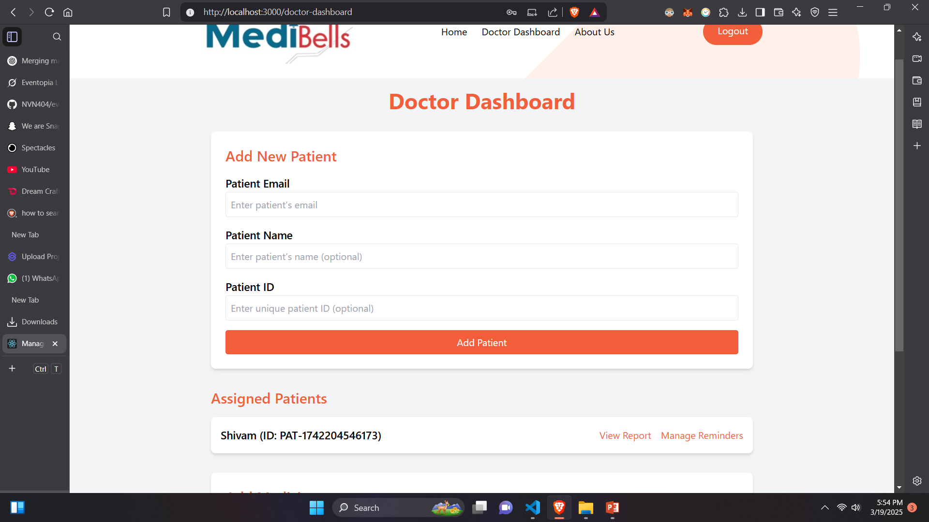

Slide 13
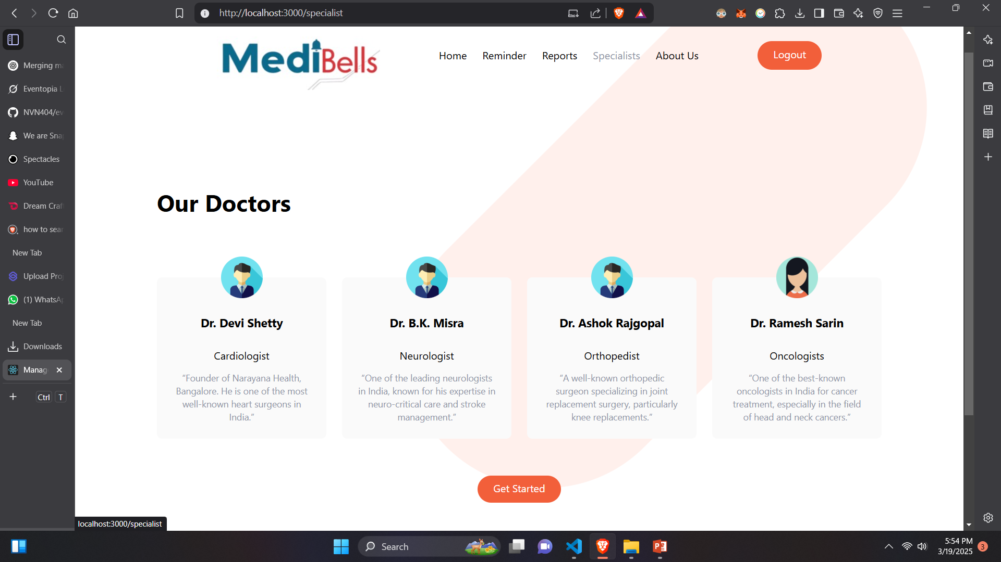

Slide 14
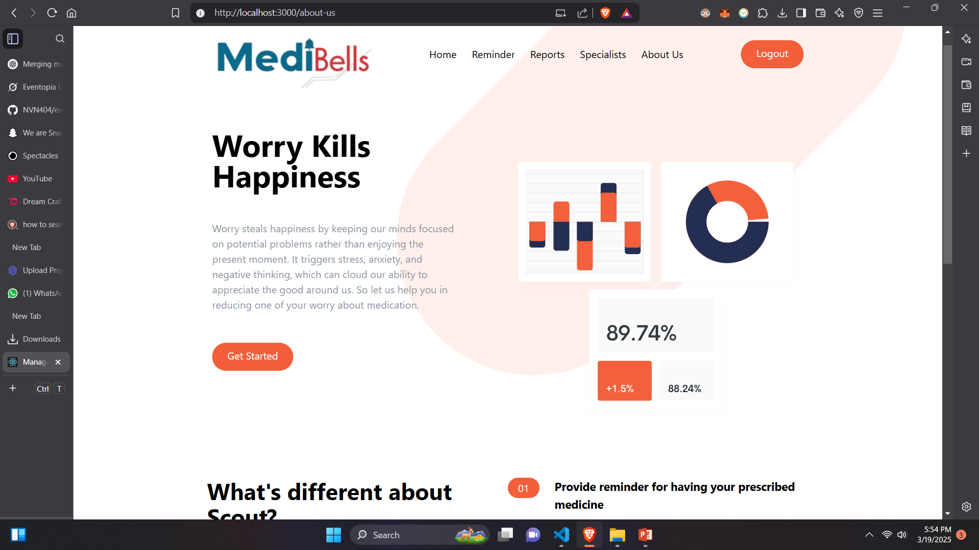

Slide 15
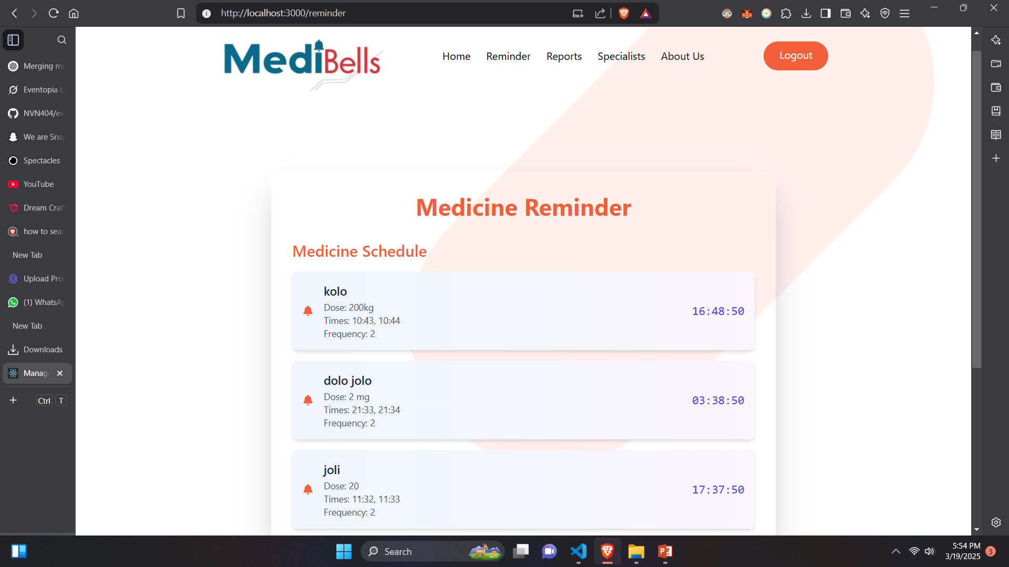

Slide 16
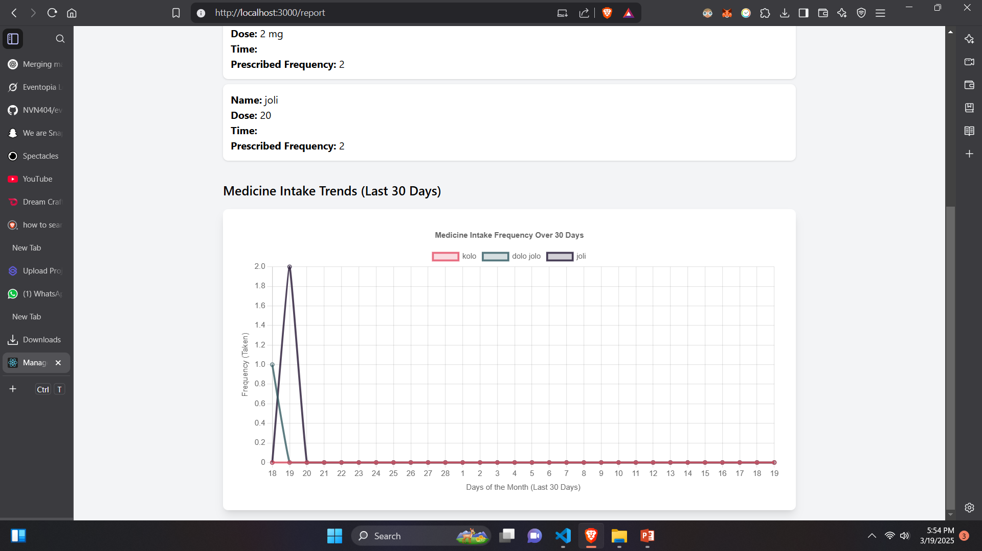

Slide 17
Conclusion
Our project provides a seamless platform that connects doctors, patients, and hospitals to enhance medicine management and patient care. By integrating automated medicine reminders, real-time intake tracking, and interactive reports with line graphs, it ensures better adherence to prescribed treatments. Doctors can efficiently monitor patient reports and manage prescriptions, while the chatbot assists patients with instant medicine-related queries. Additionally, hospitals can assign patients to doctors and track medicine intake, ensuring personalized care. This system improves communication, medication adherence, and healthcare efficiency, ultimately leading to better patient outcomes and streamlined hospital management.

Slide 18
Future Scope
1. AI-Powered Health Insights – Implement AI to analyze patient data and provide predictive health recommendations based on medicine intake trends.
2. Wearable Device Integration – Connect with smartwatches and health tracking devices to automate medicine intake logging and monitor patient vitals.
3. Telemedicine & Video Consultation – Enable real-time doctor-patient virtual consultations within the platform for better remote healthcare support.
4. Automated Prescription Refill System – Integrate with pharmacies for automatic prescription refills and medicine delivery reminders.
5. Blockchain for Data Security – Use blockchain technology to enhance security, transparency, and integrity in patient records and prescriptions.
6. Multilingual Chatbot Support – Enhance the chatbot to support multiple languages for wider accessibility and better patient engagement.
7. Machine Learning for Personalized Reminders – Implement ML algorithms to optimize medicine reminders based on patient habits and adherence patterns.

Slide 19
Future Scope
8. Integration with Electronic Health Records (EHRs) – Connect with hospital EHR systems for seamless data sharing and better medical history tracking.
9. Emergency Alert System – Introduce real-time alerts to doctors or caregivers if a patient misses critical medications or shows abnormal health patterns.
10. Scalability for Large Healthcare Networks – Expand the system to support **multi-hospital** networks, government healthcare programs, and global healthcare initiatives.

Slide 20
Thank you!
Notes:
thank you very much for joining this PPT, keep learning.
20

