Slide 1

STOCK PRICE PREDICTION
& TIME SERIES FORECASTING MODELS
Five Machine-Learning Models Written From Scratch and Tested on Real Stock Market Data
REVIEW
Presented by
R. Venkata Gopi – 24B11CS374
N. Venkata Natesh – 24B11CS310
K . Charan Teja – 24B11CS223
V. Hari Veera Venkat – 24B11CS481
K. Kalyan Sankar -24B11CS208
Department of Computer Science and Engineering
Aditya University | Academic Year 2026–27
Notes:
Good morning. Our project is the E-Commerce Smart Review & Sentiment Engine. It solves a problem every online shopper knows: hundreds of mixed reviews and no quick way to decide. Our tool reads all of them and produces a single visual verdict with an overall sentiment score and an automatically extracted Pros and Cons list.

Slide 2


INTRODUCTION
INTRODUCTION
WHAT
A self-contained web dashboard in which five prediction paradigms — ARIMA, Prophet, LSTM, XGBoost and SVR — are implemented from scratch in vanilla JavaScript and compared on real stock market data.
DOMAIN
Time-series forecasting and classical machine learning — least-squares fitting, backpropagation through time, gradient-boosted trees and kernel methods — all hand-written with zero ML libraries.
WHY IMPORTANT
Daily stock moves are mostly unpredictable noise; a model that beats a coin flip only 55–60% of the time is the honest reality. Knowing this before trusting any forecast is the point.
MOTIVATION
Build an honest workbench, not a black box — every prediction shows its error size, directional accuracy, a 90% confidence interval and the model's own reason for the number it printed.
From a noisy price chart to a five-model verdict with reasons.

Slide 3

PROBLEM DEFINITION
1
Stock prices are noisy and non-stationary; any forecast must prove itself against what the real market actually did, not a simulation.
Existing problem
2
Most projects train on synthetic data, tune until they look good, and never test against the real market; trend-chasing models overfit and directional edge is easily faked.
Difficulties faced
3
Trusting an unvalidated forecast costs real money; a model that cannot state its typical error or its directional hit-rate cannot be used with confidence.
Why important
4
Who is affected
Student teams, academic reviewers and anyone learning applied time-series machine learning.
5
Typical demos use libraries as black boxes on fake data — no hand-written math, no held-out honesty, no reason behind any predicted number.
Gap in existing tools
6
Five engines written from scratch, scored on real market data with error, direction and significance tests — not just a curve.
What needs to improve
Every line above maps to a module in our system — the solution slide shows exactly how each one is addressed.

Slide 4
PROPOSED SOLUTION
Major functions
Real-data loading · five hand-written engines · scoreboard · research tools · pick-a-day · backtest · Monte Carlo
Input → Processing → Output
Real
OHLCV
→
Fit &
Train
→
5
Engines
→
Score-
board
→
Pick a
Day
→
Forecast
+ Why
Expected users
Expected benefits
Students, reviewers and learners of applied forecasting.
Each prediction ships with its error, direction score, interval and reason.
Proposed methodology: five models hand-written in vanilla JavaScript — least squares, manual backpropagation, boosted trees, dual-descent SVR — trained on real embedded OHLCV and scored on a 63-session holdout.
Every function listed here is implemented and demonstrated — not a proposal on paper.

Slide 5
WORKFLOW
INPUT
Real two-year daily OHLCV for TCS, RELIANCE and GOOGL — embedded in data/market-data.js.
1
DATA LAYER (app.js)
buildRealDataset() loads the embedded history — no runtime network calls, deterministic
2
FIT & TRAIN
ARIMA least squares · Prophet ridge curve · LSTM backprop · boosted trees · SVR dual descent — fit on the first ~435 sessions.
3
THE SCOREBOARD
MSE · RMSE · direction on 63 hidden days
4
RESEARCH TOOLS
DM test (p = 0.845 → top-two gap is noise) · leadership rotates monthly · XGBoost importance bars.
5
PICK A DAY
User picks any future date → each model iterates its own recursion and answers with a price, a 90% interval and a plain-English reason.
6
SIMULATION
long/flat backtest + 50-path GBM Monte Carlo
OUTPUT
SVR best on TCS: RMSE 45.73, direction 57.1%
DM p = 0.845 → top-two gap is noise; leadership rotates monthly

Slide 6
DATA USED
DATA USED
Real daily OHLCV — Yahoo Finance chart API, embedded manually
496
496
502
TCS sessions
RELIANCE sessions
GOOGL sessions
Last real closes (2026-10-28)
TCS
₹2,478
RIL
₹1,167
GOOGL
$283.39
496 sessions
496 sessions
502 sessions
Source: Yahoo Finance chart API — fetched once and embedded in data/market-data.js; no runtime network calls.
Split: last 63 sessions per stock held out; the engines fit on the earlier ≈435.
Why real data: the models are checked against what the market actually did — not a simulation.
Refresh: re-fetch the Yahoo chart API and paste new rows into data/market-data.js.

Slide 7
MODULES COMPLETED SO FAR
01
Data Layer
02
XGBoost
03
Prophet
buildRealDataset() loads the embedded OHLCV and estimates each stock's drift and volatility from the real series; a seeded simulator remains as fallback.
80 rounds at learning rate 0.1 of regression trees grown by greedy quantile-bin split search with seeded row subsampling.
Hinge-changepoint trend plus Fourier seasonality (weekly + monthly), fitted on returns by ridge least squares.
market-data.js · no runtime calls
hand-grown trees · no libs
ridge LS fit
04
LSTM Network
05
ARIMA(p,d,q)
06
SVR + Dashboard
A 6-unit cell with four gates trained from scratch by batch gradient descent with manually derived backpropagation through time.
Differencing plus AR and MA coefficients fitted by conditional least squares; one-step recursion with residual feedback.
ε-SVR solved by dual coordinate descent over a precomputed RBF kernel; scoreboard, research tools, pick-a-day UI.
manual BPTT · seeded
hand-written LS solver
dual CD · RBF kernel
Five engines, one scoreboard — every equation is hand-written code, not a library call.

Slide 8
THE ALGORITHMS
ARIMA(2,1,2)
differencing + conditional least-squares AR/MA — fitted on the training split only.
Prophet
Best on GOOGL (RMSE 7.59) — hinge-changepoint trend + Fourier seasonality by ridge least squares.
LSTM (6 units)
trained from scratch by manually derived backpropagation through time — deterministic.
XGBoost
80 rounds of hand-grown quantile-split regression trees with seeded row subsampling.
SVR
ε-SVR solved through its dual by coordinate descent over a precomputed 441×441 RBF kernel matrix.
Zero ML libraries
every equation is hand-written JavaScript — the only shared code is a hand-built linear solver.
Every algorithm listed is genuinely used by the dashboard — hand-written and reproducible.

Slide 9
KEY CONCEPTS USED IN THE PROJECT
01
02
Direction Score
GBM Simulation
sign(predicted move) = sign(real move)
The share of the 63 hidden days on which the model called the real up/down move correctly — 50% is a coin flip; the LSTM hits 60.3% on TCS.
dS = μS dt + σS dW
50 random what-if futures per run — median, optimistic and worst-case (95% VaR) terminal prices quantify the honest range.
hand-written metric
p5 / p50 / p95
03
04
3. Wilder RSI & MACD
Confidence Intervals
RSI = 100 − 100/(1+RS) with Wilder smoothing; MACD = EMA12 − EMA26 with a 9-signal — the trend guides every chart.
price · (1 ± 1.645·σ_err·√h)
Each Pick-a-Day forecast ships with a 90% range built from that model's own tested return errors — wider means less reliable.
EMA · smoothing 14
σ_err from test window
Every statistic is computed from the models' actual held-out errors on real market data — nothing on these panels is hand-entered.
The math is used exactly where it is strong — fitting, recursion and statistics — all hand-written in vanilla JavaScript.
Notes:
Every component is free, well documented and already familiar from the syllabus. No GPUs, no paid APIs and no pre-trained transformer downloads — the whole stack runs on a laptop.

Slide 10
FIVE MODELS, ONE SCOREBOARD
All five engines consume the same real OHLCV history and run independently. Each is trained on the sessions before the holdout and scored on the same 63 hidden days — the scoreboard answers which model predicted best, the tools answer whether the gap is real.
STATISTICAL MODELS
LEARNED MODELS
ARIMA
Prophet
SVR
Kernel
LSTM
Backprop
XGBoost
Trees
Scoreboard + DM Test
Best Model + Confidence Intervals
ARIMA is the most consistent — best on TCS and RELIANCE, tied-second on GOOGL.
Prophet wins GOOGL outright but trails on the NSE stocks — seasonality only pays off when it dominates.
The Diebold–Mariano test between the top two (DM = −0.20, p = 0.845) says the gaps are statistical noise.
Notes:
Deliberately simple classifiers. Naive Bayes and Logistic Regression are both well suited to sparse TF-IDF vectors, they train in seconds, and their behaviour is explainable to a panel. The clever part is splitting keyword frequency by predicted class — that is what makes Pros and Cons automatic.

Slide 11
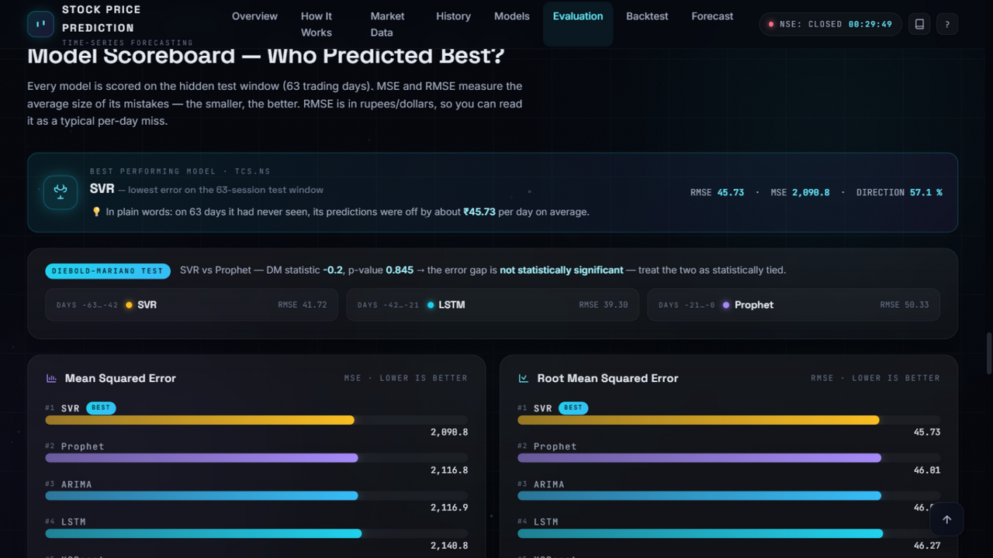
DASHBOARD AND PICK-A-DAY PANEL
Model Scoreboard — TCS.NS · five hand-written engines
real 63-session holdout · deterministic
Live dashboard — real TCS data, five hand-written engines, research tools and the Pick-a-Day panel.
Notes:
This is where the project earns its marks. The backend logic is standard, so our effort goes into the presentation layer: one dial for the headline number, breakdown bars for the split, and rounded Pros / Cons cards generated automatically from keyword frequency. A buyer gets their answer in about two seconds instead of twenty minutes of reading.

Slide 12
THANK YOU
Stock Price Prediction & Forecasting Models
Department of Computer Science and Engineering | Aditya University
Questions and suggestions are welcome.
Notes:
Thank you. We are happy to take questions on the model choice, the keyword extraction logic, or the dashboard design.

