Slide 1
Building A Quadcopter in Nine Weeks
To achieve great things, two things are needed: a plan and not quite enough time.
--Leonard Bernstein
Homepage: http://goo.gl/6V82y3

Slide 2
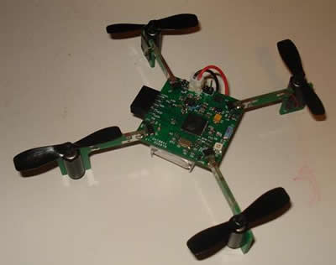
Course Goals
Build several small quadcopter
In 9 weeks
Mostly “from scratch”
Learn
Basic PCB design
How to integrate diverse hardware/software components
About quadcopter-related technologies

Slide 3
This is an Experimental Class
I haven’t done this before
You haven’t done this before
We are blazing a trail
Your Task
Work Hard
Figure stuff out
Take the initiative
My task
Provide high-level guidance
A few lectures
Make sure you have what you need to succeed.
Maybe help out with actual work.

Slide 4
Grades and Stuff
No final
To pass you must
Participate fully in the course
Keep a journal of your experiences and what you’ve learned on the wiki.
Give one presentation in class about some piece of the project you worked on.
I’ll be out of town quite a bit
Thanks giving week.
Last week of classes
Finals week.

Slide 5
High Level Plan
C1
C2
C3
C4
C5
C6
Motor & Controller
Flight Control Software
IMU/Sensors
Remote Control
Micro Controller
Power
Works
Works
Works
Works
Works
Works
Week 5
Q1
Q2
Q3
Q4
Week 10

Slide 6
IMU + Software
Tasks
Make the IMU we have chosen work with arduino
Make it work with our radio-enabled arduino
Make MultiWii work with the IMU
Demonstrate this using the MultiWii GUI
Fully understand IMU BOB schematic.
Deliverables
List of manufacturable/orderable components for the IMU
Eagle devices for those parts.
Schematic with components necessary to connect the IMU to microcontroller.
Instructions for downloading, installing MultiWii
A version of MultiWii modified/configured to meet our needs.
Known unknowns
Can the IMU talk at 3.3V?
What components of the BOB are necessary?
Does MultiWii build in Arduino? Do we need a different toolchain?
How does MultiWii interface with motors, IMU, and the radio?

Slide 7
Motor + Controller
Tasks
Figure out how to control a DC motor with an arduino.
Determine how much current the motor will draw.
Determine which transistors we should use.
Work with SW team to integrate control with MultiWii
Deliverables
Appropriate, orderable propellers and motors
A schematic for the motor driver/controller with necessary eagle devices
Documentation explaining how to use the motor controller.
Known unknowns
How much current do we need?
What kind of xtrs do we need?
Do we need diodes?
How fast can we vary the speed of the motors?
How much lift will the motors generate?

Slide 8
Microcontroller + Radio
Tasks
Successfully program our microcontroller+radio
Get two of them to communicate
Characterize it’s bandwidth and range.
Work with SW team to integrate it with MultiWii.
Fully understand the microcontroler BOB schematic
Work with other teams to understand which portions of the schematic we will need
Deliverables
Manufacturable/orderable components to implement the microcontroller and radio
Schematic for the microntroller and radio.
Documentation explaining how to upload code to the Quadcopter and controller/transmitter
Known unknowns
How fast can we send data?
How do we present interference between two communicating transmitters/quads?
How do we flash the bootloader?

Slide 9
Transmitter/controls
Tasks
Figure out what kind of joysticks/controls we need.
Design the controller.
Figure out how much power it will need and provide a solution for powring it based on lipo batteries.
Work with radio team to understand how to pair remote with quad.
Test the schematic on a bread board.
Deliverables
Manufacturable/orderable parts of the controller
Eagle components for those parts
A schematic for the controller, including micro controller and antenna.
Documentation for the controller
Known unknowns
What kind of joystick, etc?
Power requirements?
What kind of antenna to use?

Slide 10
Power
Tasks
Design power connectors
Design voltage regulation circuitry
Work with motor, IMU, microcontroller teams to understand power requirements
Learn about our batteries
Test the design on a bread board.
Deliverables
Manufacturable/orderable components for the power supply
Necessary Eagle devices and a schematic for the power supply.
Documentation explaining the operation of the power supply.
Known unknowns
How much power will the system need?
How much do we need to worry about battery voltage fading?
What components do need to manage power?
Do we need to worry about isolating logic power from motore power?

Slide 11
For all Tasks
Documentation
All the documentation goes in on the wiki: https://sites.google.com/a/eng.ucsd.edu/gadgetron/the-quadcopter-class
Everything else goes in Git
https://github.com/NVSL/Quadcopters

Slide 12
General Challenges
Identifying parts we can actually order in small quantities and in a timely fashion is hard. Places to look:
Adafruit.com
Sparkfun.com
Digikey.com
The standard Eagle libraries contain many standard packages. If you use them, you need to check them very carefully.
PCB Lead time
Our current board manufacturing solution takes 10-14 days. We are working on an alternative.
We need to order the parts for quadcopters when we we order the boards for them
Keep a close eye on weight. I’m going to buy a precise scale.
Not making mistakes…

Slide 13
Design Reviews
We will only get one chance to build the quadcopters. No respins.
You must get every Eagle device, package, schematic symbol, schematic, and board reviewed by a member of another team.
This is everyone’s best interest.
We are sharing all the elements of the design

Slide 14
Resources
We can buy more or less whatever you need (but shipping time is a potential problem)
We are building up resources in 3219 (the embedded systems lab)
We can also draw upon stuff in my research lab space, but you need to check with me
Misc tools, electrical components, hot glue, solder, etc.
We also have access to a laser cutter and a nice 3D printer, should that be useful.
We don’t have time to learn much about these
If you know what you are doing already, that’s great.
Let me know if you need something

Slide 15
Button/Light Tutorial
I’ve built a tutorial for the Eagle PCB tools
http://goo.gl/UK8hmh
The first half is about bread boards.
The second half is about using Eagle.

Slide 16
PCB Design
Eagle Part design tutorial
https://learn.adafruit.com/ktowns-ultimate-creating-parts-in-eagle-tutorial
Eagle Schematic tutorial
https://www.sparkfun.com/tutorials/108
Eagle PCB Layout Tutorial
https://www.sparkfun.com/tutorials/109
Other Eagle Part Tutorial:
https://www.sparkfun.com/tutorials/110

Slide 17
https://www.sparkfun.com/products/10935

Slide 18
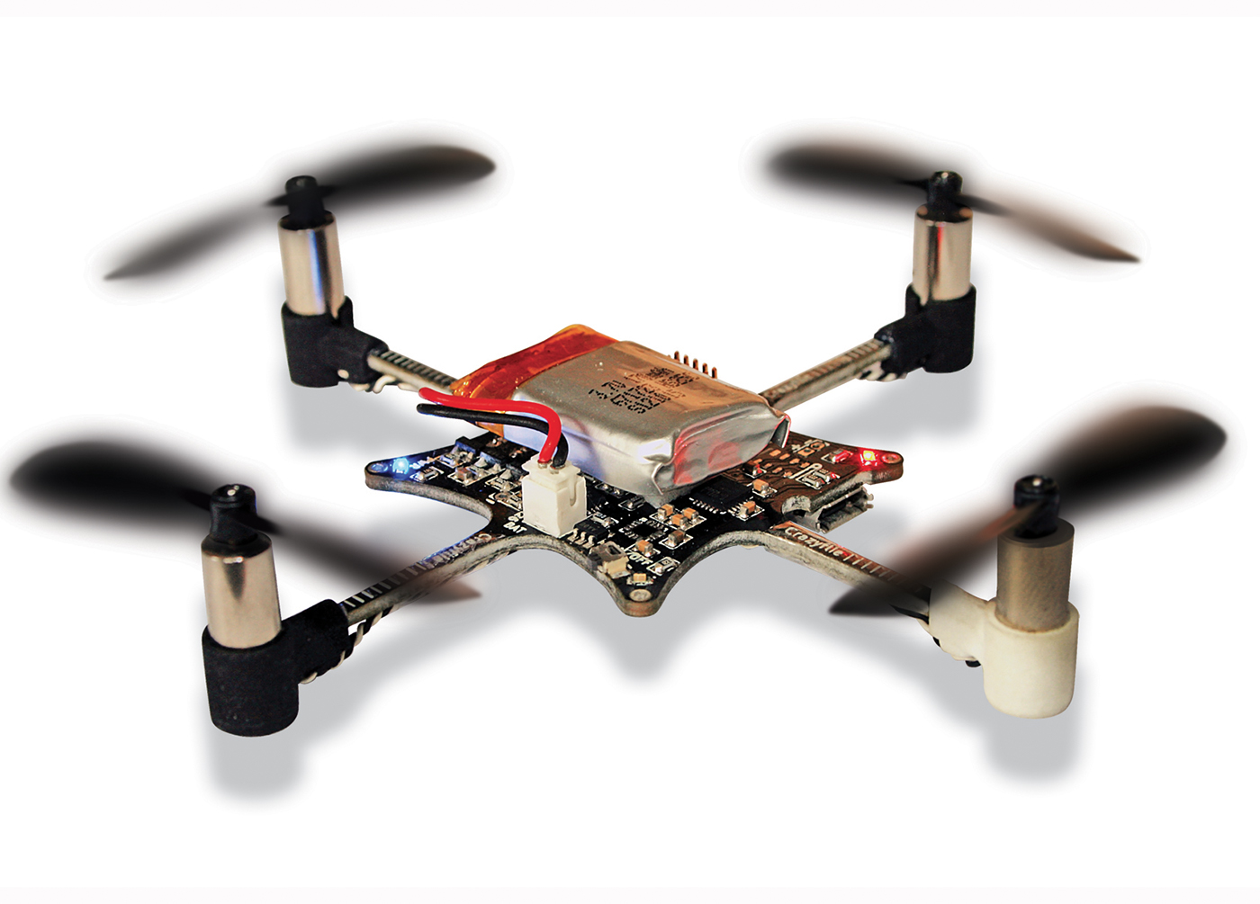
http://goo.gl/I9uZGp

Slide 19
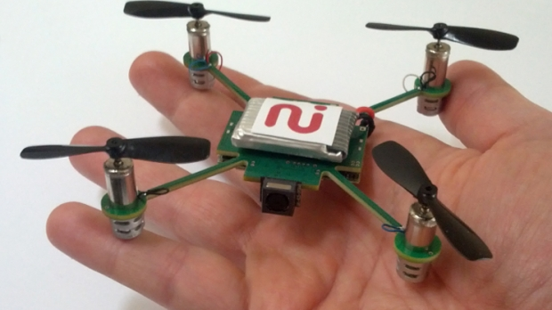
http://goo.gl/biRnp9

Slide 20
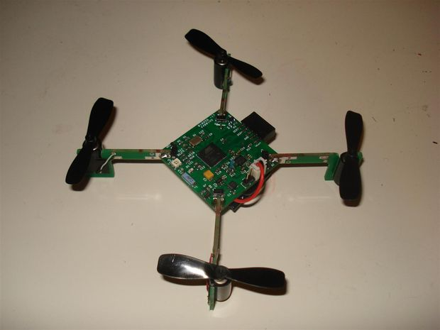
http://goo.gl/d9MZ5

Slide 21
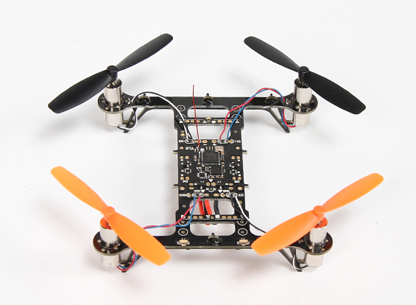
http://goo.gl/TLEIOT

